Slide 1
Server-Side Programming Languages
PHP, Python, Ruby, C#/C++, NodeJS (JavaScript)

Slide 2
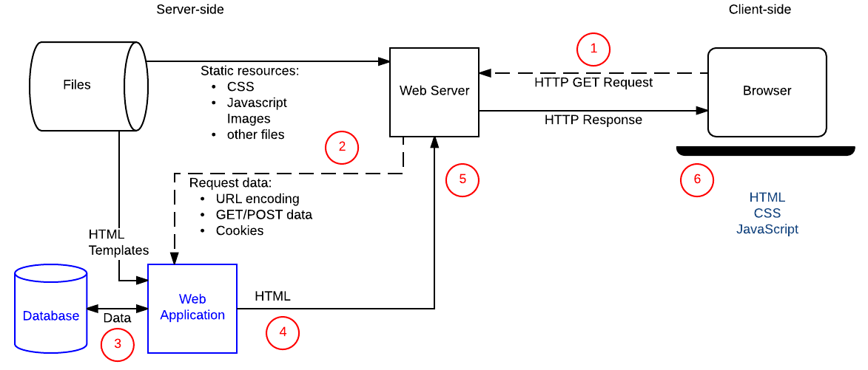
Intro to Server Programming

Slide 3
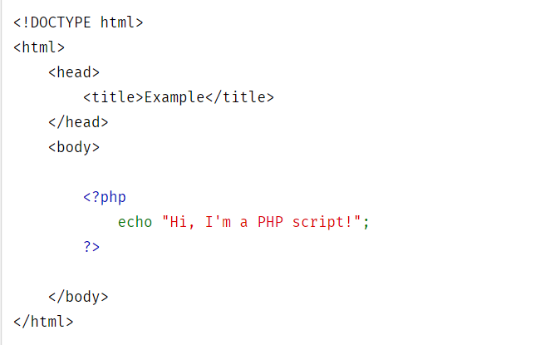
PHP
What sites use this? How Reliable is it?

Slide 4
Python
Who uses it, how reliable is it? Django framework.

Slide 5
Java
What sites use this? How reliable is it?
Syntax examples

Slide 6
C++/C#
What sites use this?
How reliable?
Syntax examples

Slide 7
NodeJS (JavaScript)
What sites use this?
How reliable
Syntax examples

