Slide 1
Server-Side Programming Languages
PHP, Python, C#/C++, JavaScript, Java

Slide 2
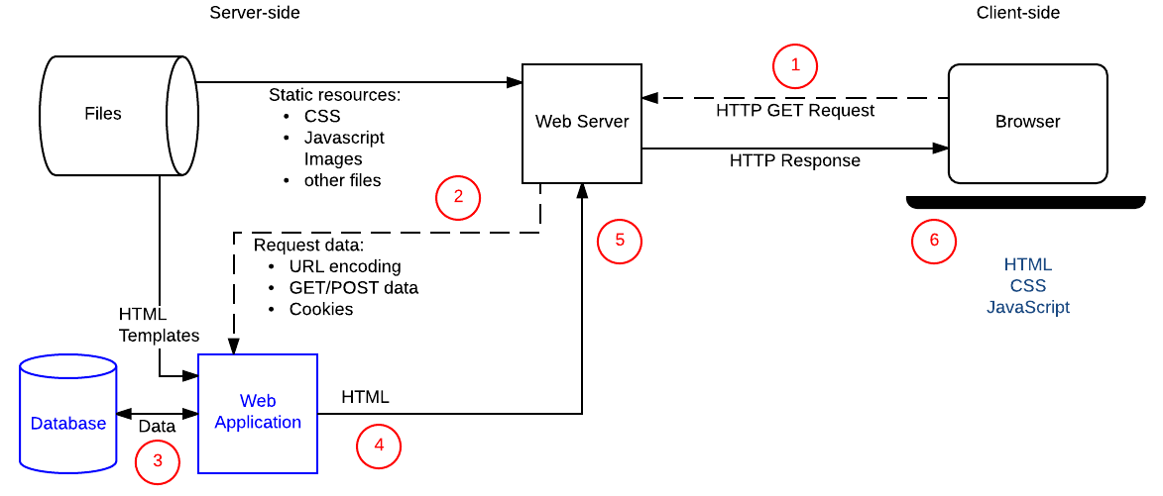
Intro to Server Programming

Slide 3
JavaScript
Popular Sites: Facebook, Google, Ebay.
Backend Frameworks: Next.js, Express, MeteorJS, Node.js.
Very convenient when using for the backend because it is also a frontend language.
Object-oriented language.

Slide 4
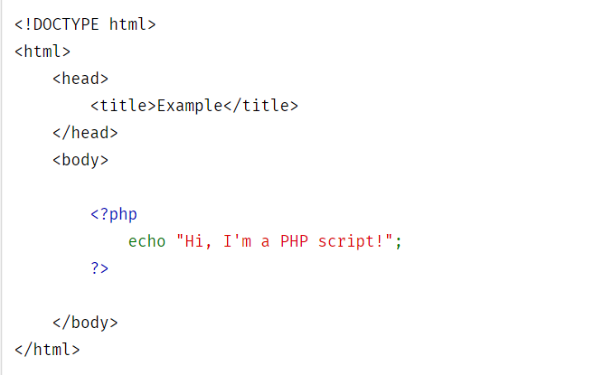
PHP
PHP or Hypertext Preprocessor pages contain HTML and PHP.
PHP generates HTML code on the server and sends it to the client/browser.
Websites using PHP: WordPress, MailChimp, Flickr.
Useful frameworks: Laravel, CodeIgniter, Symfony.

Slide 5
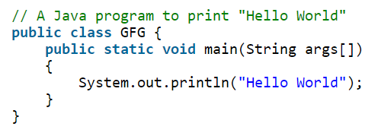
Java
LinkedIn and Yahoo both use Java as a backend language.
Object-Oriented Language
Used in Mobile App development and the Android OS is Java based
Similar syntax to C/C++
Frameworks for backend development: Spring, Struts, Grails
Supports multi-threading

Slide 6
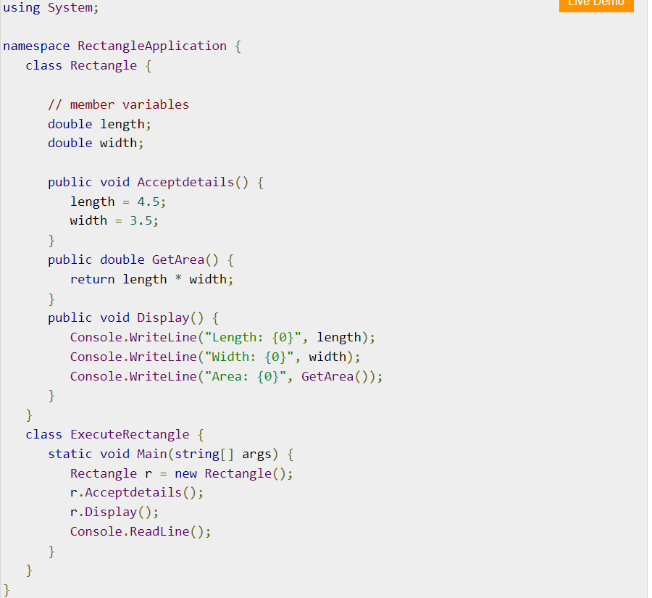
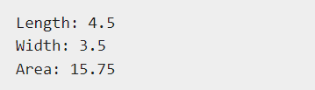
C#
Popular Sites: Marketwatch, Stack Overflow
Developed by Microsoft and is used in development of Windows applications.
Faster compilation than Java & Python
Backend Frameworks: .NET
Object-Oriented

Slide 7
Python
Python can be used as a server-side language, but it is recommended to use a Framework such as Flask, Django, Pyramid.
Popular sites using Python: Spotify, Pinterest, Instacart.
Object-Oriented capabilities.
Notes:
Show Django Project Demonstration

Slide 8
Other Languages
Ruby
Go
C++
Perl

