Slide 1
Paris Housing & Swimming Pools
Tyler Cambron

Slide 2
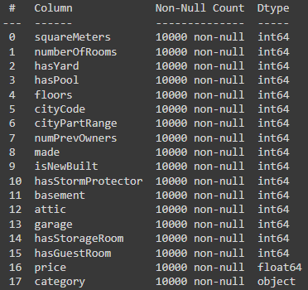
Paris Housing Data
I am trying to find out whether or not having a pool is correlated with the rest of these variables.
The column “hasPool” was chosen as my “y”, leaving the rest as “X”.
Variable “category” turned into “category_Basic” and “category_Luxury” using dummy variables.

Slide 3
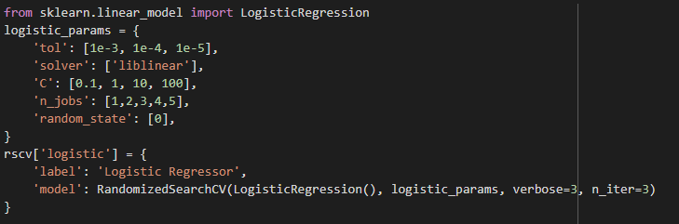
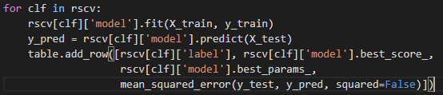
Random Search CV
Using random search cross-validation, I was able to the four different models: logistic regression, support vector regression, decisions trees, and random forest.
Each model has its own set of parameters. I created tables to test for the best possible parameters for each model.
Each model was saved to a dictionary, and then that dictionary looped to fit all of the models and find predictions.

Slide 4
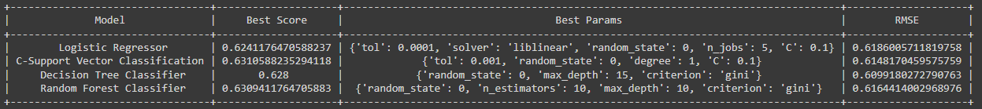
Results
The results of each of the models were put into a PrettyTable.
The results contain the model’s best score, best parameters, and the calculation of the root mean squared error (RMSE) based off of a predicted value of y (y_pred).
The lowest best score was logistic regressor, but it has the highest RMSE. The lowest RMSE is decision tree classifier, and it has the second best score. So assumably it is the best model for this data.

Slide 5
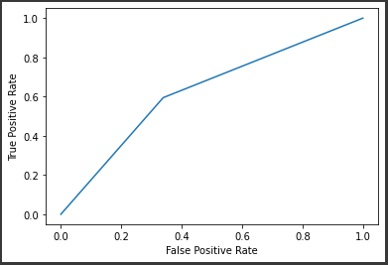
Results
ROC Curve calculated with a prediction of y from the decision tree classifier:
The area under the curve score is 0.6278.

