Slide 1
Finding Fraudulent Transactions
Tyler Cambron

Slide 2
Dataset
https://www.kaggle.com/datasets/dhanushnarayananr/credit-card-fraud
Transactions and their attributes are saved in this dataset with a classification of being fraudulent or not.
Even as security gets better, the United States Federal Trade Commission received more than 5.88 million fraud reports in 2021.
1,000,000 total entries across 8 columns.
Usability Score: 9.41
Created by Indian Software Developer, Dhanush Narayanan R.

Slide 3
Dataset
The 8 columns are:
“distance_from_home”: Transaction distance from account holder’s home.
“distance_from_last_transaction”: Transaction distance from last transaction.
“ratio_to_median_purchase_price”: A ratio in decimal form of how the transaction price compares to account median.
“repeat_retailer”: Binary classification if a repeat shopper.
“used_chip”: Binary classification if security chip was used.
“used_pin_number”: Binary classification if security pin was used.
“online_order”: Binary classification if it was ordered online.
“fraud”: Binary classification if there is a fraudulent transaction.

Slide 4
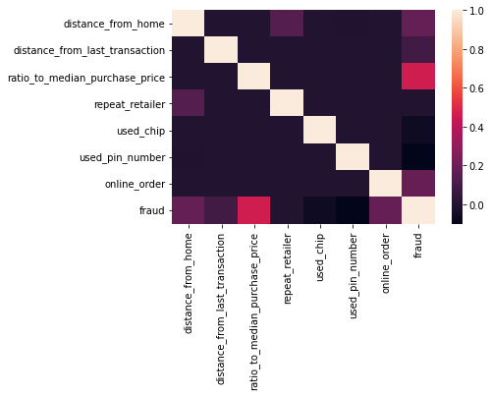
Correlation
Most prominent values relating to fraud show as distance from home, distance from last transaction, and online order.
The greatest showing is the ratio to median purchase price.
There was little to no correlation with using a chip or pin number. Which are security measures.

Slide 5
Training Models
This model has column “fraud” as our y, and the rest of the values as X.
The X was scaled.
The y values showed to be very skewed. (0: 912597, 1: 87403)
Stratify y in train-test split.
The best train-test split showed to be 80-20 after trying 85-15 and 75-25.

Slide 6
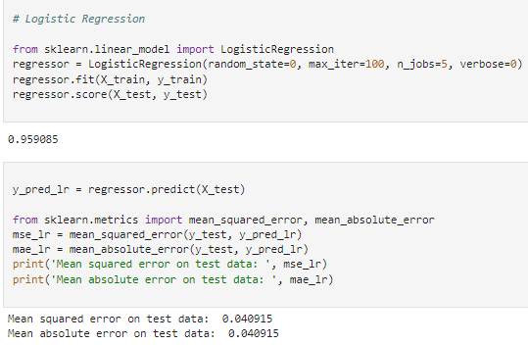
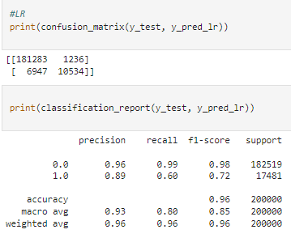
Logistic Regression
8183 wrong classifications

Slide 7
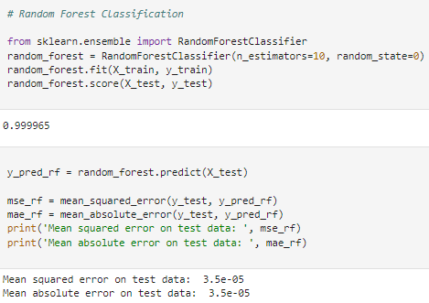
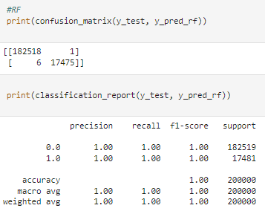
Random-Forest Classification
7 wrong classifications

Slide 8
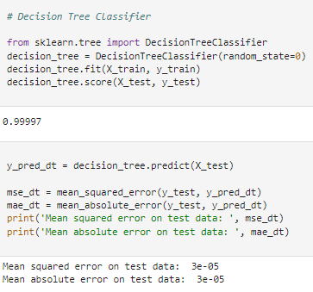
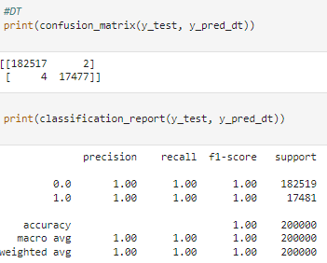
Decision Tree Classification
6 wrong classifications

Slide 9
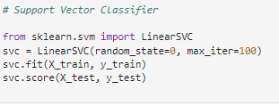
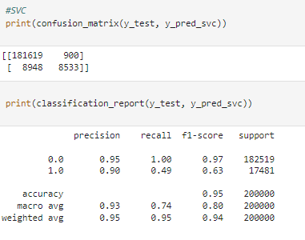
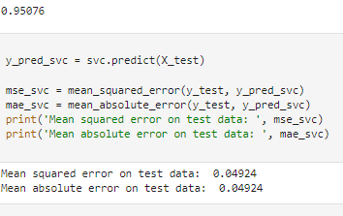
Support Vector Classification
9848 wrong classifications

Slide 10
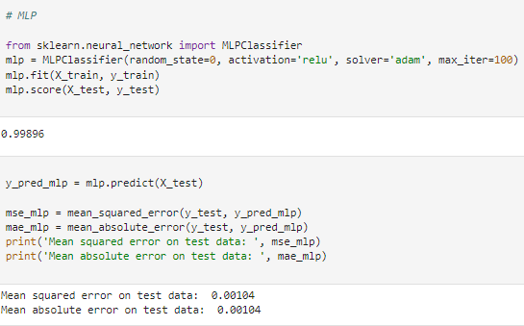
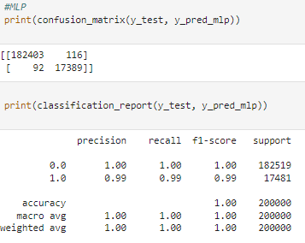
Multi-Layer Perceptron

Slide 11
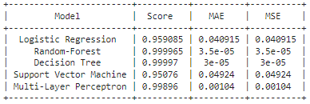
Models
Every model scored abnormally high.
Decision Tree is the highest scoring model by 0.000005. Barely scoring higher than the Random Forest. (0.99997 vs. 0.999965)
Lowest scoring model shows to be the Support Vector Machine.

Slide 12
Sources
https://www.kaggle.com/datasets/dhanushnarayananr/credit-card-fraud
Learn: Machine learning in python - scikit-learn 0.16.1 documentation. scikit. (n.d.). Retrieved December 11, 2022, from https://scikit-learn.org/

