Slide 1

Data Preprocessing
Knowledge Discovery in Databases
School of Software, Nanjing University

Slide 2

Chapter 3: Data Preprocessing
Why data preprocessing?
Data cleaning
Data integration and transformation
Data reduction
Discretization and concept hierarchy generation
Summary

Slide 3
Why Data Preprocessing?
Data in the real world is dirty
  incomplete: lacking attribute values, lacking certain attributes of interest, or containing only aggregate data
  noisy: containing errors or outliers
  inconsistent: containing discrepancies in codes or names
No quality data, no quality mining results!
  Quality decisions must be based on quality data
  Data warehouse needs consistent integration of quality data

Slide 4
Major Tasks in Data Preprocessing
Data cleaning
  Fill in missing values, smooth noisy data, identify or remove outliers, and resolve inconsistencies
Data integration
  Integration of multiple databases, data cubes, or files
Data transformation
  Normalization and aggregation
Data reduction
  Obtains reduced representation in volume but produces the same or similar analytical results
Data discretization
  Part of data reduction but with particular importance, especially for numerical data

Slide 5

Forms of data preprocessing

Slide 6
Chapter 3: Data Preprocessing
Why data preprocessing?
Data cleaning
Data integration and transformation
Data reduction
Discretization and concept hierarchy generation
Summary

Slide 7
Data Cleaning
Data cleaning tasks
  Fill in missing values
  Identify outliers and smooth out noisy data
  Correct inconsistent data

Slide 8
Missing Data
Data is not always available
  E.g., many tuples have no recorded value for several attributes, such as customer income in sales data
Missing data may be due to
  equipment malfunction
  inconsistent with other recorded data and thus deleted
  data not entered due to misunderstanding
  certain data may not be considered important at the time of entry
  not register history or changes of the data
Missing data may need to be inferred.

Slide 9
How to Handle Missing Data?
Ignore the tuple: usually done when class label is missing (assuming the tasks in classification) —not effective when the percentage of missing values per attribute varies considerably.
Fill in the missing value manually: tedious + infeasible?
Use a global constant to fill in the missing value: e.g., “unknown”, a new class?!
Use the attribute mean to fill in the missing value
Use the attribute mean for all samples belonging to the same class to fill in the missing value: smarter
Use the most probable value to fill in the missing value: inference-based such as Bayesian formula or decision tree

Slide 10
Noisy Data
Noise: random error or variance in a measured variable
Incorrect attribute values may due to
  faulty data collection instruments
  data entry problems
  data transmission problems
  technology limitation(e.g. Input cache capacity )
  inconsistency in naming convention
Other data problems which requires data cleaning
  duplicate records
  incomplete data
  inconsistent data

Slide 11
How to Handle Noisy Data?
Binning method:
  first sort data and partition into (equi-depth) bins
  then one can smooth by bin means, smooth by bin median, smooth by bin boundaries, etc.
Clustering
  detect and remove outliers
Combined computer and human inspection
  detect suspicious values and check by human
Regression
  smooth by fitting the data into regression functions

Slide 12
Simple Discretization Methods: Binning
Equal-width (distance) partitioning:
  It divides the range into N intervals of equal size: uniform grid
  if A and B are the lowest and highest values of the attribute, the width of intervals will be: W = (B-A)/N.
  The most straightforward
  But outliers may dominate presentation
  Skewed data is not handled well.
Equal-depth (frequency) partitioning:
  It divides the range into N intervals, each containing approximately same number of samples
  Good data scaling
  Managing categorical attributes can be tricky.

Slide 13
Binning Methods for Data Smoothing
* Sorted data for price (in dollars): 4, 8, 9, 15, 21, 21, 24, 25, 26, 28, 29, 34
* Partition into (equi-depth) bins:
- Bin 1: 4, 8, 9, 15
- Bin 2: 21, 21, 24, 25
- Bin 3: 26, 28, 29, 34
* Smoothing by bin means:
- Bin 1: 9, 9, 9, 9
- Bin 2: 23, 23, 23, 23
- Bin 3: 29, 29, 29, 29
* Smoothing by bin boundaries:
- Bin 1: 4, 4, 4, 15
- Bin 2: 21, 21, 25, 25
- Bin 3: 26, 26, 26, 34

Slide 14
Cluster Analysis

Slide 15
Regression
y
Y1
Y1’
y = x + 1
X1
x

Slide 16
Chapter 3: Data Preprocessing
Why data preprocessing?
Data cleaning
Data integration and transformation
Data reduction
Discretization and concept hierarchy generation
Summary

Slide 17
Data Integration
Data integration:
  combines data from multiple sources into a coherent store
Schema integration
  integrate metadata from different sources
  Entity identification problem: identify real world entities from multiple data sources, e.g., A.cust-id ≡ B.cust-#
Detecting and resolving data value conflicts
  for the same real world entity, attribute values from different sources are different
  possible reasons: different representations, different scales, e.g., metric vs. British units

Slide 18
Handling Redundant Data in Data Integration
Redundant data occur often when integration of multiple databases
  The same attribute may have different names in different databases
  One attribute may be a “derived” attribute in another table, e.g., annual revenue
Redundant data may be able to be detected by correlational analysis
Careful integration of the data from multiple sources may help reduce/avoid redundancies and inconsistencies and improve mining speed and quality

Slide 19
Data Transformation
Smoothing: remove noise from data
Aggregation: summarization, data cube construction
Generalization: concept hierarchy climbing
Normalization: scaled to fall within a small, specified range
  min-max normalization
  z-score normalization
  normalization by decimal scaling
Attribute/feature construction
  New attributes constructed from the given ones

Slide 20




Data Transformation: Normalization
min-max normalization
z-score normalization
normalization by decimal scaling
Where j is the smallest integer such that Max(| |)<1

Slide 21
Samples
Min-max normalization
  An attribute: income, having values from 12000 to 98000
  If we want to map a value 73000 to a new scope [0.0,1.0]
    Then (73000-12000)/(98000-12000)(1.0-0)=0.716
Z-score normalization
  If the average of the attribute “income” is 54000, and the standard deviation is 16000
    Then (73000-54000)/16000=1.225
Normalization by decimal scaling
  Given an attribute A, having values from –986 to 987, the maximum absolution is 987, so we get j=3(that is 1000)
    -986 will be transformed to –0.986

Slide 22
Chapter 3: Data Preprocessing
Why data preprocessing?
Data cleaning
Data integration and transformation
Data reduction
Discretization and concept hierarchy generation
Summary

Slide 23
Data Reduction Strategies
Warehouse may store terabytes of data: Complex data analysis/mining may take a very long time to run on the complete data set
Data reduction
  Obtains a reduced representation of the data set that is much smaller in volume but yet produces the same (or almost the same) analytical results
Data reduction strategies
  Data cube aggregation
  Dimensionality reduction
  Numerosity reduction
  Discretization and concept hierarchy generation

Slide 24
Data Cube Aggregation
The lowest level of a data cube
  The aggregated data for an individual entity of interest
  e.g., a customer in a phone calling data warehouse.
Multiple levels of aggregation in data cubes
  Further reduce the size of data to deal with
Reference appropriate levels
  Use the smallest representation which is enough to solve the task
Queries regarding aggregated information should be answered using data cube, when possible

Slide 25
Dimensionality Reduction
Feature selection (i.e., attribute subset selection):
  Select a minimum set of features such that the probability distribution of different classes given the values for those features is as close as possible to the original distribution given the values of all features
  reduce # of patterns in the patterns, easier to understand
There are 2^{d} possible sub-features of d features
  To test all these subsets is probably impossible if the number of features is too huge
  So heuristic methods is often used to solve the problem

Slide 26
Heuristic Feature Selection Methods
Several heuristic feature selection methods:
  Best single features under the feature independence assumption: choose by significance tests.
  Best step-wise feature selection:
    The best single-feature is picked first
    Then next best feature condition to the first, ...
  Step-wise feature elimination:
    Repeatedly eliminate the worst feature
  Best combined feature selection and elimination
  Decision tree: ID3, C4.5, etc.

Slide 27
Example of Decision Tree Induction
Initial attribute set:
{A1, A2, A3, A4, A5, A6}
A4 ?
A1?
A6?
Class 1
Class 2
Class 1
Class 2
>
Reduced attribute set: {A1, A4, A6}

Slide 28
Data Compression
String compression
  There are extensive theories and well-tuned algorithms
  Typically lossless
  But only limited manipulation is possible without expansion
Audio/video compression
  Typically lossy compression, with progressive refinement
  Sometimes small fragments of signal can be reconstructed without reconstructing the whole

Slide 29
Data Compression
Original Data
Compressed
Data
lossless
Original Data
Approximated
lossy

Slide 30
Numerosity Reduction
Parametric methods
  Assume the data fits some model, estimate model parameters, store only the parameters, and discard the data (except possible outliers)
    Regression
    Log-linear models: obtain value at a point in m-D space as the product on appropriate marginal subspaces
Non-parametric methods
  Do not assume models
  Major families: histograms, clustering, sampling

Slide 31
Regression and Log-Linear Models
Linear regression: Data are modeled to fit a straight line
  Often uses the least-square method to fit the line
Multiple regression: allows a response variable Y to be modeled as a linear function of multidimensional feature vector
Log-linear model: approximates discrete multidimensional probability distributions

Slide 32
Regress Analysis and Log-Linear Models
Linear regression: Y = α + β X
  Two parameters , α and β specify the line and are to be estimated by using the data at hand.
  using the least squares criterion to the known values of Y1, Y2, …, X1, X2, ….
Multiple regression: Y = b0 + b1 X1 + b2 X2.
  Many nonlinear functions can be transformed into the above.
Log-linear models:
  The multi-way table of joint probabilities is approximated by a product of lower-order tables.
  Probability: p(a, b, c, d) = αab βacχad δbcd

Slide 33
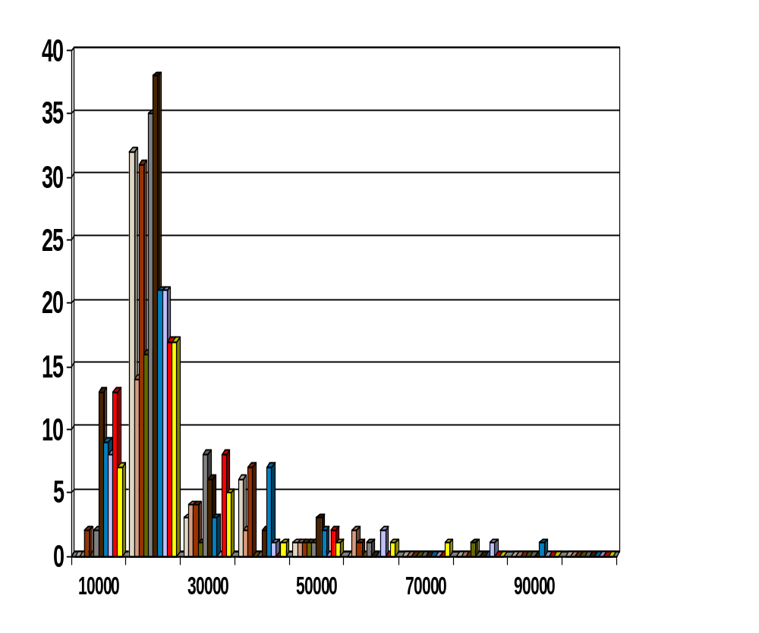
Histograms
A popular data reduction technique
Divide data into buckets and store average (sum) for each bucket
Can be constructed optimally in one dimension using dynamic programming
Related to quantization problems.

Slide 34
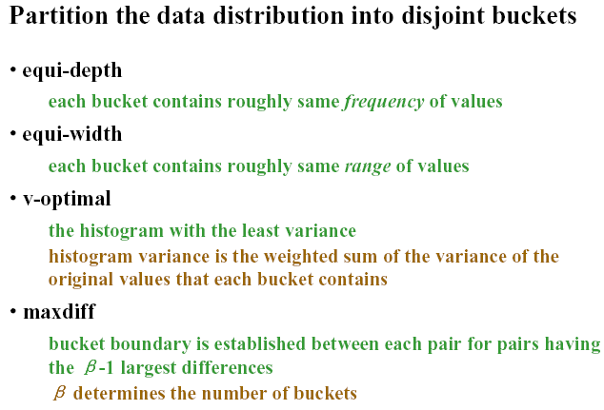

Slide 35
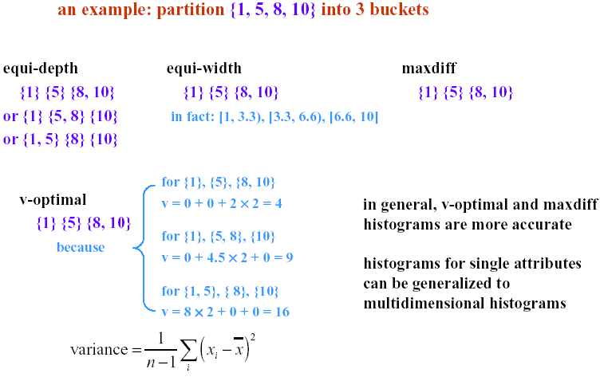

Slide 36
Clustering
Partition data set into clusters, and one can store cluster representation only
Can be very effective if data is clustered but not if data is “smeared”
Can have hierarchical clustering and be stored in multi-dimensional index tree structures
There are many choices of clustering definitions and clustering algorithms, further detailed in Chapter 8

Slide 37
Sampling
Allow a mining algorithm to run in complexity that is potentially sub-linear to the size of the data
Choose a representative subset of the data
  Simple random sampling may have very poor performance in the presence of skew
Develop adaptive sampling methods
  Stratified sampling:
    Approximate the percentage of each class (or subpopulation of interest) in the overall database
    Used in conjunction with skewed data

Slide 38
Sampling
SRSWOR
(simple random
sample without
replacement)
SRSWR
Raw Data

Slide 39
Sampling
Raw Data
Cluster/Stratified Sample

Slide 40
Chapter 3: Data Preprocessing
Why data preprocessing?
Data cleaning
Data integration and transformation
Data reduction
Discretization and concept hierarchy generation
Summary

Slide 41
Discretization
Three types of attributes:
  Nominal — values from an unordered set
  Ordinal — values from an ordered set
  Continuous — real numbers
Discretization:
  Divide the range of a continuous attribute into intervals
  Some classification algorithms only accept categorical attributes.
  Reduce data size by discretization
  Prepare for further analysis

Slide 42
Discretization and Concept hierachy
Discretization
  reduce the number of values for a given continuous attribute by dividing the range of the attribute into intervals. Interval labels can then be used to replace actual data values.
Concept hierarchies
  reduce the data by collecting and replacing low level concepts (such as numeric values for the attribute age) by higher level concepts (such as young, middle-aged, or senior).

Slide 43
Discretization and concept hierarchy generation for numeric data
Binning (see sections before)
Histogram analysis (see sections before)
Clustering analysis (see sections before)
Entropy-based discretization( will be introduced later)
Segmentation by natural partitioning

Slide 44
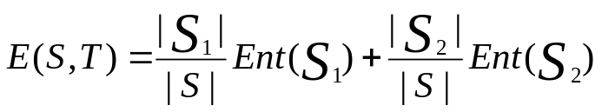

Entropy-Based Discretization
Given a set of samples S, if S is partitioned into two intervals S1 and S2 using boundary T, the entropy after partitioning is
The boundary that minimizes the entropy function over all possible boundaries is selected as a binary discretization.
The process is recursively applied to partitions obtained until some stopping criterion is met, e.g.,
Experiments show that it may reduce data size and improve classification accuracy
See the chapter ”concept description and discrimination mining”

Slide 45
Segmentation by natural partitioning
3-4-5 rule can be used to segment numeric data into
relatively uniform, “natural” intervals.
* If an interval covers 3, 6, 7 or 9 distinct values at the most significant digit, partition the range into 3 equi-width intervals
* If it covers 2, 4, or 8 distinct values at the most significant digit, partition the range into 4 intervals
* If it covers 1, 5, or 10 distinct values at the most significant digit, partition the range into 5 intervals

Slide 46
Example of 3-4-5 rule
count
Step 1:
-$351 -$159 profit $1,838 $4,700
Min Low (i.e, 5%-tile) High(i.e, 95%-0 tile) Max
Step 2:
msd=1,000 Low=-$1,000 High=$2,000
Step 3:
(-$1,000 - $2,000]
(-$1,000 – 0]
(0 -$ 1,000]
($1,000 - $2,000]
Step 4:
(-$400 -$5,000)
(-$400 – 0]
(0 - $1,000]
($1,000 - $2, 000]
($2,000 - $5, 000]
(0 -
$200]
($1,000 -
$1,200]
(-$400 -
-$300]
($2,000 -
$3,000]
($200 -
$400]
($1,200 -
$1,400]
(-$300 -
-$200]
($3,000 -
$4,000]
($400 -
$600]
($1,400 -
$1,600]
(-$200 -
-$100]
($4,000 -
$5,000]
($600 -
$800]
($1,600 -
$1,800]
($1,800 -
$2,000]
($800 -
$1,000]
(-$100 -
0]

Slide 47
Concept hierarchy generation for categorical data
Specification of a partial ordering of attributes explicitly at the schema level by users or experts
Specification of a portion of a hierarchy by explicit data grouping
Specification of a set of attributes, but not of their partial ordering
Specification of only a partial set of attributes

Slide 48
Specification of a set of attributes
Concept hierarchy can be automatically generated based on the number of distinct values per attribute in the given attribute set
The attribute with the most distinct values is placed at the lowest level of the hierarchy
country
15 distinct values
province_or_ state
65 distinct values
city
3567 distinct values
street
674,339 distinct values

Slide 49
Chapter 3: Data Preprocessing
Why data preprocessing?
Data cleaning
Data integration and transformation
Data reduction
Discretization and concept hierarchy generation
Summary

Slide 50
Summary
Data preparation is a big issue for both warehousing and mining
Data preparation includes
  Data cleaning and data integration
  Data reduction and feature selection
  Discretization
A lot of methods have been developed but still an active area of research

Slide 51
References
J. Han and M. Kamber. Data Mining: Concepts and Techniques. Morgan Kaufmann, 2000.(Including Materials)
D. P. Ballou and G. K. Tayi. Enhancing data quality in data warehouse environments. Communications of ACM, 42:73-78, 1999.
Jagadish et al., Special Issue on Data Reduction Techniques. Bulletin of the Technical Committee on Data Engineering, 20(4), December 1997.
D. Pyle. Data Preparation for Data Mining. Morgan Kaufmann, 1999.
T. Redman. Data Quality: Management and Technology. Bantam Books, New York, 1992.
Y. Wand and R. Wang. Anchoring data quality dimensions ontological foundations. Communications of ACM, 39:86-95, 1996.
R. Wang, V. Storey, and C. Firth. A framework for analysis of data quality research. IEEE Trans. Knowledge and Data Engineering, 7:623-640, 1995.

Slide 52
Knowledge Discovery in Databases
Thank you !!!

