Slide 1

Concept Description: Characterization and Comparison
Knowledge Discovery in Large Databases
School of Software, Nanjing University

Slide 2

Concept Description: Characterization and Comparison
What is concept description?
Data generalization and summarization-based characterization
Analytical characterization: Analysis of attribute relevance
Mining class comparisons: Discriminating between different classes
*Mining descriptive statistical measures in large databases(Please read text)
Discussion
Summary

Slide 3
What is Concept Description?
Descriptive vs. predictive data mining
  Descriptive mining: describes concepts or task-relevant data sets in concise, summarative, informative, discriminative forms
  Predictive mining: Based on data and analysis, constructs models for the database, and predicts the trend and properties of unknown data
Concept description:
  Characterization: provides a concise and succinct summarization of the given collection of data
  Comparison: provides descriptions comparing two or more collections of data

Slide 4
Concept Description vs. OLAP
Concept description:
  can handle complex data types of the attributes and their aggregations
  a more automated process
OLAP:
  restricted to a small number of dimension and measure types
  user-controlled process

Slide 5
Concept Description: Characterization and Comparison
What is concept description?
Data generalization and summarization-based characterization
Analytical characterization: Analysis of attribute relevance
Mining class comparisons: Discriminating between different classes
Mining descriptive statistical measures in large databases
Discussion
Summary

Slide 6
Data Generalization and Summarization-based Characterization
Data generalization
  A process which abstracts a large set of task-relevant data in a database from a low conceptual levels to higher ones.
  Approaches:
    Data cube approach(OLAP approach)
    Attribute-oriented induction approach
1
2
3
4
Conceptual levels
5

Slide 7
Characterization: Data Cube Approach (without using AO-Induction)
Perform computations and store results in data cubes
Strength
  An efficient implementation of data generalization
  Computation of various kinds of measures
    e.g., count( ), sum( ), average( ), max( )
  Generalization and specialization can be performed on a data cube by roll-up and drill-down
Limitations
  handle only dimensions of simple nonnumeric data and measures of simple aggregated numeric values.
  Lack of intelligent analysis, can’t tell which dimensions should be used and what levels should the generalization reach

Slide 8
Attribute-Oriented Induction
Proposed in 1989 (KDD ‘89 workshop)
Not confined to categorical data nor particular measures.
How it is done?
  Collect the task-relevant data( initial relation) using a relational database query
  Perform generalization by attribute removal or attribute generalization.
  Apply aggregation by merging identical, generalized tuples and accumulating their respective counts.
  Interactive presentation with users.

Slide 9
Principles of Attribute-Oriented Induction
Data focusing: task-relevant data, including dimensions, and the result is the initial relation.
Attribute-removal: remove attribute A if there is a large set of distinct values for A but (1) there is no generalization operator on A, or (2) A’s higher level concepts are expressed in terms of other attributes.
Attribute-generalization: If there is a large set of distinct values for A, and there exists a set of generalization operators on A, then select an operator and generalize A.
Attribute-threshold control: typical 2-8, specified/default.
Generalized relation threshold control: control the final relation/rule size. see example

Slide 10
Basic Algorithm for Attribute-Oriented Induction
InitialRel: Query processing of task-relevant data, deriving the initial relation.
PreGen: Based on the analysis of the number of distinct values in each attribute, determine generalization plan for each attribute: removal? or how high to generalize?
PrimeGen: Based on the PreGen plan, perform generalization to the right level to derive a “prime generalized relation”, accumulating the counts.
Presentation: User interaction: (1) adjust levels by drilling, (2) pivoting, (3) mapping into rules, cross tabs, visualization presentations.
See Implementation See example See complexity

Slide 11
Example
DMQL: Describe general characteristics of graduate students in the Big-University database
  use Big_University_DB
  mine characteristics as “Science_Students”
  in relevance to name, gender, major, birth_place, birth_date, residence, phone#, gpa
  from student
  where status in “graduate”
Corresponding SQL statement:
  Select name, gender, major, birth_place, birth_date, residence, phone#, gpa
  from student
  where status in {“Msc”, “MBA”, “PhD” }

Slide 12



Class Characterization: An Example
Initial Relation
Prime Generalized Relation
See Principles

Slide 13
Presentation of Generalized Results
Generalized relation:
  Relations where some or all attributes are generalized, with counts or other aggregation values accumulated.
Cross tabulation:
  Mapping results into cross tabulation form (similar to contingency tables).
Visualization techniques:
  Pie charts, bar charts, curves, cubes, and other visual forms.
Quantitative characteristic rules:
  Mapping generalized result into characteristic rules with quantitative information associated with it, e.g.,

Slide 14
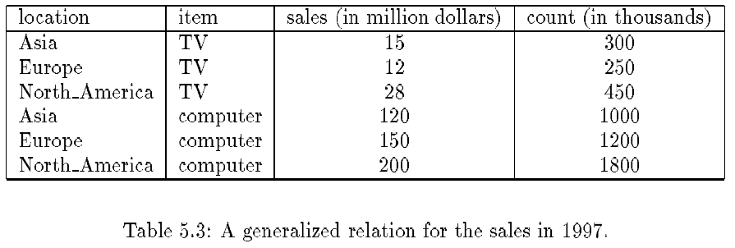
Presentation—Generalized Relation

Slide 15
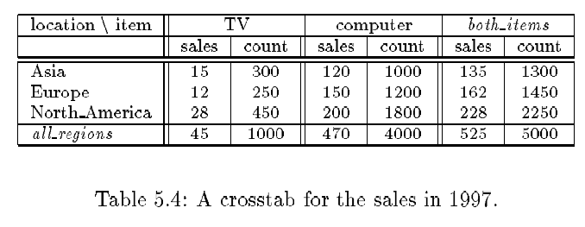
Presentation—Crosstab

Slide 16
Concept Description: Characterization and Comparison
What is concept description?
Data generalization and summarization-based characterization
Analytical characterization: Analysis of attribute relevance
Mining class comparisons: Discriminating between different classes
Mining descriptive statistical measures in large databases
Discussion
Summary

Slide 17

Characterization vs. OLAP
Similarity:
  Presentation of data summarization at multiple levels of abstraction.
  Interactive drilling, pivoting, slicing and dicing.
Differences:
  Automated desired level allocation.
  Dimension relevance analysis and ranking when there are many relevant dimensions.
  Sophisticated typing on dimensions and measures.

Slide 18
Relevance Measures
Quantitative relevance measure determines the classifying power of an attribute within a set of data.
Methods
  information gain (ID3)
  gain ratio (C4.5)
  gini index
  χ² contingency table statistics
  uncertainty coefficient

Slide 19
Information-Theoretic Approach
Decision tree
  each internal node tests an attribute
  each branch corresponds to attribute value
  each leaf node assigns a classification
ID3 algorithm
  build decision tree based on training objects with known class labels to classify testing objects
  rank attributes with information gain measure
  minimal height
    the least number of tests to classify an object
See example

Slide 20
Top-Down Induction of Decision Tree
Attributes = {Outlook, Temperature, Humidity, Wind}
PlayTennis = {yes, no}
Outlook
sunny
rain
overcast
Humidity
Wind
yes
high
normal
strong
weak
no
yes
no
yes

Slide 21
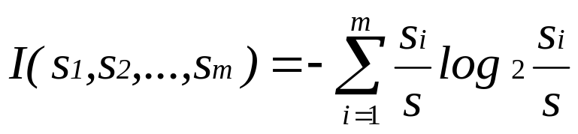
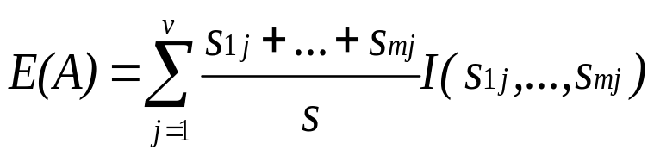

Entropy and Information Gain
S contains s_{i} tuples of class C_{i} for i = {1, …, m}
Information measures info required to classify any arbitrary tuple
Entropy of attribute A with values {a₁,a₂,…,a_{v}}
Information gained by branching on attribute A

Slide 22
Example: Analytical Characterization
Task
  Mine general characteristics describing graduate students using analytical characterization
Given
  attributes name, gender, major, birth_place, birth_date, phone#, and gpa
  Gen(a_{i}) = concept hierarchies on a_{i}
  U_{i} = attribute analytical thresholds for a_{i}
  T_{i} = attribute generalization thresholds for a_{i}
  R = attribute relevance threshold

Slide 23
Example: Analytical Characterization (cont’d)
1. Data collection
  target class: graduate student
  contrasting class: undergraduate student
2. Analytical generalization using U_{i}
  attribute removal
    remove name and phone#
  attribute generalization
    generalize major, birth_place, birth_date and gpa
    accumulate counts
  candidate relation: gender, major, birth_country, age_range and gpa

Slide 24
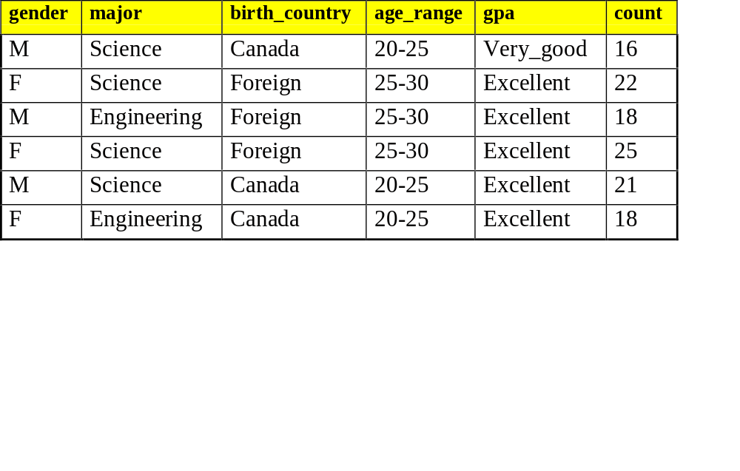
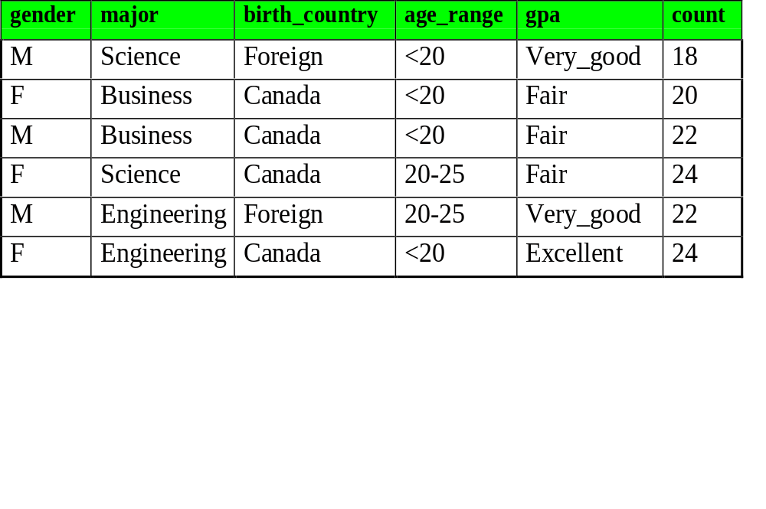
Example: Analytical characterization (2)
Candidate relation for Target class: Graduate students (Σ=120)
Candidate relation for Contrasting class: Undergraduate students (Σ=130)

Slide 25
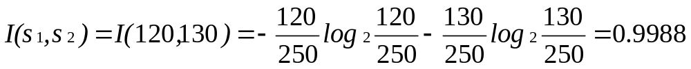
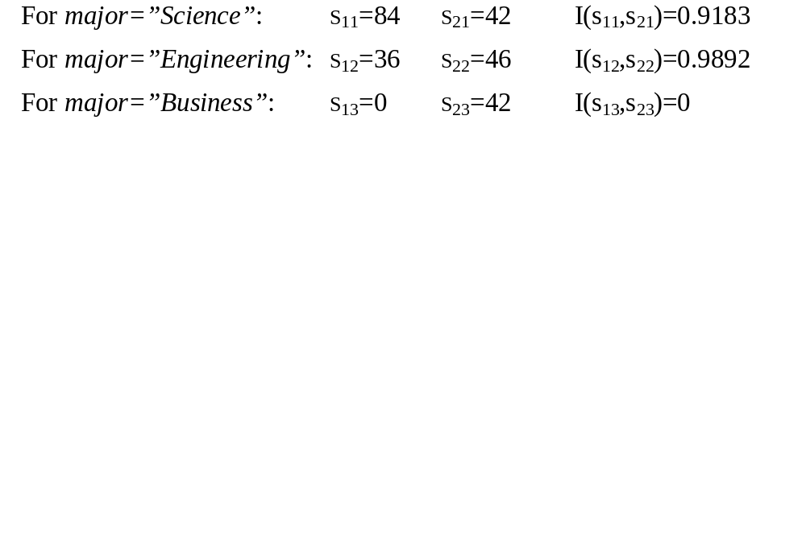
Example: Analytical characterization (3)
3. Relevance analysis
  Calculate expected info required to classify an arbitrary tuple
  Calculate entropy of each attribute: e.g. major
Number of grad students in “Science”
Number of undergrad students in “Science”

Slide 26
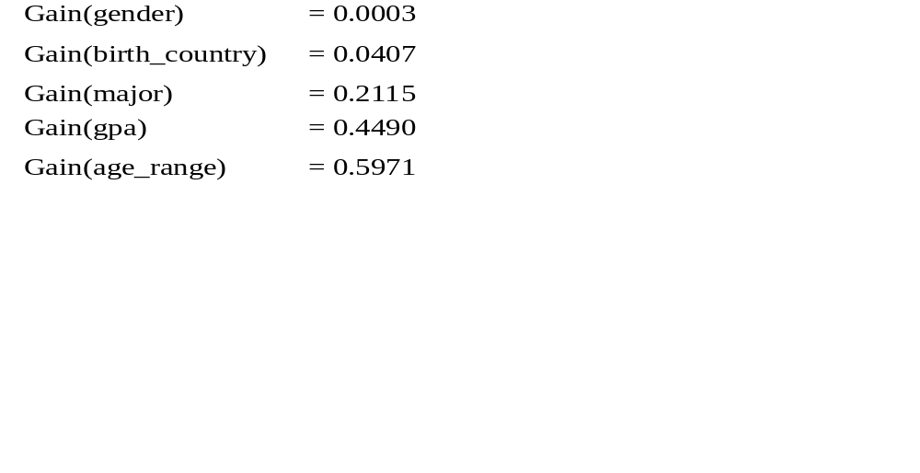
Example: Analytical Characterization (4)
Calculate expected info required to classify a given sample if S is partitioned according to the attribute
Calculate information gain for each attribute
  Information gain for all attributes

Slide 27
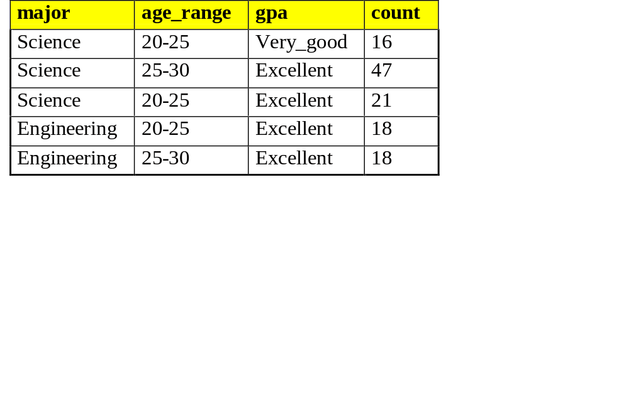
Example: Analytical characterization (5)
4. Initial working relation (W₀) derivation
  R = 0.1
  remove irrelevant/weakly relevant attributes from candidate relation => drop gender, birth_country
  remove contrasting class candidate relation
5. Perform attribute-oriented induction on W₀ using T_{i}
Initial target class working relation W₀: Graduate students

Slide 28
Concept Description: Characterization and Comparison
What is concept description?
Data generalization and summarization-based characterization
Analytical characterization: Analysis of attribute relevance
Mining class comparisons: Discriminating between different classes
Mining descriptive statistical measures in large databases
Discussion
Summary

Slide 29
Mining Class Comparisons
Comparison: Comparing two or more classes.
Method:
  Partition the set of relevant data into the target class and the contrasting class(es)
  Generalize both classes to the same high level concepts
  Compare tuples with the same high level descriptions
  Present for every tuple its description and two measures:
    support - distribution within single class
    comparison - distribution between classes
  Highlight the tuples with strong discriminant features
Relevance Analysis:
  Find attributes (features) which best distinguish different classes.

Slide 30
Example: Analytical comparison
Task
  Compare graduate and undergraduate students using discriminant rule.
  DMQL query
use Big_University_DB
mine comparison as “grad_vs_undergrad_students”
in relevance to name, gender, major, birth_place, birth_date, residence, phone#, gpa
for “graduate_students”
where status in “graduate”
versus “undergraduate_students”
where status in “undergraduate”
analyze count%
from student

Slide 31
Example: Analytical comparison (2)
Given
  attributes name, gender, major, birth_place, birth_date, residence, phone# and gpa
  Gen(a_{i}) = concept hierarchies on attributes a_{i}
  U_{i} = attribute analytical thresholds for attributes a_{i}
  T_{i} = attribute generalization thresholds for attributes a_{i}
  R = attribute relevance threshold

Slide 32
Example: Analytical comparison (3)
1. Data collection
  target and contrasting classes
2. Attribute relevance analysis
  remove attributes name, gender, major, phone#
3. Synchronous generalization
  controlled by user-specified dimension thresholds
  prime target and contrasting class(es) relations/cuboids

Slide 33
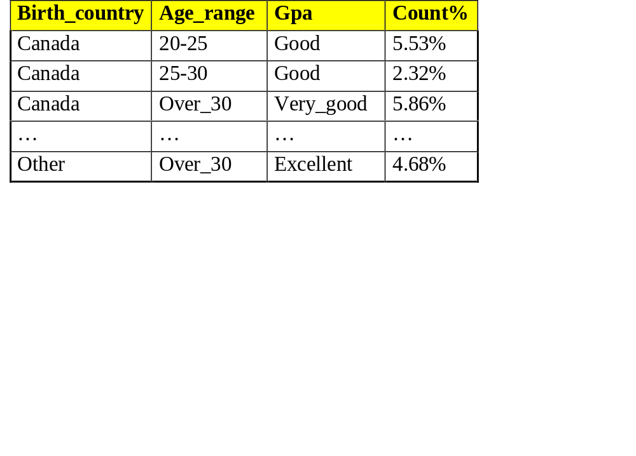
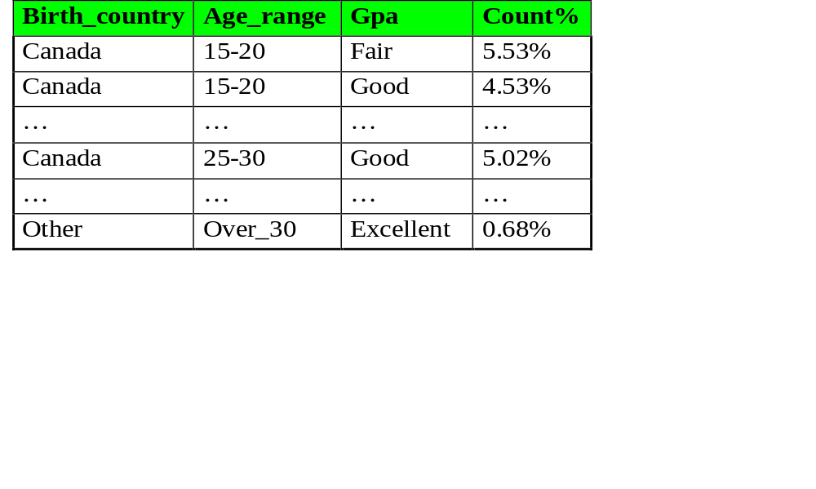
Example: Analytical comparison (4)
Prime generalized relation for the target class: Graduate students
Prime generalized relation for the contrasting class: Undergraduate students

Slide 34
Example: Analytical comparison (5)
4. Drill down, roll up and other OLAP operations on target and contrasting classes to adjust levels of abstractions of resulting description
5. Presentation
  as generalized relations, crosstabs, bar charts, pie charts, or rules
  contrasting measures to reflect comparison between target and contrasting classes
    e.g. count%

Slide 35
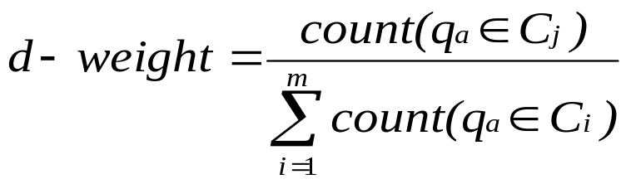
Quantitative Discriminant Rules
Cj = target class
q_{a} = a generalized tuple covers some tuples of class
  but can also cover some tuples of contrasting class
d-weight
  range: [0, 1]
quantitative discriminant rule form

Slide 36
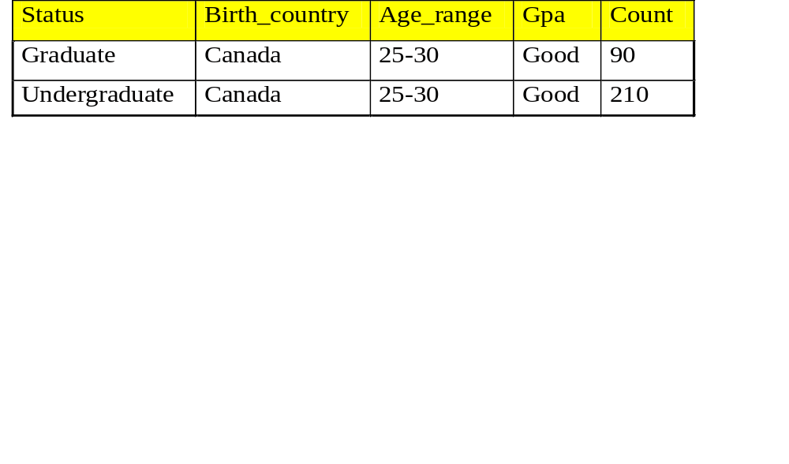
Example: Quantitative Discriminant Rule
Count distribution between graduate and undergraduate students for a generalized tuple
Quantitative discriminant rule
  where 90/(90+210) = 30%

Slide 37
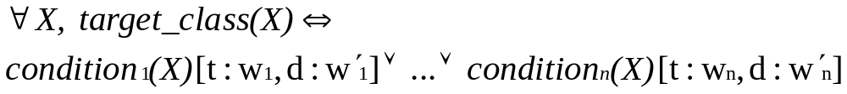
Class Description
Quantitative characteristic rule
  necessary
Quantitative discriminant rule
  sufficient
Quantitative description rule
  necessary and sufficient

Slide 38
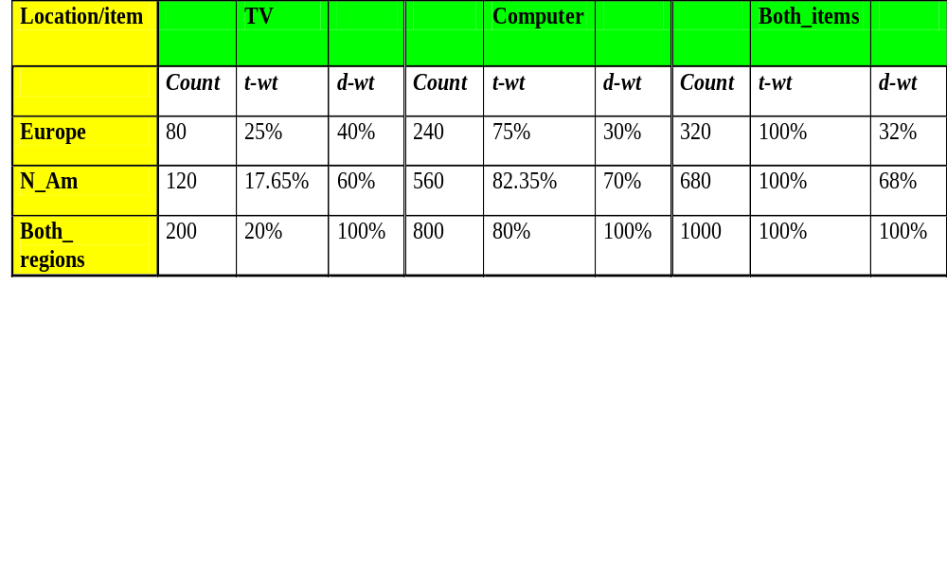
Quantitative Description Rule
Quantitative description rule for target class Europe
Crosstab showing associated t-weight, d-weight values and total number (in thousands) of TVs and computers sold at AllElectronics in 1998

Slide 39
Concept Description: Characterization and Comparison
What is concept description?
Data generalization and summarization-based characterization
Analytical characterization: Analysis of attribute relevance
Mining class comparisons: Discriminating between different classes
Mining descriptive statistical measures in large databases
Discussion
Summary

Slide 40
Mining Data Dispersion Characteristics
Motivation
  To better understand the data: central tendency, variation and spread
Data dispersion characteristics
  median, max, min, quantiles, outliers, variance, etc.
Numerical dimensions correspond to sorted intervals
  Data dispersion: analyzed with multiple granularities of precision
  Boxplot or quantile analysis on sorted intervals
Dispersion analysis on computed measures
  Folding measures into numerical dimensions
  Boxplot or quantile analysis on the transformed cube

Slide 41
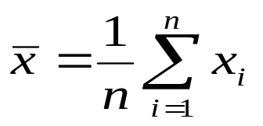

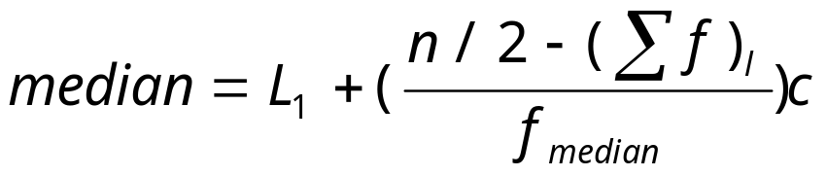
Measuring the Central Tendency
Mean
  Weighted arithmetic mean
Median: A holistic measure
  Middle value if odd number of values, or average of the middle two values otherwise
  estimated by interpolation
Mode
  Value that occurs most frequently in the data
  Unimodal, bimodal, trimodal
  Empirical formula:

Slide 42
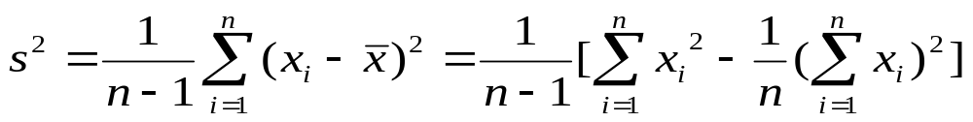
Measuring the Dispersion of Data
Quartiles, outliers and boxplots
  Quartiles: Q₁ (25th percentile), Q₃ (75th percentile)
  Inter-quartile range: IQR = Q₃ – Q₁
  Five number summary: min, Q₁, M, Q₃, max
  Boxplot: ends of the box are the quartiles, median is marked, whiskers, and plot outlier individually
  Outlier: usually, a value higher/lower than 1.5 x IQR
Variance and standard deviation
  Variance s²: (algebraic, scalable computation)
  Standard deviation s is the square root of variance s²

Slide 43
Boxplot Analysis
Five-number summary of a distribution:
  Minimum, Q1, M, Q3, Maximum
Boxplot
  Data is represented with a box
  The ends of the box are at the first and third quartiles, i.e., the height of the box is IRQ
  The median is marked by a line within the box
  Whiskers: two lines outside the box extend to Minimum and Maximum

Slide 44

A Boxplot
A boxplot

Slide 45

Visualization of Data Dispersion: Boxplot Analysis

Slide 46
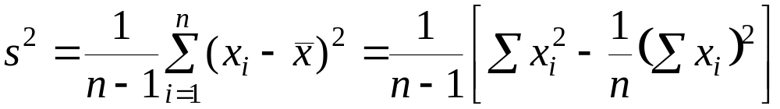
Mining Descriptive Statistical Measures in Large Databases
Variance
Standard deviation: the square root of the variance
  Measures spread about the mean
  It is zero if and only if all the values are equal
  Both the deviation and the variance are algebraic

Slide 47

Histogram Analysis
Graph displays of basic statistical class descriptions
  Frequency histograms
    A univariate graphical method
    Consists of a set of rectangles that reflect the counts or frequencies of the classes present in the given data

Slide 48
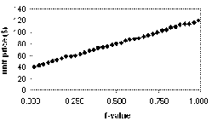
Quantile Plot
Displays all of the data (allowing the user to assess both the overall behavior and unusual occurrences)
Plots quantile information
  For a data x_{i} data sorted in increasing order, f_{i} indicates that approximately 100 f_{i}% of the data are below or equal to the value x_{i}

Slide 49
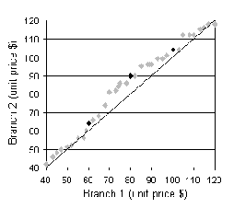
Quantile-Quantile (Q-Q) Plot
Graphs the quantiles of one univariate distribution against the corresponding quantiles of another
Allows the user to view whether there is a shift in going from one distribution to another

Slide 50
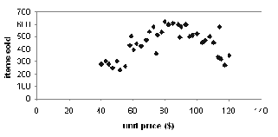
Scatter plot
Provides a first look at bivariate data to see clusters of points, outliers, etc
Each pair of values is treated as a pair of coordinates and plotted as points in the plane

Slide 51
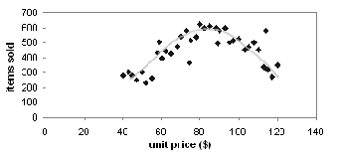
Loess Curve
Adds a smooth curve to a scatter plot in order to provide better perception of the pattern of dependence
Loess curve is fitted by setting two parameters: a smoothing parameter, and the degree of the polynomials that are fitted by the regression

Slide 52
Graphic Displays of Basic Statistical Descriptions
Histogram: (shown before)
Boxplot: (covered before)
Quantile plot: each value x_{i} is paired with f_{i} indicating that approximately 100 f_{i} % of data are ≤ x_{i}
Quantile-quantile (q-q) plot: graphs the quantiles of one univariant distribution against the corresponding quantiles of another
Scatter plot: each pair of values is a pair of coordinates and plotted as points in the plane
(local regression) curve: add a smooth curve to a scatter plot to provide better perception of the pattern of dependence

Slide 53
Concept Description: Characterization and Comparison
What is concept description?
Data generalization and summarization-based characterization
Analytical characterization: Analysis of attribute relevance
Mining class comparisons: Discriminating between different classes
Mining descriptive statistical measures in large databases
Discussion
Summary

Slide 54
AO Induction vs. Learning-from-example Paradigm
Difference in philosophies and basic assumptions
  Positive and negative samples in learning-from-example: positive used for generalization, negative - for specialization
  Positive samples only in data mining: hence generalization-based, to drill-down backtrack the generalization to a previous state
Difference in methods of generalizations
  Machine learning generalizes on a tuple by tuple basis
  Data mining generalizes on an attribute by attribute basis

Slide 55
Concept Description: Characterization and Comparison
What is concept description?
Data generalization and summarization-based characterization
Analytical characterization: Analysis of attribute relevance
Mining class comparisons: Discriminating between different classes
Mining descriptive statistical measures in large databases
Discussion
Summary

Slide 56
Summary
Concept description: characterization and discrimination
OLAP-based vs. attribute-oriented induction
Efficient implementation of AOI
Analytical characterization and comparison
Mining descriptive statistical measures in large databases(See Text)
Discussion
  Incremental and parallel mining of description

Slide 57
References
J. Han and M. Kamber. Data Mining: Concepts and Techniques. Morgan Kaufmann, 2000.(Including Materials)
Y. Cai, N. Cercone, and J. Han. Attribute-oriented induction in relational databases. In G. Piatetsky-Shapiro and W. J. Frawley, editors, Knowledge Discovery in Databases, pages 213-228. AAAI/MIT Press, 1991.
S. Chaudhuri and U. Dayal. An overview of data warehousing and OLAP technology. ACM SIGMOD Record, 26:65-74, 1997
C. Carter and H. Hamilton. Efficient attribute-oriented generalization for knowledge discovery from large databases. IEEE Trans. Knowledge and Data Engineering, 10:193-208, 1998.
W. Cleveland. Visualizing Data. Hobart Press, Summit NJ, 1993.
J. L. Devore. Probability and Statistics for Engineering and the Science, 4th ed. Duxbury Press, 1995.
T. G. Dietterich and R. S. Michalski. A comparative review of selected methods for learning from examples. In Michalski et al., editor, Machine Learning: An Artificial Intelligence Approach, Vol. 1, pages 41-82. Morgan Kaufmann, 1983.
J. Gray, S. Chaudhuri, A. Bosworth, A. Layman, D. Reichart, M. Venkatrao, F. Pellow, and H. Pirahesh. Data cube: A relational aggregation operator generalizing group-by, cross-tab and sub-totals. Data Mining and Knowledge Discovery, 1:29-54, 1997.
J. Han, Y. Cai, and N. Cercone. Data-driven discovery of quantitative rules in relational databases. IEEE Trans. Knowledge and Data Engineering, 5:29-40, 1993.

Slide 58
References (cont.)
J. Han and Y. Fu. Exploration of the power of attribute-oriented induction in data mining. In U.M. Fayyad, G. Piatetsky-Shapiro, P. Smyth, and R. Uthurusamy, editors, Advances in Knowledge Discovery and Data Mining, pages 399-421. AAAI/MIT Press, 1996.
R. A. Johnson and D. A. Wichern. Applied Multivariate Statistical Analysis, 3rd ed. Prentice Hall, 1992.
E. Knorr and R. Ng. Algorithms for mining distance-based outliers in large datasets. VLDB'98, New York, NY, Aug. 1998.
H. Liu and H. Motoda. Feature Selection for Knowledge Discovery and Data Mining. Kluwer Academic Publishers, 1998.
R. S. Michalski. A theory and methodology of inductive learning. In Michalski et al., editor, Machine Learning: An Artificial Intelligence Approach, Vol. 1, Morgan Kaufmann, 1983.
T. M. Mitchell. Version spaces: A candidate elimination approach to rule learning. IJCAI'97, Cambridge, MA.
T. M. Mitchell. Generalization as search. Artificial Intelligence, 18:203-226, 1982.
T. M. Mitchell. Machine Learning. McGraw Hill, 1997.
J. R. Quinlan. Induction of decision trees. Machine Learning, 1:81-106, 1986.
D. Subramanian and J. Feigenbaum. Factorization in experiment generation. AAAI'86, Philadelphia, PA, Aug. 1986.

Slide 59
Thank you !!!

