Slide 1

Classification and Prediction
Knowledge Discovery in Databases
School of Software, Nanjing University

Slide 2

Classification and Prediction
What is classification? What is prediction?
Issues regarding classification and prediction
Classification by decision tree induction
Bayesian Classification
Classification by backpropagation
Other Classification Methods
Prediction
Classification accuracy
Summary

Slide 3
Classification vs. Prediction
Classification:
  predicts categorical class labels
  classifies data (constructs a model) based on the training set and the values (class labels) in a classifying attribute and uses it in classifying new data
Prediction:
  models continuous-valued functions, i.e., predicts unknown or missing values
Typical Applications
  credit approval
  target marketing
  medical diagnosis
  treatment effectiveness analysis

Slide 4
Classification—A Two-Step Process
Model construction: describing a set of predetermined classes
  Each tuple/sample is assumed to belong to a predefined class, as determined by the class label attribute
  The set of tuples used for model construction: training set
  The model is represented as classification rules, decision trees, or mathematical formulae
Model usage: for classifying future or unknown objects
  Estimate accuracy of the model
    The known label of test sample is compared with the classified result from the model
    Accuracy rate is the percentage of test set samples that are correctly classified by the model
    Test set is independent of training set, otherwise over-fitting will occur

Slide 5



Classification Process (1): Model Construction
Classification
Algorithms
Training
Data
Classifier
(Model)
IF rank = ‘professor’
OR years > 6
THEN tenured = ‘yes’

Slide 6




Classification Process (2): Use the Model in Prediction
Classifier
Testing
Data
Unseen Data
(Jeff, Professor, 4)
Tenured?

Slide 7
Supervised vs. Unsupervised Learning
Supervised learning (classification)
  Supervision: The training data (observations, measurements, etc.) are accompanied by labels indicating the class of the observations
  New data is classified based on the training set
Unsupervised learning (clustering)
  The class labels of training data is unknown
  Given a set of measurements, observations, etc. with the aim of establishing the existence of classes or clusters in the data

Slide 8
Classification and Prediction
What is classification? What is prediction?
Issues regarding classification and prediction
Classification by decision tree induction
Bayesian Classification
Classification by backpropagation
Other Classification Methods
Prediction
Classification accuracy
Summary

Slide 9
Issues regarding classification and prediction (1): Data Preparation
Data cleaning
  Preprocess data in order to reduce noise and handle missing values
Relevance analysis (feature selection)
  Remove the irrelevant or redundant attributes
Data transformation
  Generalize and/or normalize data

Slide 10
Issues regarding classification and prediction (2): Evaluating Classification Methods
Predictive accuracy
Speed
  time to construct the model
  time to use the model
Robustness
  handling noise and missing values
Scalability
  efficiency in disk-resident databases
Interpretability:
  understanding and insight provided by the model
Goodness of rules
  decision tree size
  compactness of classification rules

Slide 11
Classification and Prediction
What is classification? What is prediction?
Issues regarding classification and prediction
Classification by decision tree induction
Bayesian Classification
Classification by backpropagation
Other Classification Methods
Prediction
Classification accuracy
Summary

Slide 12
Classification by Decision Tree Induction
Decision tree
  A flow-chart-like tree structure
  Internal node denotes a test on an attribute
  Branch represents an outcome of the test
  Leaf nodes represent class labels or class distribution
age?
<=30
31..40
overcast
>40
student?
yes
credit rating?
no
yes
excellent
fair
no
yes
no
yes

Slide 13
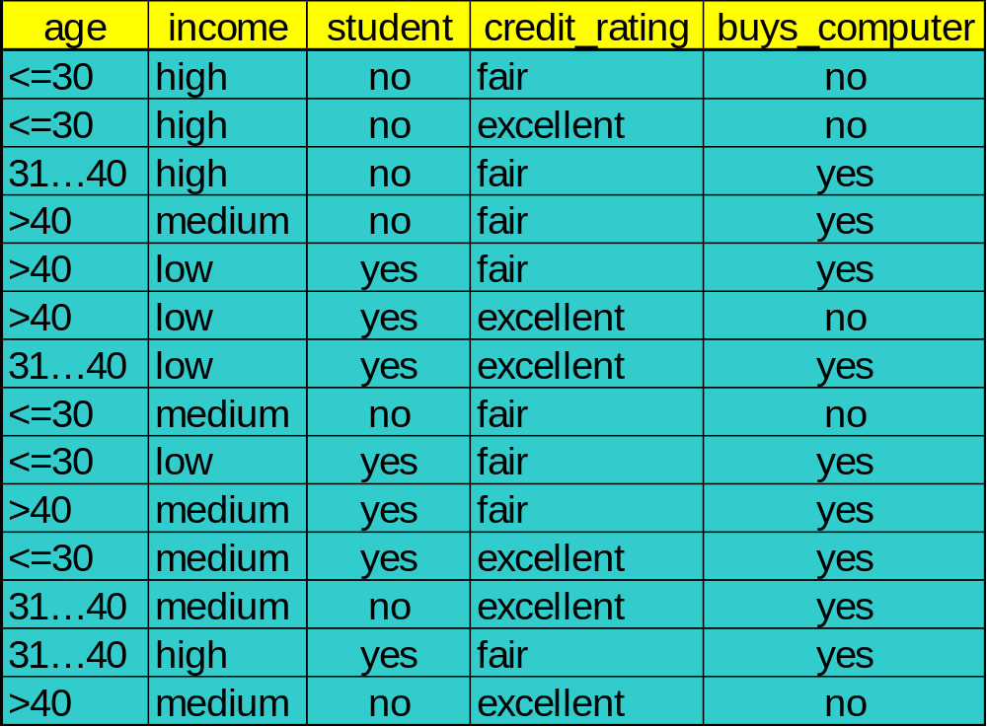
Training Dataset
This follows an example from Quinlan’s ID3
Algorithm

Slide 14
Output: A Decision Tree for “buys_computer”
age?
<=30
overcast
>40
31..40
student?
yes
credit rating?
no
yes
excellent
fair
no
yes
no
yes

Slide 15
Generating and Using Decision Tree
Decision tree generation consists of two phases
  Tree construction
    At start, all the training examples are at the root
    Partition examples recursively based on selected attributes
  Tree pruning
    Identify and remove branches that reflect noise or outliers
Use of decision tree: Classifying an unknown sample
  Test the attribute values of the sample against the decision tree

Slide 16
Algorithm for Decision Tree Induction
Basic algorithm (a greedy algorithm)
  Tree is constructed in a top-down recursive divide-and-conquer manner
  At start, all the training examples are at the root
  Attributes are categorical (if continuous-valued, they are discretized in advance)
  Examples are partitioned recursively based on selected attributes
  Test attributes are selected on the basis of a heuristic or statistical measure (e.g., information gain)
Conditions for stopping partitioning
  All samples for a given node belong to the same class
  There are no remaining attributes for further partitioning – majority voting is employed for classifying the leaf
  There are no samples left

Slide 17
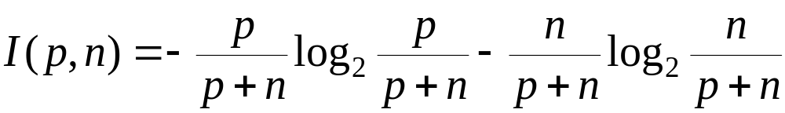
Information Gain (ID3/C4.5)
Information gain (ID3/C4.5)
  All attributes are assumed to be categorical
  Can be modified for continuous-valued attributes
Select the attribute with the highest information gain
Assume there are two classes, P and N
  Let the set of examples S contain p elements of class P and n elements of class N
  The amount of information, needed to decide if an arbitrary example in S belongs to P or N is defined as

Slide 18
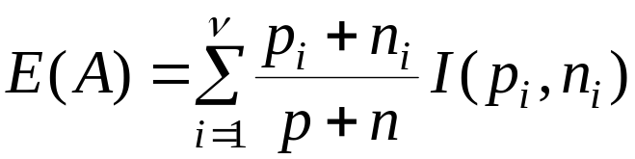

Information Gain in Decision Tree Induction
Assume that using attribute A a set S will be partitioned into sets {S₁, S₂ , …, S_{v}}
  If S_{i} contains p_{i} examples of P and n_{i} examples of N, the entropy, or the expected information needed to classify objects in all subtrees S_{i} is
The encoding information that would be gained by branching on A

Slide 19
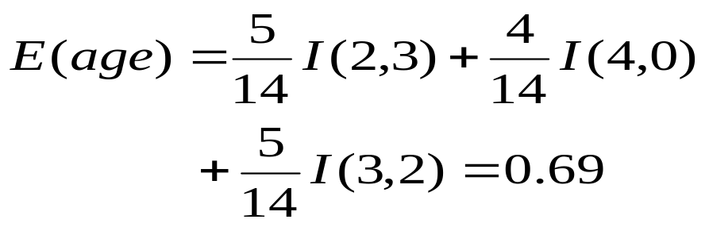
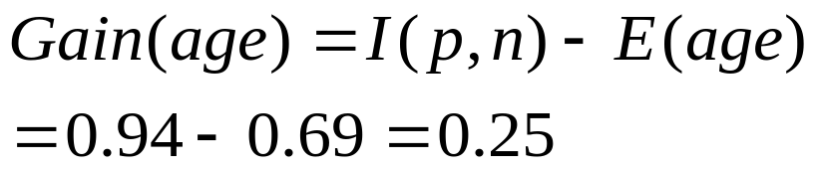


Attribute Selection by Information Gain Computation
Class P: buys_computer = “yes”
Class N: buys_computer = “no”
I(p, n) = I(9, 5) =0.940
Compute the entropy for age:
Hence
Similarly
Train Set

Slide 20
Extracting Classification Rules from Trees
Represent the knowledge in the form of IF-THEN rules
One rule is created for each path from the root to a leaf
Each attribute-value pair along a path forms a conjunction
The leaf node holds the class prediction
Rules are easier for humans to understand
Example
  IF age = “<=30” AND student = “no” THEN buys_computer = “no”
  IF age = “<=30” AND student = “yes” THEN buys_computer = “yes”
  IF age = “31…40” THEN buys_computer = “yes”
  IF age = “>40” AND credit_rating = “excellent” THEN buys_computer = “yes”
  IF age = “>40” AND credit_rating = “fair” THEN buys_computer = “no”

Slide 21
Avoid Overfitting in Classification
The generated tree may overfit the training data
  Too many branches, some may reflect anomalies due to noise or outliers
  Result is in poor accuracy for unseen samples
Two approaches to avoid overfitting
  Prepruning: Halt tree construction early—do not split a node if this would result in the goodness measure falling below a threshold
    Difficult to choose an appropriate threshold
  Postpruning: Remove branches from a “fully grown” tree—get a sequence of progressively pruned trees
    Use a set of data different from the training data to decide which is the “best pruned tree”

Slide 22
Classification in Large Databases
Scalability: Classifying data sets with millions of examples and hundreds of attributes with reasonable speed
Why decision tree induction in data mining?
  relatively faster learning speed (than other classification methods)
  convertible to simple and easy to understand classification rules
  can use SQL queries for accessing databases
  comparable classification accuracy with other methods

Slide 23
Scalable Decision Tree Induction Methods in Data Mining Studies
SLIQ (EDBT’96 — Mehta et al.)
  builds an index for each attribute and only class list and the current attribute list reside in memory
SPRINT (VLDB’96 — J. Shafer et al.)
  constructs an attribute list data structure
PUBLIC (VLDB’98 — Rastogi & Shim)
  integrates tree splitting and tree pruning: stop growing the tree earlier
RainForest (VLDB’98 — Gehrke, Ramakrishnan & Ganti)
  separates the scalability aspects from the criteria that determine the quality of the tree
  builds an AVC-list (attribute, value, class label)

Slide 24
Classification and Prediction
What is classification? What is prediction?
Issues regarding classification and prediction
Classification by decision tree induction
Bayesian Classification
Classification by backpropagation
Other Classification Methods
Prediction
Classification accuracy
Summary

Slide 25
Bayesian Classification: Why?
Probabilistic learning: Calculate explicit probabilities for hypothesis, among the most practical approaches to certain types of learning problems
Incremental: Each training example can incrementally increase/decrease the probability that a hypothesis is correct. Prior knowledge can be combined with observed data.
Probabilistic prediction: Predict multiple hypotheses, weighted by their probabilities
Standard: Even when Bayesian methods are computationally intractable, they can provide a standard of optimal decision making against which other methods can be measured

Slide 26
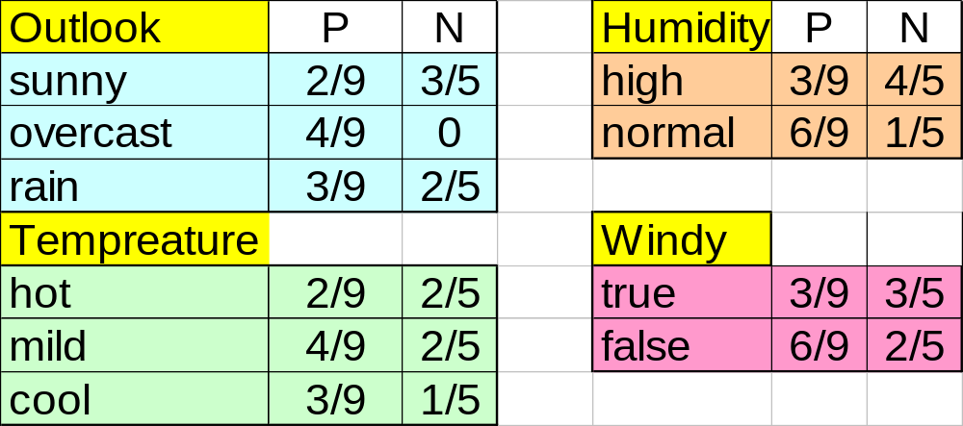
What is Bayesian?
This is a sample:
  Given a training set, we can compute the probabilities
Problem is: Play tennis?

Slide 27
Posteriori Probability
Bayesian classification is based on the theory of probability
If C= {class=apple} X={shape=round, color=red} then P(C|X) is the posterior probability of C under the condition X
  P(C|X) is the probability of:
For contrast:
  P(C) is the prior probability of C
Another example:
  E.g. P(class=N | outlook=sunny,windy=true,…)
Round,and red
Apple?

Slide 28
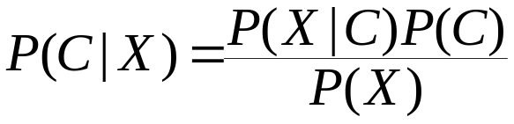
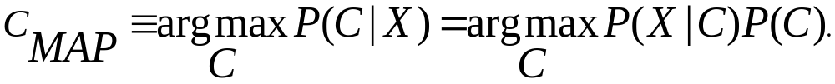
Bayesian classification
Given the sample X, posteriori probability of a hypothesis C, P(C|X) follows the Bayes theorem
Idea: assign to sample X the class label C such that P(C|X) is maximal
  That is:

Slide 29
Estimating a-posteriori probabilities
Bayes theorem:
P(C|X) = P(X|C)·P(C) / P(X)
For example: P(Apple|Round,and red) = P(Round,and red| Apple) ·P(Apple)/P(Round,and red)
Attention: P(X) is constant for all classes
P(C) = relative freq of class C samples
C such that P(C|X) is maximum =
C such that P(X|C)·P(C) is maximum
Problem: computing P(X|C) is unfeasible!

Slide 30
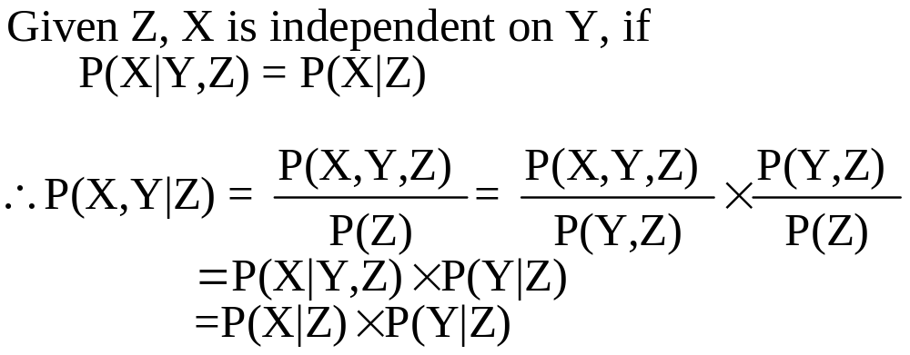
Naive Bayesian Classification
Naive assumption: attribute independence
P(x₁,…,x_{k}|C) = P(x₁|C)·…·P(x_{k}|C)
E.g: P(outlook= sunny, windy = true…|N)=P(outlook= sunny|N) AND P(windy = true|N)…

Slide 31
Naive Bayesian Classification
If i-th attribute is categorical:
P(x_{i}|C) is estimated as the relative freq of samples having value x_{i} as i-th attribute in class C
If i-th attribute is continuous:
P(x_{i}|C) is estimated thru a Gaussian density function
Computationally easy in both cases

Slide 32
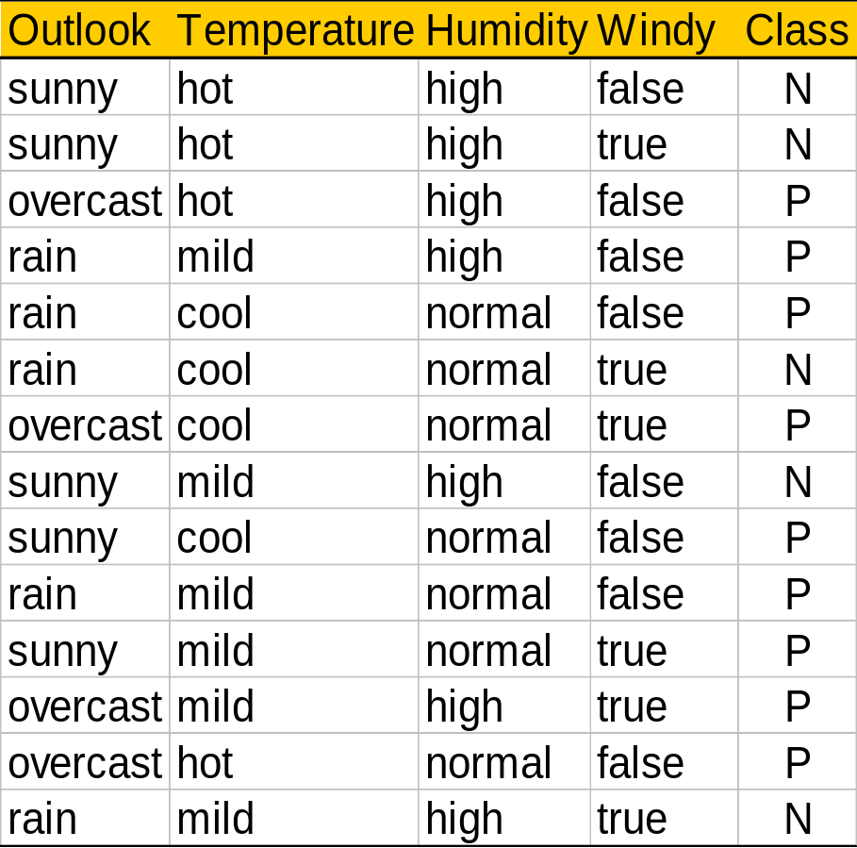
Play-tennis example: estimating P(x_{i}|C)
outlook
P(sunny|p) = 2/9 | P(sunny|n) = 3/5
P(overcast|p) = 4/9 | P(overcast|n) = 0
P(rain|p) = 3/9 | P(rain|n) = 2/5
temperature
P(hot|p) = 2/9 | P(hot|n) = 2/5
P(mild|p) = 4/9 | P(mild|n) = 2/5
P(cool|p) = 3/9 | P(cool|n) = 1/5
humidity
P(high|p) = 3/9 | P(high|n) = 4/5
P(normal|p) = 6/9 | P(normal|n) = 1/5
windy
P(true|p) = 3/9 | P(true|n) = 3/5
P(false|p) = 6/9 | P(false|n) = 2/5
P(p) = 9/14
P(n) = 5/14

Slide 33
Play-tennis example: classifying X
An unseen sample X = <rain, hot, high, false>
P(X|p)·P(p) =
P(rain|p)·P(hot|p)·P(high|p)·P(false|p)·P(p) = 3/9·2/9·3/9·6/9·9/14 = 0.010582
P(X|n)·P(n) =
P(rain|n)·P(hot|n)·P(high|n)·P(false|n)·P(n) = 2/5·2/5·4/5·2/5·5/14 = 0.018286
Sample X is classified in class n (don’t play)

Slide 34
The independence hypothesis…
… makes computation possible
… yields optimal classifiers when satisfied
… but is seldom satisfied in practice, as attributes (variables) are often correlated.
Attempts to overcome this limitation:
  Bayesian networks, that combine Bayesian reasoning with causal relationships between attributes
  Decision trees, that reason on one attribute at the time, considering most important attributes first

Slide 35
Bayesian Belief Networks (I)
Family
History
Smoker
(FH, S)
(FH, ~S)
(~FH, S)
(~FH, ~S)
LC
0.8
0.5
0.7
0.1
LungCancer
Emphysema
~LC
0.2
0.5
0.3
0.9
The conditional probability table for the variable LungCancer
PositiveXRay
Dyspnea
Bayesian Belief Networks

Slide 36
Bayesian Belief Networks (II)
Bayesian belief network allows a subset of the variables conditionally independent
A graphical model of causal relationships
Several cases of learning Bayesian belief networks
  Given both network structure and all the variables: easy
  Given network structure but only some variables
  When the network structure is not known in advance

Slide 37
Bayesian Belief Networks: Example
E = yes
0.7
D = healthy
0.25
Exercise
Food
 | HD=yes
E=yes D=healthy | 0.25
E=yes D=not healthy | 0.45
E=no D=healthy | 0.55
E=no D=not healthy | 0.75
 | Hb=yes
D=healthy | 0.2
D=not healthy | 0.85
Heart Disease
Angina
 | CP=yes
HD=yes Hb=yes | 0.8
HD=yes Hb=no | 0.6
HD=no Hb=yes | 0.4
HD=no Hb=no | 0.1
Blood Pressure
Chest Ache
 | BP=high
HD=yes | 0.85
HD=no | 0.2

Slide 38

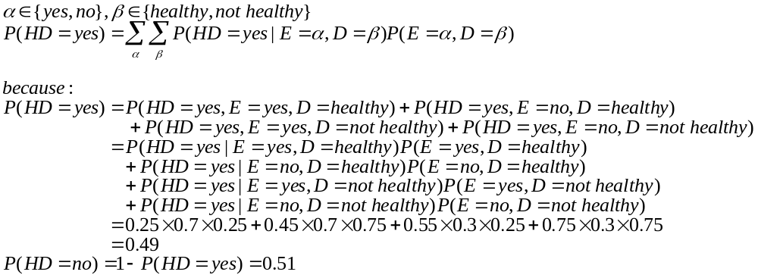
Bayesian Belief Networks: Example
No prior information
So ‘HD=no’ is more possible
Notes:
HD
E=YES
E=NO
D=HEALTHY
D=NOT HEALTHY

Slide 39
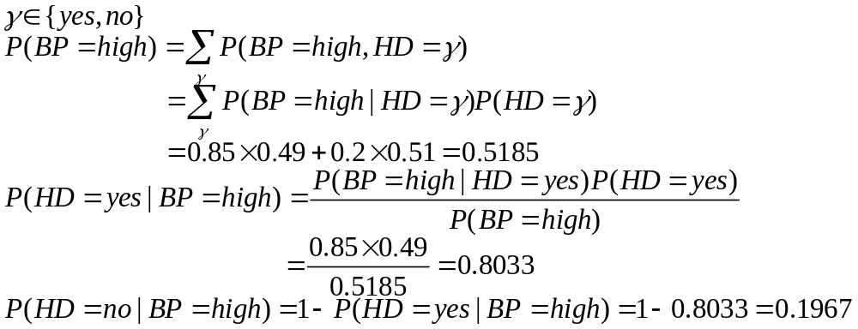
Bayesian Belief Networks: Example
High blood pressure
  Compare P(HD=yes) and P(HD=no)
So ‘HD=yes’ is more possible

Slide 40
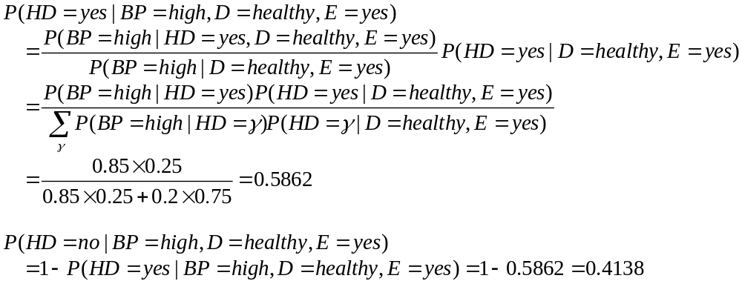
Bayesian Belief Networks: Example
High blood pressure, healthy food, exercise
So exercises and healthy foods can reduce the risk of heart disease

Slide 41
Classification and Prediction
What is classification? What is prediction?
Issues regarding classification and prediction
Classification by decision tree induction
Bayesian Classification
Classification by backpropagation
Other Classification Methods
Prediction
Classification accuracy
Summary

Slide 42

A Neuron
-
_{k}
x₀
w₀
x₁
w₁
∑
f
output y
x_{n}
w_{n}
Input
vector x
weight
vector w
weighted
sum
Activation
function
M-P model. Neuron is also called unit. Bias is also called threshold.
The n-dimensional input vector x is mapped into variable y by means of the scalar product and a nonlinear function mapping

Slide 43
Neural Network
Output vector
A multilayer feed forward NN with a hidden layer can approximate any function in any accuracy
Output nodes
Hidden nodes
w_{ij}
hidden nodes and output nodes are called functional units
Input nodes
Input vector: x_{i}

Slide 44

Neural Networks
Advantages
  prediction accuracy is generally high
  robust, works when training examples contain errors
  output may be discrete, real-valued, or a vector of several discrete or real-valued attributes
  fast evaluation of the learned target function
Criticism
  long training time
  difficult to understand the learned function (weights)
  not easy to incorporate domain knowledge

Slide 45
Network Training
The ultimate objective of training
  obtain a set of weights that makes almost all the tuples in the training data classified correctly
Steps
  Initialize weights with random values
  Feed the input tuples into the network one by one
  For each unit
    Compute the net input to the unit as a linear combination of all the inputs to the unit
    Compute the output value using the activation function
    Compute the error
    Update the weights and the bias

Slide 46
How to Get the Best Design of NN?
In general, no guarantee to converge to the best result
Few rules can tell which NN is the best
Therefore, the design of NN is a process of trial-by-error, and the network topology is often decided by the actual behavior

Slide 47
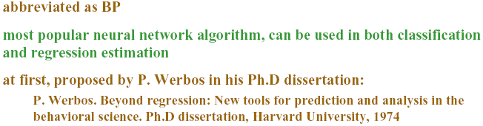
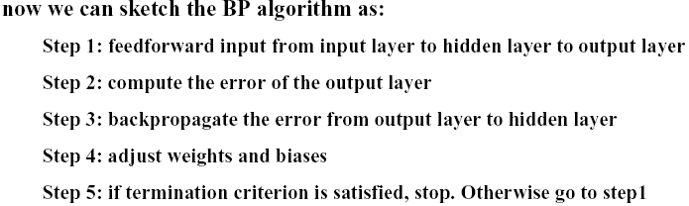
BackPropagation

Slide 48




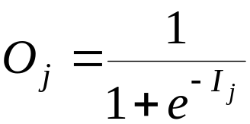
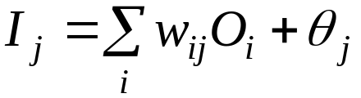

Multi-Layer Perceptron
Output vector
Output nodes
Hidden nodes
w_{ij}
Input nodes
Input vector: x_{i}

Slide 49
Example of BP
X1=1
Initial input, weight, and bias values:
Class label =1, learning rate l=0.9
1
0.2
θ₄= -0.4
-0.3
4
0.4
θ₆= 0.1
X2=0
2
-0.5
6
-0.3
T6=1
0.1
5
X3=1
-0.2
3
θ₅= 0.2
0.2
x1 | x2 | x3 | w₁₄ | w₁₅ | w₂₄ | w₂₅
1 | 0 | 1 | 0.2 | -0.3 | 0.4 | 0.1
w₃₄ | w₃₅ | w₄₆ | w₅₆ | θ₄ | θ₅ | θ₆
-0.5 | 0.2 | -0.3 | -0.2 | -0.4 | 0.2 | 0.1

Slide 50
Example of BP
X1=1
1
0.2
θ₄= -0.4
-0.3
4
-0.3
θ₆= 0.1
X2=0
0.4
T6=1
2
6
0.1
5
-0.2
-0.5
X3=1
3
0.2
θ₅=0.2
learning rate l =0.9

Slide 51

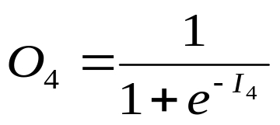



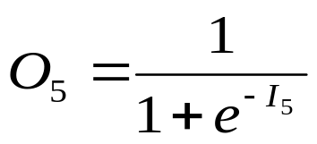
Example of BP
X1=1
1
0.2
θ₄= -0.4
-0.3
4
X2=0
-0.3
θ₆= 0.1
0.4
T6=1
2
6
0.1
5
-0.2
-0.5
X3=1
3
0.2
θ₅=0.2
learning rate l =0.9

Slide 52
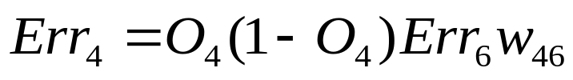











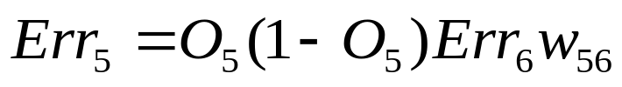

Example of BP
X1=1
1
4
X2=0
-0.3
T6=1
2
6
5
-0.2
X3=1
3
learning rate l =0.9

Slide 53
Classification and Prediction
What is classification? What is prediction?
Issues regarding classification and prediction
Classification by decision tree induction
Bayesian Classification
Classification by backpropagation
Other Classification Methods
Prediction
Classification accuracy
Summary

Slide 54
Other Classification Methods
K-nearest neighbor classifier
Case-based reasoning
Genetic algorithm
Rough set approach
Fuzzy set approaches

Slide 55
Instance-Based Methods
Instance-based learning:
  Store training examples and delay the processing (“lazy evaluation”) until a new instance must be classified
Typical approaches
  k-nearest neighbor approach
    Instances represented as points in a Euclidean space.
  Case-based reasoning
    Uses symbolic representations and knowledge-based inference

Slide 56
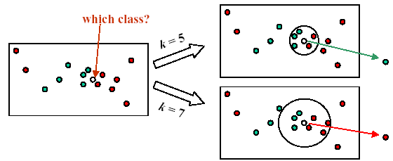
The k-Nearest Neighbor Algorithm
All instances correspond to points in the n-D space.
The nearest neighbor are defined in terms of Euclidean distance.
The target function could be discrete- or real- valued.
For discrete-valued, the k-NN returns the most common value among the k training examples nearest to xq.

Slide 57
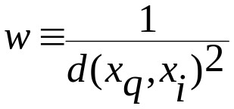
Discussion on the k-NN Algorithm
The k-NN algorithm for continuous-valued target functions
  Calculate the mean values of the k nearest neighbors
Distance-weighted nearest neighbor algorithm
  Weight the contribution of each of the k neighbors according to their distance to the query point x_{q}
    giving greater weight to closer neighbors
  Similarly, for real-valued target functions
Robust to noisy data by averaging k-nearest neighbors
Curse of dimensionality: distance between neighbors could be dominated by irrelevant attributes.
  To overcome it, axes stretch or elimination of the least relevant attributes.
  Example: the climate and the average income of the city

Slide 58
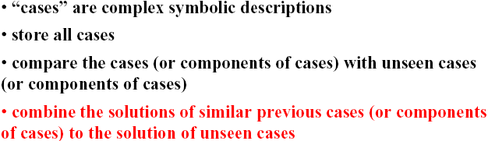
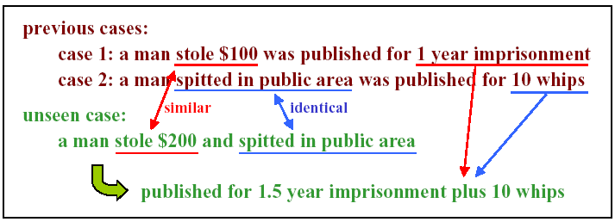
Case based reasoning

Slide 59
Remarks on Lazy vs. Eager Learning
Instance-based learning: lazy evaluation
Decision-tree and Bayesian classification: eager evaluation
Key differences
  Lazy method may consider query instance xq when deciding how to generalize beyond the training data D
  Eager method cannot since they have already chosen global approximation when seeing the query
Efficiency: Lazy - less time training but more time predicting
Accuracy
  Lazy method effectively uses a richer hypothesis space since it uses many local linear functions to form its implicit global approximation to the target function
  Eager: must commit to a single hypothesis that covers the entire instance space

Slide 60
Genetic Algorithms(I)
GA: based on an analogy to biological evolution
Darwin: survival of the fittest
Each rule is represented by a string of bits
An initial population is created consisting of randomly generated rules
  e.g., IF A₁ and Not A₂ then C₂ can be encoded as 100
  e.g., IF Not A₁ and Not A₂ then C₁ can be encoded as 001

Slide 61
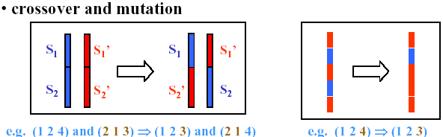
Genetic Algorithms(II)
Based on the notion of survival of the fittest, a new population is formed to consists of the fittest rules and their offsprings
The fitness of a rule is represented by its classification accuracy on a set of training examples
Offsprings are generated by crossover and mutation

Slide 62

Rough Set Approach(I)
Rough sets are used to approximately or “roughly” define equivalent classes
A rough set for a given class C is approximated by two sets: a lower approximation (certain to be in C) and an upper approximation (cannot be described as not belonging to C)

Slide 63
Rough Set Approach (II)
Finding the minimal subsets (reducts) of attributes (for feature reduction) is NP-hard but a discernibility matrix is used to reduce the computation intensity
Rough set can also be used to judge attribute relevance

Slide 64

Fuzzy Set Approaches(I)
Fuzzy logic uses truth values between 0.0 and 1.0 to represent the degree of membership (such as using fuzzy membership graph)
Attribute values are converted to fuzzy values
  e.g., income is mapped into the discrete categories {low, medium, high} with fuzzy values calculated

Slide 65
Fuzzy Set Approaches(II)
For a given new sample, more than one fuzzy value may apply
Each applicable rule contributes a vote for membership in the categories
Typically, the truth values for each predicted category are summed

Slide 66
Classification and Prediction
What is classification? What is prediction?
Issues regarding classification and prediction
Classification by decision tree induction
Bayesian Classification
Classification by backpropagation
Classification based on concepts from association rule mining
Other Classification Methods
Prediction
Classification accuracy
Summary

Slide 67
What Is Prediction?
Prediction is similar to classification
  First, construct a model
  Second, use model to predict unknown value
    Major method for prediction is regression
      Linear and multiple regression
      Non-linear regression
Prediction is different from classification
  Classification refers to predict categorical class label
  Prediction models continuous-valued functions

Slide 68
Regress Analysis
Linear regression
  Linear regression
  Multiple regression
Non-Linear regression
Other models
  Log-linear models

Slide 69
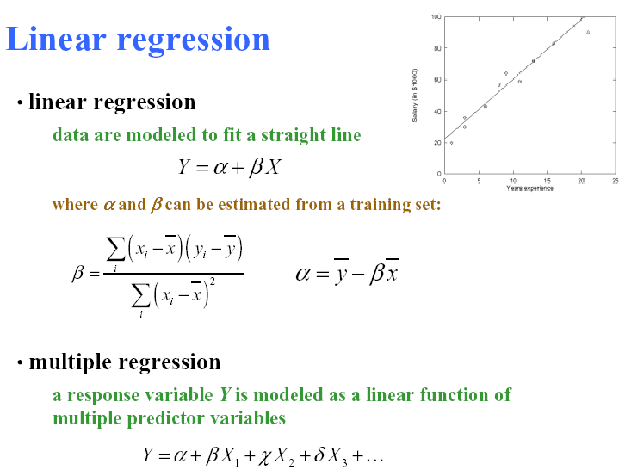
Regress Analysis

Slide 70
Example----Linear Regression
X(years) | Y(salary)
3 | 30
8 | 57
9 | 64
13 | 72
3 | 36
6 | 43
11 | 59
21 | 90
1 | 20
16 | 83
Average:
x:9.1
y:55.4
β=3.5
α=23.6

Slide 71
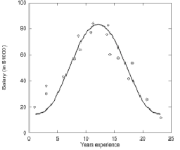
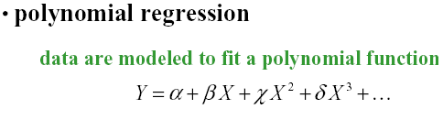

Non-Linear and Log-linear Regression
Log-linear models:
  The multi-way table of joint probabilities is approximated by a product of lower-order tables.
  Probability: p(a, b, c, d) = αab βacχad δbcd

Slide 72
Classification and Prediction
What is classification? What is prediction?
Issues regarding classification and prediction
Classification by decision tree induction
Bayesian Classification
Classification by backpropagation
Classification based on concepts from association rule mining
Other Classification Methods
Prediction
Classification accuracy
Summary

Slide 73
Classification Accuracy: Estimating Error Rates
Partition: Training-and-testing
  use two independent data sets, e.g., training set (2/3), test set(1/3)
  used for data set with large number of samples
Cross-validation
  divide the data set into k subsamples
  use k-1 subsamples as training data and one sub-sample as test data --- k-fold cross-validation
  for data set with moderate size

Slide 74
Ensemble Methods---Boosting and Bagging
Ensemble: learning systems are combined to solve a problem
Ensemble methods can improve the classification accuracy.
The most popular ensemble methods:
  Bagging
  Boosting

Slide 75
Bagging Technique
Bagging
  Training process:
    Several training sets are generated by bootstrap sampling from the initial training set
    Each set is used to train a learning system to get a model
  Prediction process:
    When a new sample comes, use these models to get different prediction results
    Finally, these prediction results of those learning models are combined
Bagging technique can be extended to predict the continuous value

Slide 76
Boosting Technique(I)----Method
Boosting increases classification accuracy
  Applicable to decision trees or Bayesian classifier
Learn a series of classifiers, where each classifier in the series pays more attention to the examples misclassified by its predecessor
Boosting requires only linear time and constant space

Slide 77
Boosting Technique(II)----Algorithm
Assign every example an equal weight 1/N
For t = 1, 2, …, T Do
  Obtain a hypothesis (classifier) h^{(t)} under w^{(t)}
  Calculate the error of h(t) and re-weight the examples based on the error
  Normalize w^{(t+1)} to sum to 1
Output a weighted sum of all the hypothesis, with each hypothesis weighted according to its accuracy on the training set

Slide 78
Classification and Prediction
What is classification? What is prediction?
Issues regarding classification and prediction
Classification by decision tree induction
Bayesian Classification
Classification by backpropagation
Classification based on concepts from association rule mining
Other Classification Methods
Prediction
Classification accuracy
Summary

Slide 79
Summary
Classification is an extensively studied problem (mainly in statistics, machine learning & neural networks)
Classification is probably one of the most widely used data mining techniques with a lot of extensions
Scalability is still an important issue for database applications: thus combining classification with database techniques should be a promising topic
Research directions: classification of non-relational data, e.g., text, spatial, multimedia, etc..

Slide 80
References (I)
J. Han and M. Kamber. Data Mining: Concepts and Techniques. Morgan Kaufmann, 2000.(Including Materials)
C. Apte and S. Weiss. Data mining with decision trees and decision rules. Future Generation Computer Systems, 13, 1997.
L. Breiman, J. Friedman, R. Olshen, and C. Stone. Classification and Regression Trees. Wadsworth International Group, 1984.
P. K. Chan and S. J. Stolfo. Learning arbiter and combiner trees from partitioned data for scaling machine learning. In Proc. 1st Int. Conf. Knowledge Discovery and Data Mining (KDD'95), pages 39-44, Montreal, Canada, August 1995.
U. M. Fayyad. Branching on attribute values in decision tree generation. In Proc. 1994 AAAI Conf., pages 601-606, AAAI Press, 1994.
J. Gehrke, R. Ramakrishnan, and V. Ganti. Rainforest: A framework for fast decision tree construction of large datasets. In Proc. 1998 Int. Conf. Very Large Data Bases, pages 416-427, New York, NY, August 1998.
M. Kamber, L. Winstone, W. Gong, S. Cheng, and J. Han. Generalization and decision tree induction: Efficient classification in data mining. In Proc. 1997 Int. Workshop Research Issues on Data Engineering (RIDE'97), pages 111-120, Birmingham, England, April 1997.

Slide 81
References (II)
J. Magidson. The Chaid approach to segmentation modeling: Chi-squared automatic interaction detection. In R. P. Bagozzi, editor, Advanced Methods of Marketing Research, pages 118-159. Blackwell Business, Cambridge Massechusetts, 1994.
M. Mehta, R. Agrawal, and J. Rissanen. SLIQ : A fast scalable classifier for data mining. In Proc. 1996 Int. Conf. Extending Database Technology (EDBT'96), Avignon, France, March 1996.
S. K. Murthy, Automatic Construction of Decision Trees from Data: A Multi-Diciplinary Survey, Data Mining and Knowledge Discovery 2(4): 345-389, 1998
J. R. Quinlan. Bagging, boosting, and c4.5. In Proc. 13th Natl. Conf. on Artificial Intelligence (AAAI'96), 725-730, Portland, OR, Aug. 1996.
R. Rastogi and K. Shim. Public: A decision tree classifer that integrates building and pruning. In Proc. 1998 Int. Conf. Very Large Data Bases, 404-415, New York, NY, August 1998.
J. Shafer, R. Agrawal, and M. Mehta. SPRINT : A scalable parallel classifier for data mining. In Proc. 1996 Int. Conf. Very Large Data Bases, 544-555, Bombay, India, Sept. 1996.
S. M. Weiss and C. A. Kulikowski. Computer Systems that Learn: Classification and Prediction Methods from Statistics, Neural Nets, Machine Learning, and Expert Systems. Morgan Kaufman, 1991.

Slide 82
Thank you !!!

