Slide 1
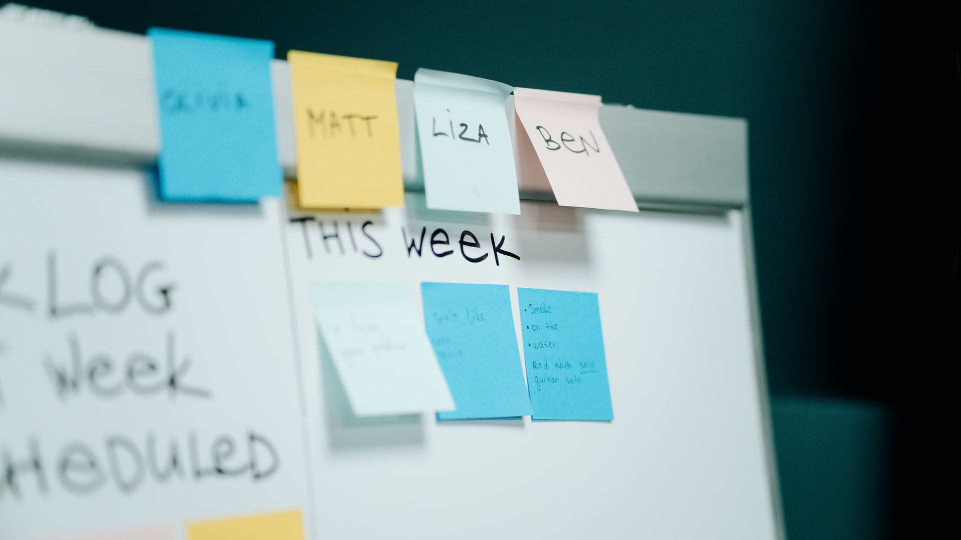
Scrum-Agile Presentation
Tyler Coplan
Southern New Hampshire University
Notes:
Thank you for joining me for my presentation on Scrum-Agile development. I am Tyler Coplan. Today I aim to compare Scrum teams and Agile development to traditional waterfall projects. I want to highlight where Scrum can be a better process than the waterfall method and breakdown the Scrum team and how the team makes progress on the project.

Slide 2
Why use Scrum?
Waterfall Method
Requires well-defined projects
Requirements cannot change
Testing done at the end
No working product during development
Scrum-Agile Method
Projects with uncertainty
Requirement changes expected
Testing alongside development
Produces a working product throughout development
Notes:
First, let’s look at why we should use Scrum in the first place. The Waterfall Method still can be used and has some advantages in certain situations. When the project is well-defined, there are no changes expected to the project requirements, and QA and working software can wait until development is completed, then the Waterfall Method is a suitable option for the project (Cobb, 2015). With the rapid change of technology these days, projects rarely meet these requirements. This is where Agile can help. When the end-product is loosely defined, users or stakeholders want working software throughout development, and project requirements are expected to change or be defined later, Agile development will help achieve these goals (Cobb). Scrum Teams and Scrum development practices are adapted to break down large projects into smaller components that can be worked on, released, and added to later.

Slide 3
Introducing the Scrum Team
Scrum Master
Facilitates Communication
Remove Impediments
Coaches Agile Practices
Product Owner
Maintain Product Backlog
Interpret Business Requirements
Create User Stories
Development Team
Self-Organizing
Testing & Development
Cross-Functional
Notes:
Let’s take a look at the different roles on the Scrum team. The Scrum Master serves as an Agile guide. They will work closely with both the development team and product owner to meet Sprint goals. The Scrum Master serves the development team by coaching them in self-organization and cross-functionality and serves the product owner by finding techniques for effective product backlog management and ensuring user stories provide the necessary details (Schwaber & Sutherland, 2020). The Product Owner works with users and stakeholders to define product requirements and create user stories. The development team is a self-organized and cross-functional team of developers who determine how to fill all the roles required to meet the “definition of done” of each user story in a Sprint (Schwaber & Sutherland).

Slide 4
Scrum Approach – The Sprint
Sprint Planning
Daily Scrum
Sprint Review
Sprint Retrospective
Notes:
The work done by a Scrum team involves different events. The Sprint is the main part of a Scrum team’s work. It usually takes place over a few weeks (the exact timeline determined ahead of time) and will have clearly defined goals. The goals and timeframe are determined through the Sprint Planning event. This is where the Development Team, Scrum Master and Product Owner decide which user stories to bring to the Sprint. The Daily Scrum is a standup meeting that is 15 minutes long with the development team and scrum master every workday. The team discusses what was done yesterday, what will be done today and anything that is impeding progress. The Sprint Review is done at the end of the Sprint and involves the Scrum Master and Product Owner. Stakeholders and users are invited to see the progress made during the Sprint. The Sprint Retrospective is for the development team and is a chance to reflect on the process of the previous Sprint and find ways the team can improve.

Slide 5
How Scrum Helped Us
Adapt to Changes
Organize Communication
Define Roles
Notes:
Scrum helped our team by allowing us to adapt to changing business requirements. When we needed to change to health and wellness vacations, our Scrum process allowed us to accommodate the business requirements. Scrum events and information radiators allowed us to organize our communications so everyone was up to date with the right information about the product. Everyone’s role was clearly defined through Scrum so we all knew what was expected of us. Scrum gave our team the flexibility to adapt the product to fast changing requirements that are common in technology these days.

Slide 6
References
Cobb, C. (2015) The Project Manager's Guide to Mastering Agile : Principles and Practices for an Adaptive Approach. Accessed at https://web-a-ebscohost-com.ezproxy.snhu.edu/ehost/ebookviewer/ebook/bmxlYmtfXzkzNzAwOV9fQU41?sid=8c8bd676-32fe-4da0-93ec-4b3699a62af4@sessionmgr4007&vid=0&format=EB&rid=1
Schwaber, K. & Sutherland, J. (2020) The 2020 Scrum Guide. Accessed at https://scrumguides.org/scrum-guide.html

