Slide 1

DriverPass System Analysis
Tyler Coplan
Notes:
[No speaker notes required for this slide.]

Slide 2

System Requirements
Functional Requirements
Schedule appointments
Purchase packages
Take tests
Nonfunctional Requirements
Web-based product
Control user access
Always available and fast
Notes:
There are various requirements that need to be met in order to create the DriverPass system. These are broken down into functional requirements, what the system needs to do, and nonfunctional requirements, how the system will do it. The main purpose of the system is to allow customers to purchase driver training packages, schedule appointments with an instructor, and take tests on DMV laws and regulations. All other functional requirements of the system, such as logging in, allowing employees to schedule appointments for customers, updating the system with the latest laws, are all there to support the key points of the system that drives the business. There are nonfunctional requirements that are essential to delivering an intuitive product that customers will want to use. A web-based system, with support for computer and smartphone access, will make it easy for customers to use the system. For security purposes, there will need to be different levels of access for users of the system. Customers can only see their own accounts, employees can schedule appointments and purchase packages for customers over the phone, and there will be administrative access for the owner to control all access to the system. That way, new employees can be added, or if an employee leaves the company access can be revoked, and passwords can be reset manually if needed. The system’s servers will be maintained offsite on the cloud, which will reduce upfront hardware costs, minimize the need for system maintenance, and ensure the system is always up and quick to respond to customers.

Slide 3
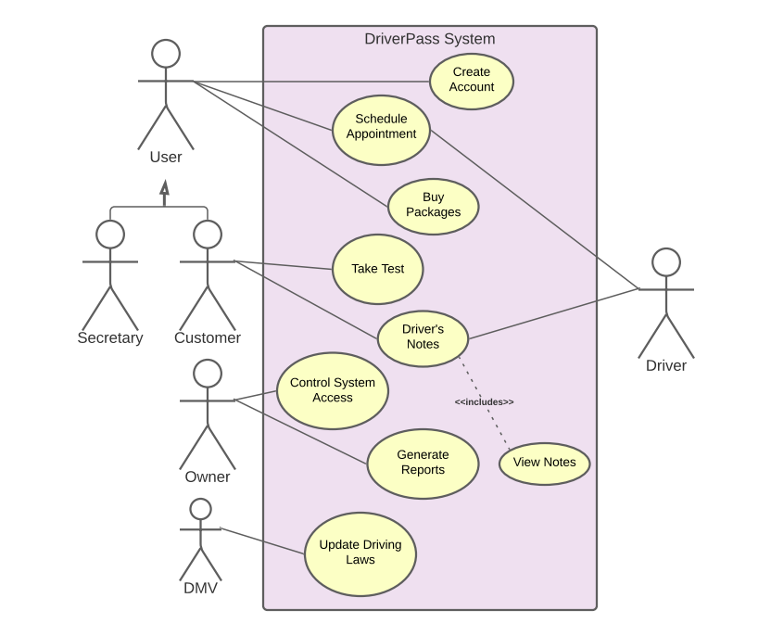
Use Case Diagram
Notes:
This visual is the use case diagram that shows the basic uses of the DriverPass system. It shows us what actions will be made possible by the system and who can carry out the different actions. To start, we see a general version of a system user that can carry out actions that both customers and a secretary or employee share. These actions are to create an account, buy a package, or schedule an appointment. Although the system will be familiar to anyone comfortable with using the internet, we also need to be able to support any customers who are not comfortable using the internet or who many not have access to the internet when they need to use our system. They can call in to our office and have an employee access their account and help them with our services. Separately, only the customer has access to taking exams in our system and accessing their notes from their driving lessons. This is an online feature and something that the employee cannot access directly for a customer. The schedule of appointments will be sent out to the drivers from the system. Drivers can also upload notes to the system after each lesson so the student can review them. The owner, Liam, will have the highest-level access to the system, which will allow him to control user access, as discussed earlier, and generate reports from the system. These reports will show things like the current schedule, who scheduled the appointments, packages purchased and so on. Lastly, the DMV will need to update our system with any changes to driving laws and this will happen automatically by the DMV sending updates to our system.

Slide 4
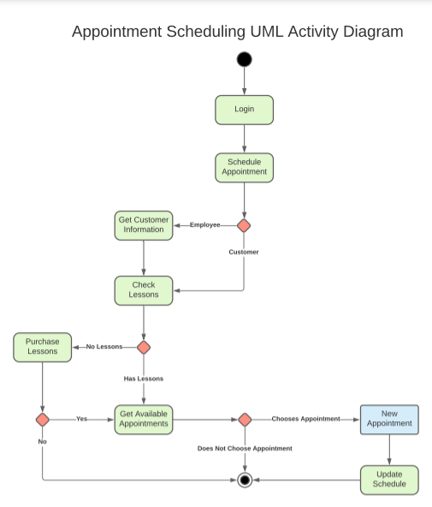
Activity Diagram
Notes:
This slide shows an activity diagram that outlines the steps the system will take to schedule an appointment. We start at the top where a person will log-in to the system. For simplicity, we assume the login was successful, since that is its own activity all by itself. Next, the person will choose to schedule an appointment. At this point, the system will determine if the person using the system is a customer or employee and this is done automatically based on the login information. If the user is an employee, it will prompt the employee to get information about the customer to find their account and then move on to the check lessons step. If it’s a customer, it will go straight to the check lessons step. Here, the system will check the users account to see if they have any unscheduled lessons available to use. If so, it will move on to getting the available appointments. However, if the user does not have lessons available, the system will ask the user if they want to purchase a package to add lessons to their account. If they choose not to purchase lessons, it will end this process right there. If they choose to purchase a package, it will take them through the package purchasing process and resume scheduling the appointment after a successful purchase. Once the system gets the available appointments, the customer can filter through them and choose an appointment that fits their schedule. If no appointment is chosen, the process ends without scheduling an appointment. If an appointment is chosen, the new appointment will be created, the schedule will be updated, the customer’s account will be debited one appointment and the process will end. As you can see, it is much easier to visualize these processes with diagrams than it is to explain them in words. These lengthy explanations are summed up on a single page with visuals that system designers are very familiar with.

Slide 5
Security
Security
Control user access
Password protected logins
Two-factor authentication
Optional store of payment information
Privacy notice
Notes:
There are some security features that need to be addressed with the system design. Giving the owner control over system access is the first key security feature. He is the biggest stakeholder in the system and has the most to lose should security be breached, so allowing him to control who can access the system keeps unauthorized users from getting information from the system. Users will need a password to log in to their account, which will be created by the users themselves and hidden in our database. I, personally, would suggest considering an optional two-factor authentication. Some users do not like it and others will feel much safer using the system with it. Basically, two-factor authentication requires the user to enter their login and password, and if it is correct, then they will get a text message or email with a one-time use PIN they must enter to complete the login. This way, even if someone else gets their password, they will also need their phone or access to their email to complete the login. Additionally, the customer should be able to choose whether they want us to store their payment information or not. That way, we will not store any card information against a customer’s wishes but can also provide the convenience to those that want quick purchases of our services. Lastly, a privacy notice needs to be provided to users about the data we collect and how we use it, so they are aware of what is happening to their personal information.

Slide 6
System Limitations
System Limitations
Driving packages are fixed
Only one level of customer
No mobile app
Internet access required
Notes:
The current design of the system will limit its abilities in some ways. First, the different driving packages that can be offered are fixed and will require changes to the system in order to offer new packages. The owner can disable any packages he no longer wants to offer but cannot add new ones without a developer. There is only one level of customer supported by the system. If there were any thoughts or plans to have premium customer levels with special appointment times or other perks, this needs to be addressed now so it can be included in the system design. There will be no mobile application for this system. Many of the things we do on our smartphones, like shopping on Amazon, use apps, but can also be done on the smartphone's mobile browser. However, we tend to use apps when they are available because they offer a better user experience than the web-browsers offer. The system can be converted into a mobile app, however, web-based systems that are converted do not have the same polished feel of a native mobile app. A mobile app would require added costs and maintenance to the system that is not feasible with the given budget. Not to worry, your system is not nearly as complex as something like Amazon’s online store, and we can provide a great user experience through the web-browser, both on smartphones and laptops. Lastly, internet access is required to use the system. If the office has internet, customers can call in to schedule appointments and purchase packages, but if the internet is out then you will not be able to access the system.

