Slide 1
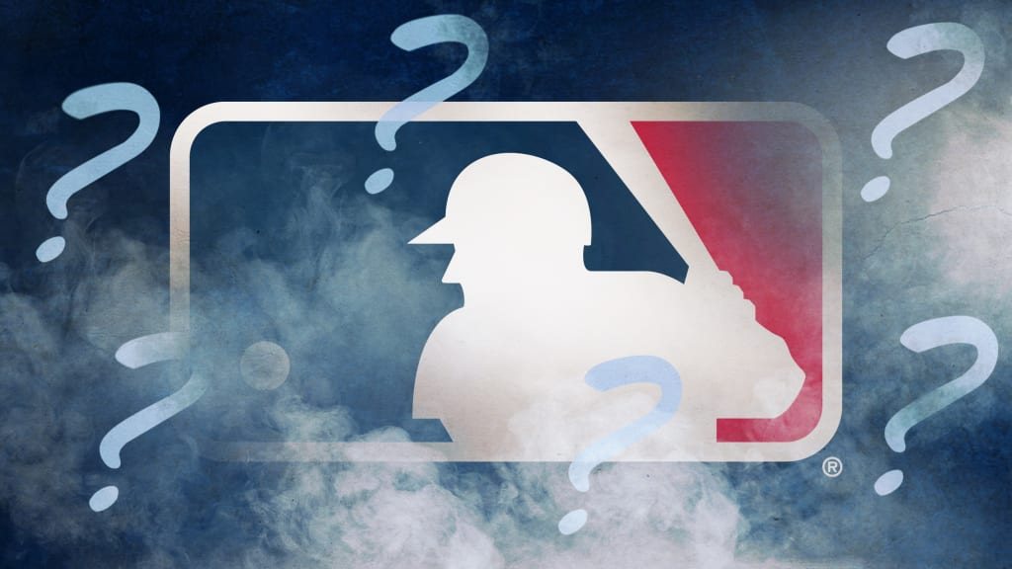
MLB
Sticky Substance

Slide 2
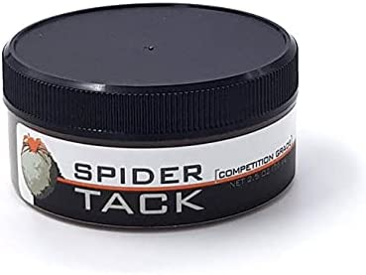
MLBs Why.
It is well known in the baseball community that pitchers were using ”sticky stuff” to increase grip on the baseball and produce more spin on the ball.
Scientist state that increased spin rate on a ball increases movement on the ball and in turn makes it harder for hitters to hit.
In 2015 Statcast was created and stats like spin rate were now being tracked.
In 2019 spin rate were at high and Batting average where at a low.
In June of 2021 MLB changed the Rule and banned any ”Sticky Stuff” from being used in hope of leveling the playing field.

Slide 3
Questions to Answer?
Does Spin rate make the ball move more ?
Does Spin rate create an unfair advantage and make it harder for the batter to hit the ball?

Slide 4
Pitch by pitch
Since every pitch in baseball is different, we are going to look at them individually.
We will look at spin rate and its correlation with batting average as well as movement and strike out percentage.

Slide 5
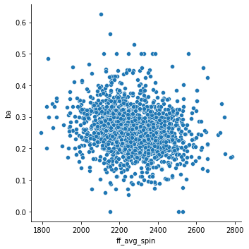
Fastball

Slide 6
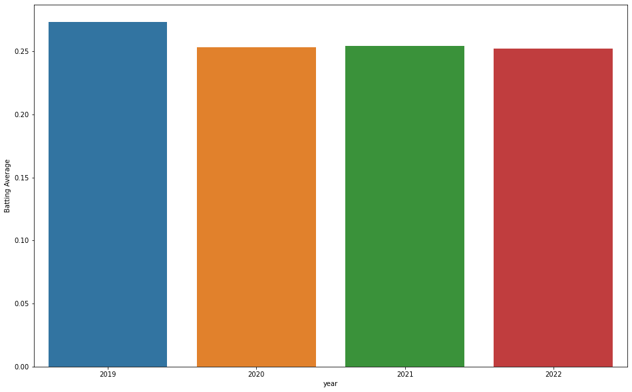
Fastball

Slide 7
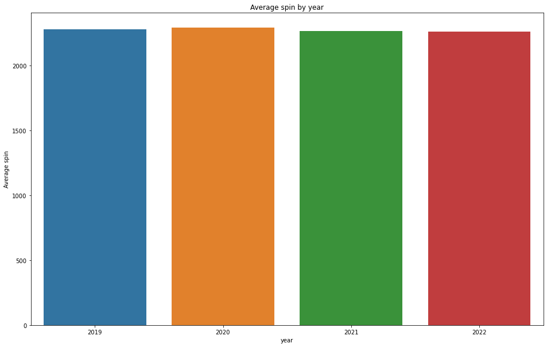
Fastball

Slide 8
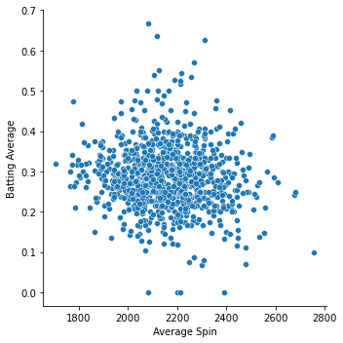
Sinker

Slide 9
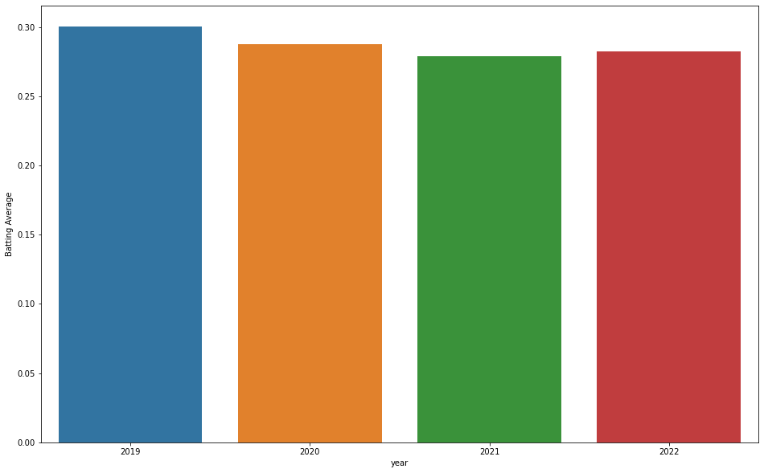
Sinker

Slide 10
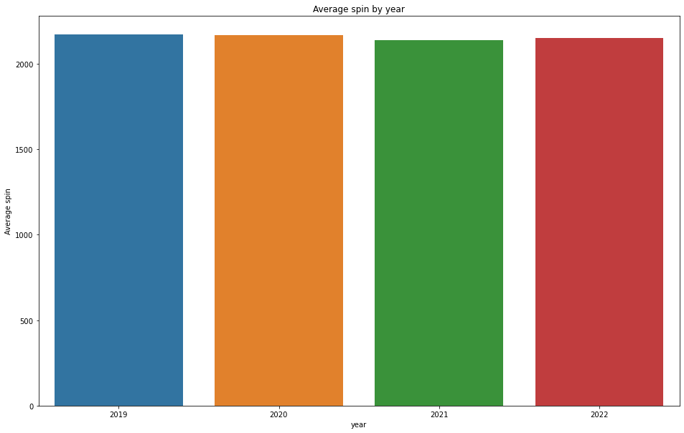
Sinker

Slide 11
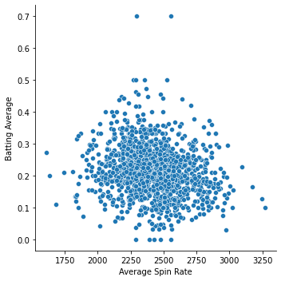
Slider

Slide 12
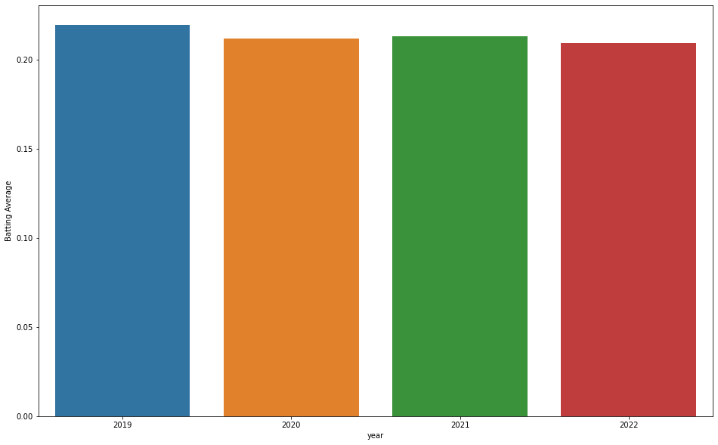
Slider

Slide 13
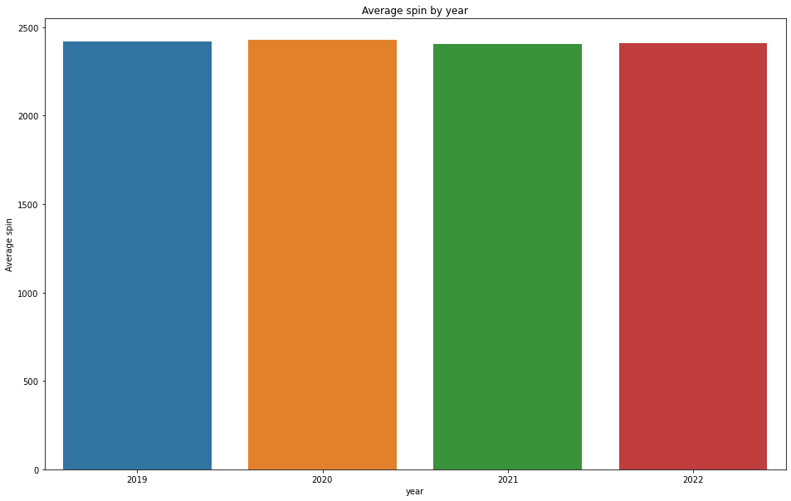
Slider

Slide 14
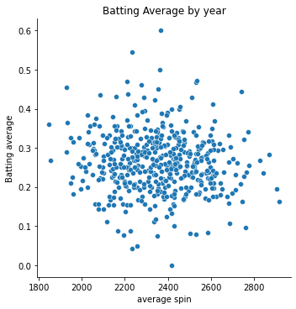
Cutter

Slide 15
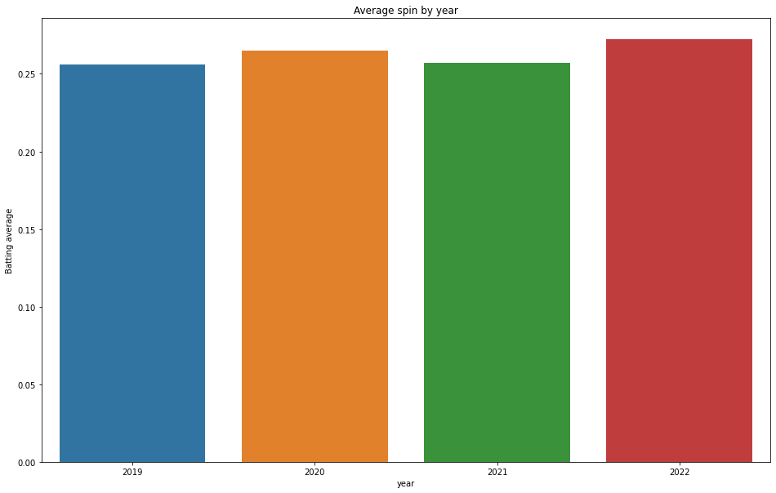
Cutter

Slide 16

Cutter

Slide 17
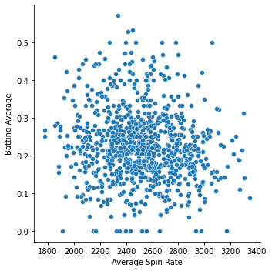
Curveball

Slide 18
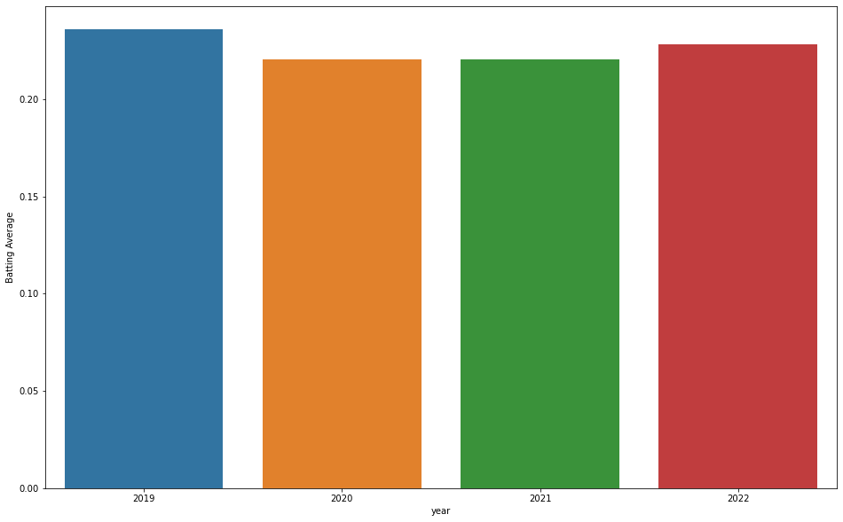
Curveball

Slide 19
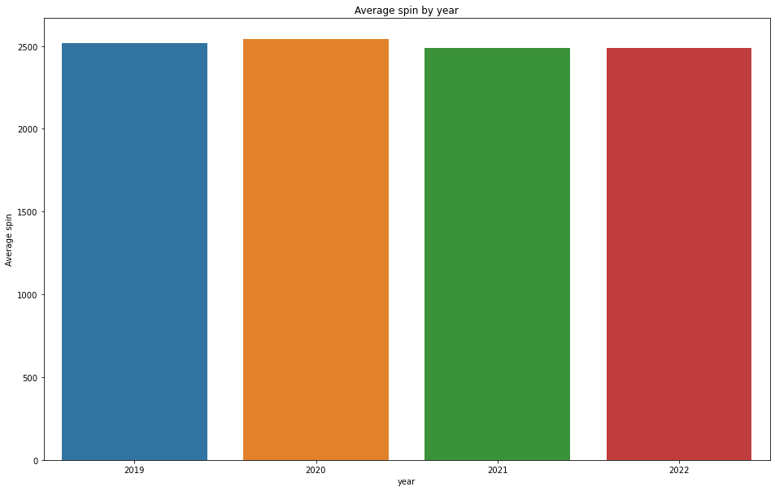
Curveball

Slide 20
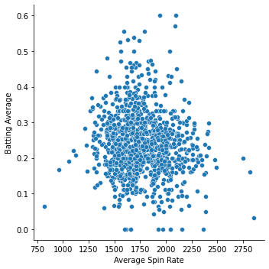
Changeup

Slide 21

Changeup

Slide 22
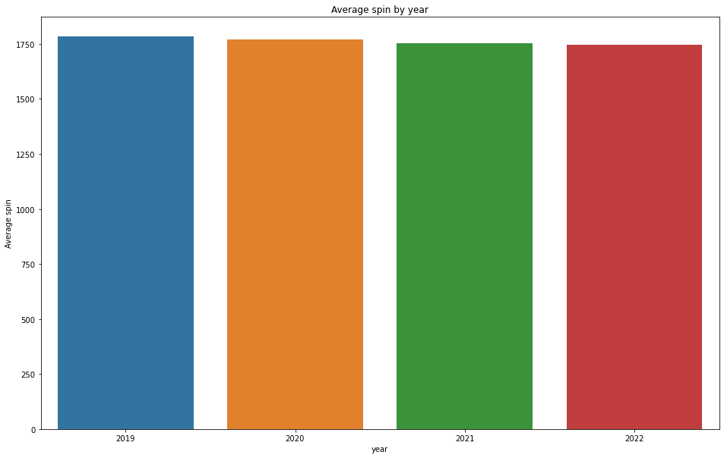
Changeup

Slide 23
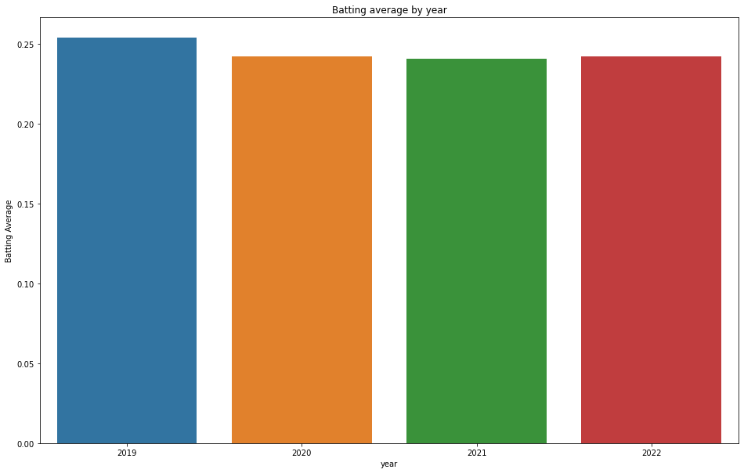
Batting average by year

Slide 24
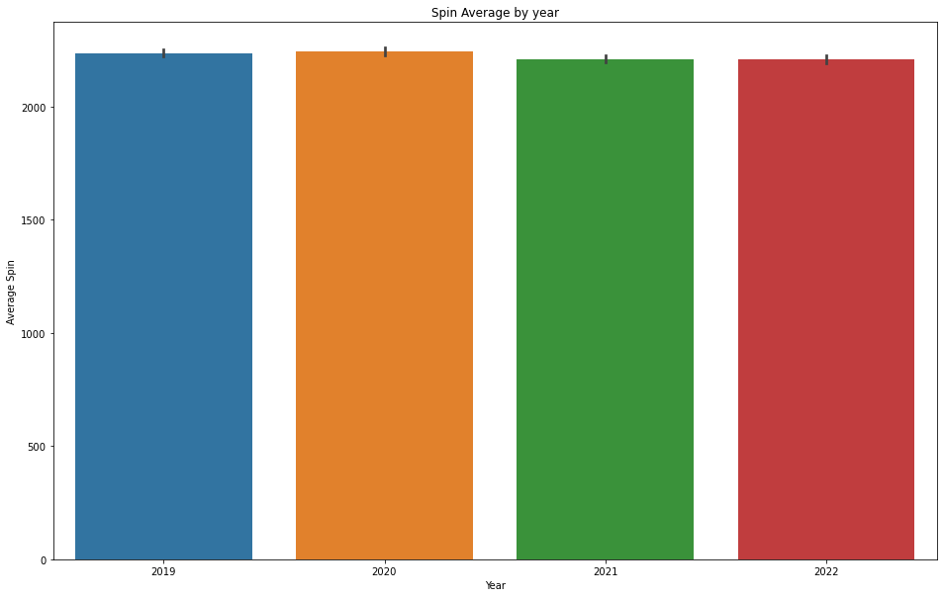
Spin by year

