Slide 1
Covert Channels
by Tyler Jackson

Slide 2
What are they?
Transmitting data undetected on a medium
Violates Security policies

Slide 3
Types of Covert Channels
Rulers and shaved heads
Modern covert channels more efficient

Slide 4
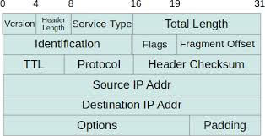
IP Header

Slide 5
Exploiting IP ID Field
Unused if packets are not fragmented
Can fit 16 bits of data or 2 letters

Slide 6
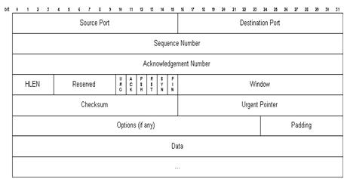
TCP Packet

Slide 7
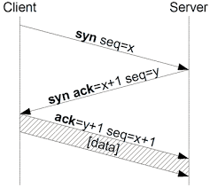
TCP Handshake

Slide 8
Exploiting TCP: ISN
Used to synchronize sequence numbers
Initial number used doesn’t matter
32 bits of covert data (4 letters)

Slide 9
Exploiting TCP: Forged Addresses
Send data while hiding where it's from
Use a “bounce” server

Slide 10
Difficulties with Covert Channels
Can’t send a lot of data at once
Hard to set up
Remaining undetected

Slide 11
When are They Used?
Kings and tattoos
Prisoners trying to escape
Thief stealing information
Mole in the company

Slide 12
My Results
Exploited IP ID with UDP client-server
Successful, but not very useful

Slide 13
Conclusions
Setting up a channel is non-trivial
Trade off between amount of data transmitted and secrecy of channel

Slide 14
Questions?
...just kidding

Slide 15
Bibliography
"2.5. TCP Headers." TCP Headers. N.p., n.d. Web. 03 May 2015.
"A Discussion of Covert Channels and Steganography." SANS. SANS Institute InfoSec Reading Room, n.d. Web.
"Covert Channels in the TCP/IP Protocol Suite | Rowland | First Monday."Covert Channels in the TCP/IP Protocol Suite | Rowland | First Monday. N.p., n.d. Web. 03 May 2015.
"Explanation of the Three-Way Handshake via TCP/IP." Explanation of the Three-Way Handshake via TCP/IP. N.p., n.d. Web. 03 May 2015.
"InetDaemon.Com." TCP 3-Way Handshake (SYN,SYN-ACK,ACK). N.p., n.d. Web. 03 May 2015.
"Internet Addressing and Routing First Step." IP Header Format. N.p., 27 Mar. 2014. Web. 03 May 2015.
"Intrusion Detection FAQ: What Is Covert Channel and What Are Some Examples?" SANS:. N.p., n.d. Web. 03 May 2015.

Slide 16
Bibliography (cont..)
"IP, Internet Protocol." IP, Internet Protocol. Network Sorcery, n.d. Web. 03 May 2015.
Nichols, K. "Definition of the Differentiated Services Field (DS Field) in the IPv4 and IPv6 Headers." Cisco, n.d. Web. 03 May 2015.
"The TCP/IP Guide - TCP Message (Segment) Format." The TCP/IP Guide - TCP Message (Segment) Format. N.p., n.d. Web. 03 May 2015.
"What Is Covert Channel? - Definition from Techopedia." Techopedias. N.p., n.d. Web. 03 May 2015.

