Slide 1

Navigate Contracts with Precision.

Slide 2

Our Project
The Department of Defense’s contract database is highly disorganized and inefficient to query.
We created an ML-powered, data-centric platform that instantly analyzes thousands of government contracts.

Slide 3
How It Works
1
Scrape the DoD’s website for new contracts daily
Extract key data from contracts with our fined-tuned ML model
2
3
Extracted data is stored in our cloud database
Dashboard displays and analyzes data from the cloud
4

Slide 4
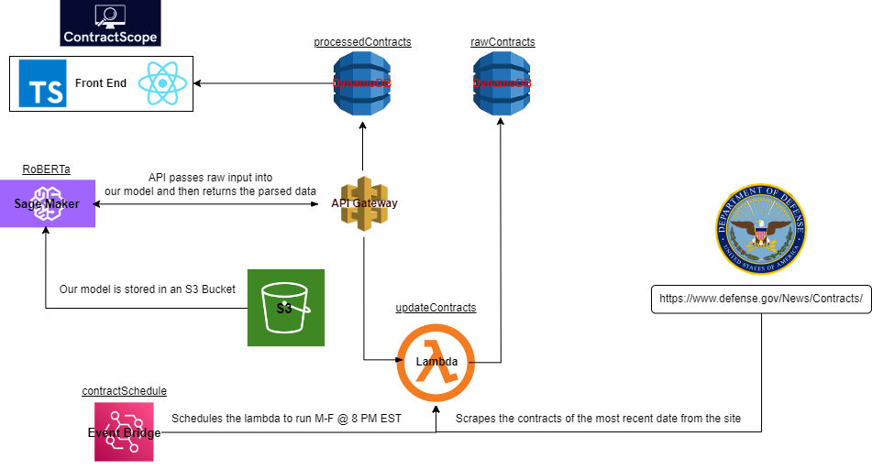
Notes:
AWS Event Bridge + DOD => once a day
AWS lambda function that takes the scraped data and saves it into a DynamoDB table.
API gateway interacts with hosted model to parse the raw contracts
Sends the predictions (you’ll see on the next slide) into another DynamoDB table.
Frontend: TS + React dashboard. Pulls data from dynamodb for analysis.

Slide 5
Arizona State University, Tempe, Arizona, was awarded a $9,991,533 firm-fixed-price contract to design, develop and deliver a foundational approach to accelerate materials discovery, development and manufacturing by creating and leveraging AI and machine learning tools. Bids were solicited via the internet with one received. Work will be performed in Tempe, Arizona, with an estimated completion date of March 27, 2026. Fiscal 2023 research, development, test and evaluation, Army funds in the amount of $4,998,407 were obligated at the time of the award. U.S. Army Corps of Engineers' Engineer Research and Development Center, Vicksburg, Mississippi, is the contracting activity (W912HZ-24-C-0022).
Key Data
Contractor
Amount awarded
Purpose
Work location
Completion date
Contracting activity
Contract number

Slide 6

The Model
Base model
RoBERTa
(Robustly Optimized BERT Training Approach)
Fine-tuning
SQuAD2.0 QA Dataset
Custom Contract QA Dataset
Accuracy
83.3%
Outperforms GPT-3.5 on Contract QA Dataset

Slide 7
Accuracy
Manually capture relevant information
Count the exact matches per column and overall.
Results:
Model vs Manual:
Total exact matches / Total cells: 100/120 = 0.83
Generate output with gpt-powered model
Count the exact matches per column and overall.
Results:
Gpt vs Manual: Total exact matches / Total cells: 65/120 = 0.54
Notes:
Our model: Exact matches in column 'company_location': 6 / 15 Gpt model: Exact matches in column 'company_location': 14 / 15
Likely because of the prompting used.
Ex of gpt wrong match:
GPT:
14 matches (by manual judgment) in contract_reason
Ex:
MANUAL: for post-delivery planning yard services in support of the LHA-7 amphibious assault ship
GPT:Post-delivery planning yard services in support of the LHA-7 amphibious assault ship
11 mathes by eyeball judgment in contract_type
Ex:
firm-fixed price, indefinite-delivery/indefinite-quantity, multiple-award
Firm-Fixed-Price, Indefinite-Delivery/Indefinite-Quantity
11 by eyeball in company_name
Ex:
MANUAL:VIASAT
GPT: VIASAT Inc.

Slide 8
Future Work
Time series analysis and prediction
Larger fine-tuning dataset
AI-assisted search bar
More data visualizations

Slide 9
Challenges
Tyler
Learning how to deploy an ML model on the cloud
Brian
Managing the dataflow of over 70,000 individual contracts
Tim
Sifting through the context to make the manual validation data
Andrew
Standardizing and aggregating results into digestible analysis

Slide 10
Demo Time!
Notes:
Start with table overview
go through the analysis/metrics at the bottom
Show the table filtering.

Slide 11
Thank you!

