Slide 1
DriverPass System Design Presentation
Prepared by Kain Mason
Notes:
This presentation is designed to give you an overview of the DriverPass system, highlighting its key features and how it meets your business needs. We will cover the system requirements, use case and activity diagrams, security features, and any limitations that need to be addressed.

Slide 2
System Requirements
Functional Requirements:
1. The system allows students to schedule driving lessons.
2. Provides real-time feedback from instructors.
Nonfunctional Requirements:
1. Fast response time (under 2 seconds).
2. Secure logins and data encryption.
Notes:
In this slide, we present the functional and non-functional requirements. Functional requirements focus on key user interactions, like scheduling lessons, while non-functional requirements ensure system performance and security, which are critical for user experience and data safety.

Slide 3
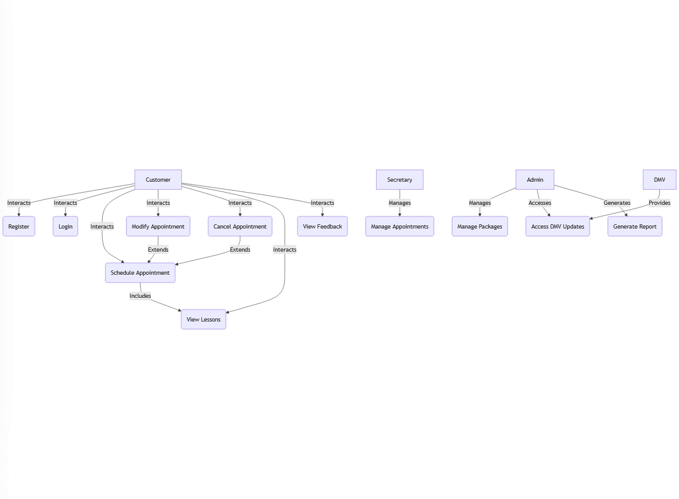
Use Case Diagram
Notes:
The Use Case Diagram outlines key actors and their interactions with the system. As you can see, customers can register, log in, and schedule appointments. Admins and secretaries manage lesson packages, appointments, and DMV updates. This clear structure helps meet DriverPass’s operational goals.

Slide 4
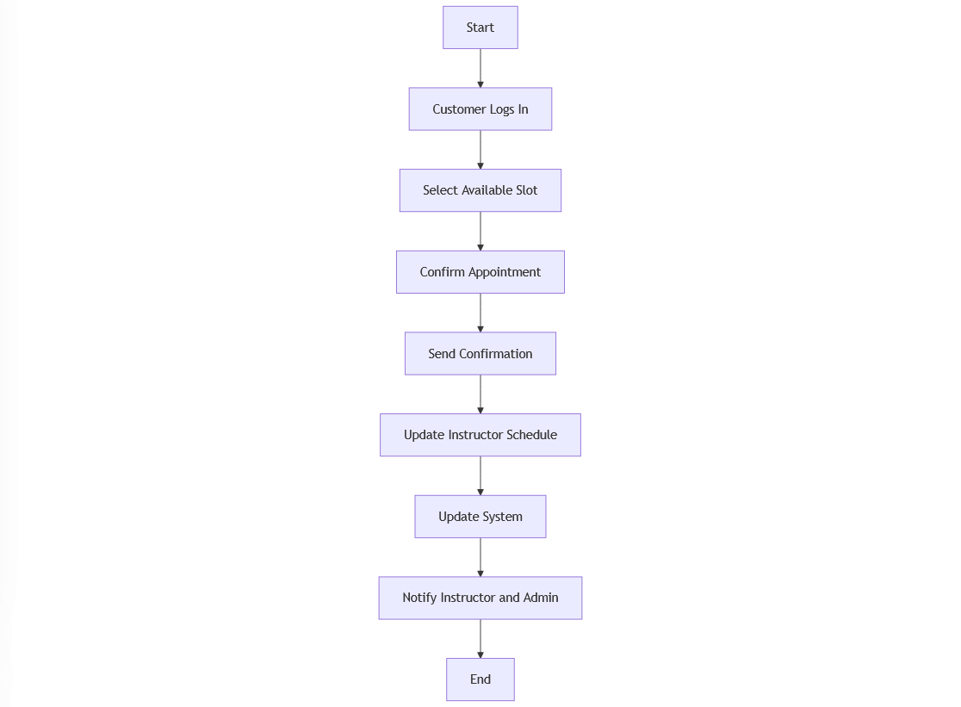
Activity Diagram - Schedule Appointment
Notes:
This Activity Diagram focuses on the scheduling process. The customer logs in, selects a slot, and the system confirms the appointment. The process ensures efficiency in booking lessons, which is a core functionality that DriverPass provides to its users.

Slide 5
Security
Key Security Features:
- SSL encryption for data transmission
- Two-factor authentication for login
- Account lockout after failed attempts
- Data encryption for user information
Notes:
This slide addresses the key security features integrated into the DriverPass system. SSL encryption ensures data is safe during transmission, while two-factor authentication adds another layer of protection for user accounts. Account locking and data encryption ensure high levels of security.

Slide 6
System Limitations
1. Limited scalability due to budget constraints.
2. May not support older browsers.
3. DMV integration might introduce delays in updates.
Notes:
This slide outlines some of the system's limitations. Scalability may be restricted during initial deployment, and support for older browsers could be limited. Integration with third-party systems, like the DMV, might introduce delays in data updates.

