Slide 1

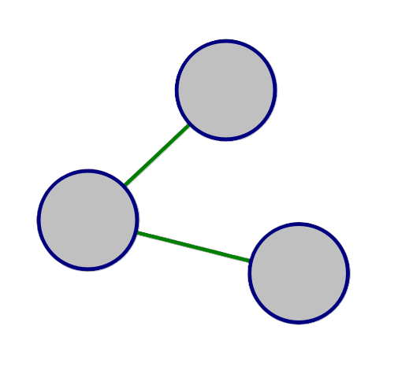
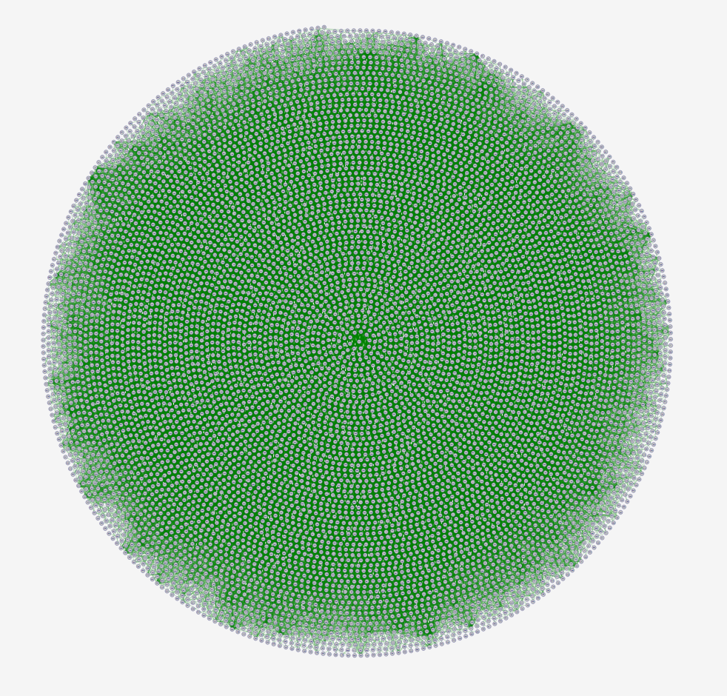
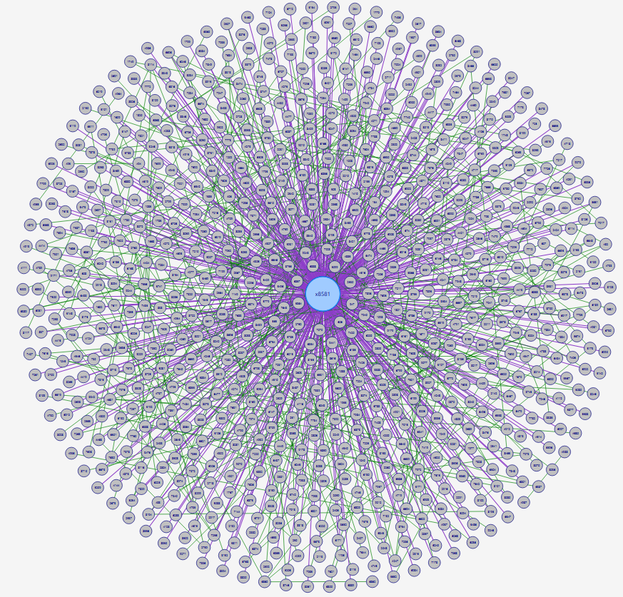
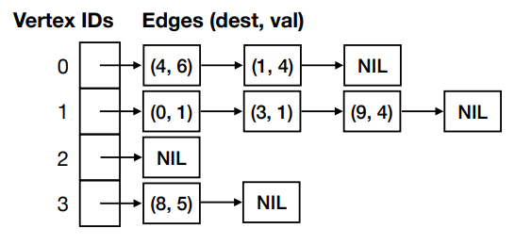
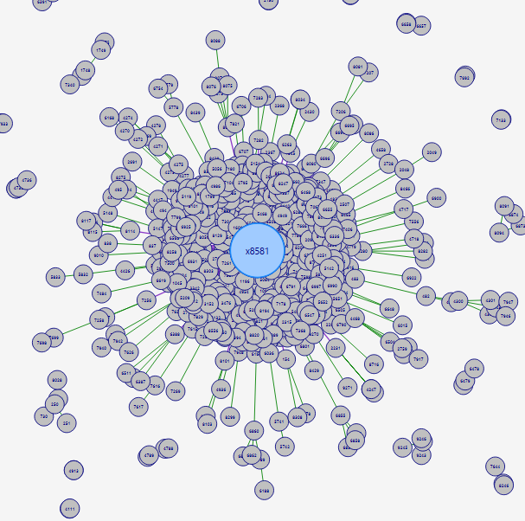
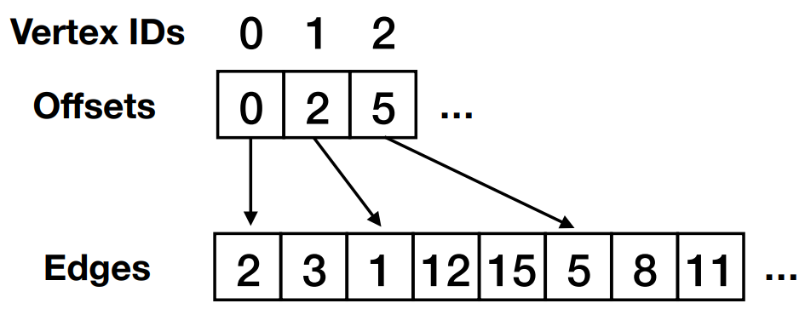
NetSim –
An Interactive Graph Visualization and Algorithm Simulator
Tyler Layton
Advised by Konstantin Zuzmin
Introduction
Existing work
Visualization Algorithms
Conclusion
Graph-structured data is fundamental to the world with applications ranging from social networks to biological pathways. Understanding the structural properties and visualizing these large networks is essential to our further exploration of them.
This research project presents an app which allows users to interact and visualize graphs presenting a variety of different visual and search algorithms. Such visual algorithms include a force-directed layout as well as a node contraction algorithm as a means of graph simplification.
Gephi is widely used for graph analysis offering a wide variety of visual statistics.
GraphViz focuses on graphing layouts with a scripting interface but lacks a user interface.
NetSim draws inspiration from these tools targeting an interactive and accessible experience for the user. A couple of NetSim features include:
Representation table which shows the nodes and edges which are in a graph.
Algorithm panel where the user can select algorithms to run on the graph
A large issue with graph visualization is scalability. Rendering thousands of nodes and edge simultaneously becomes slow and difficult to interpret. NetSim addresses this issue through node contraction which reduces rendered objects while still preserving the underlying graph structure. One contraction algorithm in NetSim selects the top X% of nodes by degree contracting Y hops outward from these nodes shown in Figure 3.
NetSim shows that interactive graph visualization can be made both through efficient graph storage and graph simplification. A packed memory array keeps memory low with fast look-up times, while node contraction and force-directed layout make large graphs navigable and easy to interpret. Though there is room for further expansion, NetSim provides a solid foundation for future research into interactive graph analysis.
Future Work
Backend Representation
Analysis of Packed Memory Array
NetSim only scratches the surface of what a graph visualization and algorithm simulator can offer. Many additional features can be added to enhance user experience:
A scripting interface so users can write and run their own algorithms
Ability to save graphs and algorithm configurations as a NetSim executable allowing work to be resumed
Further performance optimization
Additional visualization algorithms to help reduce graph objects
Visual paths shown for the search algorithms
There are several common ways to represent a graph in code.
Adjacency matrix – edges in a NxN Boolean grid. Simple to query but fails with large graphs.
Adjacency list – storing only existing edges per node but has a slow edge look up.
Packed Memory Array (PMA) – single block of memory which holds all edge information. Best solution for large graphs.
The backend consists of 2 lists, one holding nodes and the other holding edges. Each node can be found based on its index/ID and holds 2 integers: an edge index pointing to the start of its edges in the edge list and a degree indicating how many edges it has. Edges are simply 1 integer which holds its destination node’s ID and a label. Edges are sorted which allows for a binary look-up (O(log deg)). Each node is also allocated additional space within the edge array allowing room for new edges to be added without having to restructure the array on every edge addition.
Op | Adj Matrix | Adj List | PMA
Edge Insert | O(1) | O(1) | O(log²(V+E)
Edge Delete | O(1) | O(V) | O(log²(V+E)
Edge Lookup | O(1) | O(deg) | O(log deg)
Node insert | O(V²) | O(1) | O(log²(V+E)
Node Delete | O(V²) | O(V+E) | O(log²(V+E)
Node Lookup | O(1) | O(1) | O(1)
Memory Usage | O(V²) | O(V+E) | O(V+8E)
Figure 3: (Right) – |V| = 9.5k, |E| = 32k (spiral format)
(Left) – |V| = 850, |E| = 800 (top 30% of nodes contracted to 1 hop, spiral format)
Another challenge is determining where to place nodes. Simple layouts such as circular or spiral arrange nodes without any awareness of graph structure. The Scalable Force-Directed Placement (SFDP) algorithm solves this by simulating physical forces, connected nodes attract while unconnected nodes
repel. After many
iterations, the graph
reaches a state of
equilibrium, naturally
clustering related
nodes together and
making the graph’s
structure visually
apparent.
Figure 1: Complexity comparisons between Adjacency matrix, Adjacency List, and PMA
References
https://itshelenxu.github.io/files/papers/pcsr.pdf
https://networkrepository.com/bio-grid-human.php
http://yifanhu.net/PUB/graph_draw_small.pdf
https://juliagraphs.org/NetworkLayout.jl/stable/
Figure 2: Visual representation of the backend using PMA
Figure 4: The contracted graph from figure 3 after running the SFDP algorithm for 100 iterations

