Slide 1
AsterPeak Revenue Operations Command Center
End-to-end Revenue Operations case study spanning SQL, Excel, Power BI, Salesforce governance, process design, and executive recommendations
Synthetic B2B SaaS CRM dataset | 13,864 records | September 2026

Slide 2
Business Context & RevOps Challenges
CRM Data Quality
Missing/inconsistent ownership, segmentation & routing data
AsterPeak Software
Fictional U.S. B2B SaaS company
~$15–20M ARR
~100 employees
HubSpot → marketing & early lifecycle management
Salesforce → sales system of record
Pipeline & Forecasting
Stale opportunities, overdue close dates & forecast exceptions
Lead Handoff
Routing inconsistencies and unclear ownership across Marketing → Sales
Revenue teams: Marketing Ops, SDRs, AEs, Sales Leadership, RevOps, Finance & Legal
Commercial Governance
Deal Desk approvals were not consistently documented in CRM
Core challenge: AsterPeak needed both better revenue visibility and stronger operational controls — not just another dashboard.

Slide 3
Key Findings — What the Data Revealed
$2.05M ARR at Risk
53 open opportunities were stale, overdue, or both
34% of total open pipeline ARR
87.5% Routing Compatibility
1,138 leads matched expected routing logic
Exceptions included unassigned, territory, and segment issues
95.7% Forecast Alignment
847 of 885 forecast snapshots aligned
38 exceptions remained
40.7% Deal Desk Evidence Coverage
150 closed opportunities met review criteria
Only 61 had identifiable approval evidence
Key takeaway: Forecast alignment was strong, but pipeline risk, routing exceptions, and Deal Desk evidence gaps created material operational risk.

Slide 4
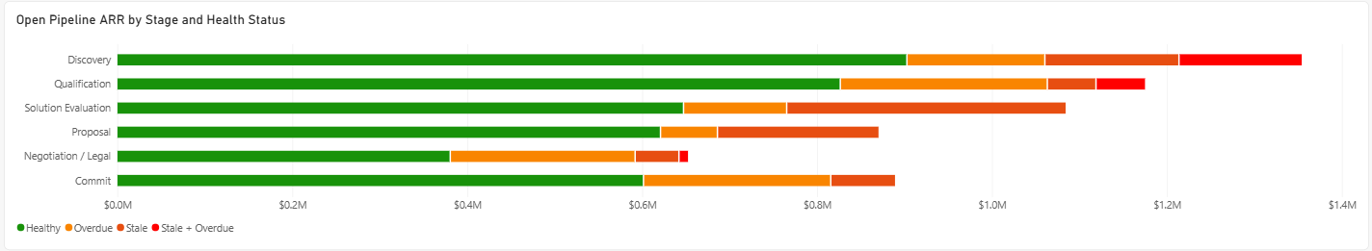
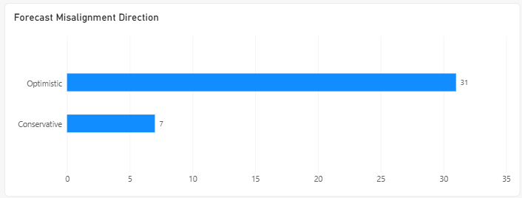
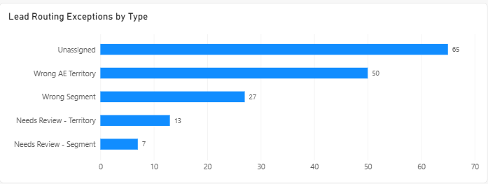
Pipeline, Forecast & Routing Risk
Pipeline Health: 53 flagged opportunities / $2.05M ARR at risk
Forecast Reliability: 95.7% aligned / 38 exceptions
Lead Routing: 87.5% compatible / 162 exceptions
Key Takeaway: Pipeline hygiene and routing exceptions represented the primary operational risks, while overall forecast alignment remained strong.

Slide 5
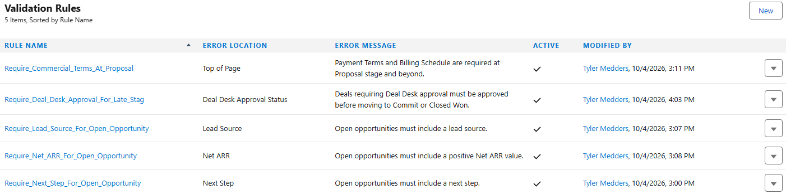
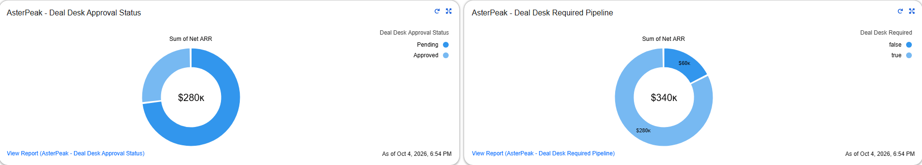
Salesforce Governance Implementation
Key takeaway: Analytics identified the risks; Salesforce governance combined preventative controls with operational monitoring at the point of execution.

Slide 6
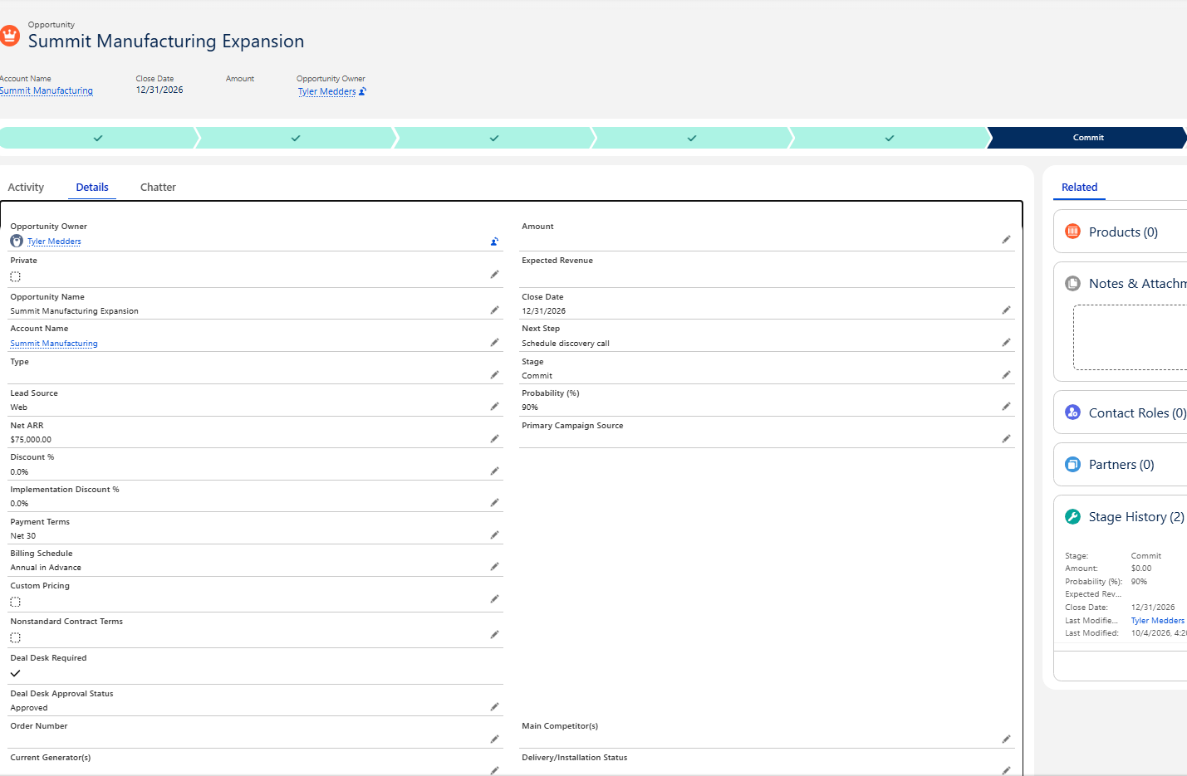
Salesforce Governance at the Record Level
Commit Stage
Opportunity reached the gated late-stage point.
Deal Desk Required = True
Commercial review was triggered.
Deal Desk Approval Status = Approved
Required approval is documented before progression.
Key takeaway: Governance was enforced at the individual opportunity level, not just documented in policy or reporting.

Slide 7
Process & Deal Desk Operating Model
Marketing-to-Sales Handoff
Lead → MQL→ SQL → Opportunity → Customer
Pipeline Governance
Discovery → Qualification → Solution Eval → Proposal → Negotiation / Legal → Commit
Deal Desk Governance
Trigger → Review → Approval → Salesforce Gate
Segment + territory routing
SDR assignment
4-business-hour MQL follow-up SLA
HubSpot early lifecycle → Salesforce after conversion
Required opportunity data
Stage-aligned forecast categories
Stale / overdue monitoring
Seller + Sales Leadership remediation
>10% discount or $100K+ ARR
Nonstandard commercial terms
RevOps / Sales / Finance / Legal routing
Approval required before Commit / Closed Won
Supporting governance: Formal process maps and SOPs document ownership, escalation paths, and repeatable execution across all three workflows.
Key takeaway: AsterPeak’s RevOps model connected lifecycle management, pipeline discipline, and commercial approvals into one governed operating process.

Slide 8
Executive Recommendations
Strengthen CRM Data Governance
Prevent errors where possible; audit exceptions that cannot be prevented.
Required-field standards
Ownership, segment & territory governance
Recurring RevOps data-quality reviews
Improve Pipeline Hygiene & Forecast Reliability
Make pipeline review a recurring management process.
Review stale & overdue opportunities
Enforce stage / close-date accuracy
Surface forecast exceptions
Formalize Marketing-to-Sales Handoff
Standardize qualification, routing and response expectations.
MQL criteria
Segment + territory routing
4-business-hour follow-up SLA
Enforce Deal Desk Governance
Document commercial exceptions before late-stage progression.
Configured Deal Desk triggers
Cross-functional approval routing
Approval recorded in Salesforce
Establish Ongoing RevOps Operating Cadence
Turn one-time cleanup into continuous governance.
Weekly pipeline review
Routing / CRM exception monitoring
Periodic Deal Desk review
Priority: Shift RevOps from reactive reporting and cleanup toward continuous, system-enforced revenue governance.

Slide 9
Business Impact & Project Summary
Business Impact
Cleaner, more reliable CRM data
Stronger pipeline hygiene
More credible forecasting
More consistent lead handoff and follow-up
Better Deal Desk approval traceability
Reduced risk of undocumented commercial exceptions
What This Project Demonstrated
SQL analysis and reconciliation
Excel audit workflows
Power BI executive reporting
Salesforce configuration and governance
Lead, pipeline, forecast, and Deal Desk process design
SOPs, executive recommendations, and business communication
Project outcome: Built an end-to-end Revenue Operations operating model that connected analysis, reporting, CRM governance, and repeatable business processes.
Note: AsterPeak Software and all underlying data are synthetic; business impact reflects expected operational value rather than realized production outcomes.

