Slide 1
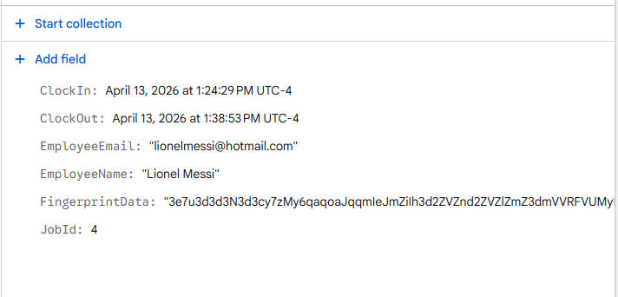

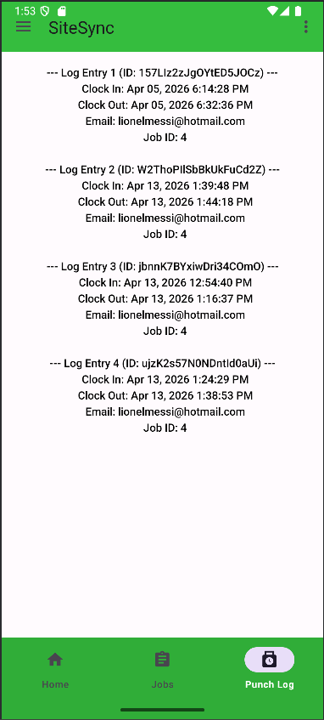
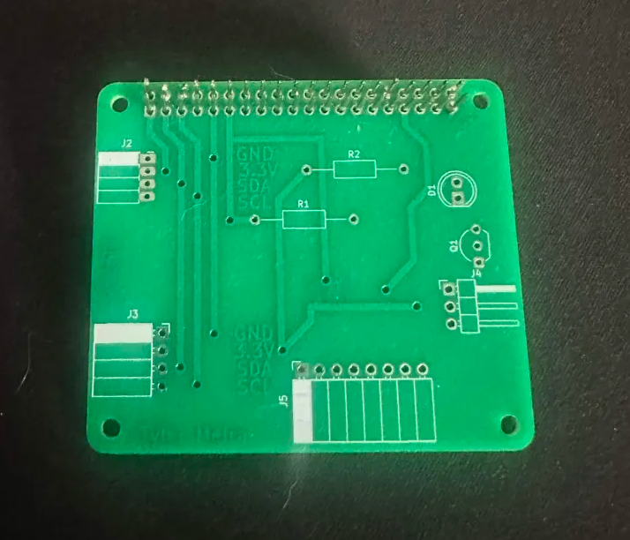
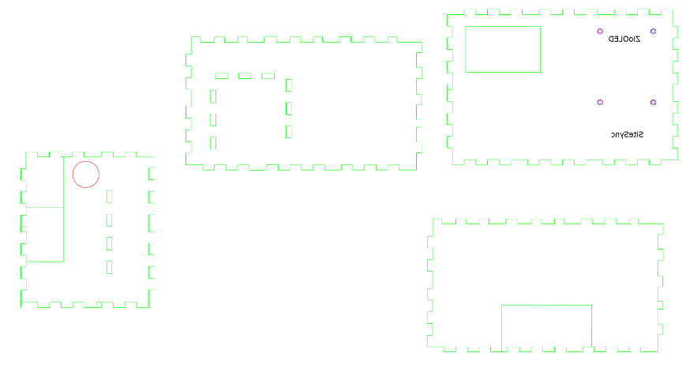
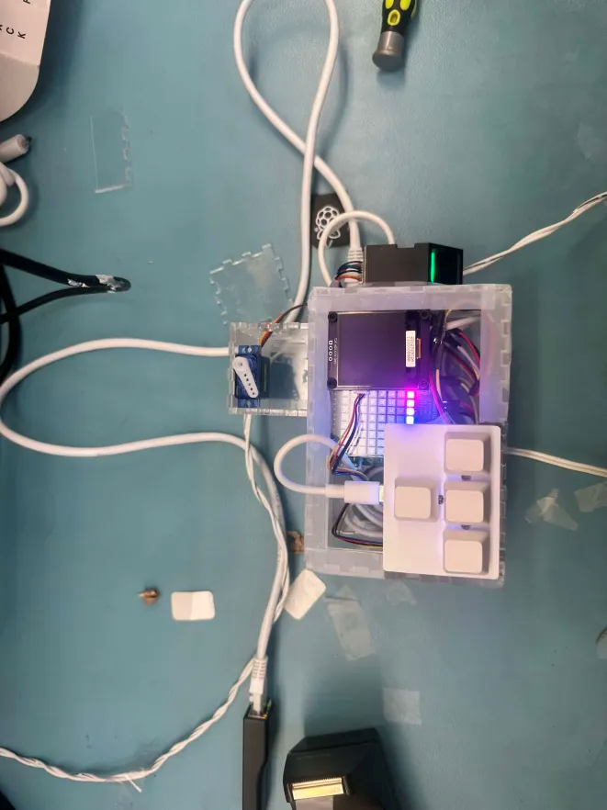
SiteSync – Job Management System
Tyler Meira, Anthony Mancia, Ngoc Le, Amos Sadiq, Computer Engineering Technology
INTRODUCTION
SiteSync is a time management system mainly targeted towards construction sites, warehouses or residential jobsites, with portability in mind. Our app will also help connect employers and employees, while helping them maintain an open line of communication throughout the job process.
PCB ASSEMBLY
We are using the PCB we designed last semester in our hardware production course, to make all our sensors work, we are using two QWICC ports, UART connection through the GPIO pins on the raspberry pi and a PWM signal through the GPIO pins. For our project, instead of designing a new PCB, we decided to stack to break out boards on top of each other, plus the sense hat, this helped us save time and allocate that time that we would have used into other aspects of the project such as the case, since we decided to reprint one from the ground up.
MOBILE APP RESULTS
Employers can see when the employees punch logs in the app. Employers also can add more jobs in the job board. Employee can clock in and clock out using fingerprint scanner.
Users are allowed to change their information.
There is help available in the app in case users needs guidance.
Our app has 3 tabs such as home, job and punch logs
.
DATABASE
Our Punch System, takes the fingerprint data collected at clock in and clock out, and stores that with the associated used to make sure the correct person is clocking in and clocking out at the job site, to help protect against time fraud.
TESTING AND NEXT STEPS
All of our sensors are working properly. Our future goal for now is to fix some of the old code from our mobile application, to take into account the new changes we had to make to our database, and think about adding authentication to our clock in and clock out process and when users create an account
ENCLOSURE DESIGN
We have ordered 3D cut for our case. The pi is mounted to the bottom of the case. Buzzer is mounted to the side and Oled display is mounted above the pi. The case is taller than usual because we need two pcbs and pi to complete our project.
ACKNOWLEDGEMENTS
Professors, parts crib, Digi key, Humber technologist.
Notes:
Section Start Slide

