Slide 1

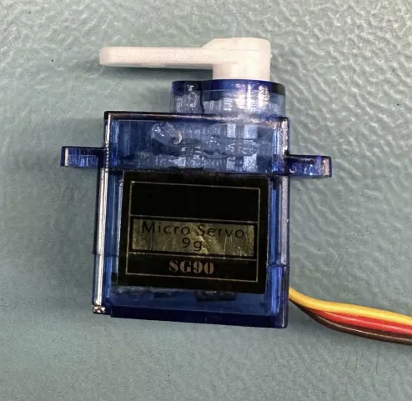
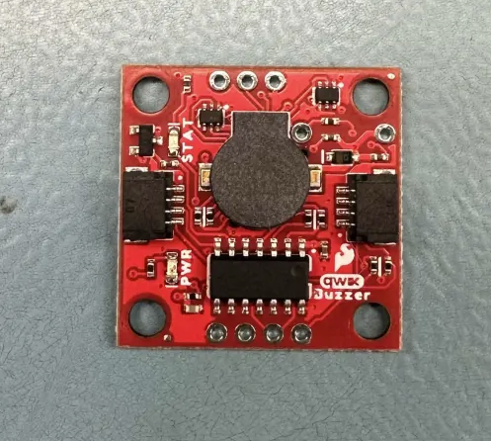
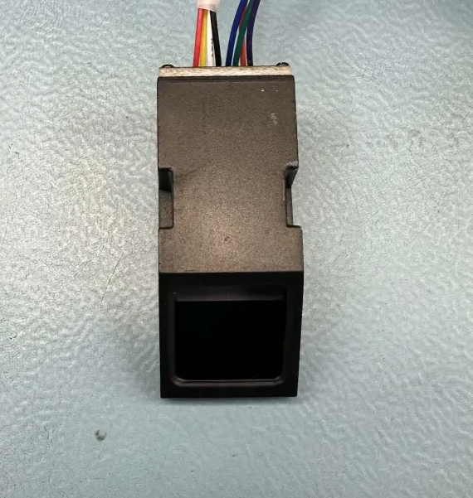
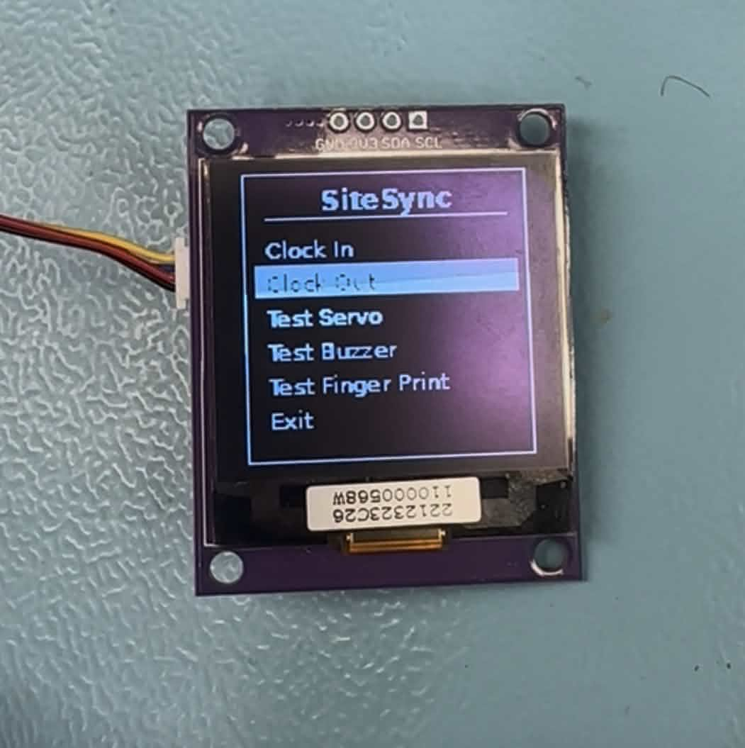
Hardware
360 Micro Servo
Amos Sadiq
AtTiny84
Ngoc Le
4690 Fingerprint Scanner
Anthony Mancia
Zio Oled
Tyler Meira

Slide 2
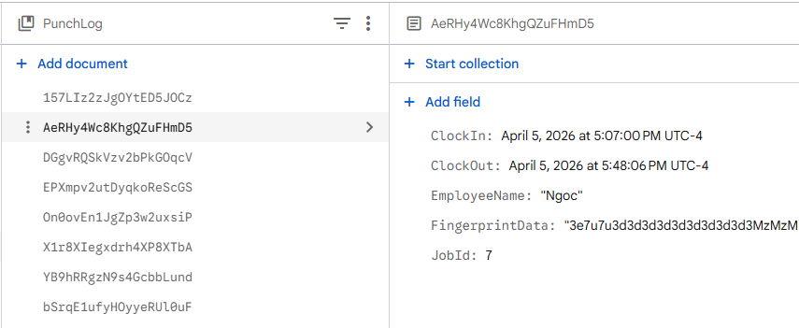
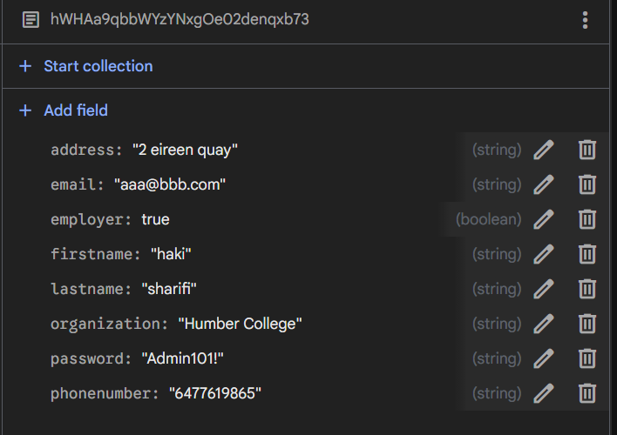
Database

Slide 3
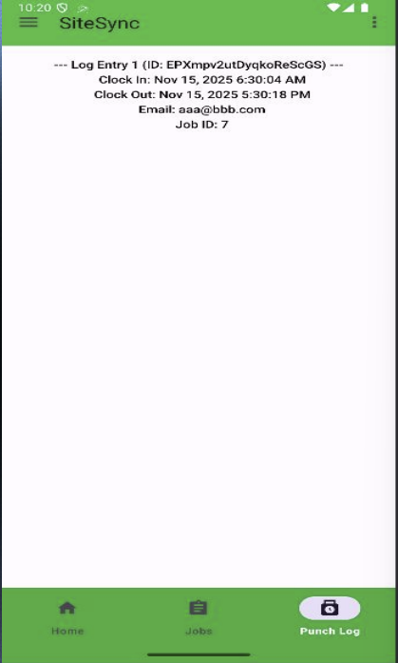
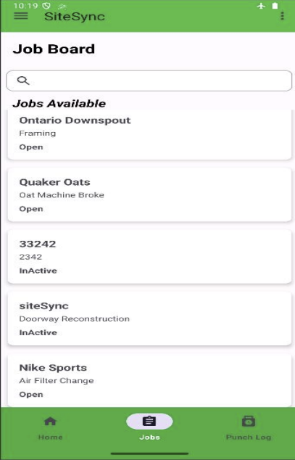
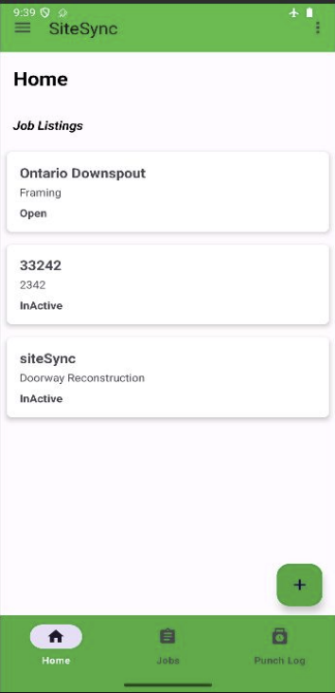
Mobile App

Slide 4
Demonstration Setup
We are using Anthonys Raspberry pi, the power supply and cables will be provide by Anthony aswell.
We will be using Ngoc Le’s laptop for our demonstration,
The pcB’s being used in our project are Tyler’s And Ngocs created last semester in our Hardware production Class
For our demonstration a user will have already created an account through our app
We simulate how a user would interact with our hardware once they have accepted a job
A user will use the keypad to interact wit the menu through the Zio Oled,
Select who they are and punch in using the fingerprint sensor
Our Project is a proof-of-concept prototype.

Slide 5
Demonstration
* Video To be included.

