Slide 1
driverscan.
An app to keep your eyes on the road

Slide 2
Problem: Distracted Driving
According to NHTSA, in 2015
3,477 drivers killed by distracted driving
391,000 injured
“During daylight hours, approximately 660,000 drivers are using cell phones while driving. That creates enormous potential for deaths and injuries on U.S. roads”

Slide 3
Solution: Get drivers’ attention
Voice alert when driver enters high-risk area
Doesn’t require drivers to use phones
Reminds drivers to pay attention
TXDOT CRIS Data
26,000+ car accidents over 7 years
Roughly 43% of accidents happen in one of 20 clusters
App alerts users when they are approaching a cluster

Slide 4
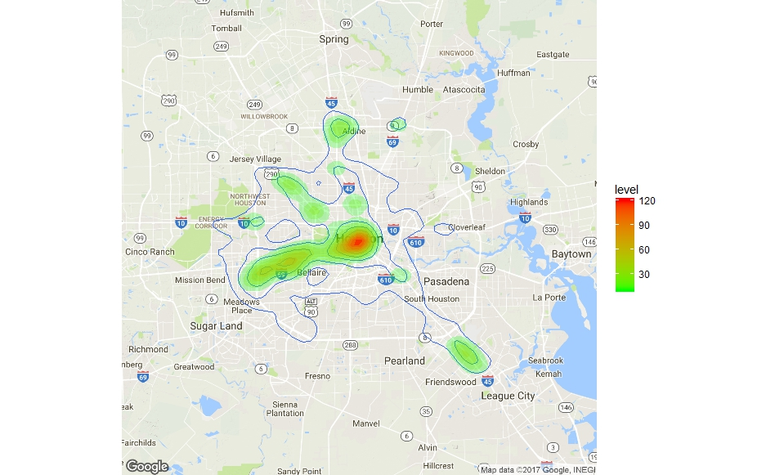

Slide 5
Possible Next Steps
Functionality for pedestrians
Improved voice alerts
Conditional subsets of data
Extension to other cities

