Slide 1
A GUIde for Orbiting the Sun
Kai C. Gronborg
27 March 2019

Slide 2
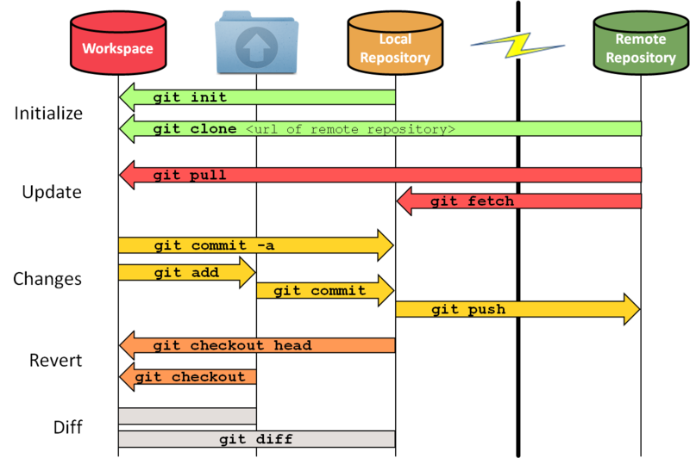


https://sselab.de/lab2/public/wiki/sselab/index.php?title=Git

Slide 3
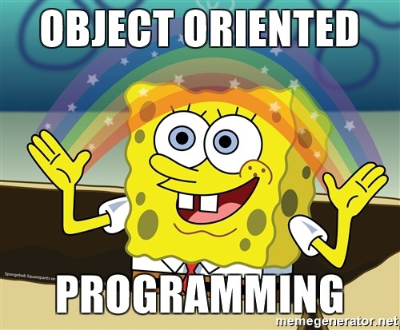

Slide 4
Programming Paradigms
Imperative: The programmer tells the computer how to change its state
Procedural: groups instructions into procedures
Object-oriented: groups instructions together with the part of the state they operate on
Declarative: The programmer declares properties of the desired result but not how to compute it
Functional: the desired result is declared as the value of a series of function applications
Logic: the desired result is declared as the answer to a question about a system of facts and rules
Mathematical: the desired result is declared as the solution of an optimization problem
https://www.wikiwand.com/en/Programming_paradigm

Slide 5
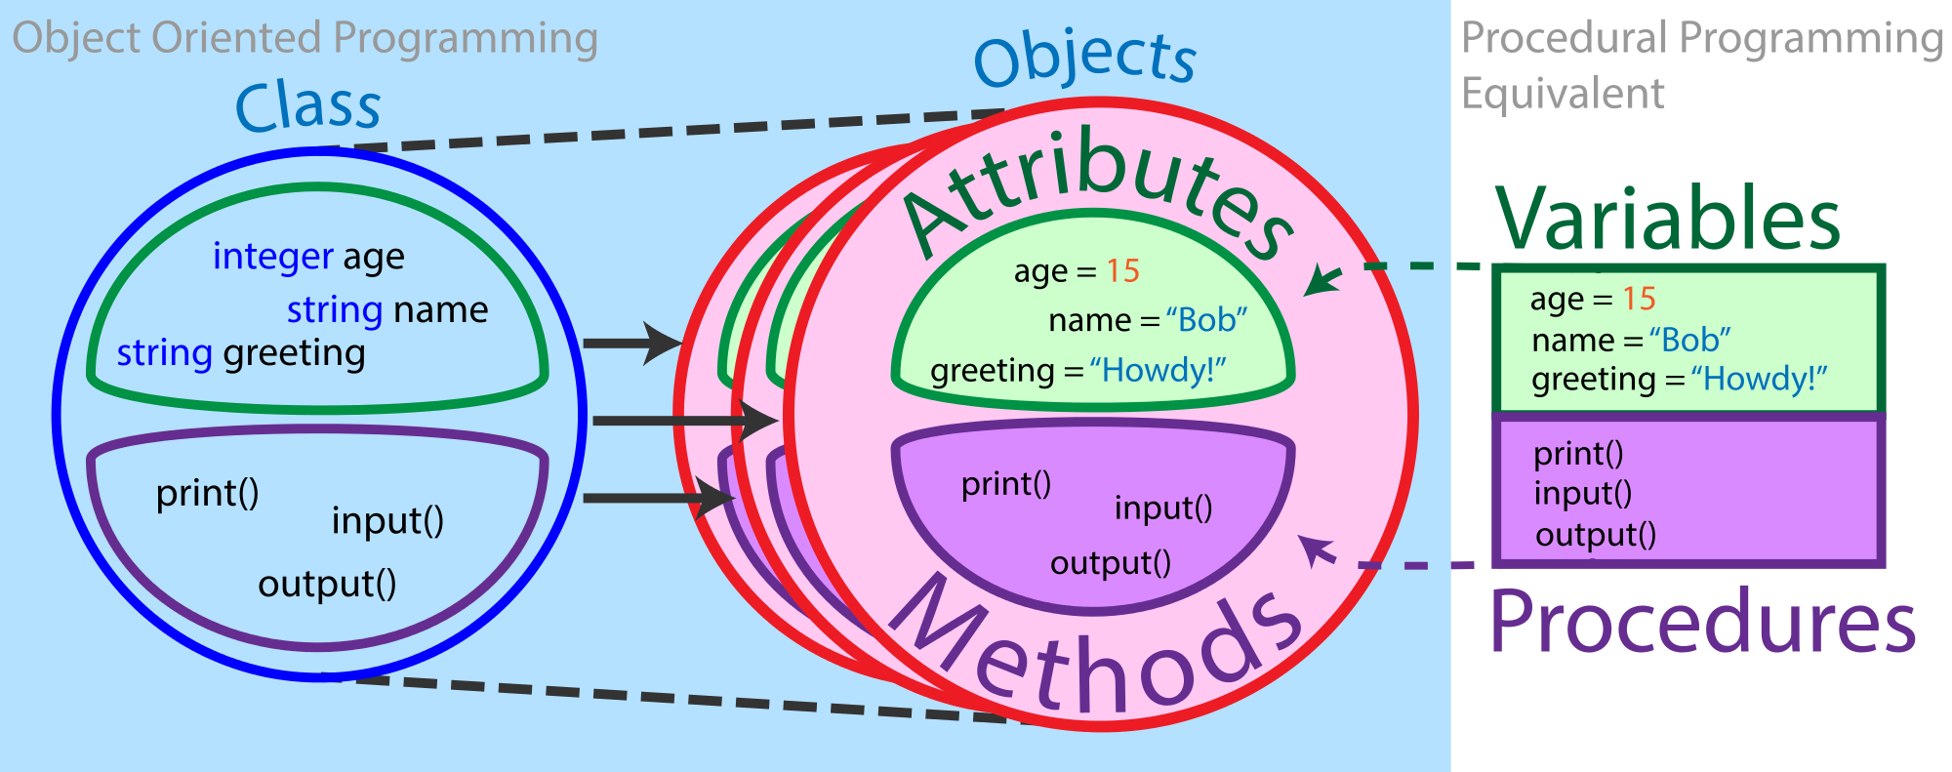
What Are The Components Of Object Oriented Programming?

Slide 6
There Are Four Advantages To Object Oriented Programming (OOP)
Encapsulation
Abstraction
Inheritance
Polymorphism
https://medium.freecodecamp.org/object-oriented-programming-concepts-21bb035f7260

Slide 7
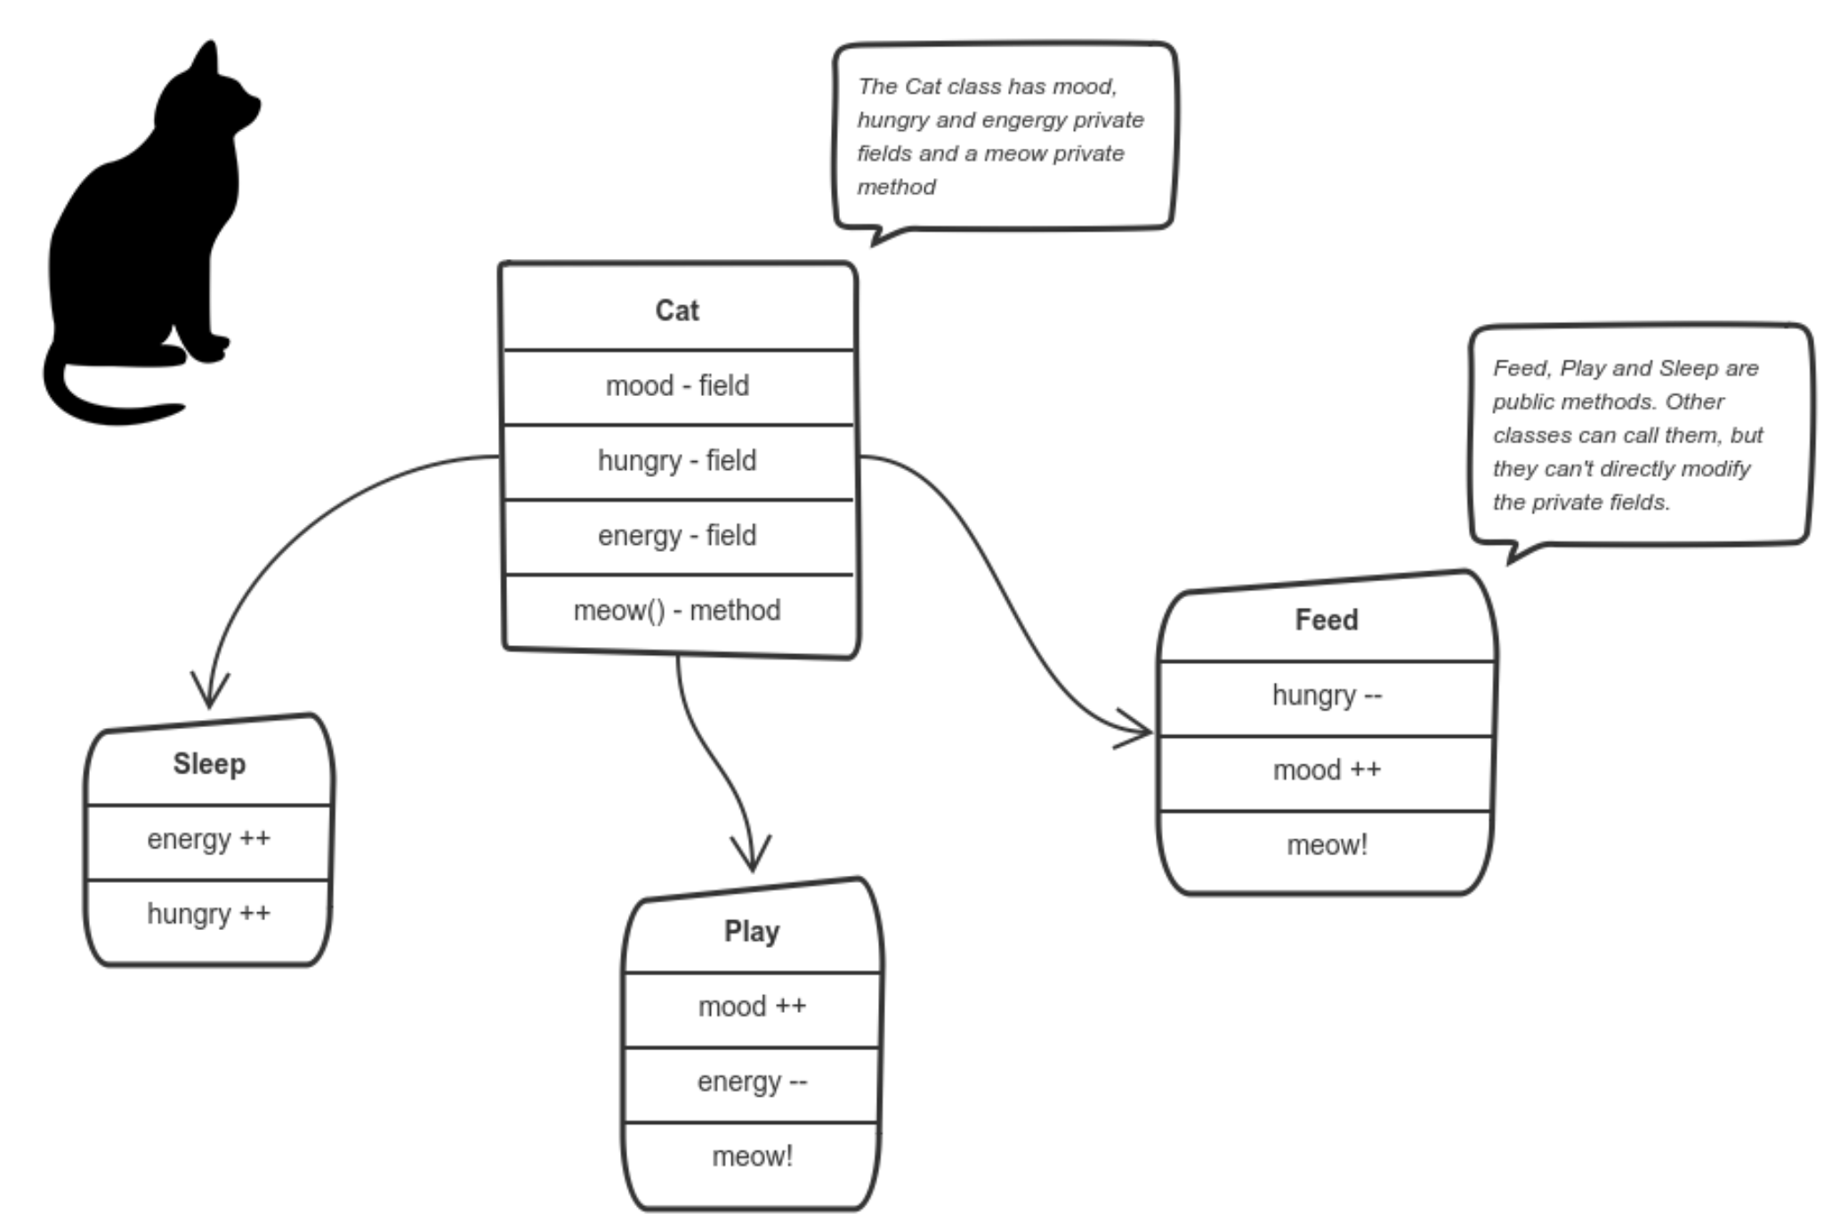
Encapsulation Allows Us To Know Which Cat We Are Feeding
https://medium.freecodecamp.org/object-oriented-programming-concepts-21bb035f7260

Slide 8
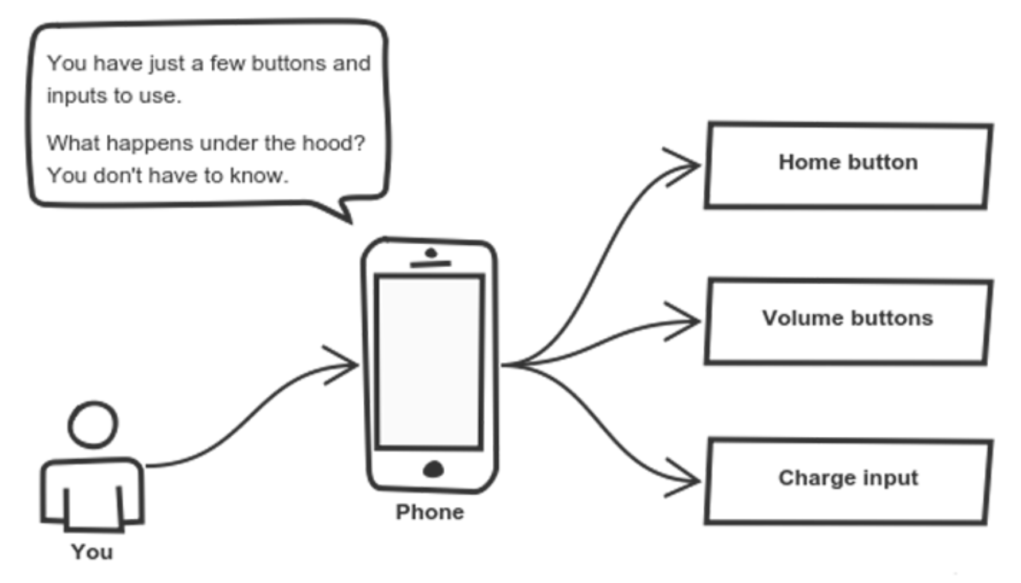
Abstraction Lets Us Turn Up Our Music Without Knowing How To Turn Up Our Music
https://medium.freecodecamp.org/object-oriented-programming-concepts-21bb035f7260

Slide 9
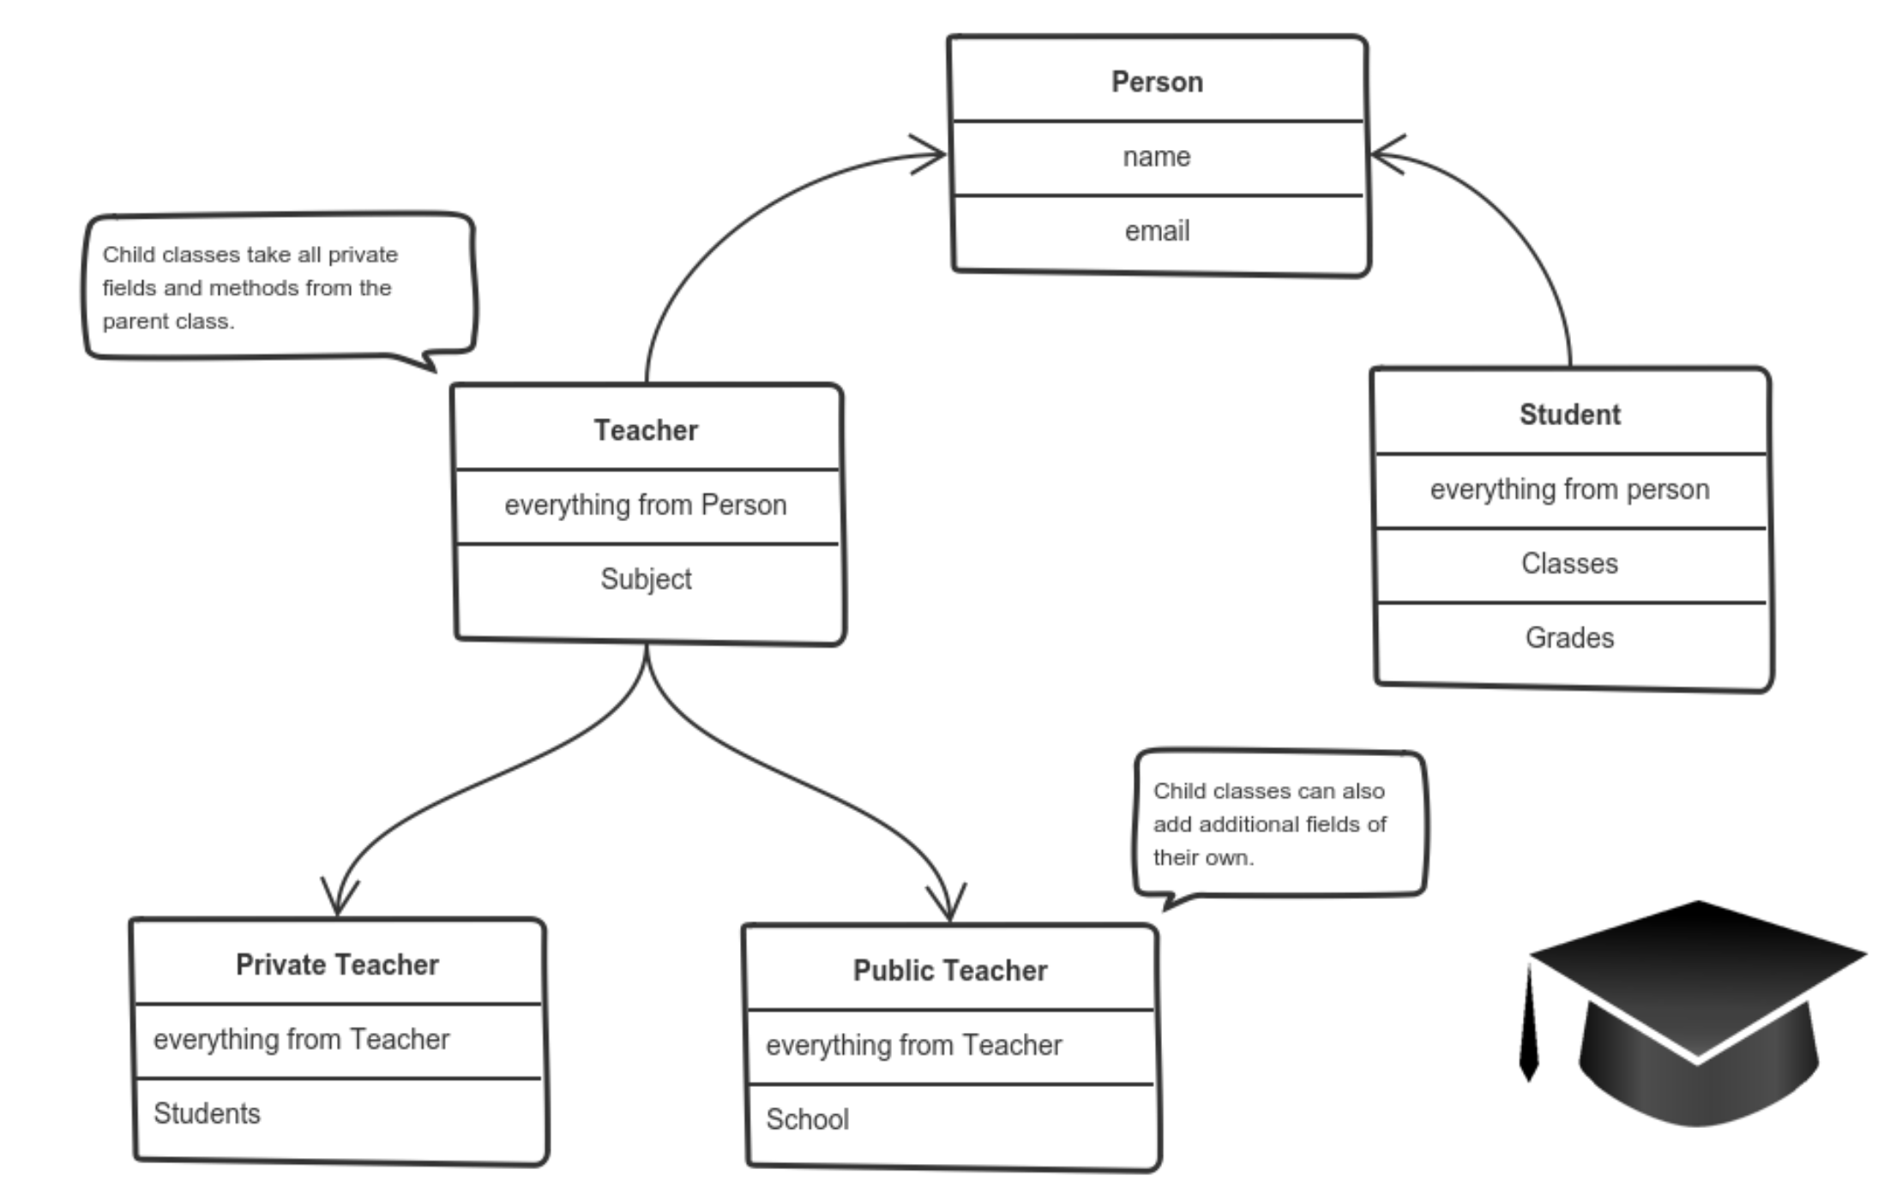
Inheritance Means That Child Classes Inherit All Of Their Parent Class’s Attributes (Yes, Even The Bad Ones…)
https://medium.freecodecamp.org/object-oriented-programming-concepts-21bb035f7260

Slide 10
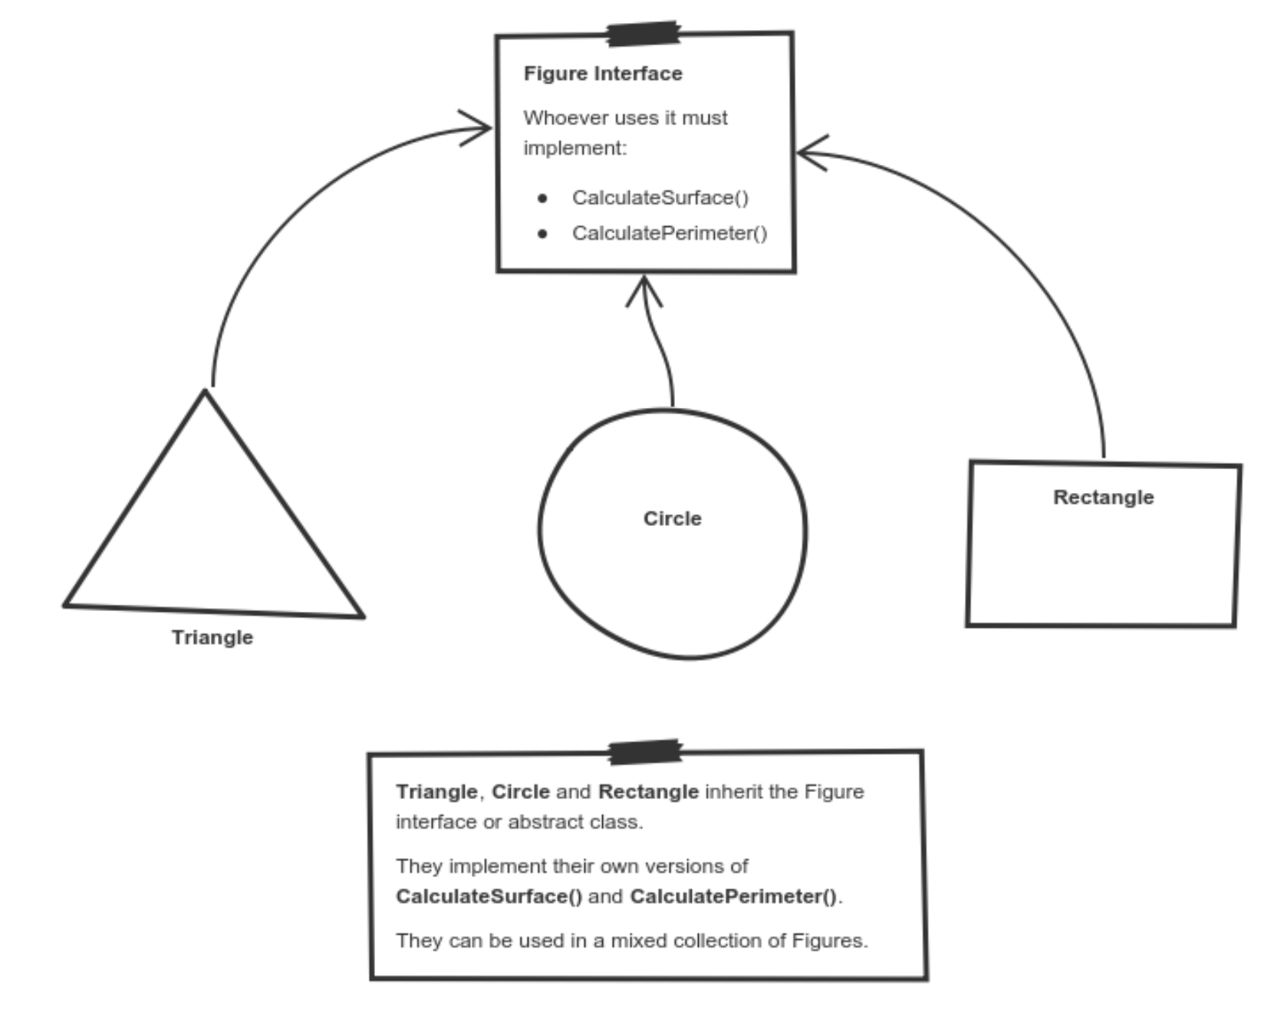
Polymorphism Lets Us Abstractly Define The Idea Of Shapes Without Knowing Much About Shapes
https://medium.freecodecamp.org/object-oriented-programming-concepts-21bb035f7260

Slide 11
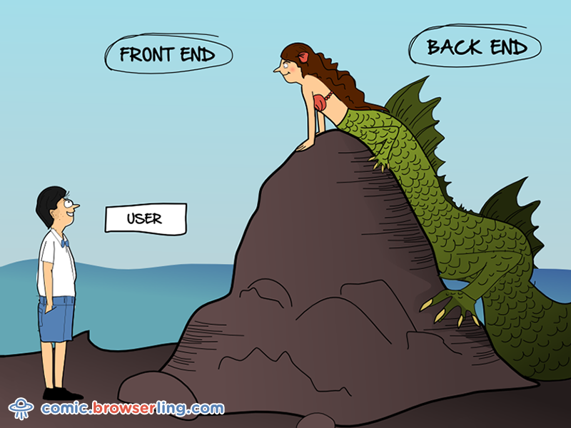
Graphical User Interfaces Allow Users To Use Code In Blissful Ignorance

Slide 12
Why Would We Use A Graphical User Interface (GUI)?
They allow for input control
They allow complex procedures to occur at the push of a button
Accessibility to code interface

Slide 13
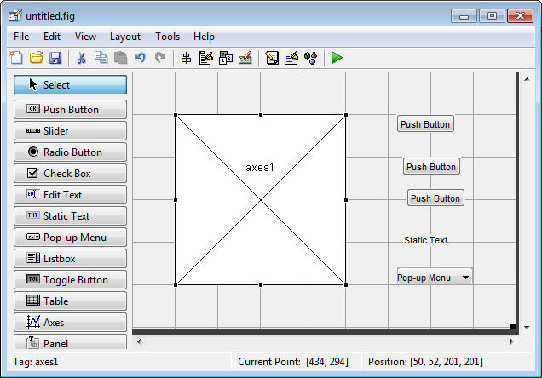
That’s Neato! How Can I Build A GUI Using MatLab?
MatLab offers a package called “guide” which is essentially a GUI for… well, making GUIs

Slide 14
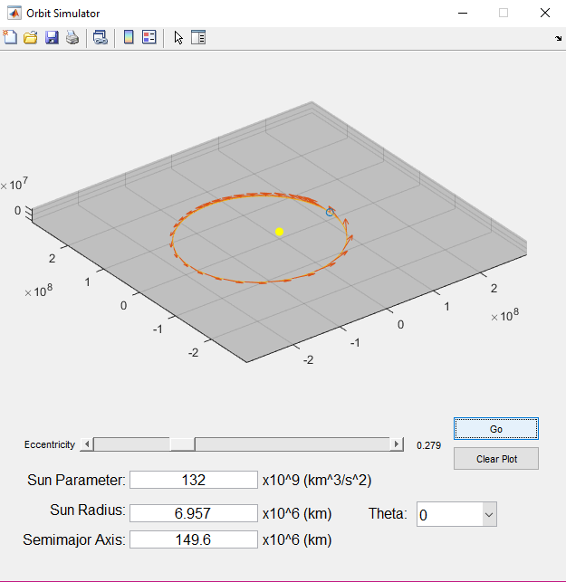
Example: Orbit Plotter

Slide 15
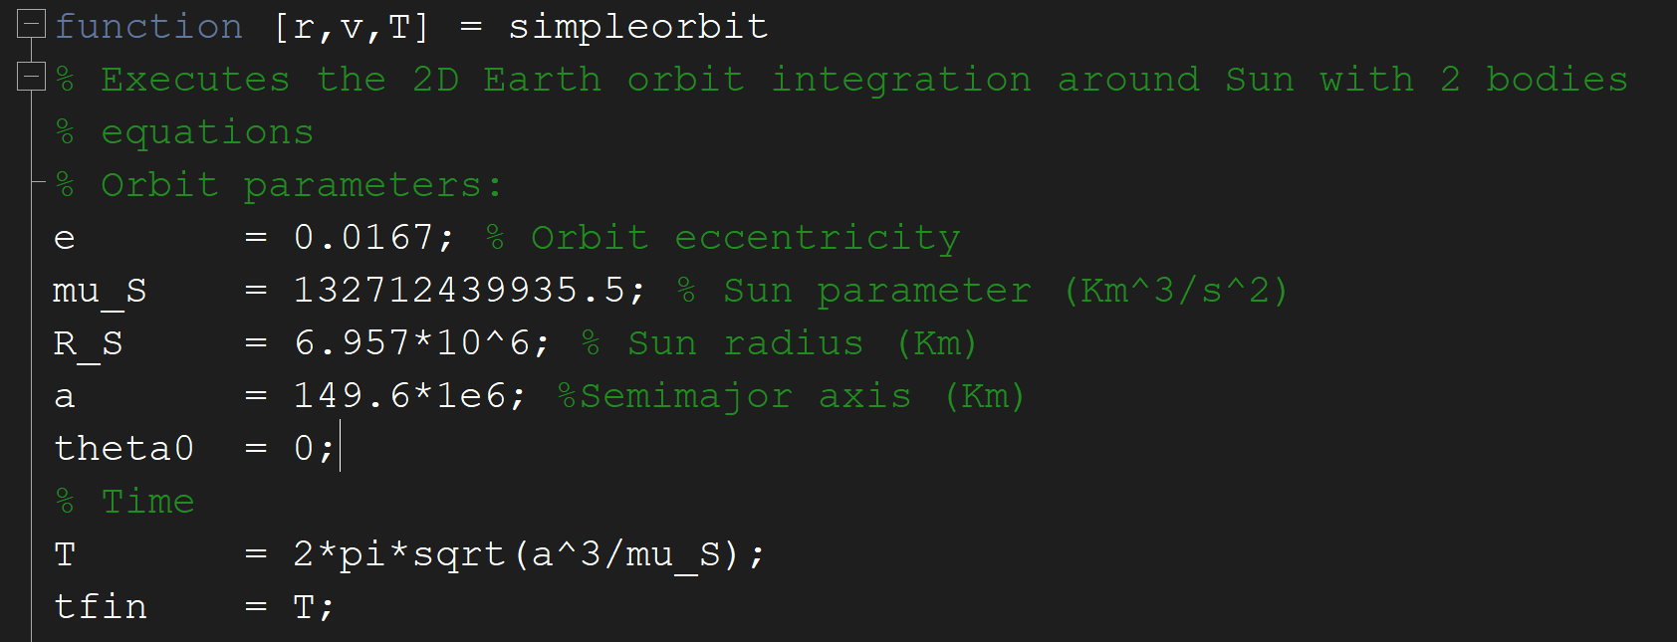
Source Code Is Provided By NASA
~/GUIWorkspaces/src/simpleorbit.m

Slide 16
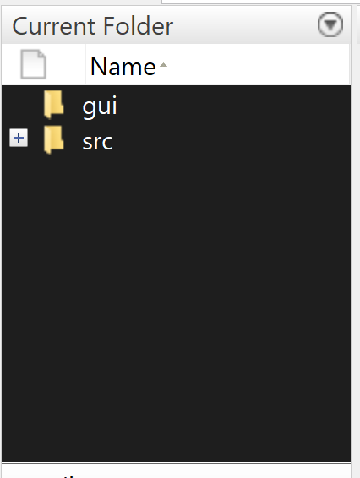
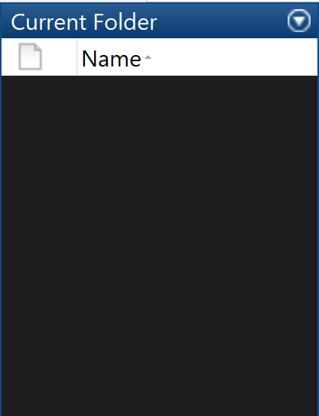
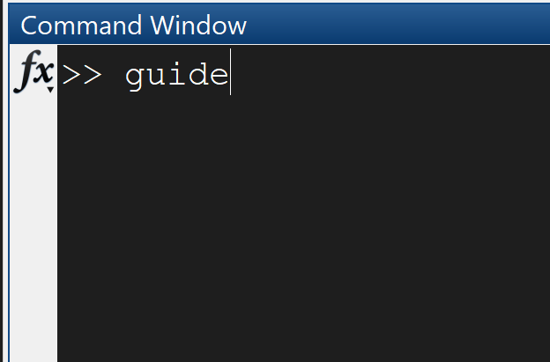
Setup
1. Create GUI Directory
2. Go to “gui” directory
3. Type “guide” in to Command Window

Slide 17
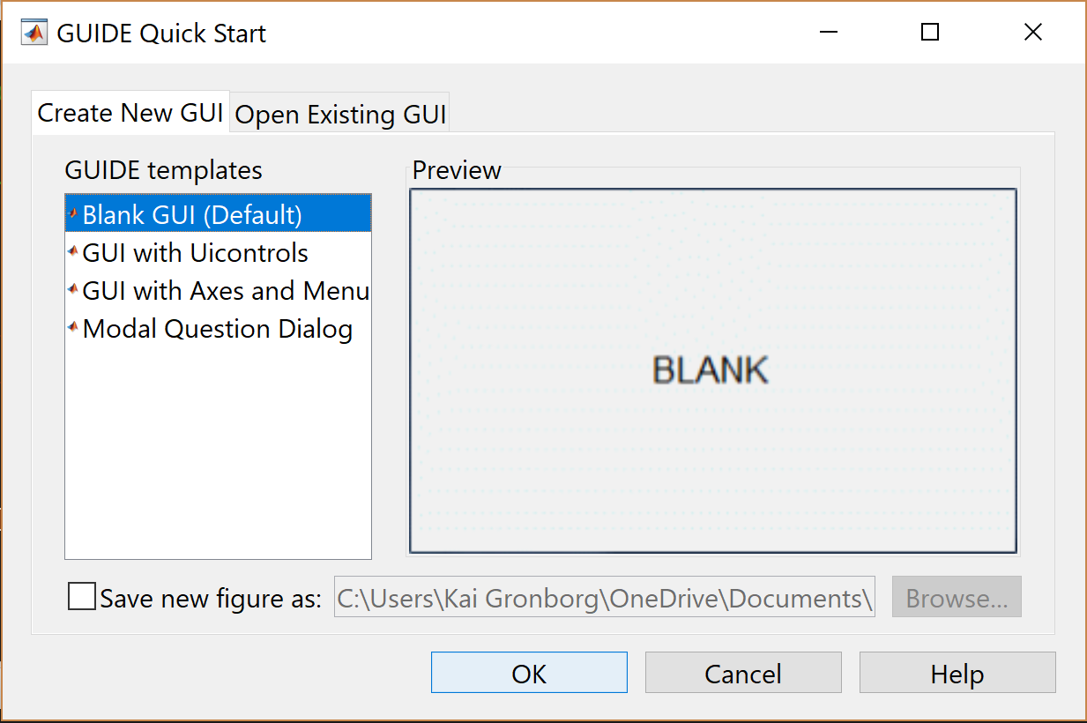
Select Blank GUI; Click OK!!

Slide 18
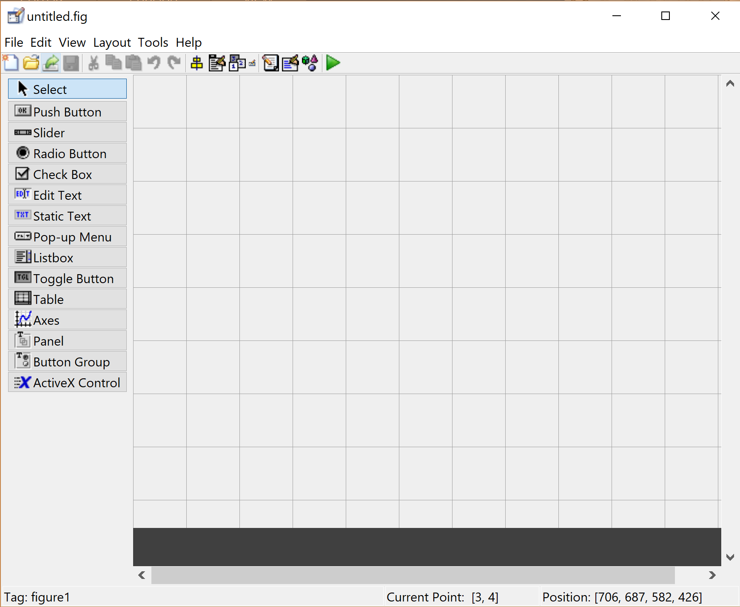
This is a guide layout designer…it’s super cool, Right?
Component Palette:
These are the available GUI components!
Layout Area:
Where you put the GUI components

Slide 19
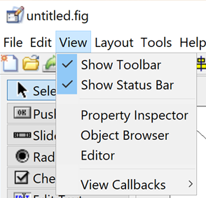
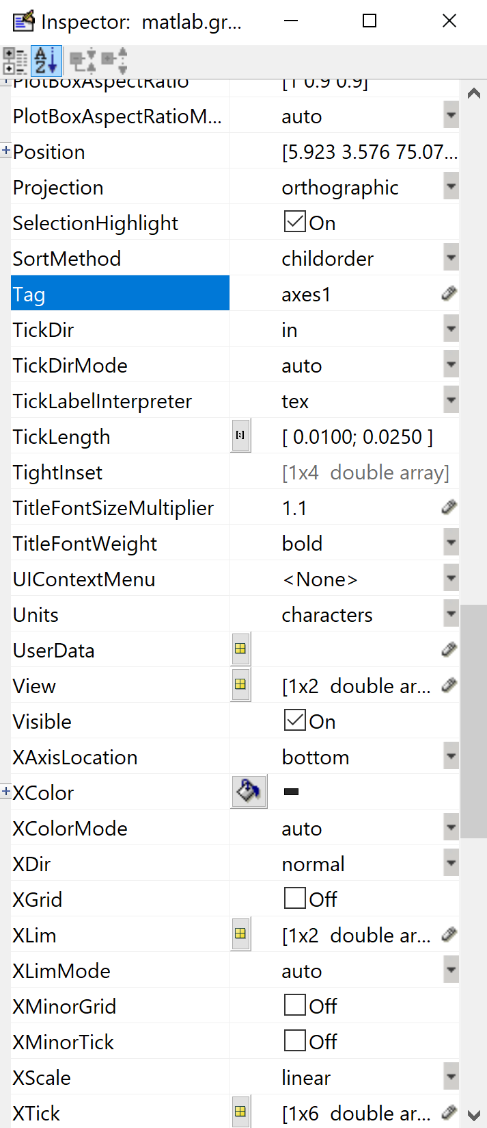
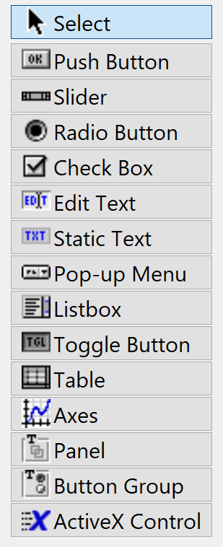
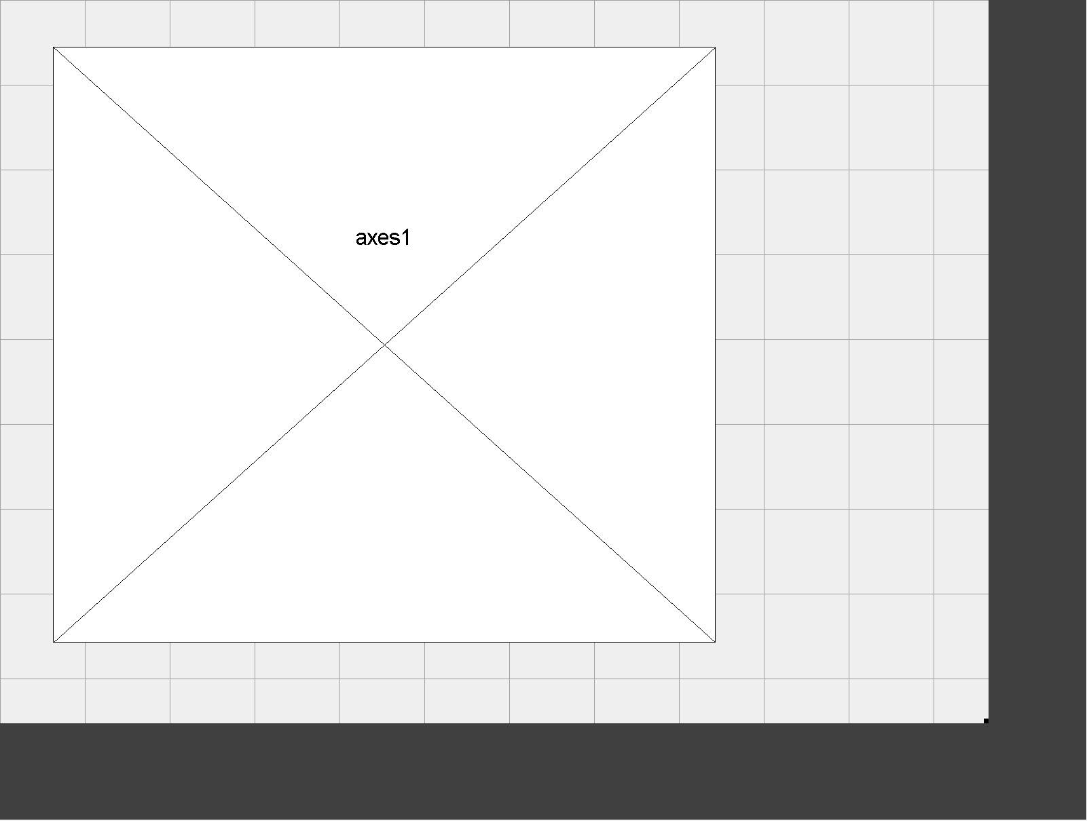
Let’s add a plot! (or as guide calls it “Axes”)
Draw “Axes” in Layout area
Click
Change Tag to something you can remember
Click Here

Slide 20
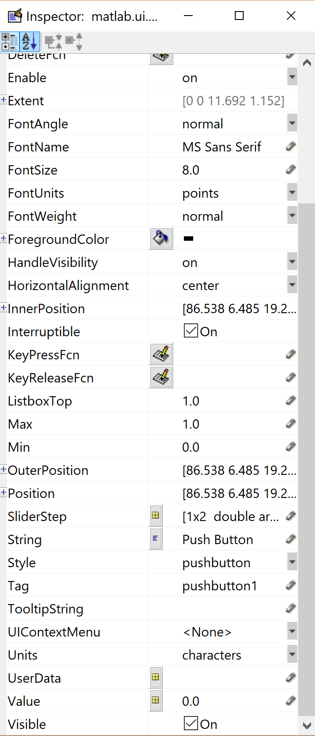
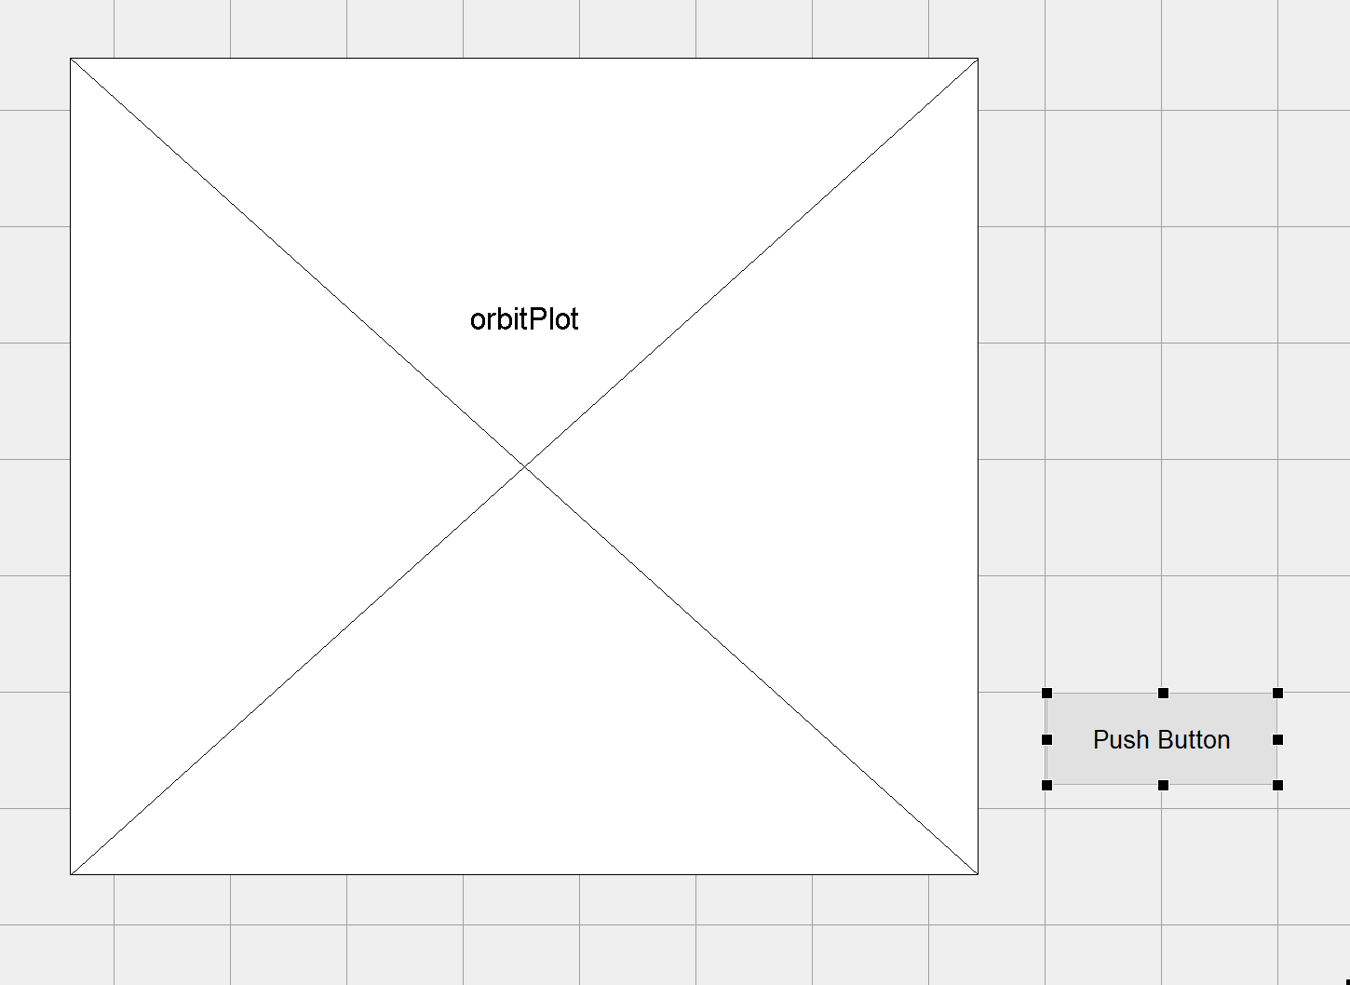
Add a Button!
Draw “Push Button”
Click Here
Click
Change Tag to something you can remember

Slide 21
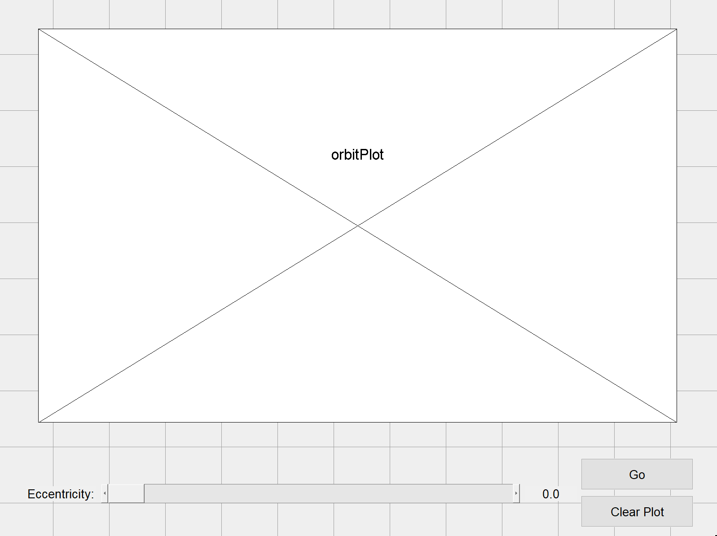
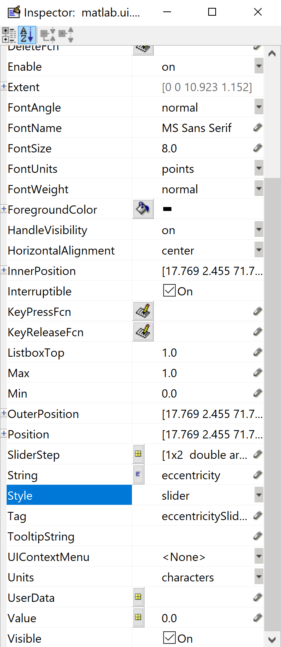
Let’s add some other components and arrange them and edit their properties

Slide 22
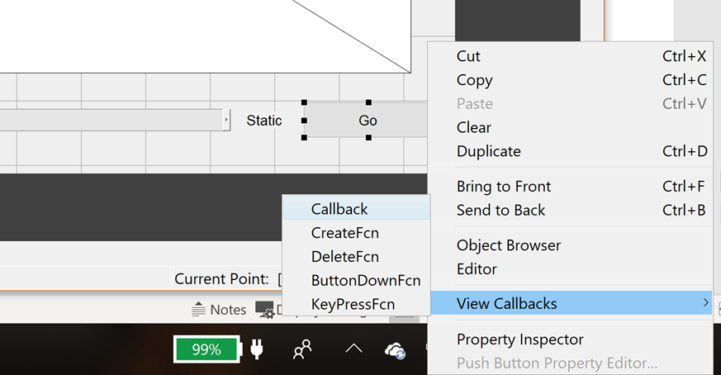
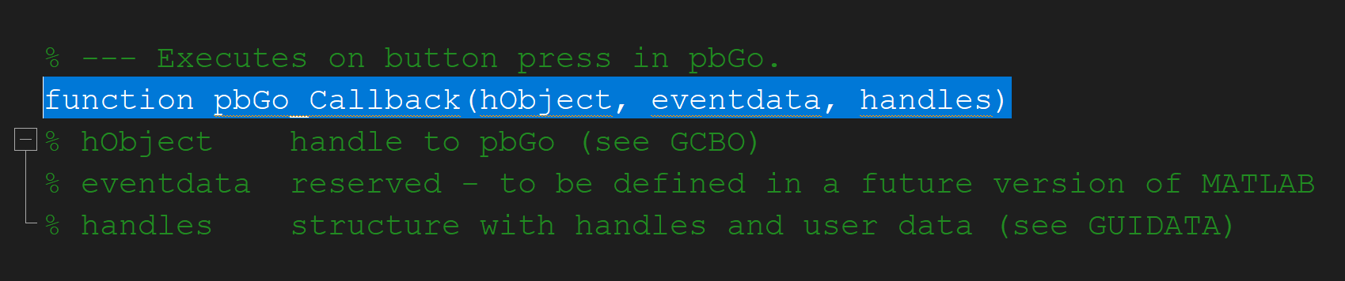
Ooookk, So we have a nice looking GUI but how do we make it do stuff?

Slide 23
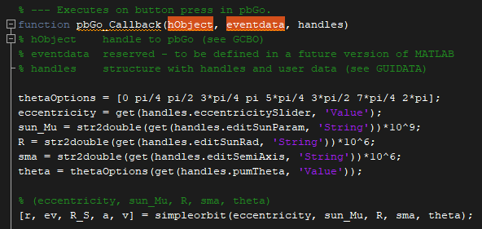
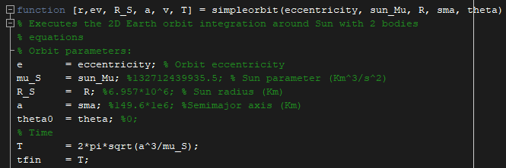
Now Code Behavior of GUI and Edit simpleorbit.m to work with GUI

Slide 24
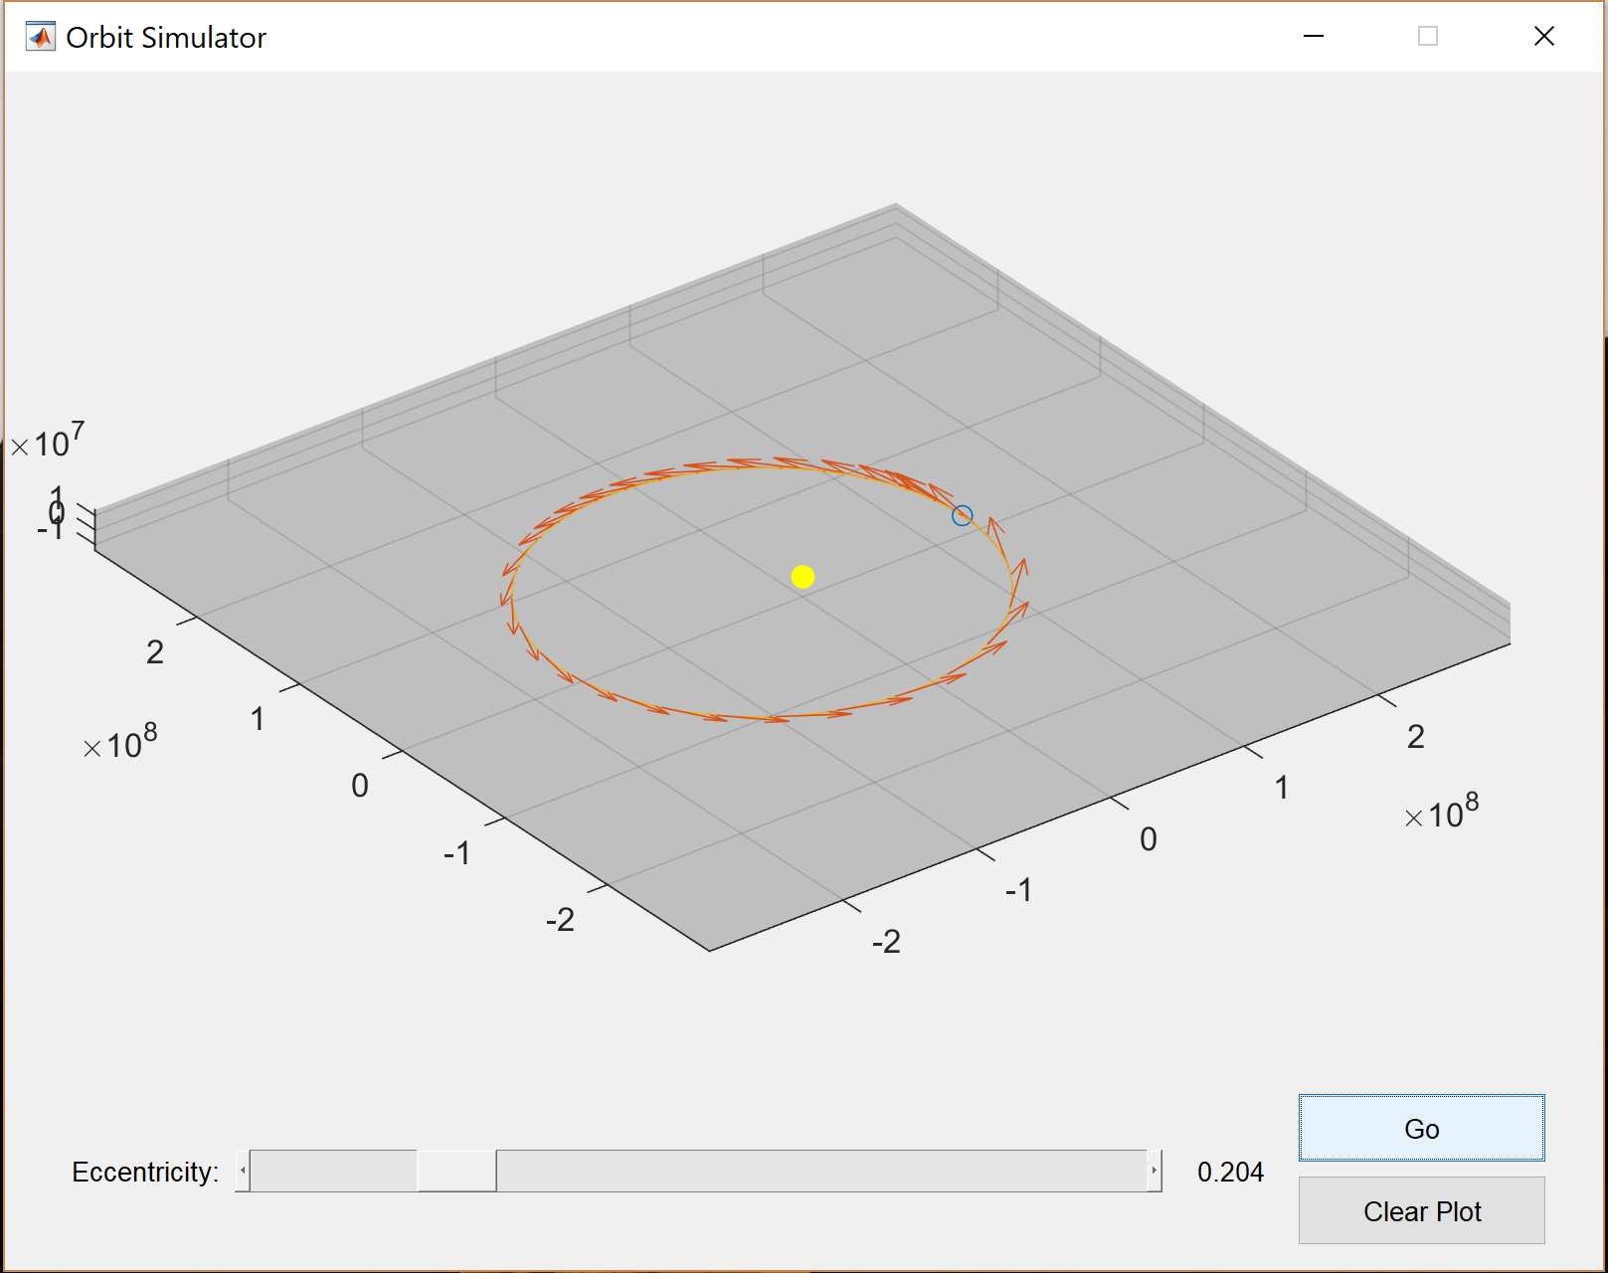

Thank you!

