Slide 1
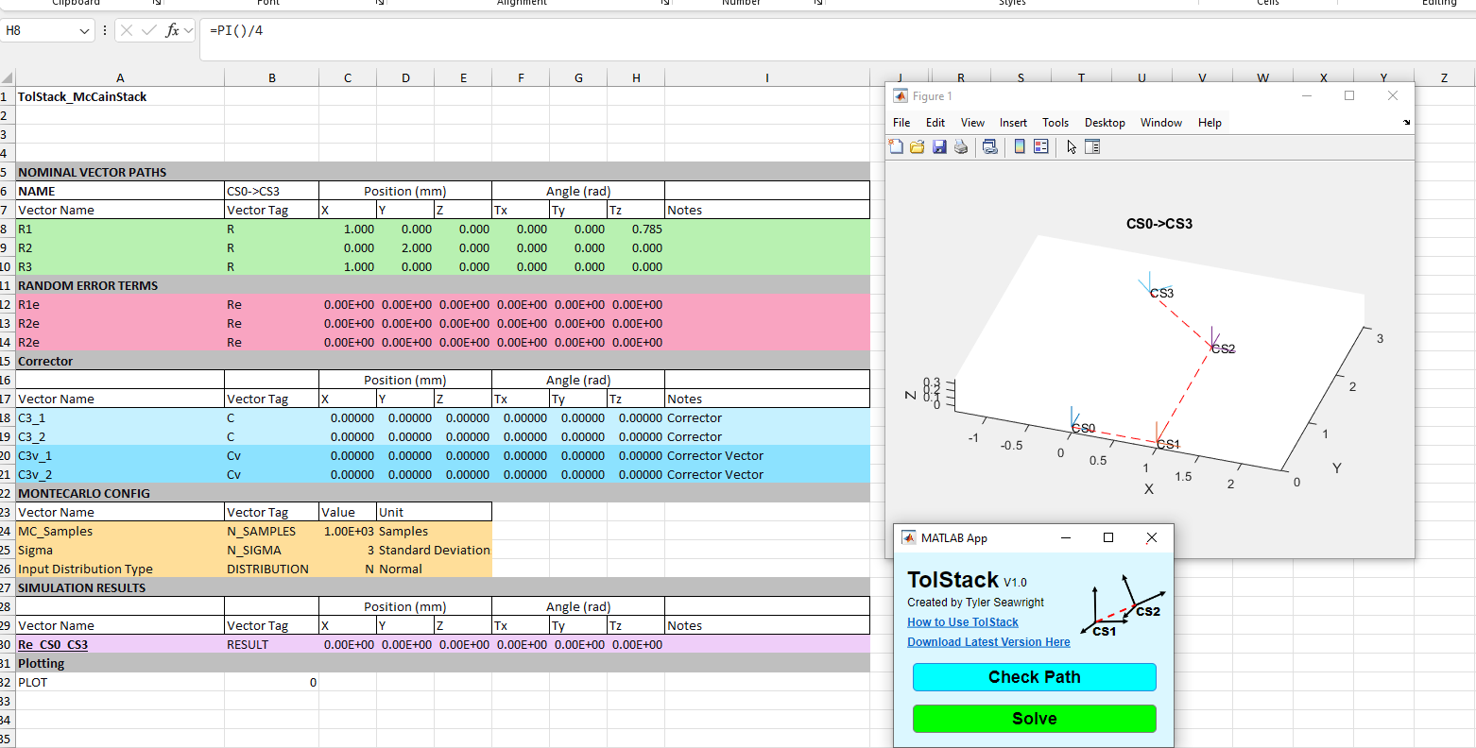
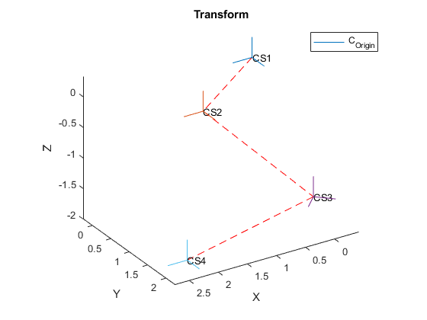

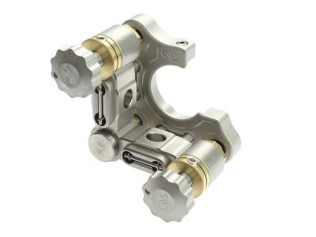



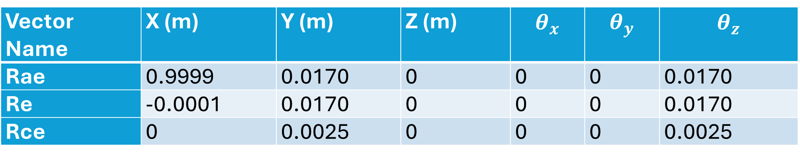
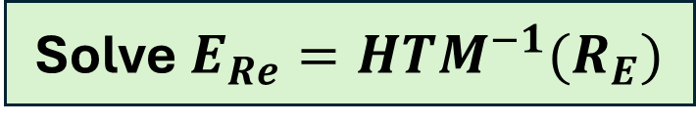






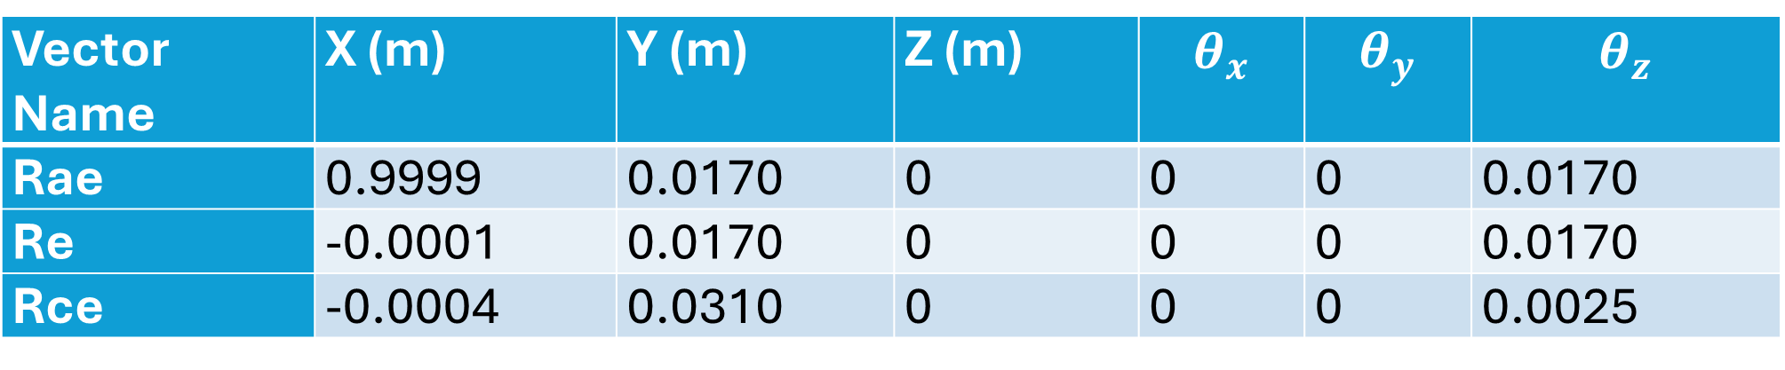
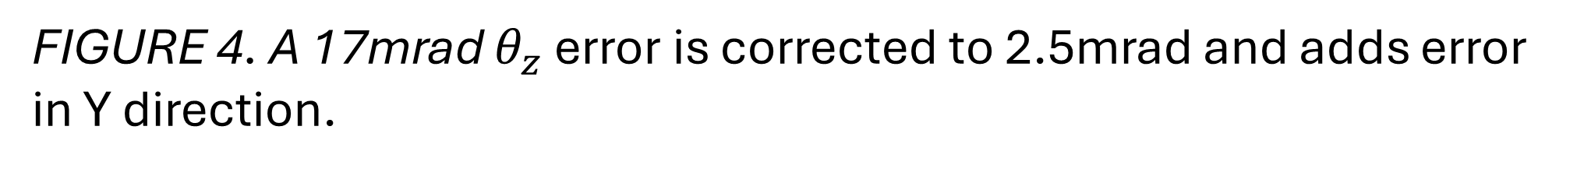
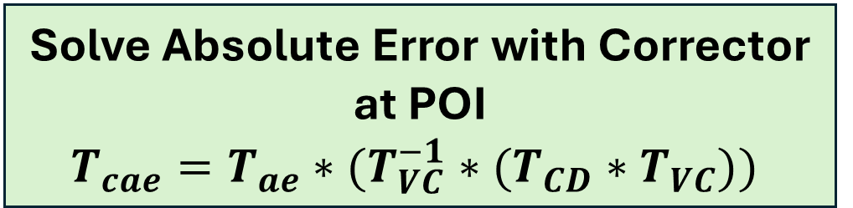

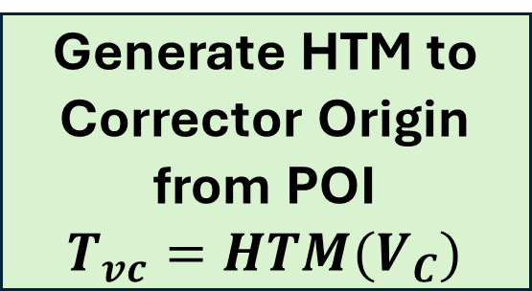
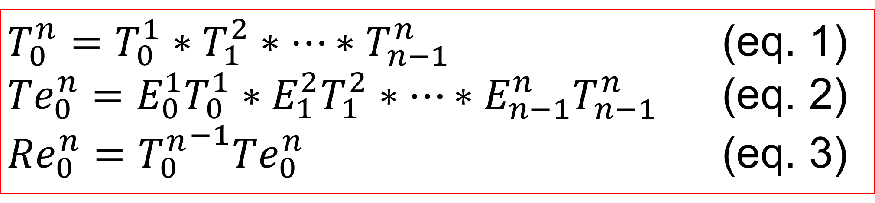
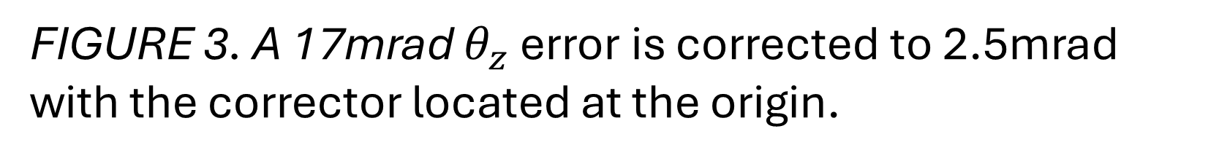

APPLICATION FOR APPLYING CORRECTORS WITH COUPLED ERROR TO TOLERANCE ANALYSIS
APPLICATION WORKFLOW IN EXCEL
Tyler Seawright
M.S. Mechanical Engineering
ERROR CORRECTOR COUPLING AND PROPAGATION
Nominal Vectors
Nominal Transform
Start
Local Errors
Solve $E_{Re}=HTM^{−1}(R_{E})$
Solve Absolute Error with Corrector at POI
$$T_{cae}=T_{ae}∗(T_{VC}^{−1}∗(T_{CD}∗T_{VC}))$$
MC Config
Correctors
Generate Corrector Difference Vector and HTM when $C≠0$
$C_{D}=C −E_{Re}$
$$T_{CD}=HTM(C_{D})$$
Result
TolStack App UI
Solve Relative Error with Corrector at POI and Convert to Vector
$$T_{cre}=T_{n}^{−1}T_{cae}$$
$$R_{CE}=HTM^{−1}(T_{cre})$$
FIGURE 1. The TolStack application is 2 buttons that read from and write to the highlighted cells in an active Excel spreadsheet without any setup or install.
Generate HTM to Corrector Origin from POI
$$T_{vc}=HTM(V_{C})$$
Solution: $R_{CE}$
Input data with tagged rows for each input.
Verify the nominal path with Check Path.
Output results with Solve.
FIGURE 2. Corrector parasitic error is propagated to the system using the corrector difference transform solved by the process in the flowchart.
MODEL VALIDATION 1
Vector Name | X (m) | Y (m) | Z (m) | $$θ_{x}$$ | $$θ_{y}$$ | $$θ_{z}$$
Rae | 0.9999 | 0.0170 | 0 | 0 | 0 | 0.0170
Re | -0.0001 | 0.0170 | 0 | 0 | 0 | 0.0170
Rce | 0 | 0.0025 | 0 | 0 | 0 | 0.0025
ERROR PROPAGATION BY HOMOGENEOUS TRANSFORMS
$$R_{ae}$$
y
$θ_{z}$ Error
y
$$R_{cae}$$
x
$$Origin$$
1m
z
z
x
1m
$θ_{z}$ Correction
Y Error
FIGURE 3. A 17mrad $θ_{z}$ error is corrected to 2.5mrad with the corrector located at the origin.
MODEL VALIDATION 2
$T_{0}^{n}=T_{0}^{1}∗T_{1}^{2}∗…∗T_{n−1}^{n}$ (eq. 1)
${Te}_{0}^{n}=E_{0}^{1}T_{0}^{1}∗E_{1}^{2}T_{1}^{2}∗…∗{E_{n−1}^{n}T}_{n−1}^{n}$ (eq. 2)
${Re}_{0}^{n}={T_{0}^{n}}^{−1}{Te}_{0}^{n}$ (eq. 3)
Vector Name | X (m) | Y (m) | Z (m) | $$θ_{x}$$ | $$θ_{y}$$ | $$θ_{z}$$
Rae | 0.9999 | 0.0170 | 0 | 0 | 0 | 0.0170
Re | -0.0001 | 0.0170 | 0 | 0 | 0 | 0.0170
Rce | -0.0004 | 0.0310 | 0 | 0 | 0 | 0.0025
Rae
Rcae
y
Compute absolute and relative error between the global reference and point of interest.
y
y
POI
1m
$θ_{z}$ Error
1m
x
1m
z
x
$$Origin$$
z
x
1m
z
Y Error
$θ_{z}$ Correction
ERROR CORRECTOR DEFINITION
FIGURE 4. A 17mrad $θ_{z}$ error is corrected to 2.5mrad and adds error in Y direction.
Tilt
A corrector at the origin corrects to the resolution of the adjuster with crosstalk.
POI
Origin
Tip
An error corrector is a device used to correct an error with respect to a reference.

Slide 2
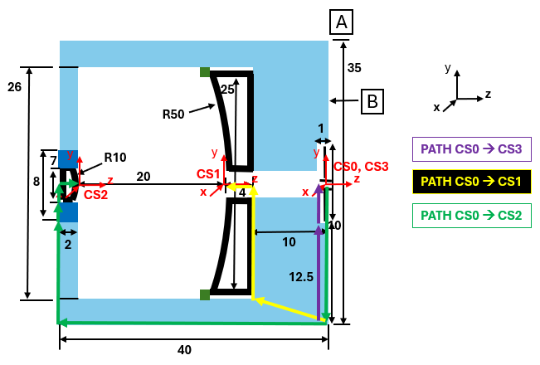
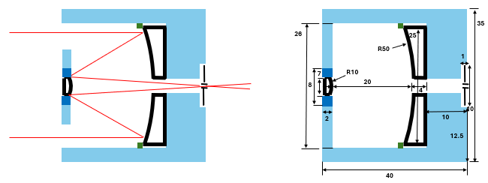
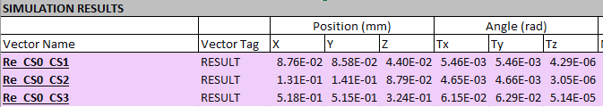

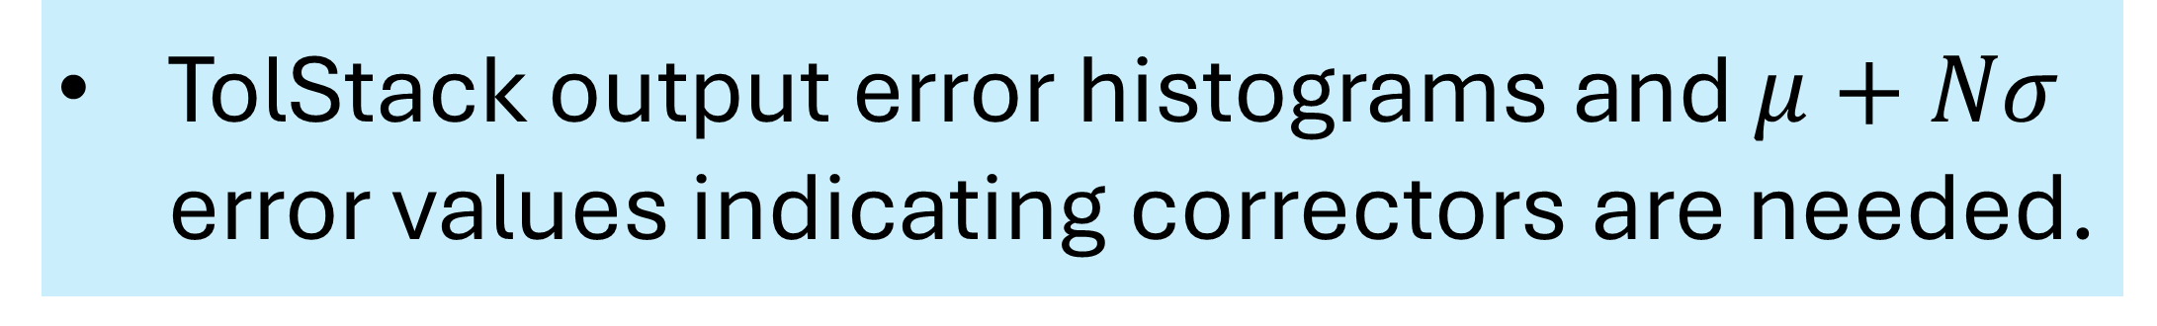
APPLICATION FOR APPLYING CORRECTORS WITH COUPLED ERROR TO TOLERANCE ANALYSIS
SAMPLE APPLICATION: OPTIC ALIGNMENT
Task: Determine if the focusing optics of this telescope can be assembled with respect to mechanical datums using mechanical tolerances or require alignment.
Ray Trace
Transform Path
FIGURE 5. Sample optical system under evaluation.
CS0→CS1
Requirements not met
Correctors Needed
CS0→CS2
CS0→CS3
FIGURE 6. Without any correction or adjusters, the requirements are not met so correctors are required to align the optics.
TolStack output error histograms and $μ+Nσ$ error values indicating correctors are needed.
CS0→CS1
CS0→CS2
CS0→CS3
Correctors Used
Requirements met
FIGURE 7. Using correctors, the requirements are met and decreased the standard deviation shown by width of the distributions.
Using correctors, the error is reduced but not eliminated entirely due to coupled motion.
REFERENCES
2025 Joint Committee for Guides in Metrology. Evaluation of measurement data – Guide to the expression of uncertainty in measurement. 2008.
T. A. Seawright, TolStack V1.0 [Computer Software]. 2025. https://github.com/TylerSeawright/TolStack
A. H. Slocum, Precision Machine Design. Prentice-Hall, Inc., 1992.
Duenner, Andrew C. An Error Budgeting Framework for Engineering Design. Massachusetts Institute of Technology. 2019.

