Slide 1
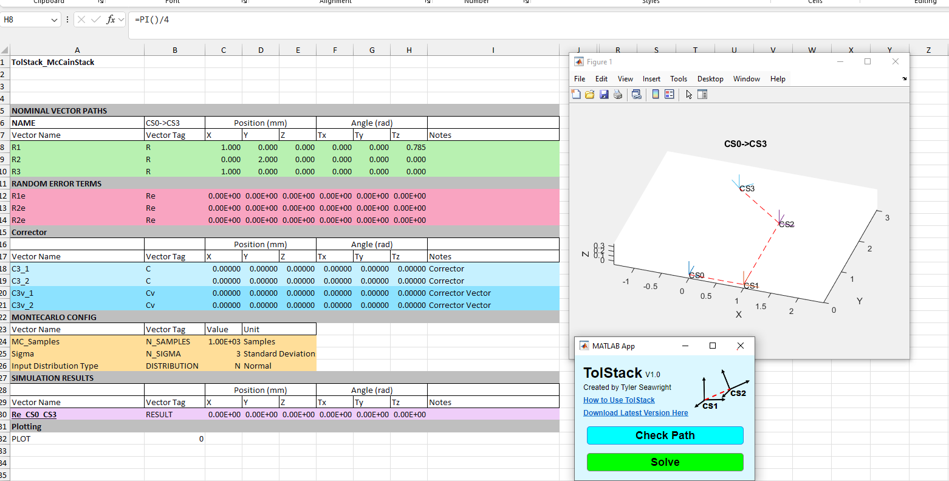
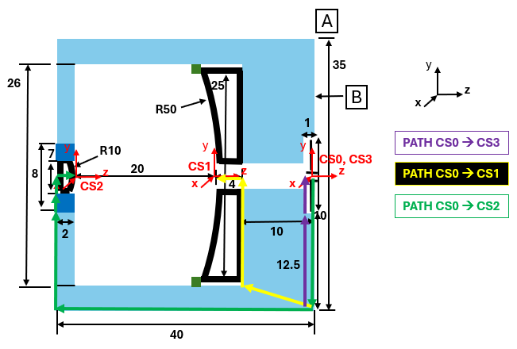
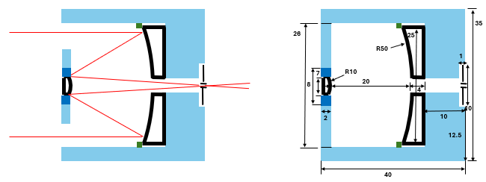
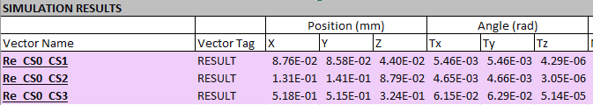
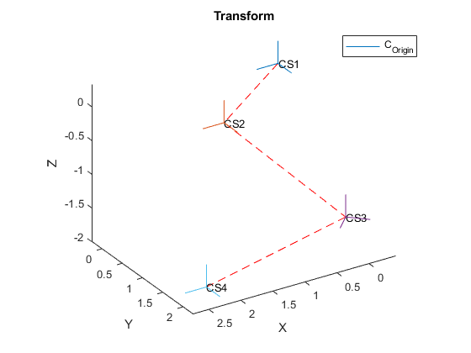


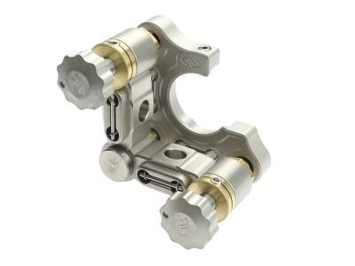


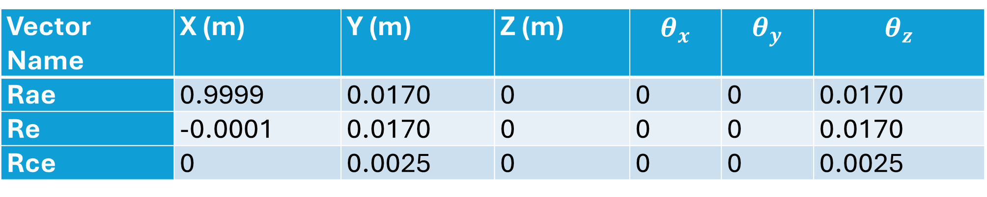
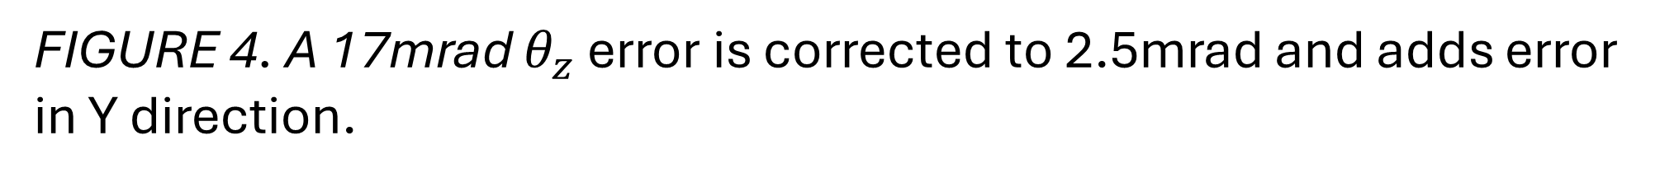
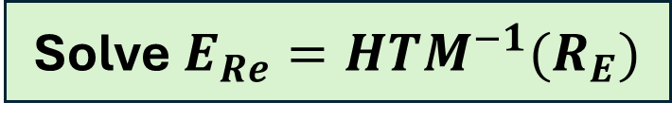






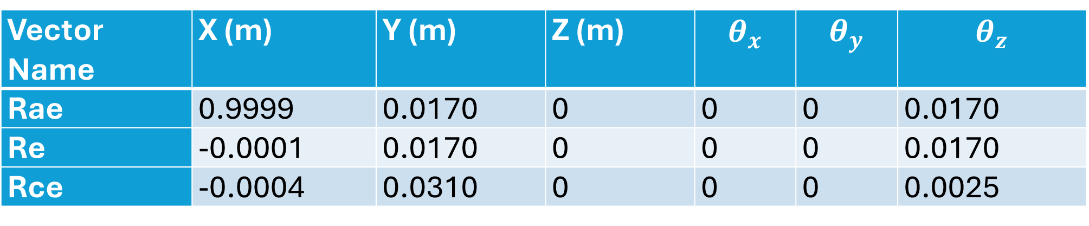
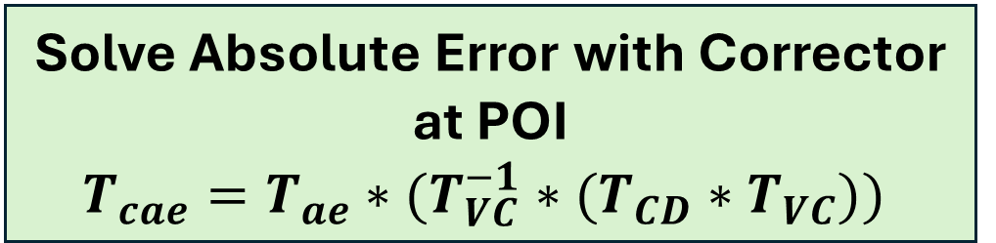

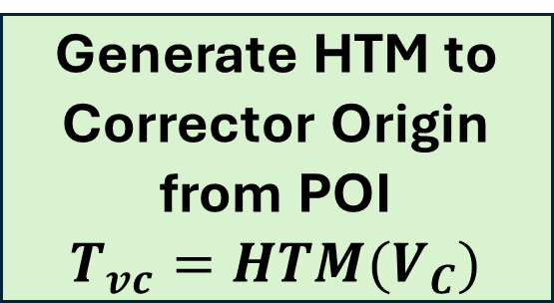
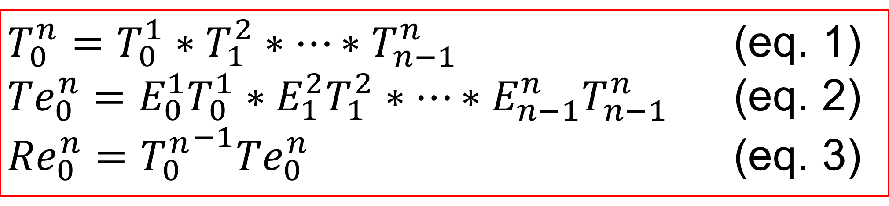
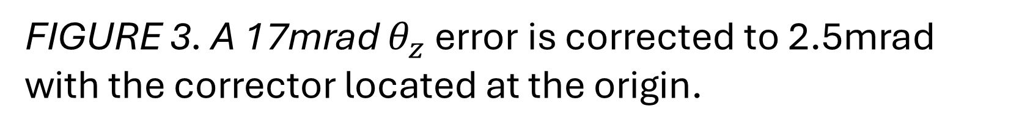


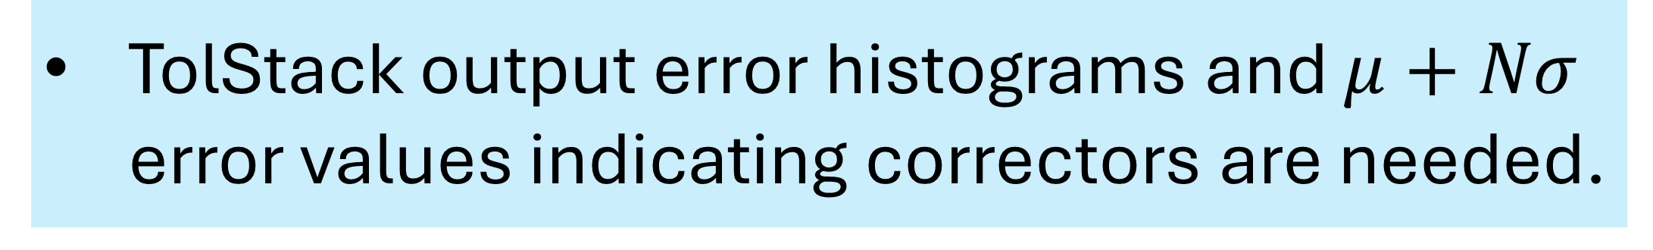
APPLICATION FOR APPLYING CORRECTORS WITH COUPLED ERROR TO TOLERANCE ANALYSIS
Tyler Seawright
M.S. Mechanical Engineering
APPLICATION WORKFLOW IN EXCEL
SAMPLE APPLICATION: OPTIC ALIGNMENT
ERROR CORRECTOR COUPLING AND PROPAGATION
Task: Determine if the focusing optics of this telescope can be assembled with respect to mechanical datums using mechanical tolerances or require alignment.
Nominal Transform
Start
Nominal Vectors
Solve Absolute Error with Corrector at POI
$$T_{cae}=T_{ae}∗(T_{VC}^{−1}∗(T_{CD}∗T_{VC}))$$
Local Errors
Solve $E_{Re}=HTM^{−1}(R_{E})$
Correctors
Generate Corrector Difference Vector and HTM when $C≠0$
$C_{D}=C −E_{Re}$
$$T_{CD}=HTM(C_{D})$$
MC Config
Solve Relative Error with Corrector at POI and Convert to Vector
$$T_{cre}=T_{n}^{−1}T_{cae}$$
$$R_{CE}=HTM^{−1}(T_{cre})$$
TolStack App UI
Result
Generate HTM to Corrector Origin from POI
$$T_{vc}=HTM(V_{C})$$
FIGURE 1. The TolStack application is 2 buttons that read from and write to the highlighted cells in an active Excel spreadsheet without any setup or install.
Ray Trace
Transform Path
Solution: $R_{CE}$
FIGURE 5. Sample optical system under evaluation.
FIGURE 2. Corrector parasitic error is propagated to the system using the corrector difference transform solved by the process in the flowchart.
Input data with tagged rows for each input.
Verify the nominal path with Check Path.
Output results with Solve.
CS0→CS1
Requirements not met
Correctors Needed
CS0→CS2
MODEL VALIDATION 1
CS0→CS3
Vector Name | X (m) | Y (m) | Z (m) | $$θ_{x}$$ | $$θ_{y}$$ | $$θ_{z}$$
Rae | 0.9999 | 0.0170 | 0 | 0 | 0 | 0.0170
Re | -0.0001 | 0.0170 | 0 | 0 | 0 | 0.0170
Rce | 0 | 0.0025 | 0 | 0 | 0 | 0.0025
FIGURE 6. Without any correction or adjusters, the requirements are not met so correctors are required to align the optics.
ERROR PROPAGATION BY HOMOGENEOUS TRANSFORMS
$$R_{ae}$$
TolStack output error histograms and $μ+Nσ$ error values indicating correctors are needed.
y
$θ_{z}$ Error
$$R_{cae}$$
y
x
1m
$$Origin$$
z
x
z
1m
CS0→CS1
$θ_{z}$ Correction
Y Error
FIGURE 3. A 17mrad $θ_{z}$ error is corrected to 2.5mrad with the corrector located at the origin.
CS0→CS2
MODEL VALIDATION 2
CS0→CS3
$T_{0}^{n}=T_{0}^{1}∗T_{1}^{2}∗…∗T_{n−1}^{n}$ (eq. 1)
${Te}_{0}^{n}=E_{0}^{1}T_{0}^{1}∗E_{1}^{2}T_{1}^{2}∗…∗{E_{n−1}^{n}T}_{n−1}^{n}$ (eq. 2)
${Re}_{0}^{n}={T_{0}^{n}}^{−1}{Te}_{0}^{n}$ (eq. 3)
Vector Name | X (m) | Y (m) | Z (m) | $$θ_{x}$$ | $$θ_{y}$$ | $$θ_{z}$$
Rae | 0.9999 | 0.0170 | 0 | 0 | 0 | 0.0170
Re | -0.0001 | 0.0170 | 0 | 0 | 0 | 0.0170
Rce | -0.0004 | 0.0310 | 0 | 0 | 0 | 0.0025
Correctors Used
Requirements met
y
Rae
Rcae
FIGURE 7. Using correctors, the requirements are met and decreased the standard deviation shown by width of the distributions.
Compute absolute and relative error between the global reference and point of interest.
y
y
POI
1m
$θ_{z}$ Error
x
Using correctors, the error is reduced but not eliminated entirely due to coupled motion.
1m
1m
x
z
$$Origin$$
z
x
$θ_{z}$ Correction
1m
z
Y Error
FIGURE 4. A 17mrad $θ_{z}$ error is corrected to 2.5mrad and adds error in Y direction.
REFERENCES
ERROR CORRECTOR DEFINITION
Tilt
A corrector at the origin corrects to the resolution of the adjuster with crosstalk.
2025 Joint Committee for Guides in Metrology. Evaluation of measurement data – Guide to the expression of uncertainty in measurement. 2008.
T. A. Seawright, TolStack V1.0 [Computer Software]. 2025. https://github.com/TylerSeawright/TolStack
A. H. Slocum, Precision Machine Design. Prentice-Hall, Inc., 1992.
Duenner, Andrew C. An Error Budgeting Framework for Engineering Design. Massachusetts Institute of Technology. 2019.
POI
Origin
Tip
An error corrector is a device used to correct an error with respect to a reference.

Slide 2

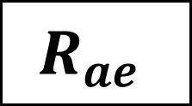


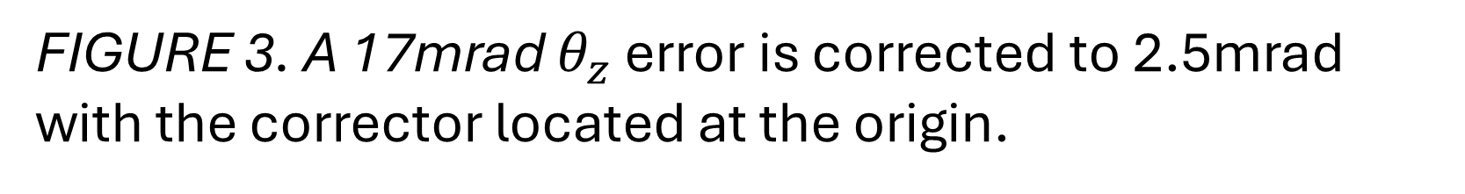
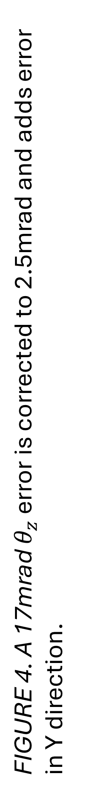
APPLICATION FOR APPLYING CORRECTORS WITH COUPLED ERROR TO TOLERANCE ANALYSIS
Tyler Seawright
M.S. Mechanical Engineering
APPLICATION WORKFLOW IN EXCEL
SAMPLE APPLICATION: OPTIC ALIGNMENT
ERROR CORRECTOR COUPLING AND PROPAGATION
Task: Determine if the focusing optics of this telescope can be assembled with respect to mechanical datums using mechanical tolerances or require alignment.
Nominal Transform
Start
Nominal Vectors
Solve Absolute Error with Corrector at POI
$$T_{cae}=T_{ae}∗(T_{VC}^{−1}∗(T_{CD}∗T_{VC}))$$
Local Errors
Solve $E_{Re}=HTM^{−1}(R_{E})$
REFERENCES
Correctors
Generate Corrector Difference Vector and HTM when $C≠0$
$C_{D}=C −E_{Re}$
$$T_{CD}=HTM(C_{D})$$
MC Config
Solve Relative Error with Corrector at POI and Convert to Vector
$$T_{cre}=T_{n}^{−1}T_{cae}$$
$$R_{CE}=HTM^{−1}(T_{cre})$$
TolStack App UI
2025 Joint Committee for Guides in Metrology. Evaluation of measurement data – Guide to the expression of uncertainty in measurement. 2008.
T. A. Seawright, TolStack V1.0 [Computer Software]. 2025. https://github.com/TylerSeawright/TolStack
A. H. Slocum, Precision Machine Design. Prentice-Hall, Inc., 1992.
Duenner, Andrew C. An Error Budgeting Framework for Engineering Design. Massachusetts Institute of Technology. 2019.
Result
Generate HTM to Corrector Origin from POI
$$T_{vc}=HTM(V_{C})$$
FIGURE 1. The TolStack application is 2 buttons that read from and write to the highlighted cells in an active Excel spreadsheet without any setup or install.
Ray Trace
Transform Path
Solution: $R_{CE}$
FIGURE 5. Sample optical system under evaluation.
FIGURE 2. Corrector parasitic error is propagated to the system using the corrector difference transform solved by the process in the flowchart.
Input data with tagged rows for each input.
Verify the nominal path with Check Path.
Output results with Solve.
CS0→CS1
Requirements not met
Correctors Needed
CS0→CS2
MODEL VALIDATION 1
CS0→CS3
Vector Name | X (m) | Y (m) | Z (m) | $$θ_{x}$$ | $$θ_{y}$$ | $$θ_{z}$$
Rae | 0.9999 | 0.0170 | 0 | 0 | 0 | 0.0170
Re | -0.0001 | 0.0170 | 0 | 0 | 0 | 0.0170
Rce | 0 | 0.0025 | 0 | 0 | 0 | 0.0025
FIGURE 6. Without any correction or adjusters, the requirements are not met so correctors are required to align the optics.
ERROR PROPAGATION BY HOMOGENEOUS TRANSFORMS
TolStack output error histograms and $μ+Nσ$ error values indicating correctors are needed.
$$R_{ae}$$
FIGURE 4. A 17mrad $θ_{z}$ error is corrected to 2.5mrad and adds error in Y direction.
ERROR CORRECTOR DEFINITION
$$R_{cae}$$
y
Tilt
y
x
CS0→CS1
$θ_{z}$ Error
A corrector not located at the origin adds translational error through coupled motion while reducing error on the rotation Z axis.
POI
1m
$$Origin$$
CS0→CS2
Origin
z
x
z
1m
Tip
$θ_{z}$ Correction
Y Error
CS0→CS3
FIGURE 3. A 17mrad $θ_{z}$ error is corrected to 2.5mrad with the corrector located at the origin.
An error corrector is a device used to correct an error with respect to a reference.
MODEL VALIDATION 2
$T_{0}^{n}=T_{0}^{1}∗T_{1}^{2}∗…∗T_{n−1}^{n}$ (eq. 1)
${Te}_{0}^{n}=E_{0}^{1}T_{0}^{1}∗E_{1}^{2}T_{1}^{2}∗…∗{E_{n−1}^{n}T}_{n−1}^{n}$ (eq. 2)
${Re}_{0}^{n}={T_{0}^{n}}^{−1}{Te}_{0}^{n}$ (eq. 3)
Correctors Used
Vector Name | X (m) | Y (m) | Z (m) | $$θ_{x}$$ | $$θ_{y}$$ | $$θ_{z}$$
Rae | 0.9999 | 0.0170 | 0 | 0 | 0 | 0.0170
Re | -0.0001 | 0.0170 | 0 | 0 | 0 | 0.0170
Rce | -0.0004 | 0.0310 | 0 | 0 | 0 | 0.0025
A corrector at the origin corrects to the resolution of the adjuster with crosstalk.
Requirements met
FIGURE 7. Using correctors, the requirements are met and decreased the standard deviation shown by width of the distributions.
y
Compute absolute and relative error between the global reference and point of interest.
Rae
Rcae
y
y
Using correctors, the error is reduced but not eliminated entirely due to coupled motion.
POI
1m
$θ_{z}$ Error
x
1m
1m
x
z
$$Origin$$
z
x
$θ_{z}$ Correction
1m
z
Y Error

Slide 3
Nominal Transform
Nominal Vectors
Local Errors
Correctors
MC Config
TolStack App UI
Result

Slide 4



Re_CS0_CS1
Re_CS0_CS2
Re_CS0_CS3
y
Rae
Rcae
y
y
POI
1m
$θ_{z}$ Error
x
1m
x
1m
z
$$Origin$$
z
x
1m
z
$θ_{z}$ Correction
Y Error

Slide 5
CS0→CS1
CS0→CS2
CS0→CS3
Correctors Used
Requirements met

