Slide 1

APPLICATION FOR APPLYING CORRECTORS WITH COUPLED ERROR TO TOLERANCE ANALYSIS
American Society for Precision Engineering
Precision Machine Design Topical Conference
Tyler Seawright
M.S. Mechanical Engineering
July 15, 2025

Slide 2

Error Budgets and Why they are Feared
“Budget” is associated with scarcity and stress
Budgets can be difficult to organize and manage
Often requires advanced modeling of a complex system
Notes:
Error budgets are one of the last requests the typical engineer wants to hear, but why?
Budget is associated with the stress of deciding what to do with a scarce resource
Without a good budget, systems don’t operate as intended whether it is tracking calories, planning monthly finances, or developing a precision machine.
We look to the GUM for guidance on error budgets

Slide 3
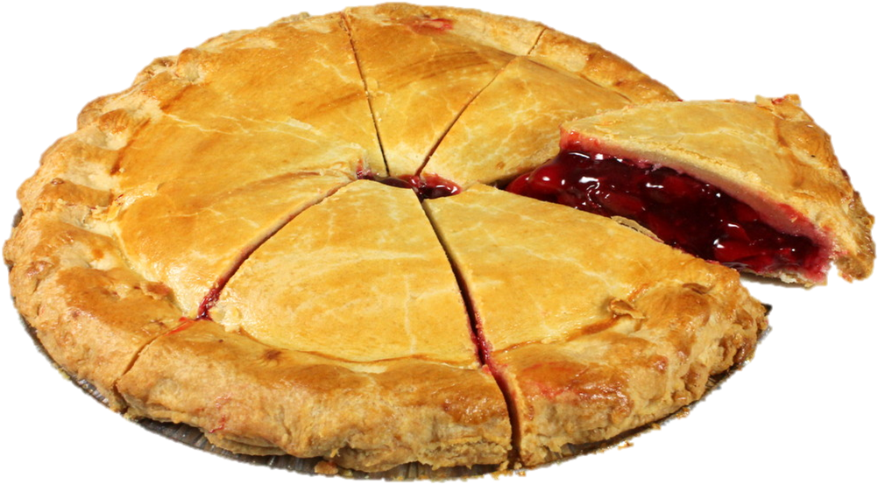
Error Budget Definitions
Each person gets a portion of the pie, but all must agree on how to divide it
After a lengthy debate and negotiation, it was determined Dylan needs ¼ for a gym bulk and Sue and Timothy only want a taste since they prefer cake.
Image credit to pngall.com
Notes:
After addressing why each person needed specific quantities, the allocation of the pie can be determined.
Error budgets apportion total error to identified sources to drive design decisions
Good error budgets identify the sources the system is most sensitive to such as Dylan, who needs to maintain a daily calorie intake and consumes the largest portion of the pie.

Slide 4



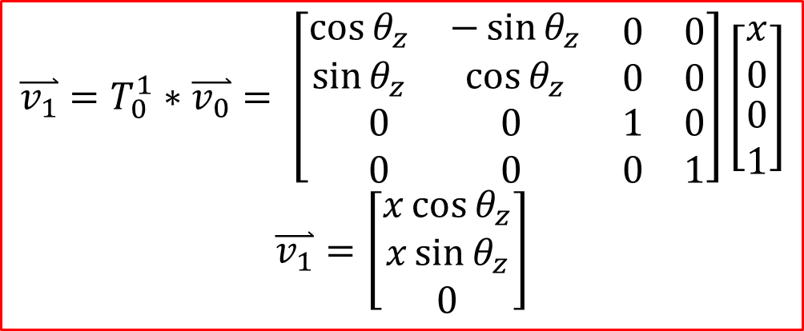


Generalized Error Analysis with Coupled Motion
Geometric error types often include coupled error on other axes such as Abbe error.
3D error stacks including coupled error are the most general, yet can be challenging to model, manage, and validate.
Simple 2D case modeled with a rotation propagated across a unit distance.
y
y
$$\overset{⃑}{v_{1}}=T_{0}^{1}∗\overset{⃑}{v_{0}}= \left[\begin{matrix}\begin{matrix}\cos{θ_{z}} & −\sin{θ_{z}} \\ \sin{θ_{z}} & \cos{θ_{z}}\end{matrix} & \begin{matrix}0 & 0 \\ 0 & 0\end{matrix} \\ \begin{matrix}0 & 0 \\ 0 & 0\end{matrix} & \begin{matrix}1 & 0 \\ 0 & 1\end{matrix}\end{matrix}\right]\left[\begin{matrix}\begin{matrix}x \\ 0\end{matrix} \\ \begin{matrix}0 \\ 1\end{matrix}\end{matrix}\right]$$
$$\overset{⃑}{v_{1}}=\left[\begin{matrix}\begin{matrix}x\cos{θ_{z}} \\ x\sin{θ_{z}}\end{matrix} \\ 0\end{matrix}\right]$$
$$θ_{z}$$
x
$$\overset{⃑}{v_{1}}$$
$$CS1$$
$$Origin$$
z
z
x
$$\overset{⃑}{v_{0}}$$
(X,Y) Displacement
Notes:
Coupled error propagates through stacks of parts
3D stacks are challenging to model when considering stacking abbe error
In this 2D case, you could use trigonometry to solve in your head, but moving to 3D or to multiple parts becomes more challenging

Slide 5
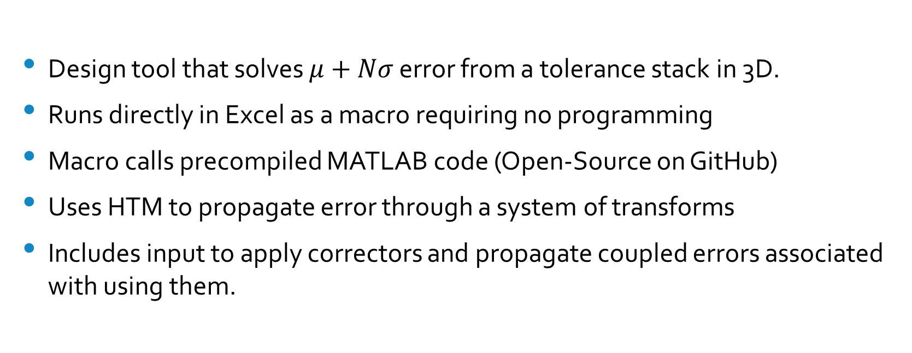
Application Overview
Design tool that solves $μ+Nσ$ error from a tolerance stack in 3D.
Runs directly in Excel as a macro requiring no programming
Macro calls precompiled MATLAB code (Open-Source on GitHub)
Uses HTM to propagate error through a system of transforms
Includes input to apply correctors and propagate coupled errors associated with using them.
Notes:
u + Nsigma analysis provides a realistic distribution of many built systems because what is “worst case” when you have many parts assembled? RSS works for 1D, but not well for 3D so Montecarlo is used.
App is an excel macro running an executable written in Matlab.
Does not require Matlab to use and does not require programming. Matlab source code and Macro are open sourced.
Errors are propagated using HTM

Slide 6
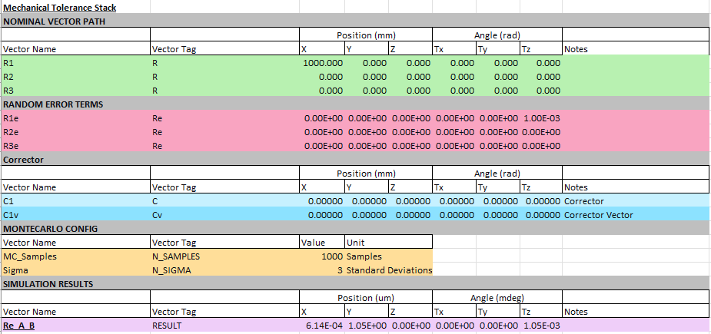
Application UI
Run TolStack
Excel Button
Nominal Vectors
Local Errors
Corrector Definition
Montecarlo Setup
Exported Result
Notes:
UI is Excel
Formatting flexible, but information must be tagged
Freedom to build Excel as you wish
Highlight data and hit run button to calculate
Figures and results placed in Excel

Slide 7
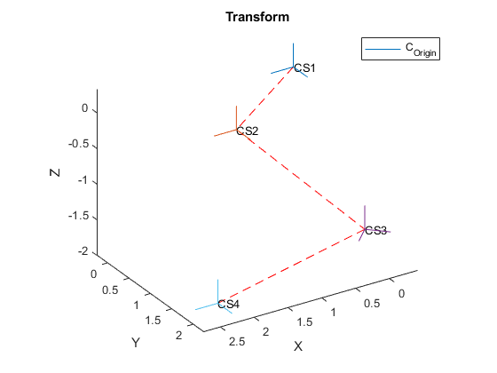
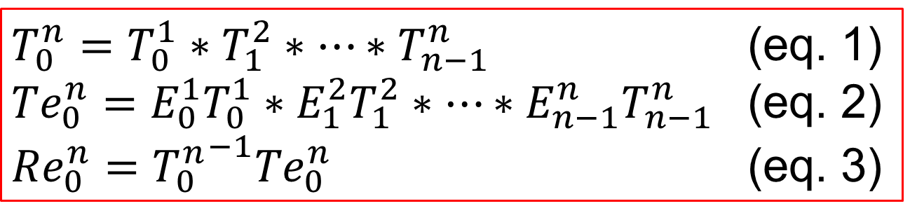

Error Model by HTM
A transform path is defined by multiplying 4x4 HTMs.
Applying error terms to each transform solves the absolute error transform.
Eq. 3 solves relative difference between the two, representing error in this analysis.
$T_{0}^{n}=T_{0}^{1}∗T_{1}^{2}∗…∗T_{n−1}^{n}$ (eq. 1)
${Te}_{0}^{n}=E_{0}^{1}T_{0}^{1}∗E_{1}^{2}T_{1}^{2}∗…∗{E_{n−1}^{n}T}_{n−1}^{n}$ (eq. 2)
${Re}_{0}^{n}={T_{0}^{n}}^{−1}{Te}_{0}^{n}$ (eq. 3)
$${T_{0}^{n}Re}_{0}^{n}={Te}_{0}^{n}$$
Re-arranged
Notes:
Transform path is defined by 4x4 HTMs multiplied together
Error terms at each transform solve absolute error transform
Eq. 3 solves the relative difference between two transforms

Slide 8
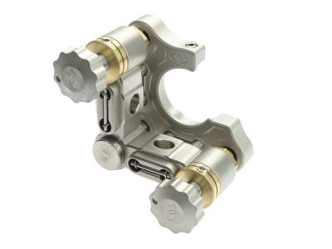
Error Corrector Definition
Corrector is a device that corrects an error in a system with respect to a coordinate system.
A corrector is defined with a 1x6 vector as the minimum adjustable resolution on each axis and a 1x6 vector as the position and orientation with respect to the adjusted point of interest
Tilt
POI
₊
Origin
Tip
Tip/Tilt Adjuster Credit Newport SN100C-F2K
Notes:
A corrector is a device that corrects an error such as an adjuster or actively controlled device.
A corrector is defined by minimum adjustable resolution and origin in 6 axes with respect to the corrected object.
Often, the corrector origin is not located at the point of interest (POI) to be corrected.

Slide 9


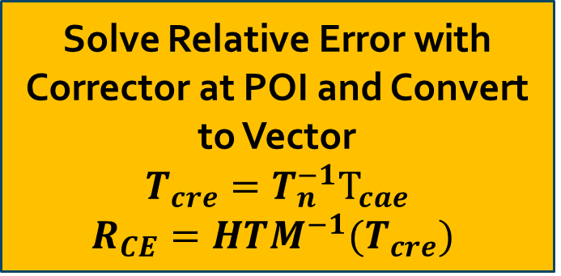
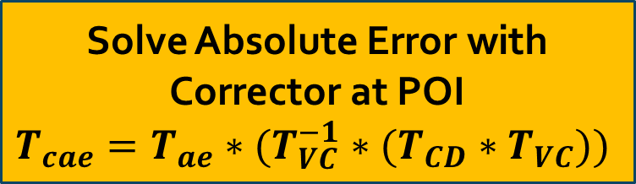
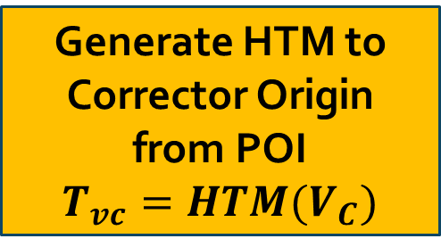
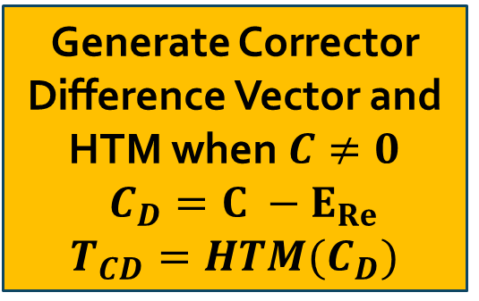
Error Correcting by HTM
Start
Solve Absolute Error with Corrector at POI
$$T_{cae}=T_{ae}∗(T_{VC}^{−1}∗(T_{CD}∗T_{VC}))$$
Solve $E_{Re}=HTM^{−1}(R_{E})$
Generate Corrector Difference Vector and HTM when $C≠0$
$C_{D}=C −E_{Re}$
$$T_{CD}=HTM(C_{D})$$
Solve Relative Error with Corrector at POI and Convert to Vector
$$T_{cre}=T_{n}^{−1}T_{cae}$$
$$R_{CE}=HTM^{−1}(T_{cre})$$
Generate HTM to Corrector Origin from POI
$$T_{vc}=HTM(V_{C})$$
Solution: $R_{CE}$
Notes:
Do not spend much time on this slide, it is explained in the paper
This flowchart outlines how the difference between errored position and corrected position is solved and the corrector is applied at a distance of POI to corrector origin.
HTM() represents MATLAB functions to convert vectors to and from HTM’s
First convert relative error transform to vector
Solve corrector difference – zeros ignored in algorithm to apply only on axes of correction
Determine transform from POI to corrector coordinate system
Solve new POI transform with correction including parasitic errors
Convert to relative error transform and extract error vector R_CE

Slide 10

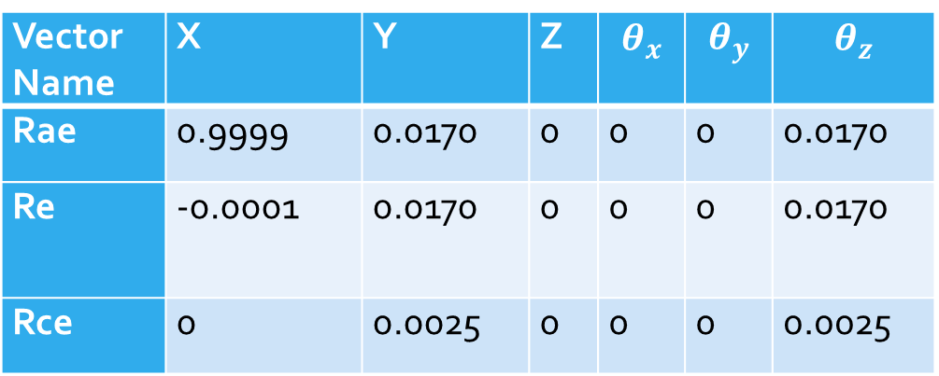



Model Validation 1
17mrad $θ_{z}$ error corrected to 2.5mrad with corrector located at Origin
Vector Name | X | Y | Z | $$θ_{x}$$ | $$θ_{y}$$ | $$θ_{z}$$
Rae | 0.9999 | 0.0170 | 0 | 0 | 0 | 0.0170
Re | -0.0001 | 0.0170 | 0 | 0 | 0 | 0.0170
Rce | 0 | 0.0025 | 0 | 0 | 0 | 0.0025
$$R_{ce}=R_{a}^{−1}R_{cae}$$
Rae
y
Rcae
y
$θ_{z}$ Error
x
1un
$$Origin$$
z
z
x
1un
$θ_{z}$ Correction
Y Error
Notes:
17mrad theta z error is corrected by a corrector with rotation axis at the origin
Across a unit length, such as a meter, 17mrad error results in 17mm error.
Correcting for rotation to the resolution of the adjuster, the position error is reduced with the angle error.

Slide 11
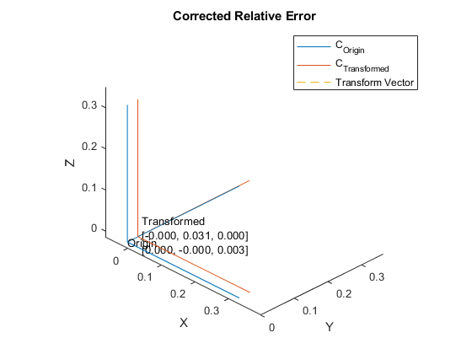

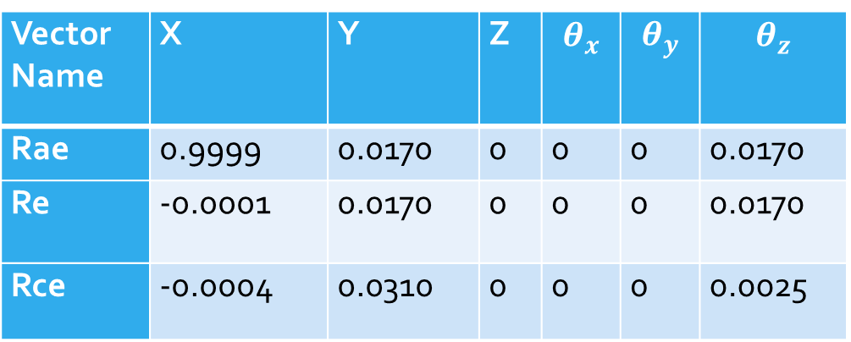


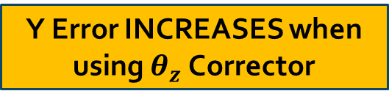
Model Validation 2
17mrad $θ_{z}$ error corrected to 2.5mrad with corrector located 1 unit from POI
Vector Name | X | Y | Z | $$θ_{x}$$ | $$θ_{y}$$ | $$θ_{z}$$
Rae | 0.9999 | 0.0170 | 0 | 0 | 0 | 0.0170
Re | -0.0001 | 0.0170 | 0 | 0 | 0 | 0.0170
Rce | -0.0004 | 0.0310 | 0 | 0 | 0 | 0.0025
y
Rae
Rcae
y
y
POI
1un
$θ_{z}$ Error
x
1un
x
1un
z
$$Origin$$
Y Error INCREASES when using $θ_{z}$ Corrector
z
x
1un
z
$θ_{z}$ Correction
Y Error
Notes:
In this example the corrector axis is moved and introduces an additional position error in Y as a result of correcting angle.
Since the corrector is placed 1 unit away in the opposite direction, correcting angle increases error in Y

Slide 12
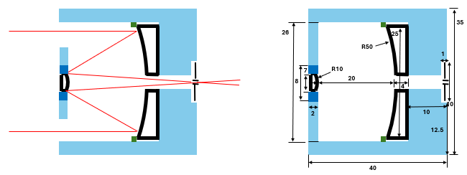
Application: Telescope Objective
Eyepiece Imaging Optics
Aberration Correction Optics
Focusing Optics
Ray Trace
Assembly Dimensions
Task: Determine if the focusing optics of this telescope can be assembled with respect to mechanical datums using mechanical tolerances or require alignment.
Notes:
Walk through example
Fictional telescope objective has two mirrors and a pinhole.
Dimensions are given and tolerances added in Excel.
Task, determine if the focusing optics can be assembled with respect to the mechanical datums of the assembly fixed or require alignment before bonding.

Slide 13
Telescope Objective Requirements
Requirement | Value | Unit
Uncertainty must be within ±N-sigma distribution | 3 | -
First and Second Mirror, and Pinhole Centration wrt mechanical datums (x,y,z) | 0.08 0.08 0.08 | mm mm mm
First and Second Mirror Orientation wrt mechanical datums (Tx, Ty, Tz) | 1.7 1.7 25 | mrad mrad mrad
Ray Trace
Assembly Dimensions
Notes:
All uncertainties must be within a ±3-sigma distribution or 6-sigma distribution range.
Requirements are 80um position on all three optics and orientations for the mirrors with Z-orientation loose for axially symmetric mirrors.

Slide 14
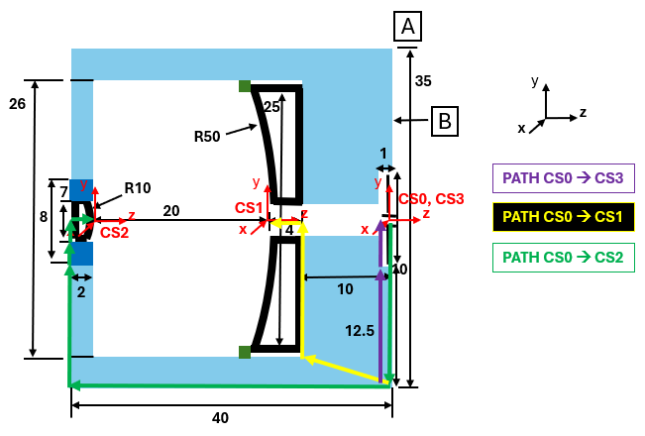
System Error Model
3 transform paths from each optic center to mechanical datums.
Each feature has tolerances
Notes:
The error model starts with defining the transform path between coordinate systems.
Three transform paths modeled by vectors from the mechanical datum of the subassembly to each optic are created and input into Excel with local tolerances.

Slide 15
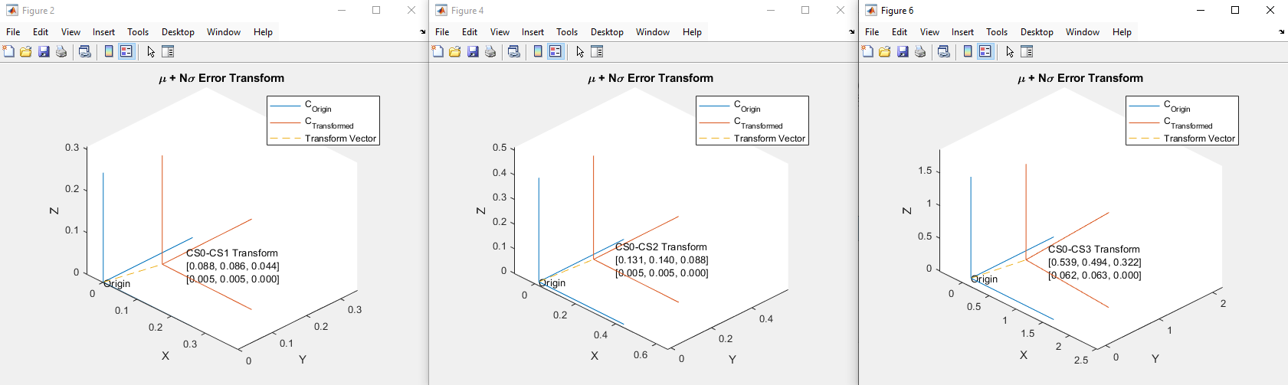



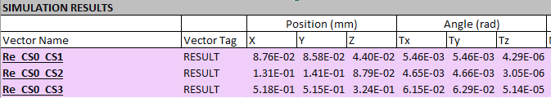
Fixed Optic Model Outputs
Requirements not met
Notes:
Mu + Nsigma requirements not met, concern areas circled in red
No correctors used.
Correctors needed on all circled in red if tolerances are not changed.

Slide 16
Fixed Optic Model Output Histograms
CS0→CS1
CS0→CS2
CS0→CS3
Notes:
Distributions are normal as expected and have reasonable 3-sigma ranges.

Slide 17
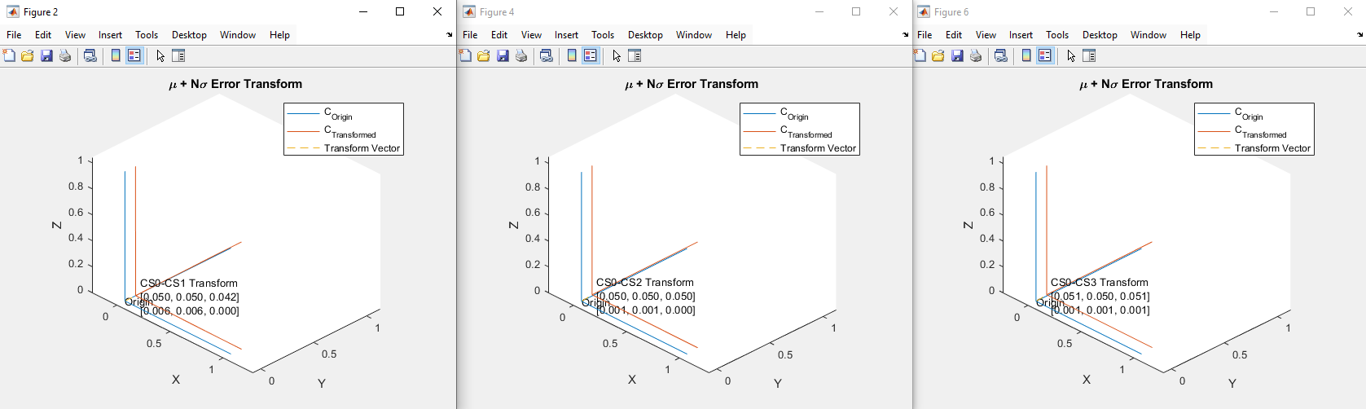




Aligned Optic Model Outputs
Correctors Used
Requirements met
Notes:
Mu + Nsigma uncertainty requirements met
Correctors used on pinhole and 2nd mirror

Slide 18
Aligned Optic Model Output Histograms
CS0→CS1
CS0→CS2
CS0→CS3
Notes:
Corrected axis distributions tighten as standard deviation goes to zero and average approaches corrector resolution

Slide 19
Conclusion
Script is a powerful addition to the ME’s toolbox for rapid tolerance analysis and determination of required corrector axes and ranges
Script is open sourced and may be plugged into custom analyses in MATLAB, however, functions well for studies completely built in Excel for non-programmers.
Systems of high complexity may be modeled with a few bridges in Excel called the “Math Model”
Notes:
Powerful addition to ME toolbox without needing to code
Open sourced and modular enough to create custom analysis
Bridge connections between subsystems in Excel like serially adding error between independent subsystems.

Slide 20
Future Work
Embed macro into Excel and pre-compile MATLAB script
Add sensitivity input option for non-mechanical error analysis
Add ability to change input error distribution types
Add code smarts to suggest corrector range and resolution when given requirements.
Add code smart to use corrector as ± centered at zero instead of always +
Add code smarts to configure solutions steps based on input complexity
Notes:
Complete tool with Excel Macro to eliminate all coding. Solve only highlighted region of spreadsheet.
Enable sensitivity inputs
Enable custom error input distributions
Enable code to suggest corrector range and res when given requirements
Enable code to pick corrector direction (nit picky but more generalized)
Enable the code to solve simpler cases such as uncorrected solution (faster) if no corrector is input is supplied.

Slide 21
References
Joint Committee for Guides in Metrology. Evaluation of measurement data – Guide to the expression of uncertainty in measurement. 2008.
A. H. Slocum, Precision Machine Design. Prentice-Hall, Inc., 1992.
Duenner, Andrew C. An Error Budgeting Framework for Engineering Design. Massachusetts Institute of Technology. 2019.
Notes:
Complete tool with Excel Macro to eliminate all coding. Solve only highlighted region of spreadsheet.
Enable sensitivity inputs
Enable custom error input distributions
Enable code to suggest corrector range and res when given requirements
Enable code to pick corrector direction (nit picky but more generalized)
Enable the code to solve simpler cases such as uncorrected solution (faster) if no corrector is input is supplied.

