Slide 1
Moving to Cloud Computing
Presentation by Tyler Smith | 7/10/2017
CSS/422 | Software Architecture
Prof. Mohammad Kamali
Notes:
Hello everyone and welcome to my presentation on moving towards Cloud-Based systems, and why they will work for you

Slide 2
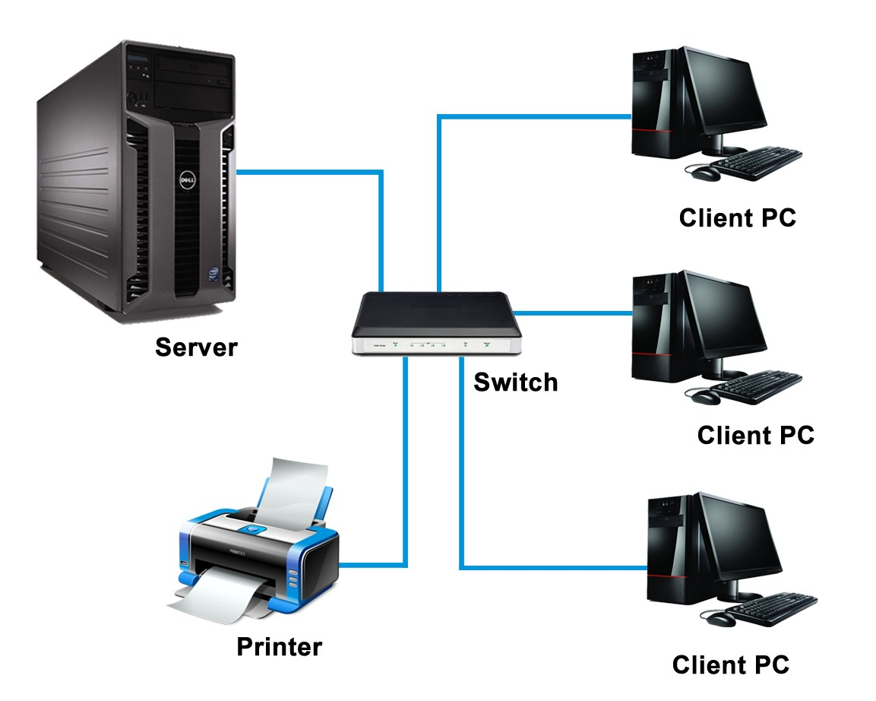
Your Current System:
Hosting your own application has many risks and few rewards
Systems are dependent on one or a few servers being online
Servers are maintained in-house
Server connection is based on in-house bandwidth, meaning scalability is low
Notes:
Traditional Client-Server models have many risks and very few rewards, and while they may have worked quite well for us in the past few decades, they are quickly becoming outclassed by more innovative architectural models.
Hosting your own server can be stressful- and not just because of how expensive it is. If your one server goes down, your entire system goes down with it, adding down-time and decreased dependability to your list of worries.

Slide 3
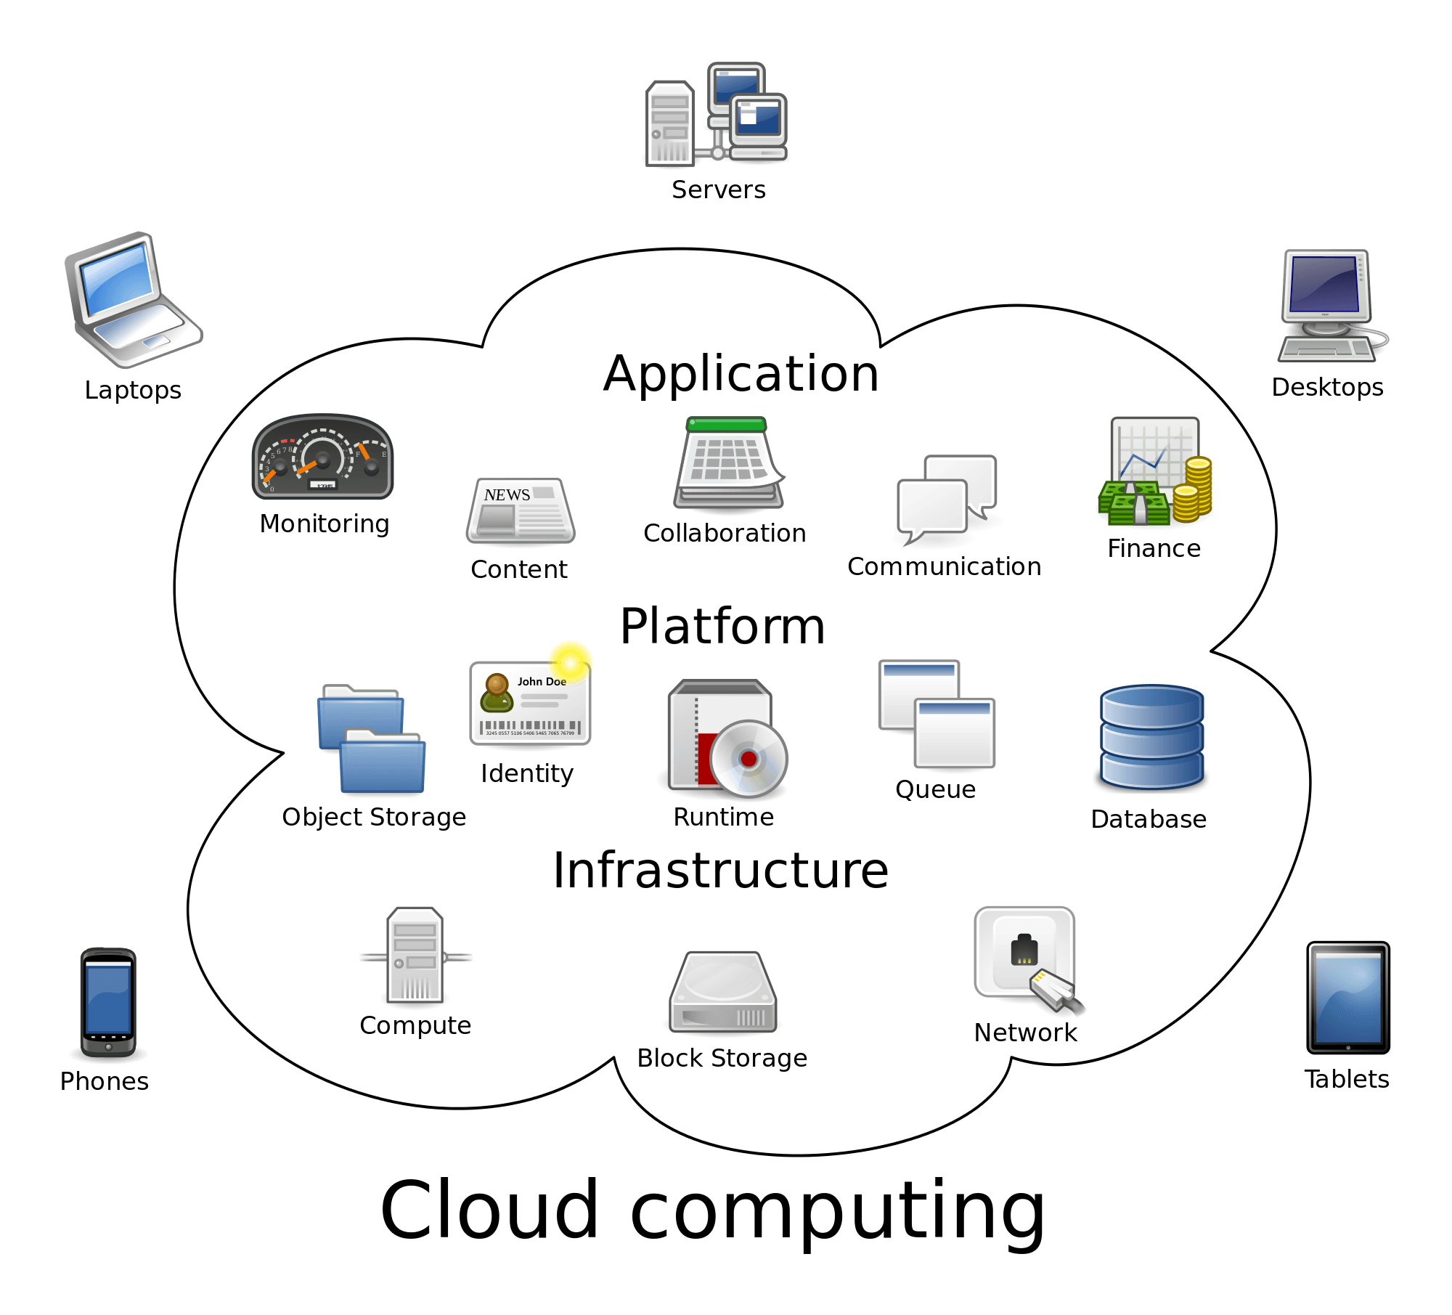
Cloud-Based System:
Services hosted out-of-house
24/7 Technical Support
Data Backup
Server Reliability
Available on any computer-connected device
High-Level System Security
Competitive Pricing Options
Notes:
Cloud-Based systems operate using a Service-Oriented Architectural model, which focuses on modularity, scalability, and accessibility
Servers are managed by another company which has 24/7 tech support, and they have the ability to be as large, or as small as you need them to be.

Slide 4
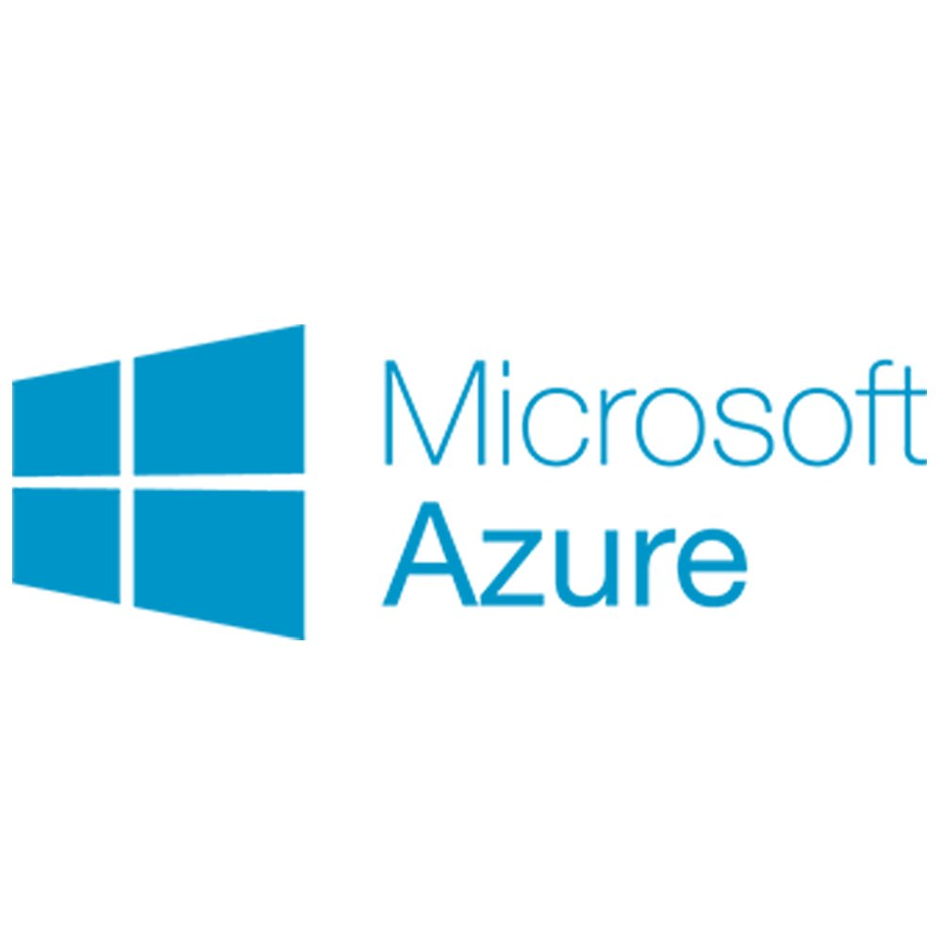
Microsoft’s Azure Cloud Services
Build your system, your way with support for a broad selection of Operating Systems and Programming Languages
The most trusted Cloud service provider with 50 different compliance offerings
Achieve Global Scale with availability in over 50 countries
Develop Mobile Apps easily with integrated development tools
Notes:
Microsoft’s Azure is a relatively new cloud-based service provider that has the most powerful security tools on any cloud system in the world.
Also, since this product is developed by Microsoft, it has tools and services that connect with your Microsoft Office products.
Azure also has the most comprehensive list of support for a variety of Operating Systems and Programming languages of any other cloud-based service.

Slide 5
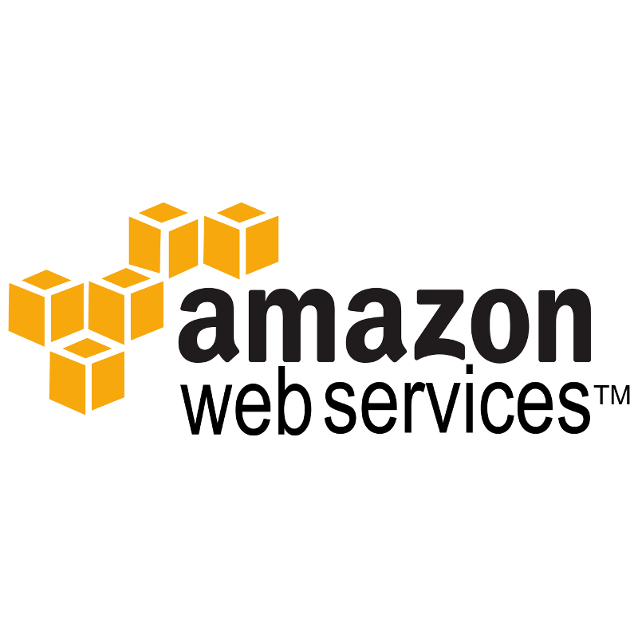
Amazon Web Services
A platform for virtually every use case
Innovative Features being improved on day by day
Compliance and Governance guaranteed with Audibility features
IT infrastructure trusted by over a million customers
Notes:
While Amazon’s Web Services may not seem as powerful as Microsoft’s at first glance, they have actually been around longer than Azure and have quite an impressive resume’ of services they offer to their even more impressive list of clients
Amazon’s Web Services also has high functionality, and is considered to be the most auditable of cloud-based services on the web.

Slide 6
Why Cloud Computing?
Cloud Computing operates using a service-oriented model, which focuses on providing ‘services’ that customers can pick and choose from as needed
These services are as scalable as system cans be. With the huge data centers that these services provide, any system can be as large or as small as it needs to be
Server maintenance and technical support provided by these companies, meaning there is no hassle with hiring and managing your own maintenance team
Pricing is based on what you need, not what you might need
Notes:
Among its other advantages, Cloud-based systems are modular, which allow you to change or update one service of the system without having to change the others. This makes changes to the system happen faster and get implemented faster as well.

Slide 7
Risks and Challenges
Cost: One of the main challenges with Cloud-Based systems is their reliance on businesses who offer their products at a high price
Due to its reliance on heavy data exchange, GUI based applications might have difficulty being implemented with Cloud services
Cloud services cannot provide asynchronous communication
Notes:
Like every system, Cloud Computing has its own set of risks and rewards, but I think its list of benefits far outweighs its few short-falls.

Slide 8
The Benefits of Cloud Computing
Pick and Choose the right services for your system
No Down-Time and Guaranteed 24/7 Technical Support
Quick Development Cycle for applications and systems
Modular, allowing parts of the system to be updated without having to change the entire system
While Cloud Computing might have a few risks, they are heavily outweighed by its overwhelmingly powerful benefits
Notes:
Cloud-Computing services have many benefits, including their focus on modularity, guaranteed support anytime and anywhere, accessibility from any internet connected device, and the ability to change what services your system offers with just a few clicks.

Slide 9
Final Thoughts
The rise of Cloud Computing has ushered in a new era of information availability
Cloud Computing’s pricing cannot be beat, especially when compared to the price of purchasing on managing your own servers
Many of the world’s largest internet based companies run on these services, including names like Netflix, DOW Jones, and Adobe
Cloud-based systems are easy to update, with updates going out instantly to all platforms, and maintenance made easy with modular services
Notes:
If you are still skeptical about Cloud-Computing and the benefits it might hold for your company, then I ask you to think about moving forward with your company into the future. Cloud-Based services are replacing hundreds of client-server based systems every day, and your company can either be left behind, or move into the future with one of the service providers that we talked about today.

Slide 10
References:
Microsoft. (). Chapter 3: Architectural Patterns and Styles. Retrieved from Microsoft, CSS422 - Software Architecture website.
Microsoft Azure: Cloud Computing Platform & Services. (n.d.). Retrieved from https://azure.microsoft.com/en-us/?v=17.14
Amazon Web Services (AWS) - Cloud Computing Services. (n.d.). Retrieved from https://aws.amazon.com/?nc2=h_lg

