Slide 1
The Move to Mobile Platforms
Presentation by Tyler Smith, 7/17/2017
MBL/400: Mobile Fundamentals
Prof. Earl Campbell

Slide 2
Why move to a mobile platform?
Since November of 2016, the mobile market has accounted for more than half of all internet usage
Mobile Apps are becoming standard for companies who are looking to connect with their customers in new ways
Mobile apps have many advantages in terms of functionality, because of the devices they function on
While mobile app development requires a bit of overhead to get started, apps for this market are surprisingly easy to develop
Notes:
Mobile internet usage has become the largest market for internet data usage, now accounting for more than half of all internet traffic.
Companies that fail to innovate in these changing times may get left behind
While mobile apps may seem intimidating, they are actually pretty straightforward to develop for and have a large support community for developers

Slide 3

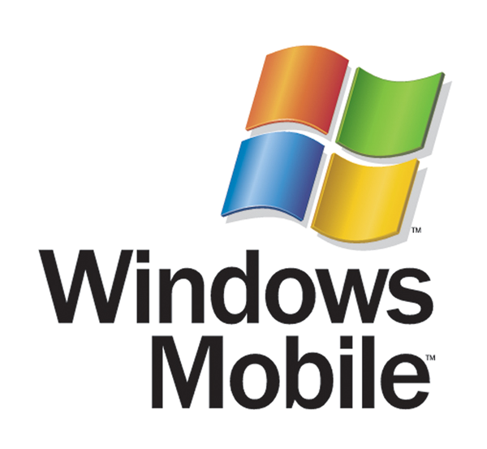
The Competition
Windows Mobile
Android
Runs on Win32
Not open source
Has the smallest market share (14% in 2009)
Popular among major cell phone retailers
Open-source and easy to develop for
Runs on Linux
Notes:
Windows Mobile has fallen behind in recent years, with only 14% in 2009 and down from 23% in 2004 (Analysis of Mobile Platforms)
Android is a popular open source choice, but theyhave a wide variety of phones being created with its operating system, which makes it a bit difficult to develop for

Slide 4
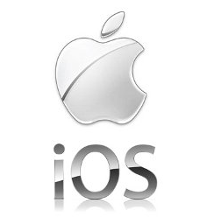
Apple’s iOS
Largest market share (33% in 2016)
Open-source SDK that is available for free online
Huge online community and support base
The standard for mobile app integration
Notes:
iOS has the most secure mobile market of the three, which claims over 33% of all mobile users in 2013 (9to5Mac)
While some compatibility issues may arise when developing for iOS, many of these issues have a variety of solutions that can be implemented to solve the issue

Slide 5
Why iOS is right for you
Huge market to start off in, with over 1/3 of mobile customers using Apple’s iPhones
Development is easy to start and open source
Can also be used on Apple tablets and personal computers
Support and Bug Fixes are easily handled in the App store
Notes:
With the largest market share, its easy to see that iOS will get your app to the largest amount of your customers.
These seem programs can be used on Apples tablets AND personal computers
Apple’s App Store provides tools to help developers send out patches and keep customer info up to date

Slide 6
References
Comparison and Analysis of Mobile Platforms. (n.d.). Retrieved from http://mobileplatforms.wikidot.com/
iPhone market share grows 6.4% in USA, takes share from Android in most markets. (2017, January). 9to5Mac, (), . Retrieved from https://9to5mac.com/2017/01/11/ios-market-share-kantar/
Mobile internet usage surpasses desktop usage for the first time in history. (2016, November). BGR, (), . Retrieved from http://bgr.com/2016/11/02/internet-usage-desktop-vs-mobile/

