Slide 1
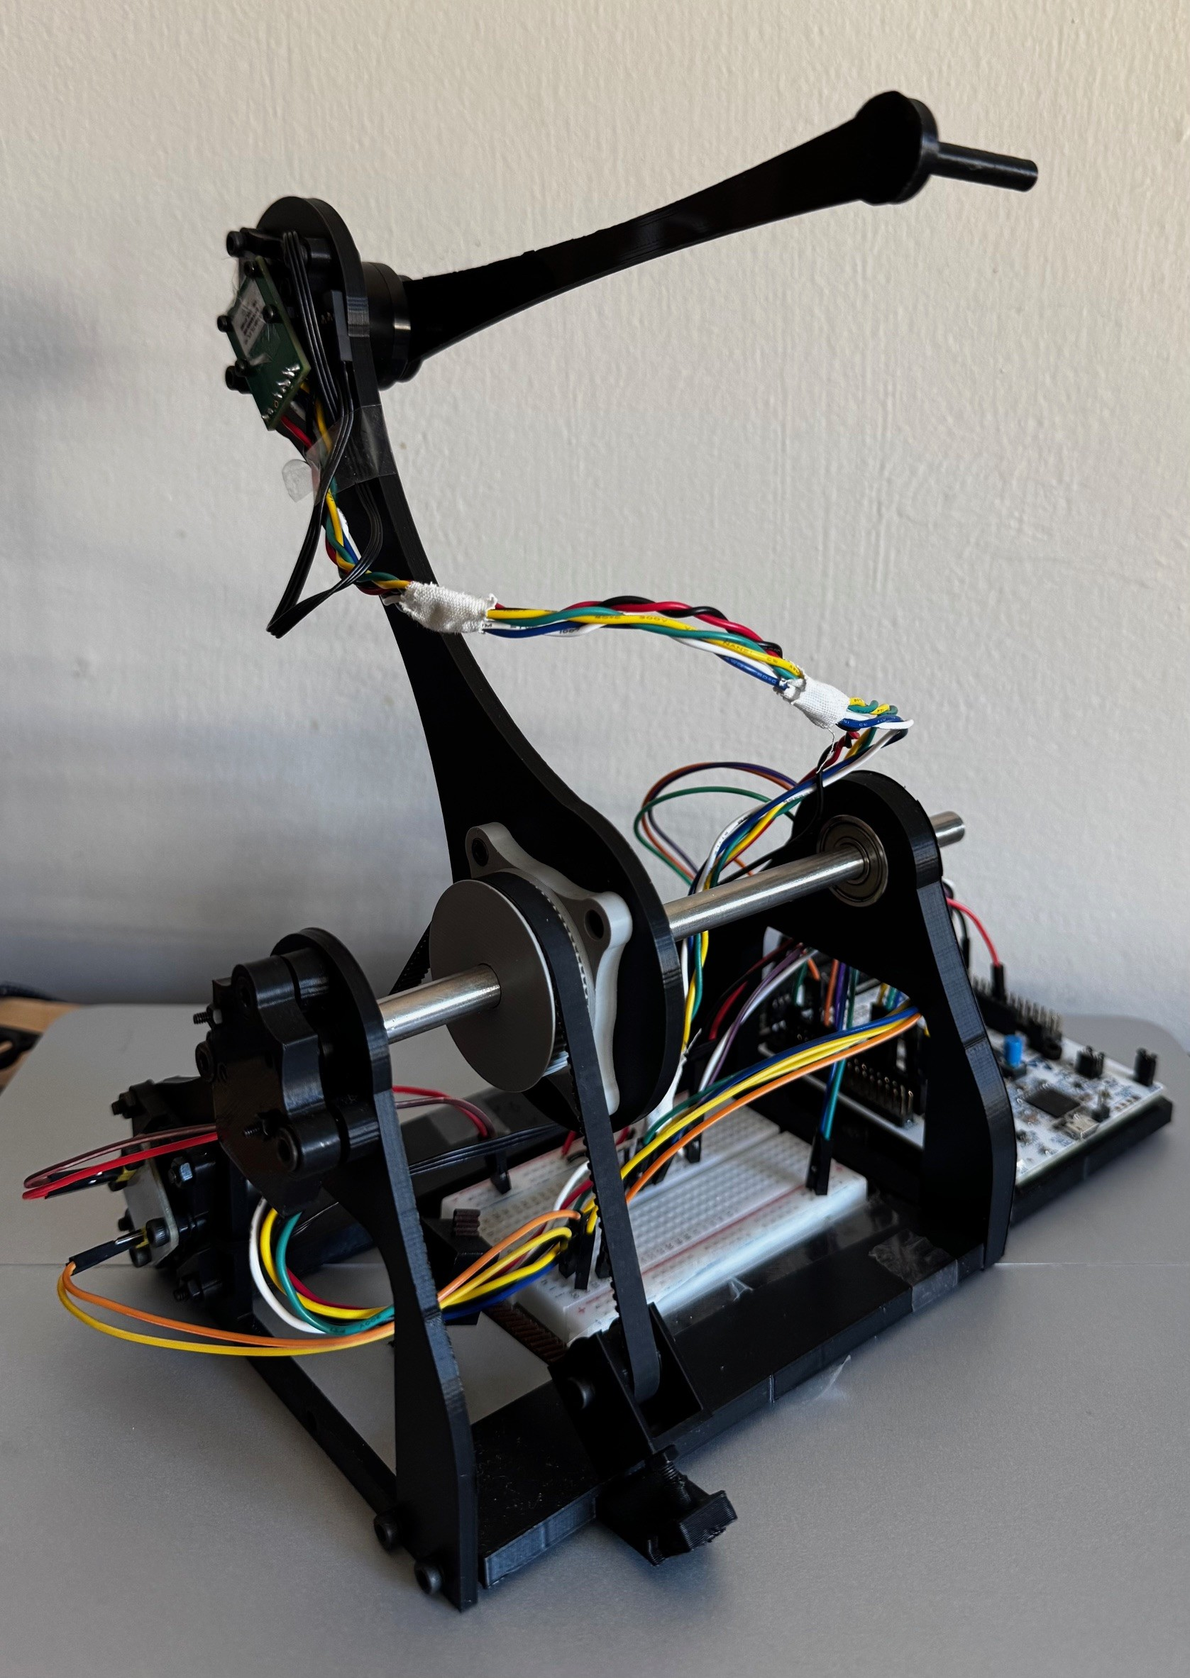
Real-Time Haptic Rendering System
Low-cost bidirectional force feedback for virtual robotic interaction
Final Demonstration / Presentation
A complete low-cost haptic loop, built and measured end to end.
- 12 minute technical presentation
- 3 minute hybrid live demo
- Prepared fallback media and quantitative evidence
1

Slide 2
Assessment Target
The presentation must show clear objectives, technical achievement, evidence, and confident answers.
- Handbook limit: 15 minutes maximum, then up to 15 minutes questions
- Main claim: bounded usable haptic interaction was achieved with low-cost hardware
- Main insight: communication delay, not host computation, limits fidelity
Story: build the full loop, measure it, and be honest about the limits.
2

Slide 3
Report Objectives
These six objectives match the dissertation objective set in the Introduction.
Objective (i)
Objective (iv)
Build a physical haptic interface below GBP200 with joint sensing and actuator torque-command capability.
Validate rendered contact quantitatively using force-penetration data, with fitted stiffness within 5 percent of the configured coupling value.
Objective (ii)
Objective (v)
Achieve reliable host-device exchange at 1 kHz, assessed by receive rate, packet loss, out-of-order events, and RTT.
Verify force saturation, embedded torque limiting, slew-rate limiting, and watchdog torque removal during communication interruption.
Objective (iii)
Objective (vi)
Show host computation is not the dominant bottleneck by measuring mean closed-loop host latency below 1 ms.
Evaluate motor-enabled contact and constrained motion, reporting penetration bounds, command consistency, and multi-axis limitations.
Scope note: final motor-enabled force-feedback validation was limited to one joint after actuator failure.
3

Slide 4
End-to-End Architecture
The technical contribution is integration across hardware, firmware, communication, simulation, and rendering.
Device
Joint sensing
BLDC torque output
Firmware
STM32 + SimpleFOC
watchdog + slew limit
Serial Link
Packet protocol
COM4, 460800 baud
Host App
C++17 threads
OpenGL + PhysX + haptics
Feedback
Jacobian torque map
force returns to user
- Haptic and device loops target 1 kHz
- PhysX simulation and visualisation are decoupled from haptic rendering
- Snapshot channels avoid stale queue buildup under bursty packet delivery
4

Slide 5
Physical Prototype
A custom two-link planar interface was built around low-cost sensing and BLDC actuation.
- Two-link planar mechanism with magnetic encoders
- BLDC gimbal motors with belt-driven base joint for torque amplification
- STM32 Nucleo-G431RB firmware with watchdog torque removal
- Designed for experimental transparency rather than commercial polish
5

Slide 6
Haptic Rendering Implementation
Contact is rendered with a proxy method and virtual spring-damper coupling.
- Signed distance functions identify surface penetration and normals
- A proxy is constrained to the surface during contact
- Virtual coupling force: F = K(x_p - x_d) + D(v_p - v_d)
- Cartesian force is mapped to actuator torque using tau = J^T F
Practical stability comes from damping, saturation, slew limiting, and latest-state communication.
6

Slide 7
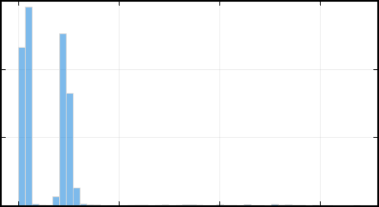
Communication and Host Timing
The system achieved throughput near 1 kHz, but round-trip delay dominated the loop.
- Packet streaming at about 1 kHz in the tested configuration
- Measured RTT: 15.60-15.67 ms across tested intervals
- Host-side processing: 0.299 ms mean, 2.04 ms at 99th percentile
- Conclusion: transport delay is the bottleneck, not host computation
7

Slide 8
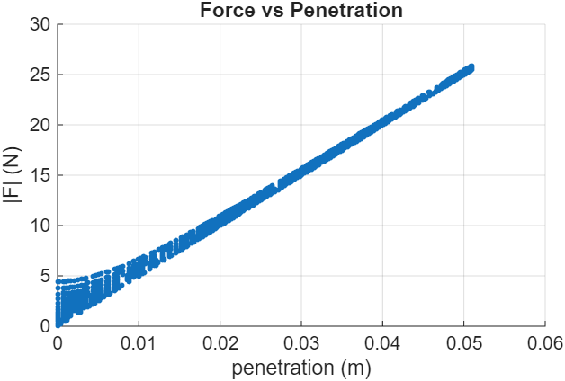
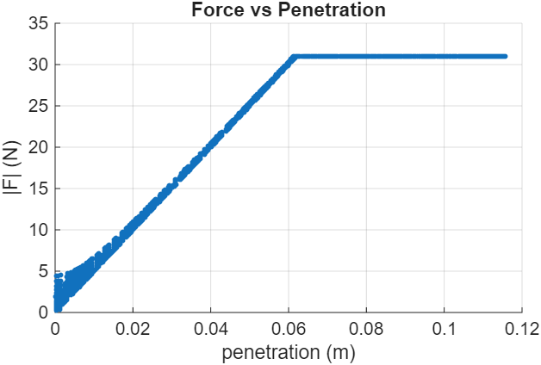
Contact Model Validation
Logged rendered-force data matched the configured virtual coupling stiffness closely.
- Configured stiffness: 500 N m^-1
- Fitted stiffness: 489.57 N m^-1
- Fit quality: R^2 = 0.9973
- Deep penetration force saturation occurs at about 31 N
Evidence slides use local report figures copied into assets/.
8

Slide 9
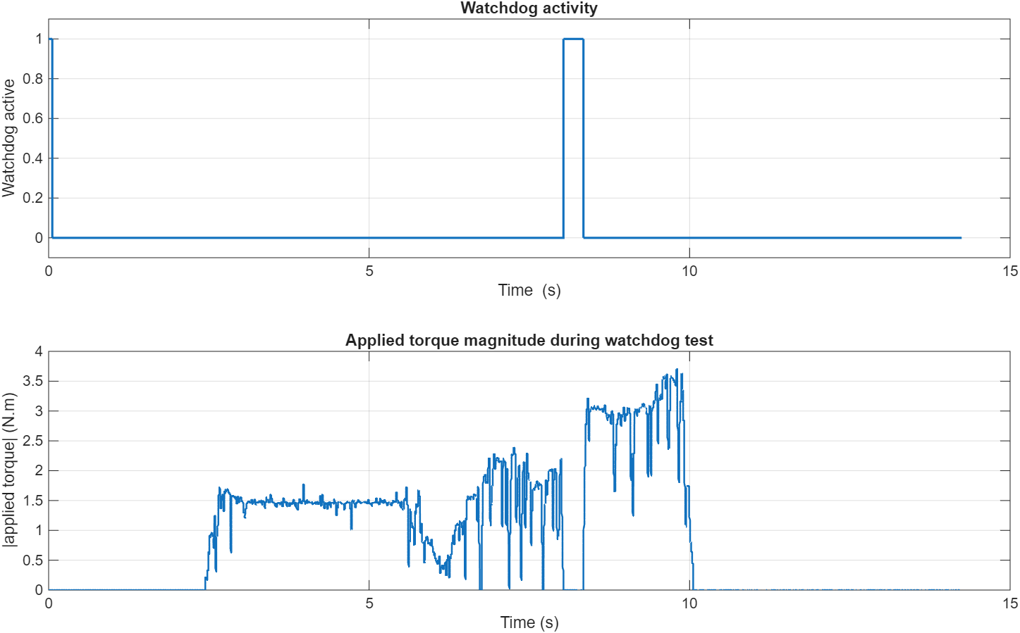
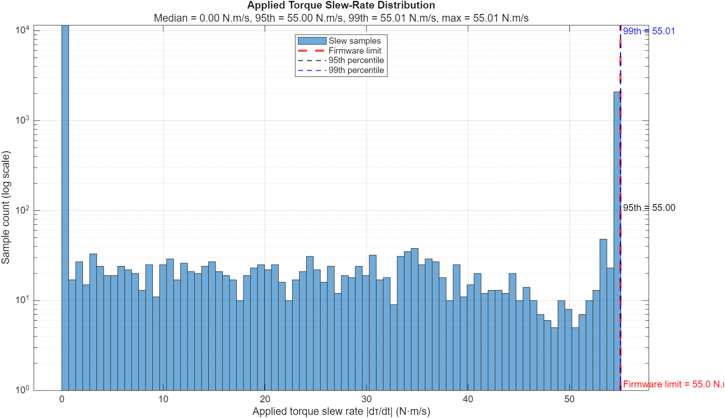
Safety Validation
The device was evaluated with explicit limits for force, torque change, and communication loss.
- Force clamp limits commanded interaction force
- Firmware torque slew-rate bound: about 55 N m s^-1
- Watchdog removed torque during interrupted host command transmission
- Safety controls are central because latency can excite contact oscillations
Evidence slides use local report figures copied into assets/.
9

Slide 10
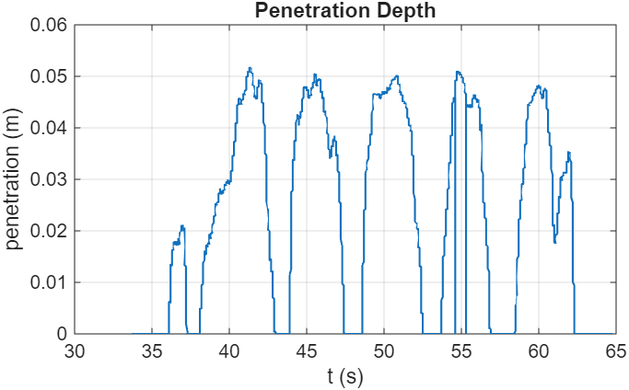
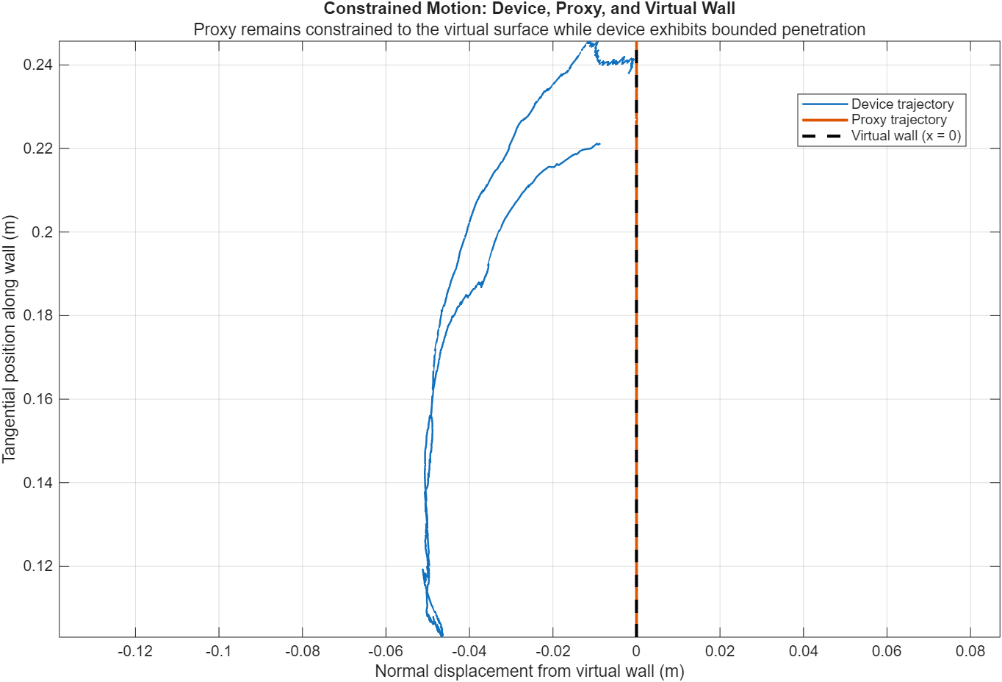
Hardware Interaction Results
Motor-enabled tests showed bounded contact and constrained motion within final hardware limits.
- Repeated contact with a virtual wall showed bounded penetration
- Constrained-motion test kept the proxy aligned to the virtual wall
- Results support usable interaction, not calibrated commercial-grade force rendering
- Generalisation to full 2-DOF feedback remains limited by final actuator state
Evidence slides use local report figures copied into assets/.
10

Slide 11
Critical Discussion and Future Work
The project succeeds as a measured prototype and identifies the next engineering bottlenecks.
- Dominant limitation: ST-Link virtual COM buffering/scheduling delay
- Hardware limits: finite torque, no current sensing, belt slip, one-axis final actuation
- Next step: lower-latency transport through native USB, dedicated USB-UART, CAN, or Ethernet
- Then add current sensing, improved transmission, restored 2-DOF actuation, and user/task studies
The most useful result is knowing where the system actually fails.
11

Slide 12
Final Demonstration Handoff
Live demo first; fallback media ready so the assessment stays focused on evidence.
- Live path: launch build\Debug\app.exe and show tool/proxy/contact behaviour
- Show gentle contact with the virtual wall/object and bounded response
- Fallback path: assets/fallback_kinematics_demo.mp4 plus result plots
- Do not recompile, flash firmware, or debug live for more than about 20 seconds
Closing line: the loop is working, instrumented, and bounded; fidelity is limited by measured transport delay.
12

