Slide 1
Migration in the Mediterranean
Tyler Wilson

Slide 2
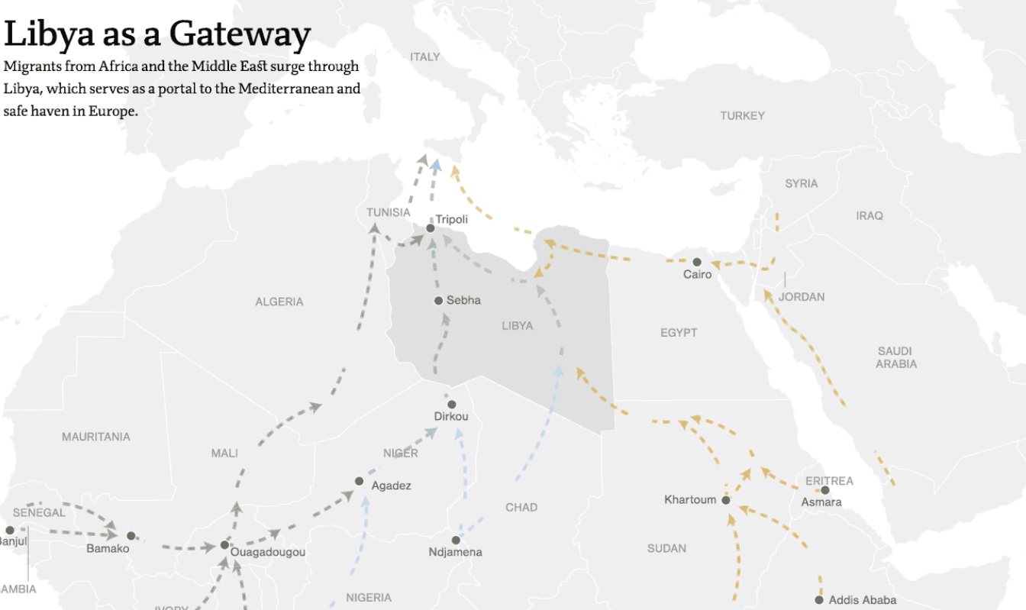
Why are there so many immigrants?
Graph from:
MSNBC

Slide 3
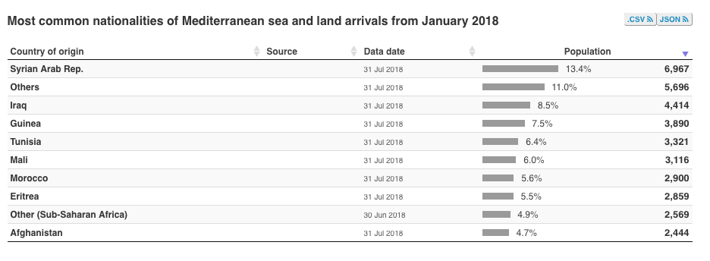
Why are there so many immigrants?
Graph from:
UNCHR

Slide 4
Migrant Numbers
In 2017 172,301 refugees arrived on the coasts across southern Europe.
In 2018 60,000 have arrived thus far.
17,000 migrants have either died or gone missing at sea since 2014.

Slide 5
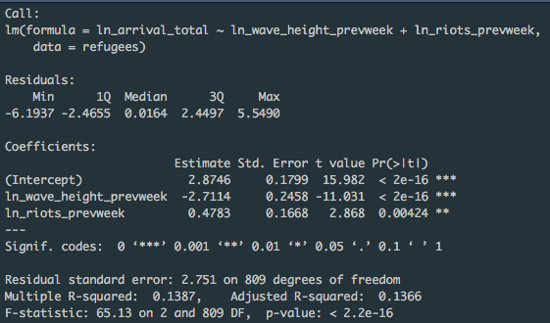
Quick Regression Analysis
Wave Height and Riots both significant impact on total arrivals

Slide 6
Migrant Death Rate at Sea

Slide 7
Mediterranean Wave Height

Slide 8
Combined plot

Slide 9
What do we do?
Governments and NGOs can expand on the methods used to save and prepare for immigrants.
Know when to look for migrants at sea.
Know when to expect larger total arrivals of migrants.

