Slide 1
Transact Games Proposal
By Tyler Nullmeier

Slide 2

Idea
Allow users to trade video games online
Notes:
People who play video games find themselves with an increasing number of games they have completed, or are no longer interested in. Some retailers allow people to trade their games for cash; however, these trades are often skewed more in favor of the retailer. My proposal is to supply a service that allows people to trade their games directly, game for game, with other people.

Slide 3
Supply and Demand
A Web Search reveals:
Only two similar services exist
There is demand for such a service
One of the services is user-driven
Notes:
A search for, “online video game trading,” yields many results; however, most of the results refer to a service where users trade games for money. My proposal is specifically focused on trading one game for another game. There were only two services on the first ten pages of the search that were the same as mine. Of those services, one was a large, user-driven service (https://www.reddit.com/r/gameswap/). Consequently, demand for such a service is high; however, the service needs an attractive business model to compete.

Slide 4
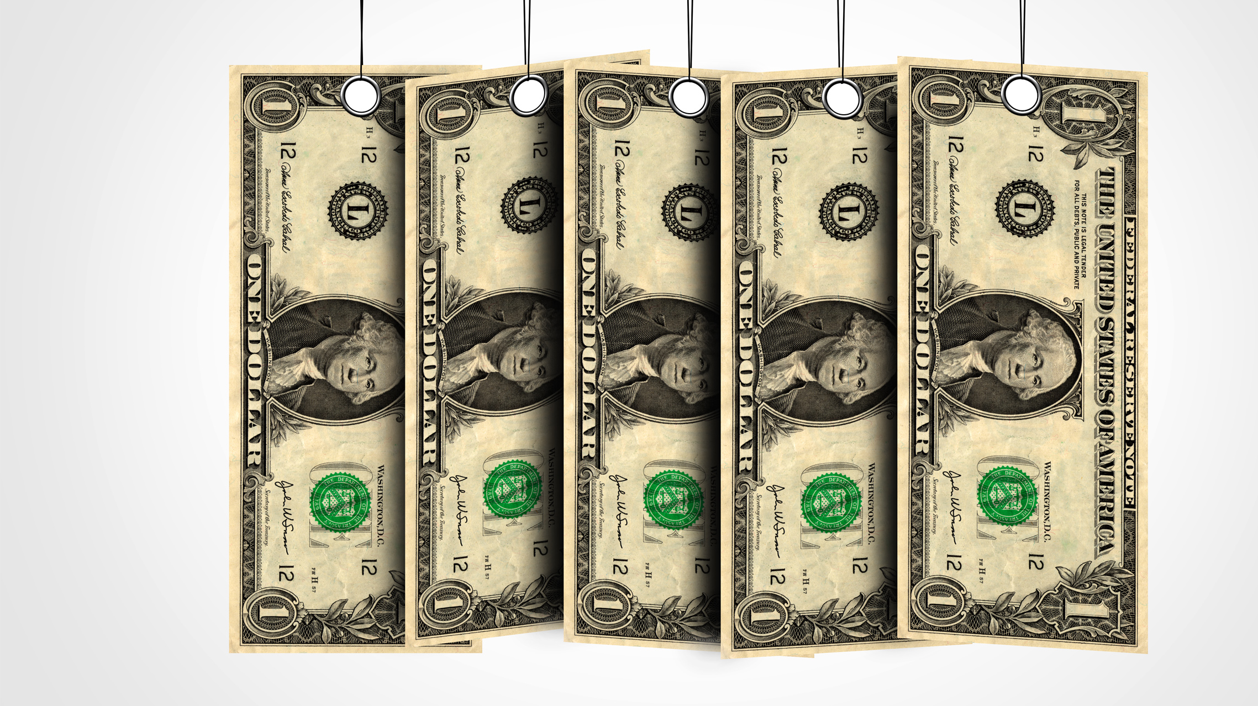
Business model
Subscription-based
Recurring payment
Users ship their games in before trades occur
Around $3-5 per month is the target price point
Notes:
The site will be a subscription service. The aim is to allow users to trade as many games as they would like while they are paying the fee. Before a trade will occur, however, the user must ship their game to us. This is necessary to ensure that users are not abusing the trading service by trading the incorrect game, or by trading empty cases.

Slide 5
Business Pros and Cons
Pros
Cons
Allows people to trade old games
Less overhead cost to customers than game trade-ins
Requires staff to check quality of games sent in
Requires facilities to keep an inventory of games
Potential for abuse
Using service to store games
Notes:
This service would be attractive to customers because it would allow people to trade old games. Additionally, this service would allow customers to trade their games without as much overhead as game trade-in services. In other words, rather than trading in a game and getting 30% of it’s value, the customer trades one game for another; therefore, this service allows customers to leverage the full value of their games.
Some of the drawbacks of offering this service include the requirements of staff and facilities to check the quality of games and store the games, respectively. These two issues are mitigated by the monthly subscription fee. Another problem is the potential for users to send in all their games and use our service as a game storage service. This could be prevented by introducing a maximum on the number of games that the user can have attached to their account at a time.

Slide 6
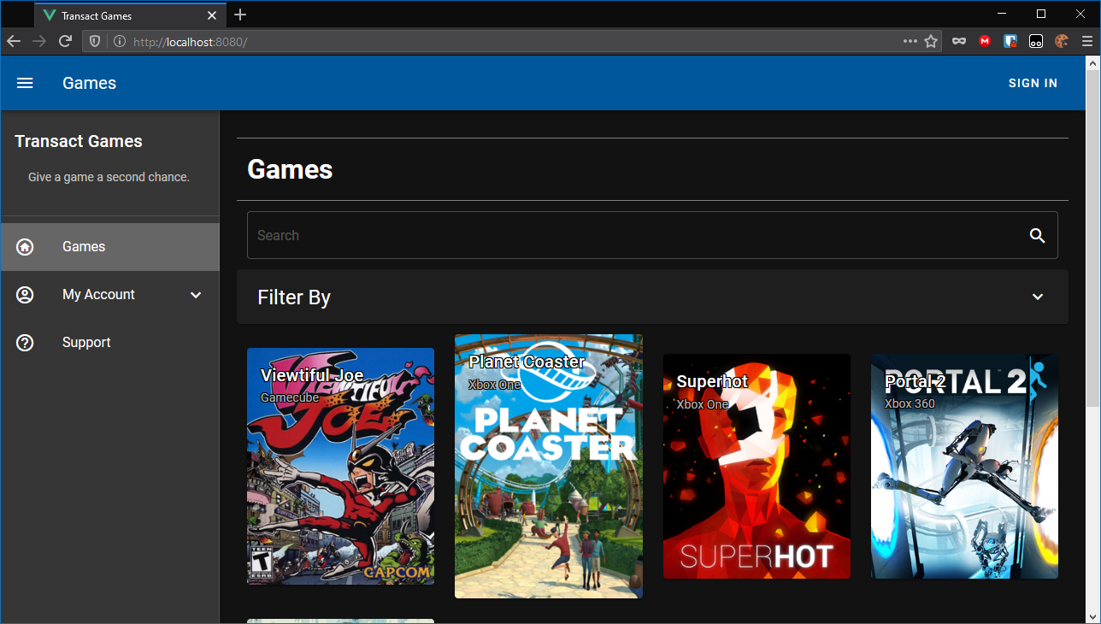
What is in it for the user?
An easy-to-use service available through a web browser
Use on a smartphone or a PC
Notes:
As more services shift towards phone apps, Transact Games offers a website that feels like an app. On the website, users can browse and trade games from their phone or their PC.

Slide 7
Here is what users can expect from Transact Games.

Slide 9
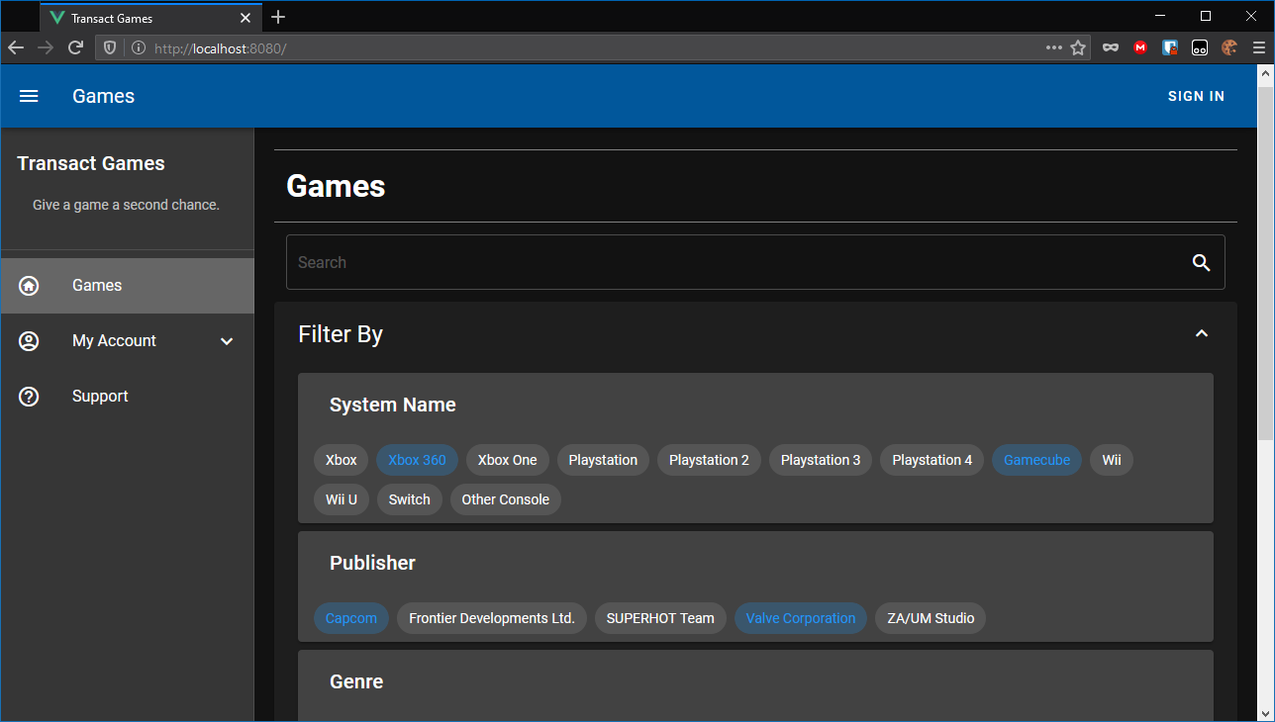

Slide 10
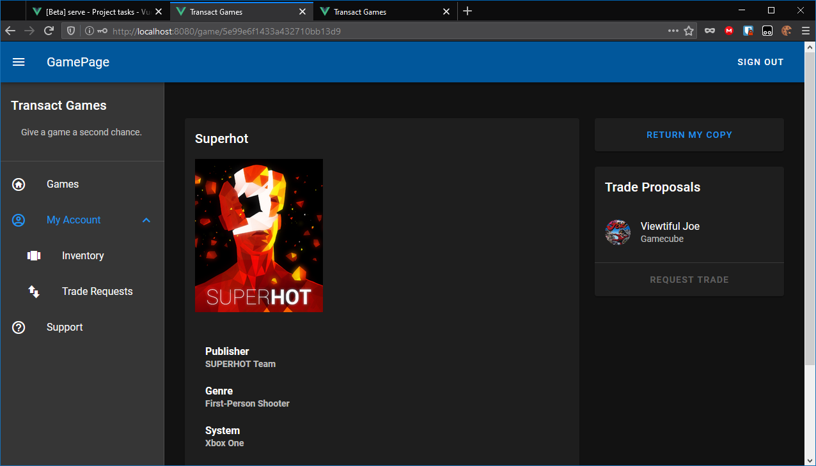

Slide 11
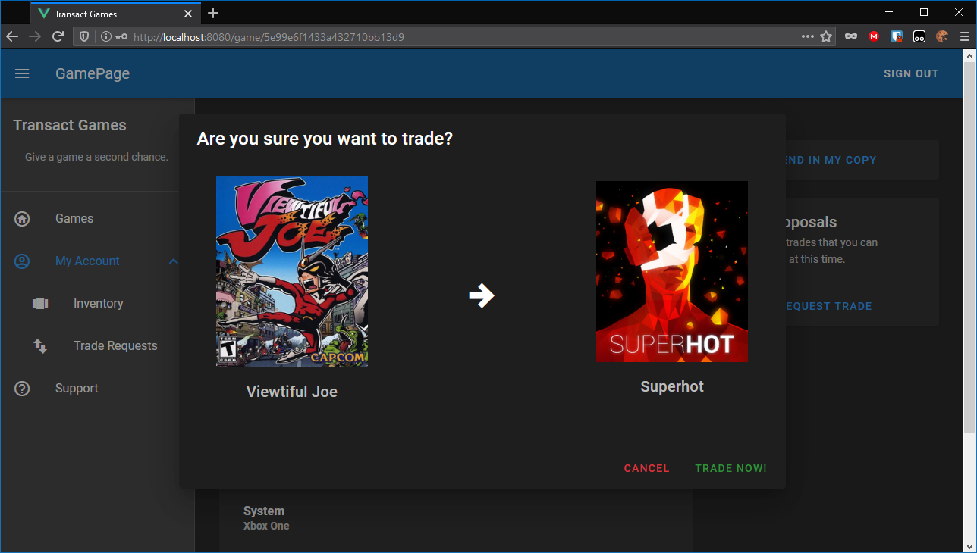

Slide 12
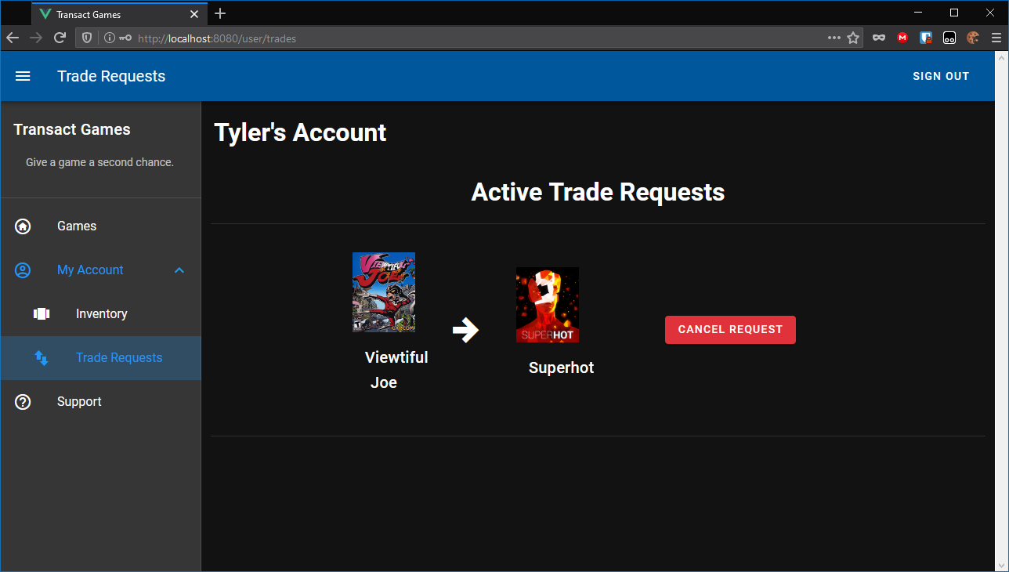

Slide 13
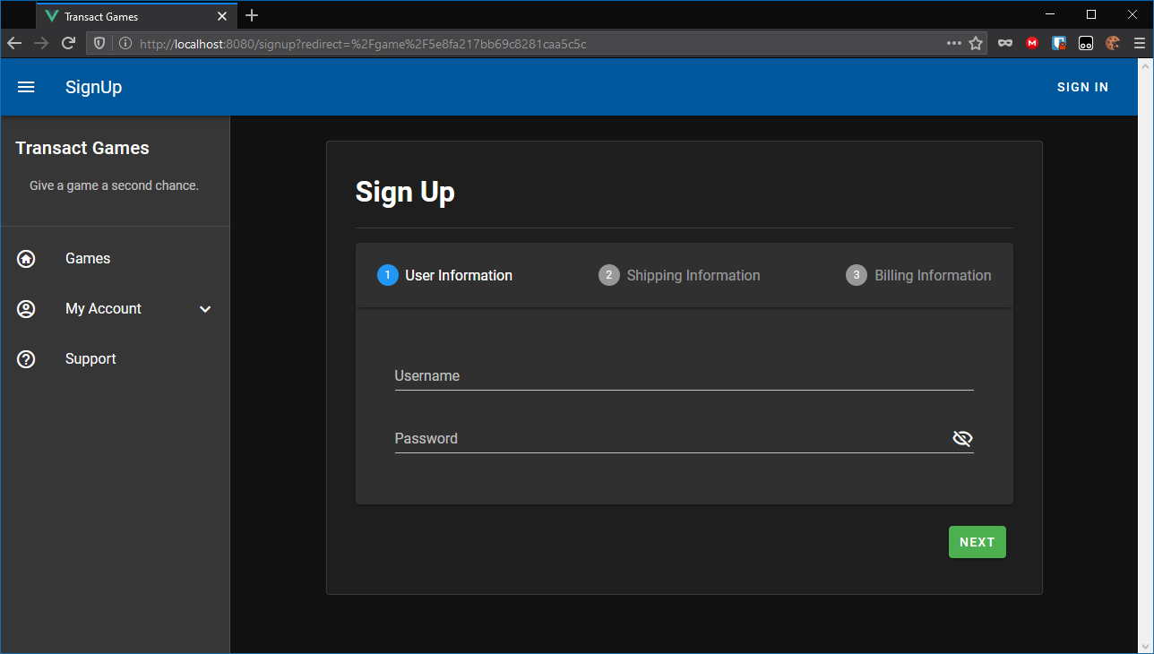

Conclusion
The concept of organized game trading is one that exists in an informal form
Transact Games offers the same service in a more organized manner
Notes:
The concept of organized game trading is one that exists in an informal form on reddit and other social media platforms. Transact Games entices users by offering them the same service in a more organized manner.

