Slide 1

A/B Test Results
By Tyler Barrow
Growth Product & Engineering Team, GloBox

Slide 2
Project Context
Duration of test | Jan. 25th to Feb. 6th
Approach | Provide a/b test results
Primary Hypothesis | A > B
Data Collection and Storage | Gathered separately to database
Sample Size | 48,943, A: 24,343, B: 24,600

Slide 3
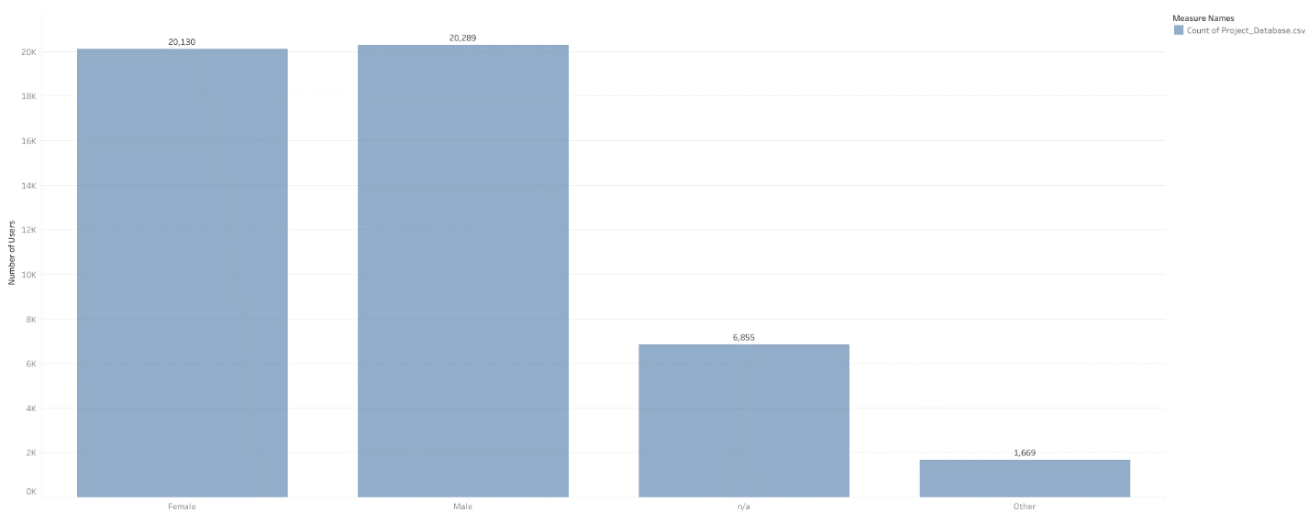
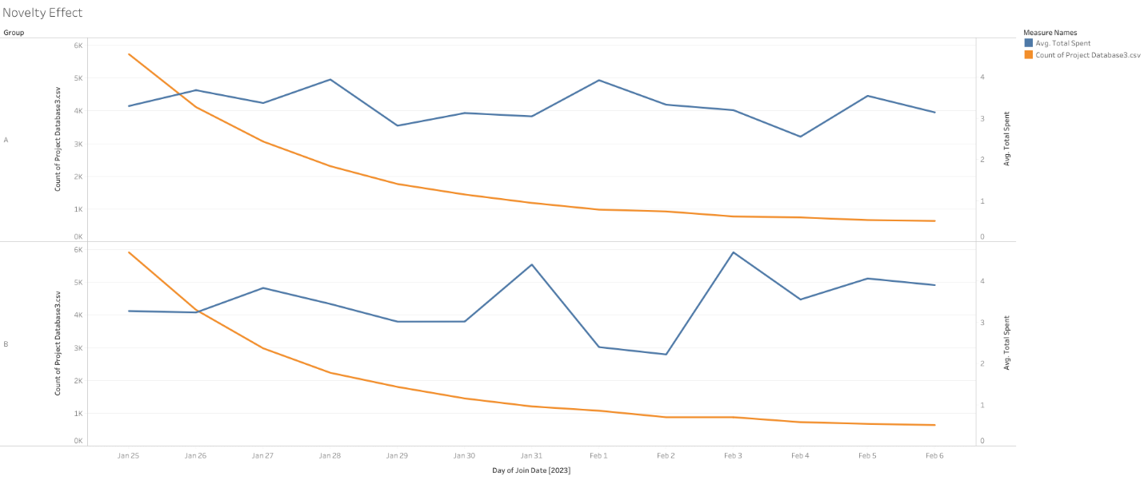
Determining the Validity of Data Utilized
Novelty Effect was not a factor.
Evenly distributed female and male users.
Power analysis was not significant enough to invalidate a/b test.

Slide 4
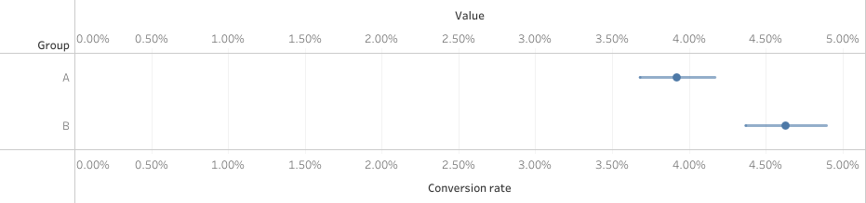
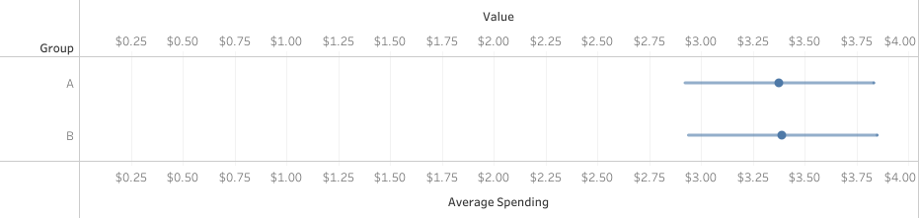
A/B Testing Results
Average spent per user is statistically insignificant
Conversion rate is statistically significant
Practical statistics shows us a more so significant difference

Slide 5
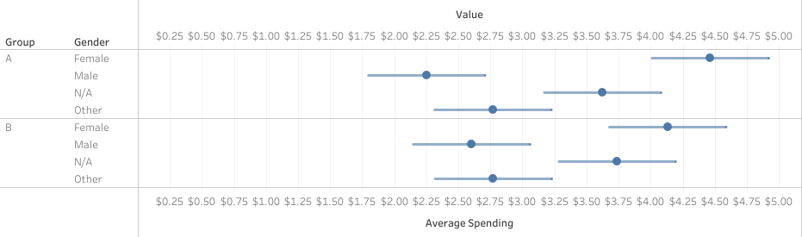
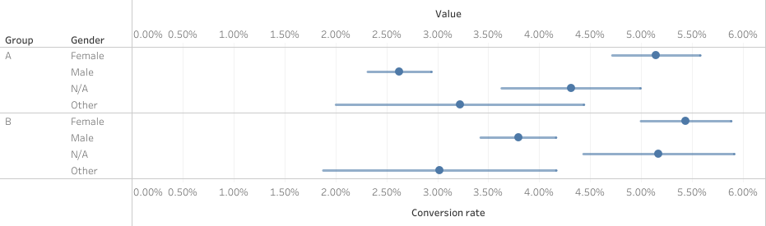
Gender’s Effect on A/B Testing Results
Females are our highest revenue and conversion demographic
The test did not affect this demographic in the same way
We need to focus on improving this metric
Female versus Male conversion rates and average spent per user is a significant difference
Comparison of Female and Male is due to Other and N/A not having a large enough sample size.

Slide 6



Recommendations and Next Steps
Female demographic is where majority of our revenue comes from.
I recommend next steps to be:
Marketing team to create new advertisement that resonates with our female clientele.
Utilize new marketing to hold another A/B test
Expenditure for this would be inexpensive due to already having technology in place
Compare new A/B test to the old

