Slide 1
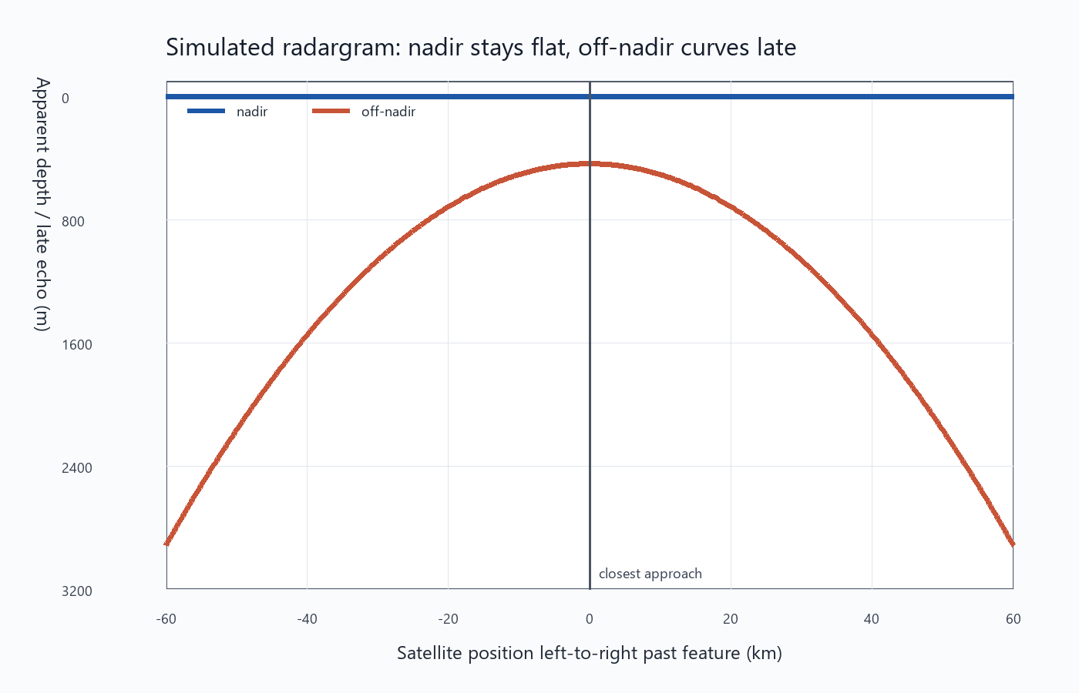
PREDICTION
01
My prediction: off-nadir clutter can look like a real 440 m layer.
The key test is whether the same side-looking geometry also predicts the delay, phase, radargram shape, and Doppler/PRF behavior.
SIDE OFFSET
FALSE DEPTH
MIN PRF
Replotted radargram-style prediction: nadir stays flat; off-nadir curves.
25 km
438.5 m
890 Hz
Horizontal, not altitude.
Matches the 440 m idea.
Simple Doppler Nyquist.
Cleaned deck uses the replotted graph set and adds the missing evidence slides.

Slide 2
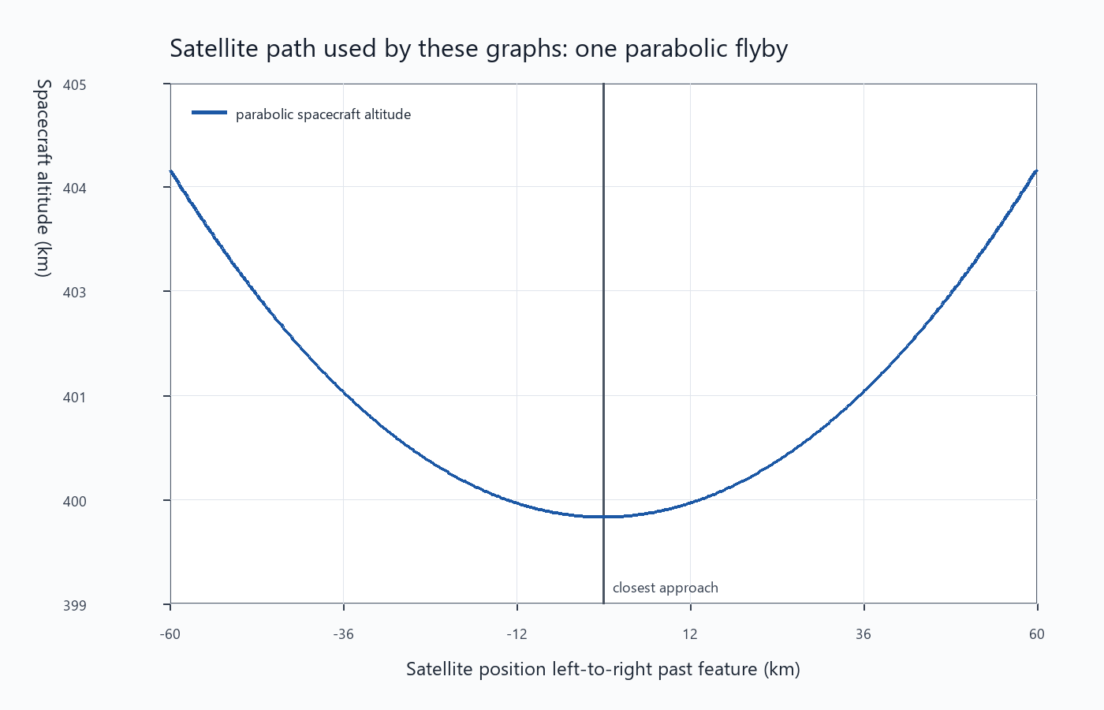
GEOMETRY
02
The side offset alone can create the false-depth signal.
Geometry math
R_off(x) = sqrt(z(x)^2 + y^2)
R_nadir(x) = z(x)
extra range = R_off - R_nadir
x = along-track position
z(x) = satellite altitude along the parabolic pass
y = 25 km cross-track offset
R = one-way distance from radar to reflector
At closest approach, the off-nadir echo travels farther even if the reflector is on the surface.
Parabolic flyby: closest approach is 400 km, with a 25 km cross-track return.
Local replotted graph outputs; model values from project summary JSON files.

Slide 3
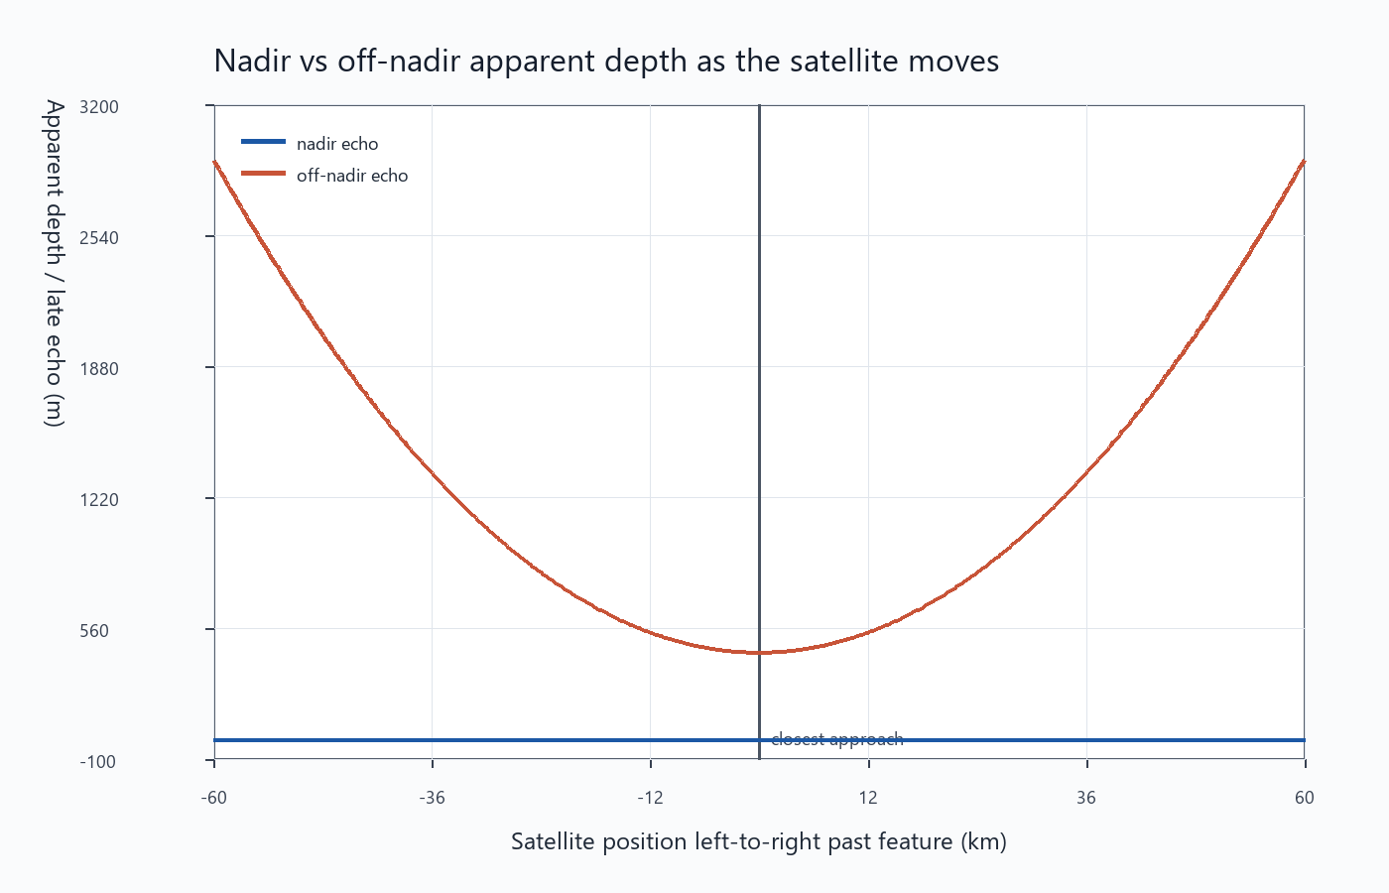
APPARENT DEPTH
03
The off-nadir surface echo lands almost exactly at the candidate depth.
Depth conversion
d_app = (R_off - R_nadir) / n_ice
= 780.5 m / 1.78
= 438.5 m
d_app = apparent ice depth
n_ice = ice index of refraction
R_off - R_nadir = extra one-way air path from the side-looking surface return
That is why a surface feature 25 km sideways can masquerade as a ~440 m layer.
Nadir remains near zero apparent depth; off-nadir forms the predicted curved false layer.
Local replotted graph outputs; model values from project summary JSON files.

Slide 4
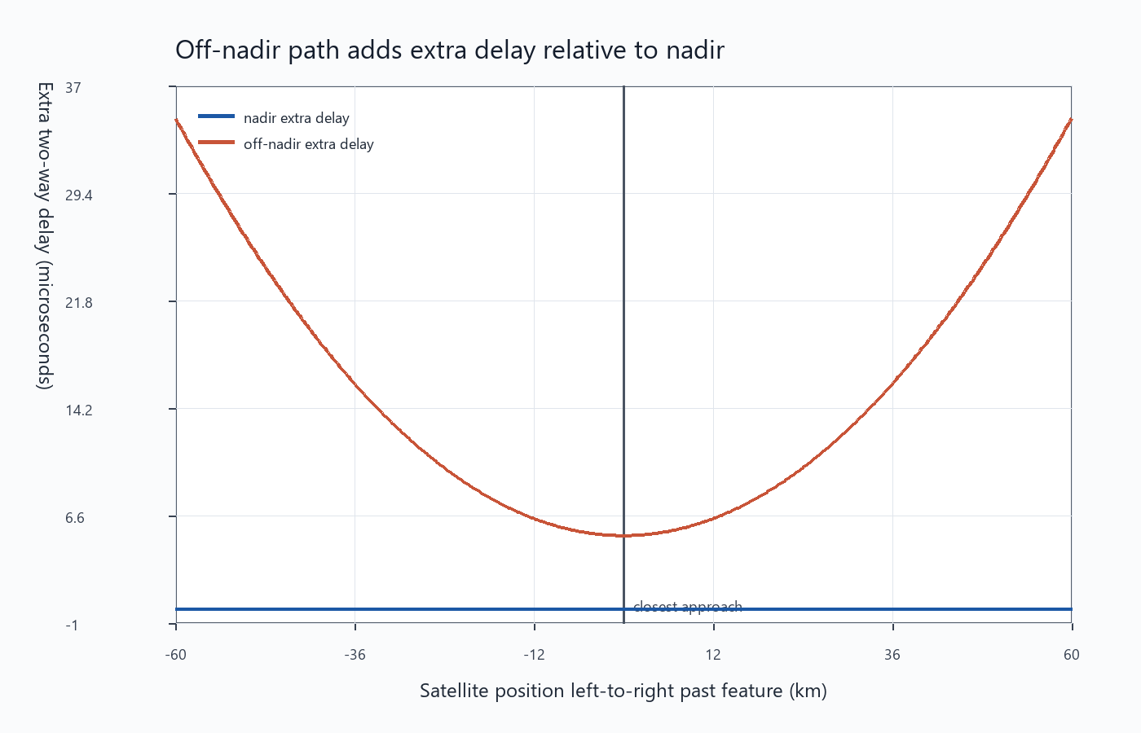
ECHO DELAY
04
The same geometry predicts the extra return time.
Two-way delay
Delta t = 2(R_off - R_nadir) / c
Delta t = 2(780.5 m) / c
Delta t = 5.21 us
Delta t = extra echo arrival time
c = speed of light in air
factor 2 = radar signal travels out and back
The delay and the apparent depth are the same prediction written in two radar units.
Extra delay peaks at closest approach because the off-nadir path is longest relative to nadir.
Local replotted graph outputs; model values from project summary JSON files.

Slide 5
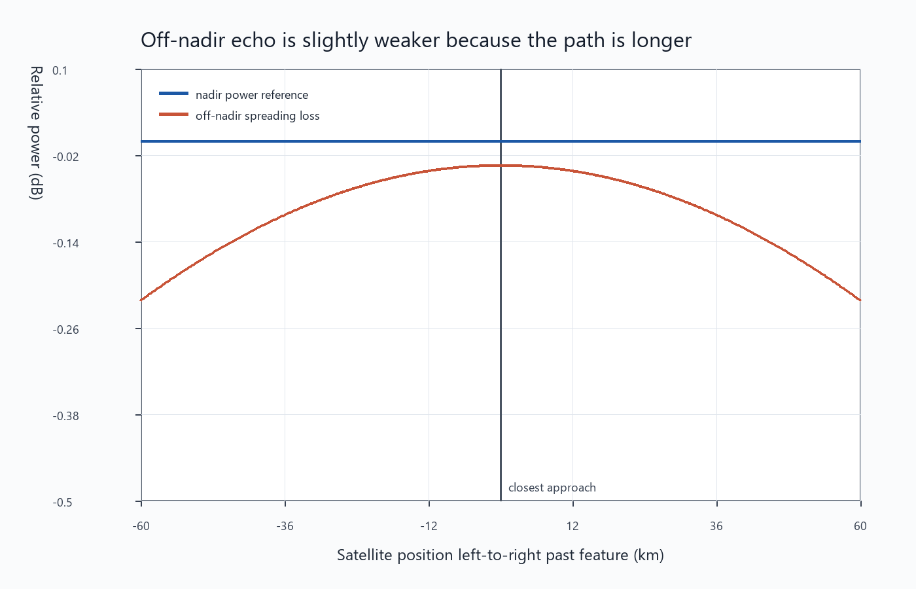
RETURN STRENGTH
05
Geometry alone does not make the clutter disappear.
Power check
relative power ~ (R_nadir / R_off)^4
loss near closest approach:
-0.034 dB
The fourth power is the two-way spreading approximation: out path and return path both matter.
INTERPRETATION
Power is not the blocker
The graph says the side-looking surface return could still be visible if the terrain/beam response supports it.
The modeled spreading loss is tiny for 25 km sideways compared with 400 km altitude.
Local replotted graph outputs; model values from project summary JSON files.

Slide 6
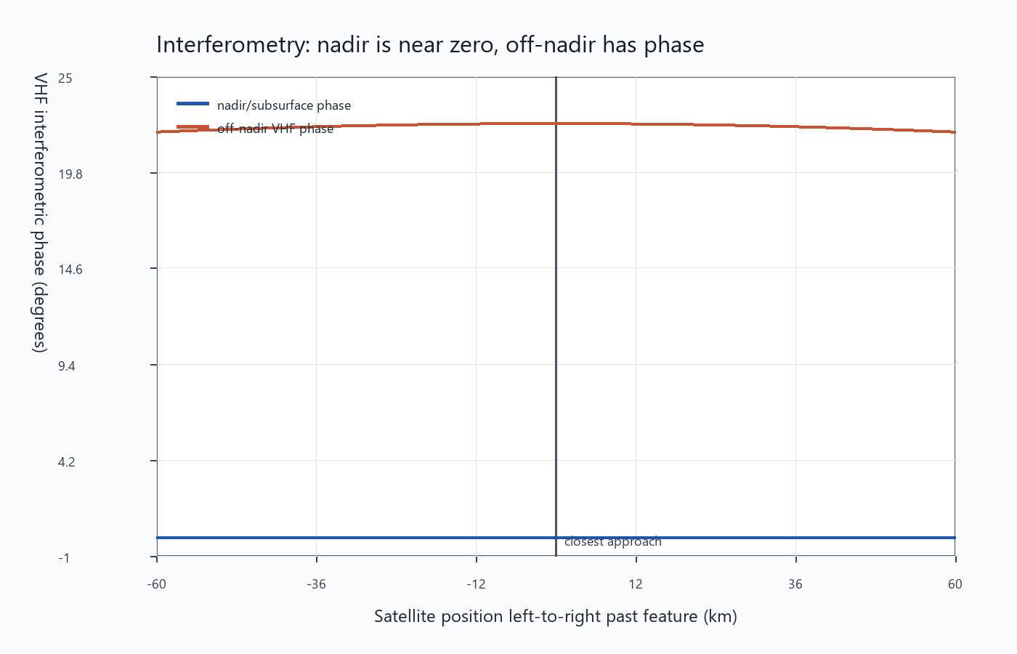
PHASE
06
The off-nadir echo should have a nonzero interferometric phase.
Phase relation
phi = 2*pi*(B/lambda)*sin(theta)
theta = atan(y / z)
phi ~= 22.5 deg
phi = interferometric phase
B = antenna baseline
lambda = radar wavelength
theta = look angle from nadir
If the candidate is clutter, phase should point sideways instead of behaving like a nadir layer.
VHF phase is near zero for nadir and nonzero for the side-looking return.
Local replotted graph outputs; model values from project summary JSON files.

Slide 7
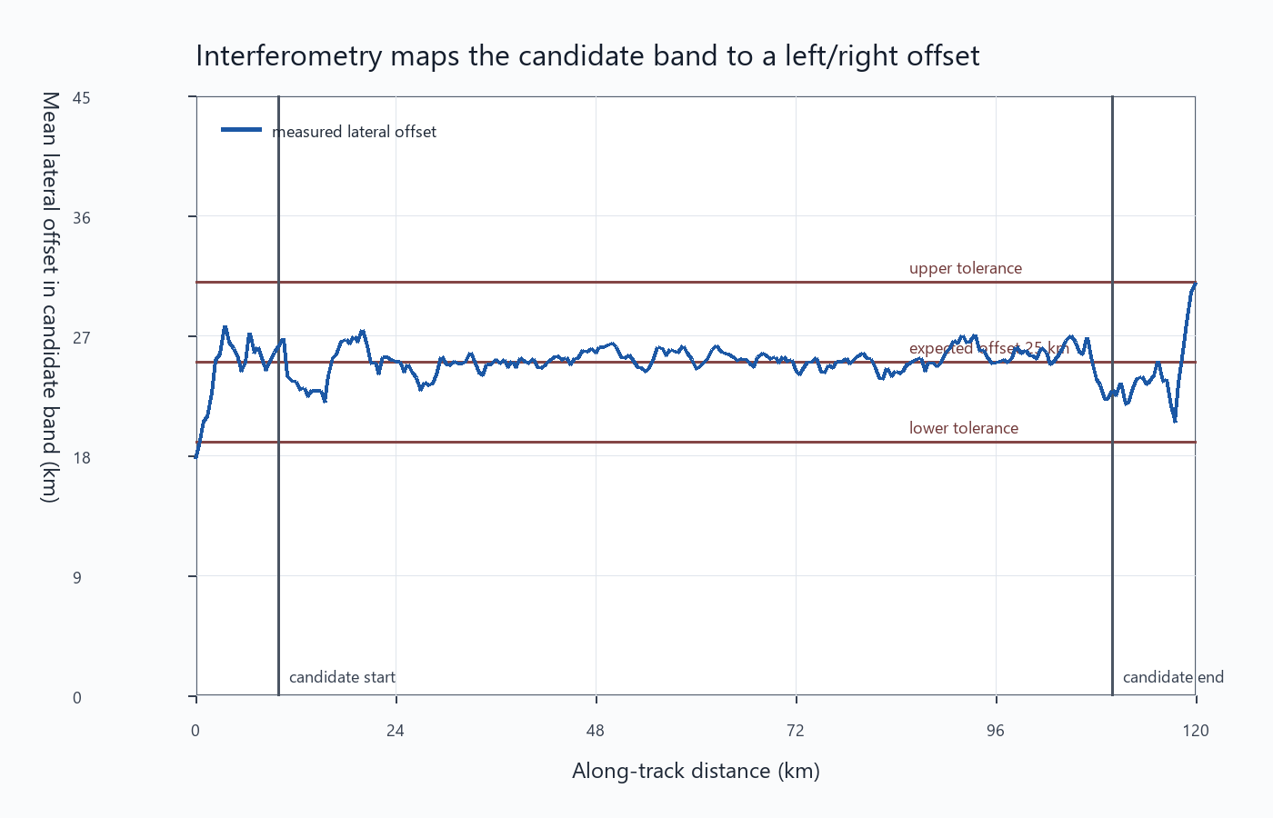
INTERFEROMETRY CHECK
07
The phase-derived offset should cluster near 25 km.
Offset inversion
theta = asin(phi*lambda / (2*pi*B))
y_est = z*tan(theta)
mean y_est ~= 25.1 km
theta is recovered from phase.
y_est is the cross-track position implied by the interferometric measurement.
This gives a falsifiable test: the phase should recover the same side offset that creates the false depth.
Cleaned graph: the inferred offset stays close to the 25 km prediction.
Local replotted graph outputs; model values from project summary JSON files.

Slide 8
RADARGRAM SIGNATURE
08
A clutter trace should curve with flyby geometry, not stay flat like a layer.
The replotted radargram-style view is the most professor-friendly evidence slide.
How to say it: the orange off-nadir feature has the shape of a moving surface reflector; a real horizontal subsurface layer would not naturally follow this side-looking range curve.
Local replotted graph outputs; model values from project summary JSON files.

Slide 9
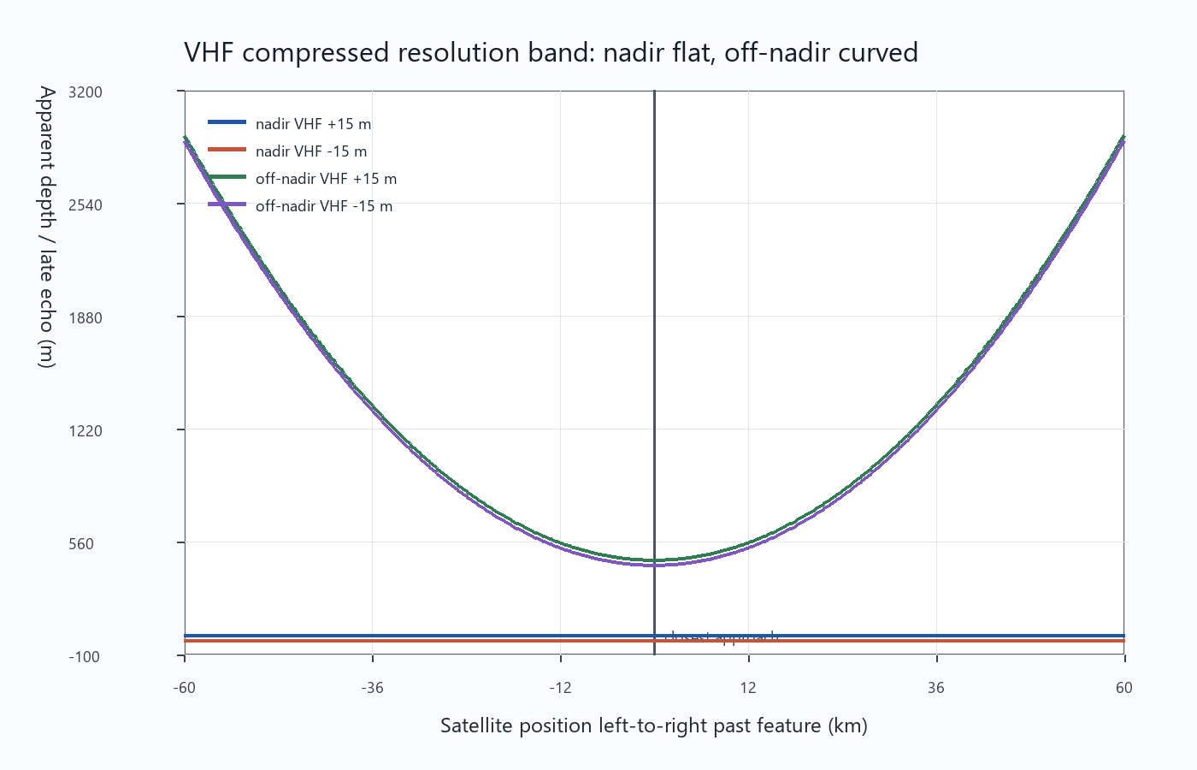
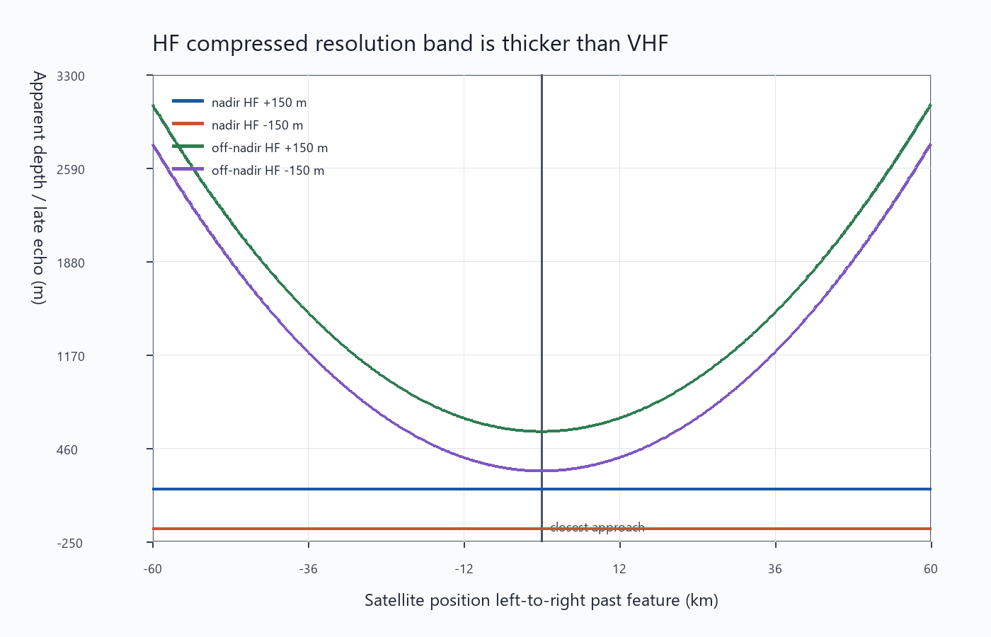
RESOLUTION
09
The same echo can look thin or broad depending on radar band.
VHF resolution band around the false layer.
HF resolution band is broader in this modeled setup.
Math: range resolution in ice is approximately c / (2*n_ice*B). B is bandwidth; larger bandwidth gives a thinner vertical response. This matters because the same off-nadir surface return can be interpreted differently depending on the radar band and processing.
Local replotted graph outputs; model values from project summary JSON files.

Slide 10
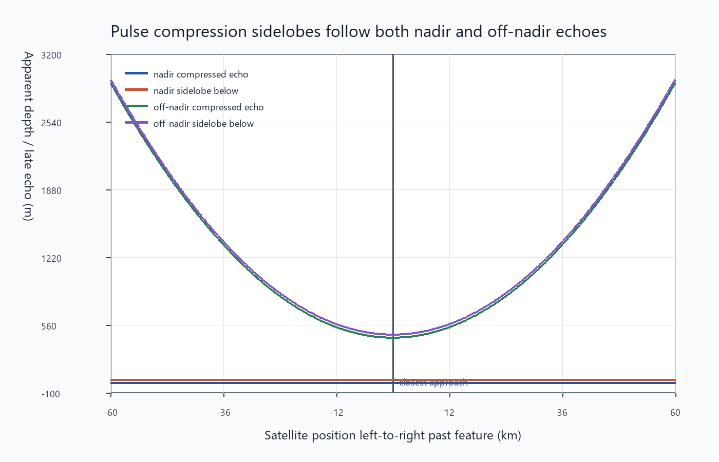
PULSE COMPRESSION
10
Sidelobes can add weaker echoes around the main clutter trace.
Processing idea
compressed echo = pulse autocorrelation
main lobe = strongest return
sidelobes = weaker copies nearby
This is not data compression. It is radar pulse compression: a long coded/chirped pulse is processed into a shorter effective range response.
WHAT TO LOOK FOR
Repeating weak bands
They should move with the same off-nadir geometry, not independently.
Pulse-compressed response follows the off-nadir curve and creates nearby sidelobe energy.
Local replotted graph outputs; model values from project summary JSON files.

Slide 11
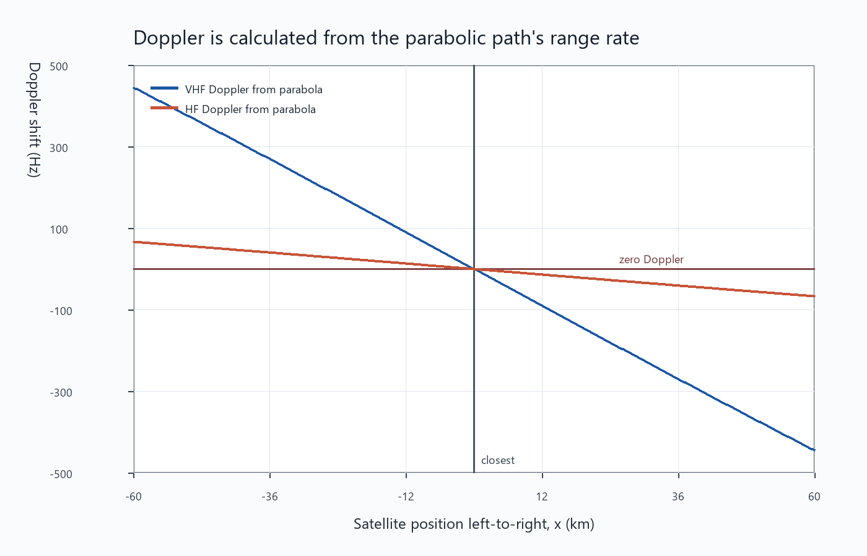
DOPPLER
11
The parabolic flyby changes range rate, so it also predicts Doppler.
Chain rule
x(t) = v*t
z(x) = z0 + a*x^2
R = sqrt(x^2 + y^2 + z(x)^2)
dR/dt = (x*dx/dt + z*dz/dt)/R
fD = -2*(dR/dt)/lambda
v = along-track speed
a = parabola curvature
lambda = radar wavelength
fD = two-way Doppler shift
The maximum modeled VHF Doppler is about 445 Hz.
Doppler is derived from how fast the slant range changes during the pass.
Local replotted graph outputs; model values from project summary JSON files.

Slide 12
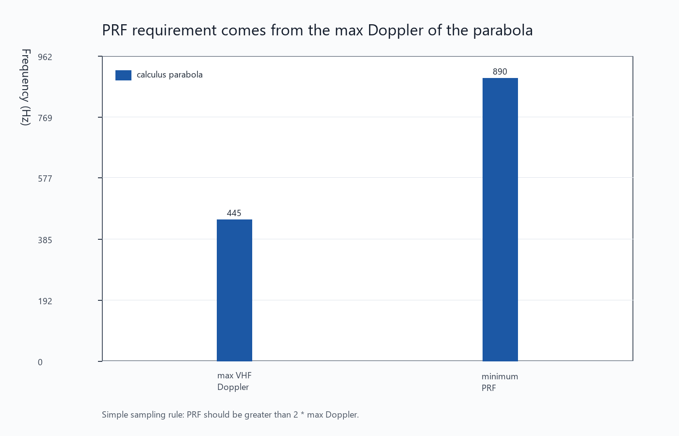
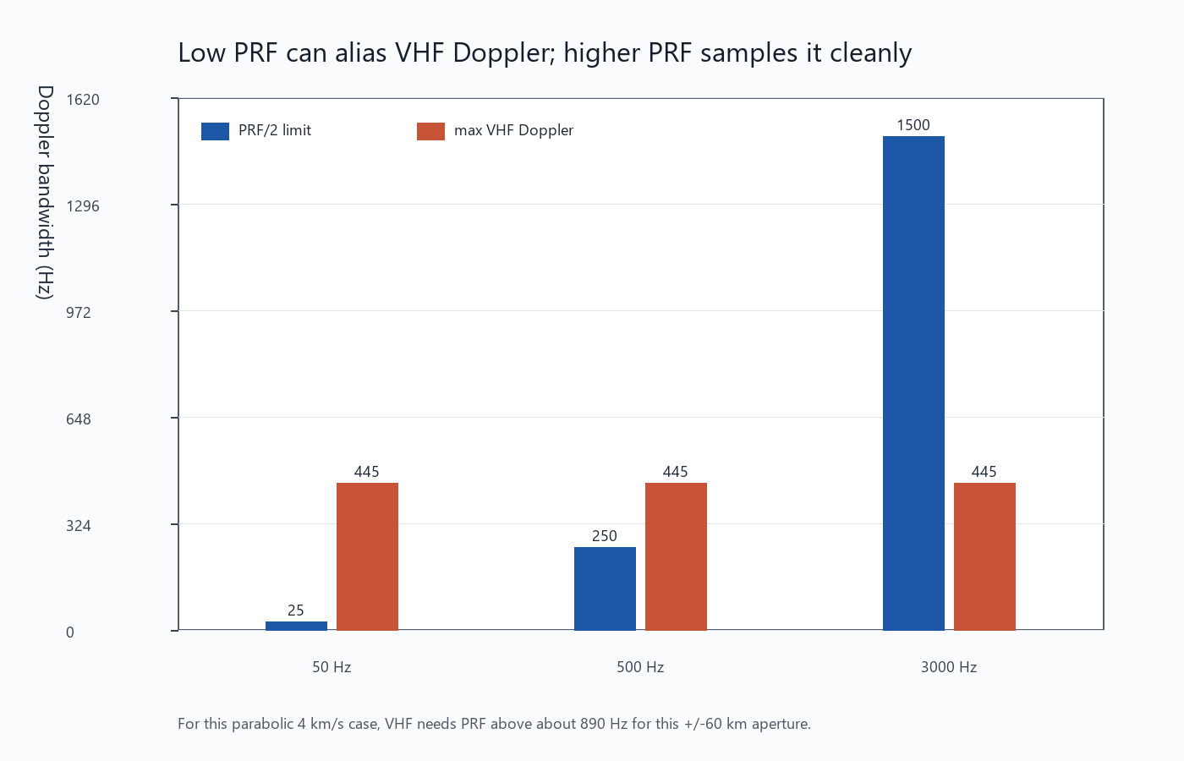
PRF CONSTRAINT
12
Doppler does not set PRF directly, but it tells us the PRF cannot be too low.
PRF requirement from the maximum modeled Doppler.
Example PRF choices compared with the Doppler sampling threshold.
Math: PRF >= 2*max(|fD|). With max VHF Doppler about 445 Hz, the simple no-aliasing threshold is about 890 Hz. PRF also affects along-track pulse spacing and unambiguous range, so the final value is a tradeoff.
Local replotted graph outputs; model values from project summary JSON files.

Slide 13
PROFESSOR SUMMARY
13
What I think will happen in the data.
1. DEPTH
A ~440 m false layer
Created by 25 km side-looking geometry.
2. SHAPE
Curved radargram trace
False-depth prediction
Radargram shape
It follows range-to-surface geometry.
3. PHASE AND PRF
Side phase, PRF > 890 Hz
Phase should recover about 25 km offset.
PRF sampling check
Bottom line: if the candidate is off-nadir clutter, the geometry, phase, and Doppler should agree with each other. If they do not, the hypothesis gets weaker.

