Slide 1
PREDICTION
Off-nadir clutter can
masquerade as a 440 m layer.
What I think will happen
A curved, view-dependent reflector appears near 438 m at closest approach, even though the reflecting point is on the surface.
My explanation is that a surface feature to the side adds extra slant-path travel time. The radar converts that time delay into an ice-equivalent depth, so a surface echo can look subsurface.
400 km
25 km
1.78
438 m
5.21 us
spacecraft altitude h
side offset x
ice refractive index n_ice
predicted apparent depth
extra two-way delay
Sources: config.yaml, integrated_nadir_offnadir_graphs/summary.json, REASON paper parameter extraction.
01

Slide 2
GEOMETRY MATH
The 440 m depth comes from extra slant path, not true ice depth.
radar
Equation stack
slant path
R_slant = sqrt(h^2 + x^2)
Delta R = R_slant - h
d_app = Delta R / n_ice
Delta t = 2 Delta R / c
h = 400 km
vertical altitude
x = 25 km side offset
surface feature
Plug in h = 400 km, x = 25 km, n_ice = 1.78.
R_slant = 400.781 km
Delta R = 780.4 m
d_app = 438.5 m
Delta t = 5.21 us
WHAT EACH PART MEANS
h is altitude. x is how far sideways the surface point is from nadir. R_slant is the longer path to that side point. Delta R is the extra one-way distance. Dividing by n_ice converts the delay into ice-equivalent apparent depth.
Geometry uses h=400 km, x=25 km, n_ice=1.78. Apparent depth is ice-equivalent delay, not measured physical depth.
02

Slide 3
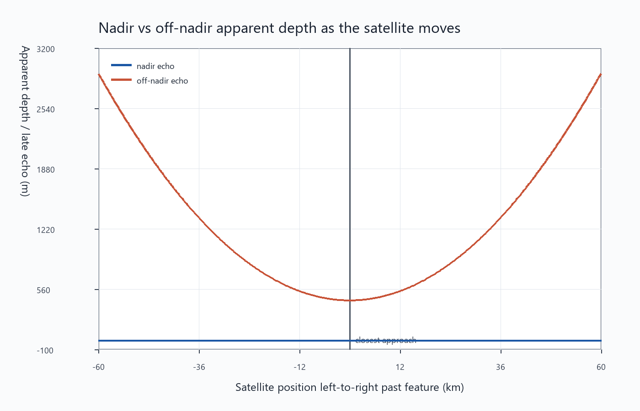
KEY GRAPH 1
The prediction is a U-shaped apparent-depth curve as the spacecraft passes the feature.
X-AXIS
Satellite position left-to-right past the surface feature. Zero is closest approach.
Y-AXIS
Apparent depth or late echo. Larger values mean the return arrived later and would plot deeper.
ORANGE CURVE
The off-nadir surface echo is shallowest near closest approach and deeper away from it, producing the U shape.
438 m
minimum apparent depth at closest approach
Source graph: integrated_nadir_offnadir_graphs/01_apparent_depth_nadir_vs_offnadir.png.
03

Slide 4
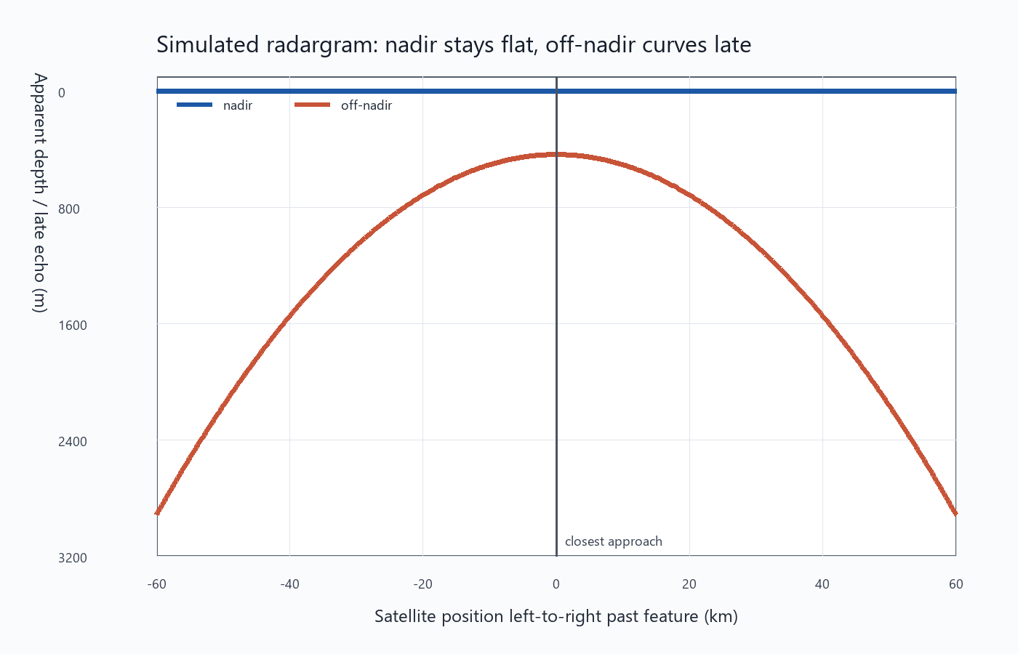
RADARGRAM PREDICTION
In radargram form, the off-nadir echo should curve while the nadir echo stays flat.
WHAT TO SAY
If this is clutter, the feature is not physically buried at the plotted depth. It looks deep because the wave traveled extra distance to a side-looking surface point.
WHY THE CURVE MATTERS
The shape is tied to view geometry. The echo is shallowest when the spacecraft is closest to the side feature, then shifts deeper as the spacecraft moves away.
PROFESSOR CHECK
A real subsurface layer should not automatically trace this symmetric geometry around a surface feature.
Source graph: integrated_nadir_offnadir_graphs/09_radargram_style_nadir_vs_offnadir.png.
04

Slide 5
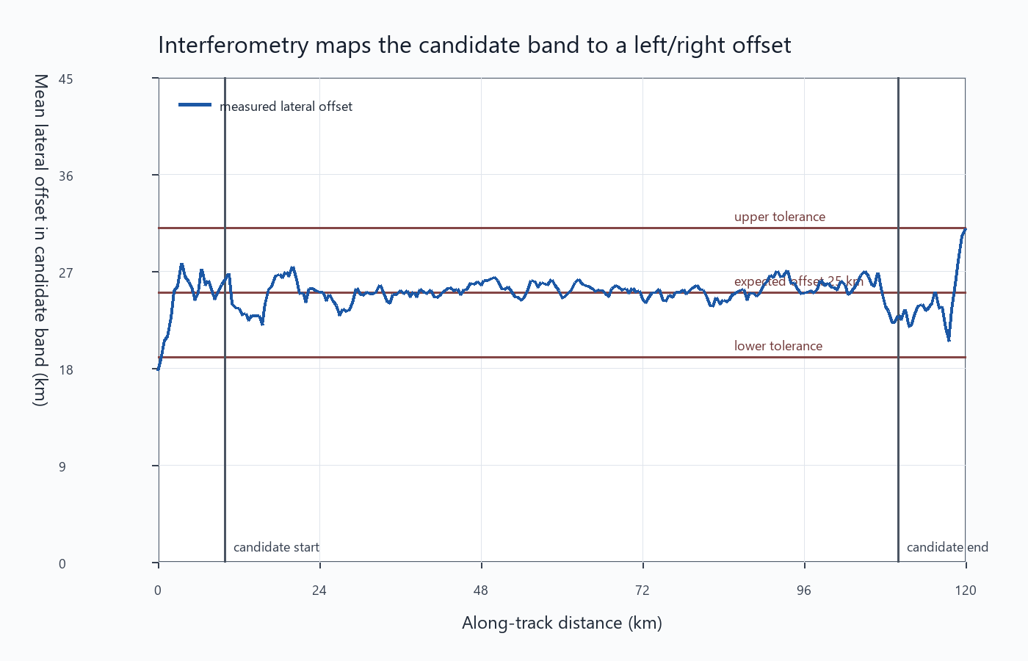
TESTABLE SIGNATURE
Interferometry should point sideways, not straight down, if the candidate is clutter.
25.04 km
offset required by 440 m geometry
25.09 km
mean interferometry offset
INTERPRETATION
The measured lateral offset sits near the offset predicted by the math. That is exactly what I would expect if the apparent layer is a side-looking surface return.
WHAT WOULD WEAKEN IT
If VHF phase stayed near zero and the offset did not match the surface geometry, the clutter explanation would be much less convincing.
Source graph: question_graphs_clean/04_interferometry_offset_along_track.png; summary offset values from question_graphs_clean/summary.json.
05

Slide 6
EVIDENCE BALANCE
The model is not proof by itself, but most independent checks point toward clutter.
Verdict from local tests: probable clutter
My cautious wording: probably clutter, not definitely clutter.
Four tests support off-nadir geometry. One test says a subsurface reflector is detectable in principle, so it is not impossible.
Cluttergram
clutter
Candidate window has a coherent counterpart in the DEM-only cluttergram.
Interferometry
clutter
Candidate-bin phase maps to the expected off-nadir surface offset.
Crossovers
clutter
Apparent depths disagree by several range cells, consistent with view-dependent clutter.
Bias table
clutter
A DEM feature exists at the lateral offset required by the observed apparent depth.
Blind zone
subsurface possible
The candidate depth is outside the measured blind zone and could be detectable.
Source: reason_outputs/verdict_report.txt.
06

Slide 7
PROFESSOR ANSWER
I would present this as a prediction with clear ways to prove me wrong.
Short explanation I can say out loud
Prediction
Main test
I think the 440 m candidate is probably an off-nadir surface echo. At 400 km altitude, a surface point 25 km to the side adds about 780 m of one-way slant range. When the radar interprets that delay through ice with n_ice = 1.78, it becomes about 438 m of apparent depth. As the spacecraft passes the feature, that extra distance changes, so the false reflector should curve in the radargram. VHF interferometry should also show nonzero phase and recover a lateral offset near 25 km.
curved false layer near 438 m
VHF phase gives side offset
WHAT WOULD SUPPORT IT
The apparent layer curves with spacecraft position, interferometry maps it sideways, and crossovers disagree in depth.
WHAT WOULD CHANGE MY MIND
Near-zero interferometric phase, consistent crossover depths, and no DEM feature at the required offset.
Bottom line: the graph is a geometry prediction, not a claim that the surface feature is actually 438 m below the ice.
Conclusion synthesized from local model outputs and evidence tests in reason_outputs/verdict_report.txt.
07

