Slide 1
CONDENSED VIEWPOINT
01
The problem is simpler than the graph pile made it look.
We are asking what radar measurements do when the spacecraft/object moves along a parabolic path past a target.
NOT THE MAIN QUESTION
MAIN QUESTION
DECK GOAL
Is it water?
What changes?
Explain the chain
That could be a later interpretation, but it is not the first thing this model answers.
Range changes first. Delay, apparent depth, phase, Doppler, and PRF follow from that.
Use fewer graphs and show how to interpret the outputs.
Talk track: one path creates one changing distance, and that changing distance creates the radar effects.

Slide 2
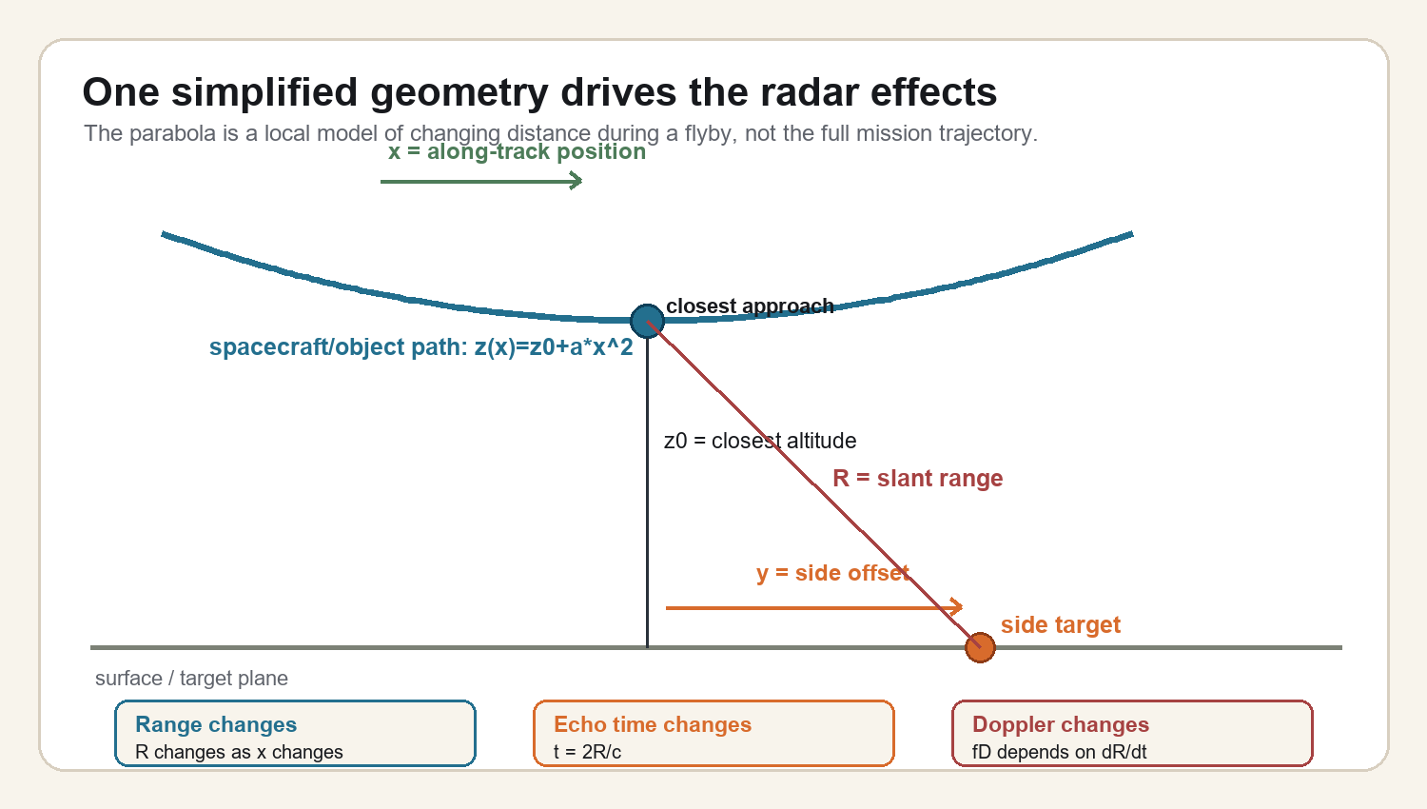
GEOMETRY
02
One simplified geometry replaces most of the repeated plots.
Condensed interpretation deck; values from local parabolic-motion graph summaries.

Slide 3
FORMULA CHAIN
03
The interpretation comes from one dependency chain.
PATH
RANGE
RANGE RATE
DOPPLER
z(x)=z0+a*x^2
R=sqrt(x^2+y^2+z^2)
dR/dt
fD=-2(dR/dt)/lambda
->
->
->
The parabola describes how altitude changes near closest approach.
This is the distance from spacecraft/object to the target.
How quickly the distance changes as it moves.
Motion turns range-rate into a frequency shift.
ECHO TIMING
APPARENT DEPTH
PHASE
t = 2R/c
d=(Roff-Rnadir)/n
phase ~ y/R
Longer range means the echo arrives later.
Extra path can look like vertical depth in the radargram.
Side-looking geometry can create nonzero interferometric phase.
Condensed interpretation deck; values from local parabolic-motion graph summaries.

Slide 4
INTERPRETATION
04
Read the outputs as symptoms of changing range.
Observable
What changes
How to explain it
Range
Gets shortest near closest approach.
This is the source variable; everything else follows from it.
Delay
Later echo when range is longer.
The radar sees distance as time because the pulse has to travel out and back.
Apparent depth
Extra path can appear as depth.
A side path can be drawn as a deeper echo if interpreted as straight down.
Phase
Changes with look direction.
Interferometry can tell whether the echo is straight down or sideways.
Doppler / PRF
Doppler follows dR/dt; PRF must sample it.
PRF is not caused by Doppler, but it must be high enough to avoid aliasing.
Condensed interpretation deck; values from local parabolic-motion graph summaries.

Slide 5
COMPACT RESULTS
05
The example values are anchors, not the whole story.
APPARENT DEPTH
EXTRA DELAY
VHF PHASE
MAX DOPPLER
SIMPLE PRF
438.5 m
5.21 us
22.5 deg
445 Hz
890 Hz
A 25 km side path can map to about 440 m apparent depth.
That same path difference is about 5.21 microseconds of extra two-way time.
Side-looking geometry predicts nonzero phase.
Motion creates a VHF Doppler shift over the aperture.
A basic no-alias rule says PRF should exceed about twice the max Doppler.
Better interpretation: do not treat each graph as a separate claim. Treat each one as a different measurement of the same geometry.
If the geometry is right, the outputs should agree with each other instead of telling separate stories.
Condensed interpretation deck; values from local parabolic-motion graph summaries.

Slide 6
WHAT IS MISSING
06
What would make this interpretation stronger?
The parabolic model is useful, but it is still a simplified viewpoint. These are the pieces to check before overclaiming.
GEOMETRY INPUTS
RADAR INPUTS
ENVIRONMENT INPUTS
Do we know the real path?
Do settings support it?
What else changes range?
Actual trajectory, altitude at the observation time, ground track, pointing, and target location.
PRF, receive window, pulse compression, antenna pattern, phase calibration, and signal-to-noise.
Surface topography, ice index, plasma/ionosphere, roughness, and any motion not captured by the simple parabola.
Strongest next step: replace the simple parabola with the real trajectory/geometry, then see whether the same range-based chain still explains the observations.
Talk track: I am not claiming the simplified model is final; I am using it to understand which radar effects should move together.

