Slide 1

Jester is a website that recommend jokes to you based on the ratings you've given to the jokes you've read. It is a research website created by UC Berkeley to study social information filtering.

Slide 2
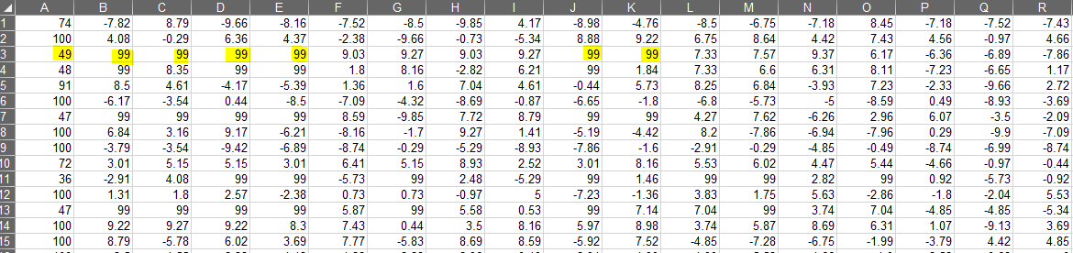
Data Format:
24,983 rows and 101 columns. Each row is a user. Each column is a joke ratings, except 1st column.
The first column gives the number of jokes rated by that user. The next 100 columns give the ratings for jokes 01 - 100.
Ratings are real values ranging from -10.00 to +10.00
The value "99" corresponds to “not rated”.

Slide 3
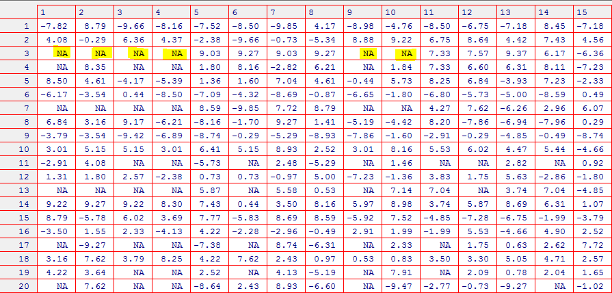
Loading into R, removing 1st column, and replacing value “99” with “NA”:
The goal is to fill in the “NA” cells, with predict values, based on the jokes the user had rated before and on the rating of similar jokes (collaborative filtering).
Base on the predict rating, we can predict if the user will like the joke or not, and recommend to the user the more favorable jokes.

Slide 4
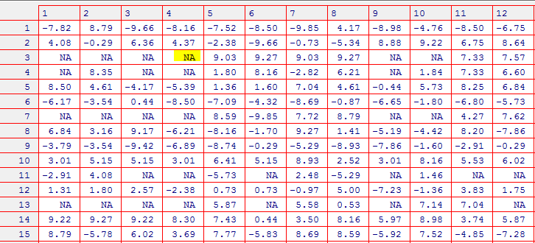
Example:
If I want to fill
the NA cell for
User #3,
Joke #4…
Steps:
Calculate the similarities between Joke #4 and all other 99 jokes. (A vector of 99 values)
Remove the similarities of those jokes the user never rated. (User #3 rated 49 jokes, so remove all other similarities except for the 49 elements).
Rank the similarities, and choose the top N neighbors most similar to Joke #4.
Fill the NA cell with weighted average of the N neighbors.

Slide 5
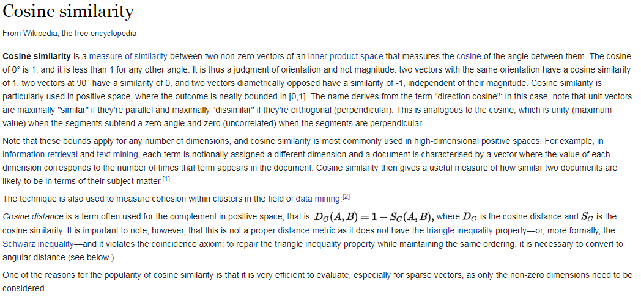
For the similarity function, I used the cosine similarity. Below is the definition from Wikipedia.

Slide 6
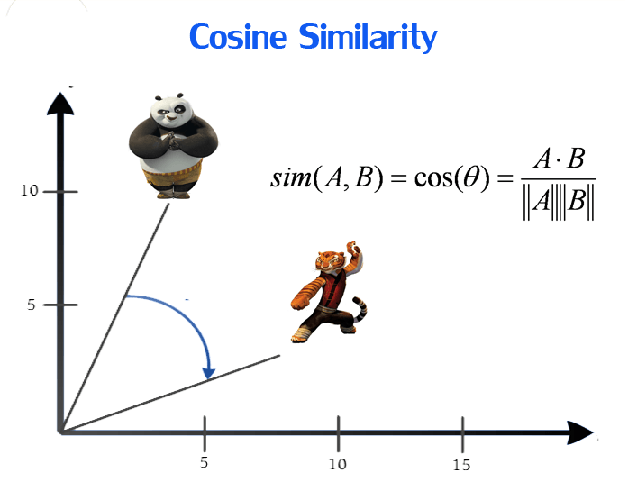
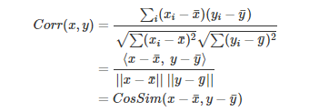
Image from techinpink.com
Centered Cosine Similarity:
What is “centered cosine similarity”?
There is another name for it: Pearson Correlation. It is a value between -1 and 1 to measure the linearity of two variables.
Tigress = (7.5, 2.5)
Panda = (4, 10)

Slide 7
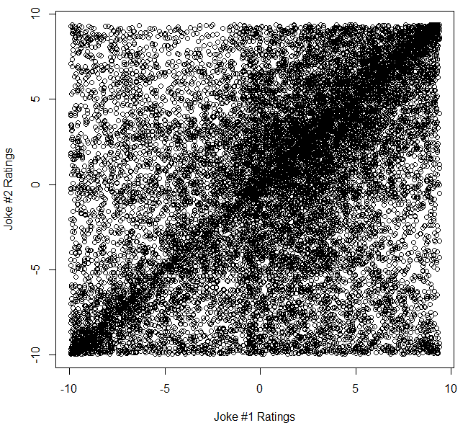
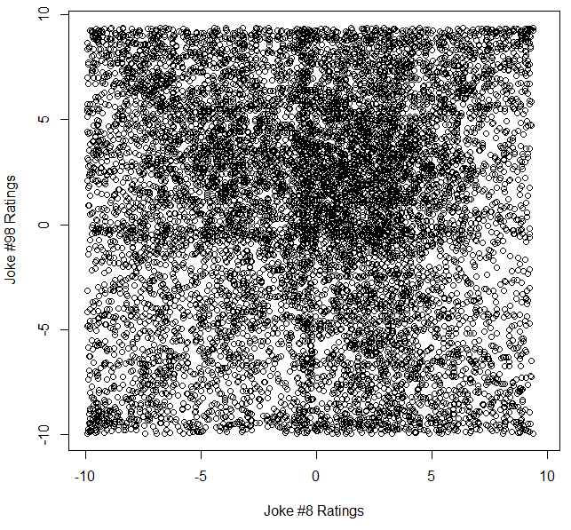
> plot(jester[,1],jester[,2], xlab="Joke #1 Ratings", ylab="Joke #2 Ratings")
> sim(jester[,1],jester[,2])
[1] 0.3629353
> plot(jester[,8],jester[,98], xlab="Joke #8 Ratings", ylab="Joke #98 Ratings")
> sim(jester[,8],jester[,98])
[1] -0.003671474

Slide 8
Weighted Average
Example:
A user has rated Joke B thru F, but has not rated Joke A. Predict this user’s rating for Joke A.
Sim(Joke A, Joke B) = 0.32 | Joke B Rating = 8.2 | 0.32x8.2 = 2.624
Sim(Joke A, Joke C) = 0.21 | Joke C Rating = 6.5 | 0.21x6.5 = 1.365
Sim(Joke A, Joke D) = 0.16 | Joke D Rating = 5.5 | 0.16x5.5 = 0.88
Sim(Joke A, Joke E) = 0.11 | Joke E Rating = 9.0 | 0.11x9.0 = 0.99
Sim(Joke A, Joke F) = 0.07 | Joke F Rating = -4.3 | 0.07x-4.3 = -0.301
Sum = 0.87 |  | Sum = 5.558
Joke A rating prediction = 5.558 / 0.87 = 6.4
Implementation: http://rpubs.com/azureblue83/327856

Slide 9
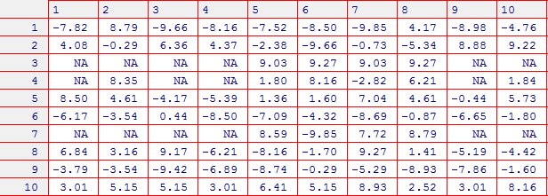
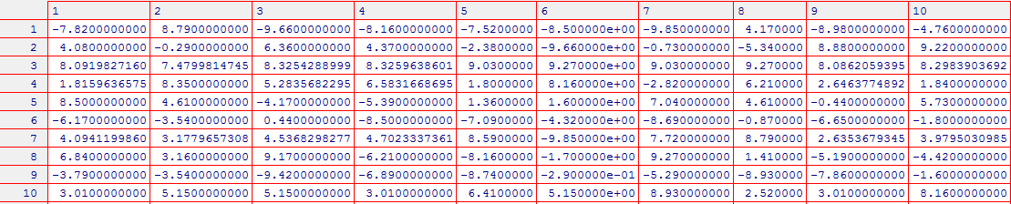
Before and after filtering
(with n = 5)

Slide 10
Example: For User #3, I will recommend Joke #75 to the user, since it has the highest predicted rating.
> round(predict_ratings[[3]],3)
1 2 3 4 9 10 22 24 25 30 33 34 37 44 46 51
8.092 7.480 8.325 8.326 8.086 8.298 7.261 7.763 7.866 8.886 8.333 7.810 8.156 8.113 7.842 6.931
52 55 57 58 59 63 64 67 70 71 72 73 74 75 77 78
7.291 8.434 5.261 7.782 7.987 7.410 8.141 8.648 8.409 8.156 8.833 8.657 8.803 9.101 8.602 8.608
79 81 82 83 84 85 86 87 88 89 91 92 93 95 96 97
8.567 7.850 8.289 8.265 8.246 9.068 8.992 8.828 8.635 8.179 8.613 8.599 8.538 8.393 8.206 8.223
98 99 100
7.869 8.201 7.239
> max_rating <- max(predict_ratings[[3]])
> max_rating
[1] 9.101352
> which(predict_ratings[[3]] == max_rating)
75

