Slide 1

Project 3:
You’ve Got an eMAIL
Presented by:
Raquel Quaglia
Tyler Ryan

Slide 2
Motivation:
Machin learning.
Algo_Trading
The strategy has been built using the Conversion and Base lines from the Ichimocu Cloud indicator.
To evaluate the strategy, we calculated Metrics Values and cumulative returns and compared them against the Strategy of Holding the Position for the same time frame.
Strategy evaluated:
Ichimocu_trend: Conversion line > Base line , Buy
Holding_Position : Buy (sell at the end of period)
We used Three different time frame:
60 days / 1 hour
6 months / 1 hour
5 years / 1 day

Slide 3
You’ve got an eMail
Machine Learning
5 Days
Stock Price
Prediction
Stock Price Will Go Up
Stock Price Will Go Down
Buy and Hold for 5 Days
Waite for New Opportunity
Trade Stock with Ichimoku Strategy
Execute Strategy

Slide 4
You’ve got an eMail
Machine learning

Slide 5
You’ve got an eMail

Slide 6

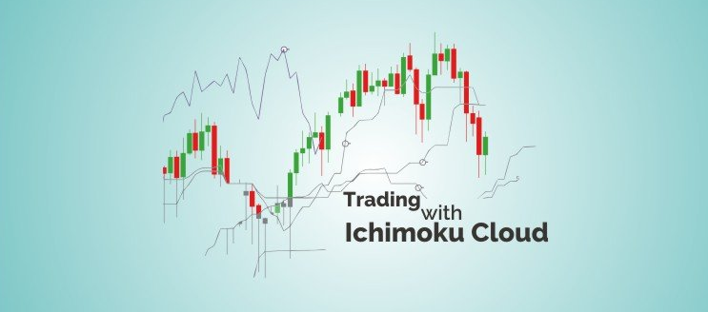

a Japanese technical analysis technique.

Slide 7
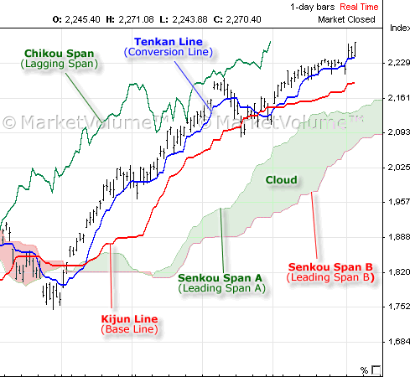
The Ichimoku Cloud, developed by Goichi Hosoda in 1960
Is a technical indicator composed of five lines or calculations
Conversion and Base lines: a 9-period average, a 26-period average of high and low prices.
Lagging Span, 26 closing price line.
Leading Span A line, average of Base line and Close price, and Leading Span B line, a 52-period average of high price. The space between these two lines forms the Cloud. Used to forecast support and resistance price.

Slide 8
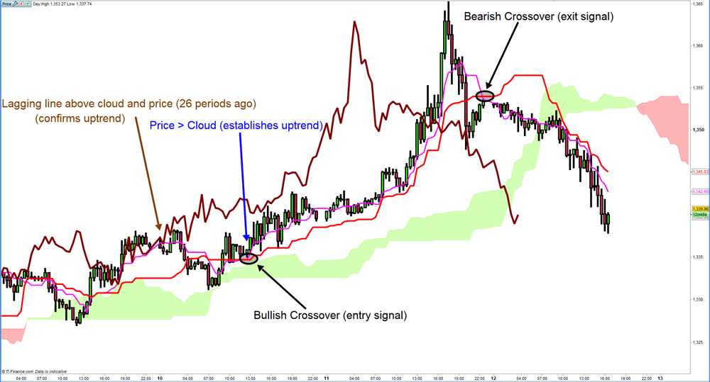
Strategy: Tenkan line > Kijun Line, Buy
Strategy: Tenkan line < Kijun Line , Sell

Slide 9
You’ve got an eMail
The Ichimoku Cloud Strategy
Indicator: The Technical Analysis Library for Python, ta
import ta
from ta import add_all_ta_features
To get: Tenkan line 'trend_ichimoku_a’,
Kijun Line 'trend_ichimoku_b'
Data: Yahoo! Finance Library
import yfinance as yf
to get: Date, Close, High, Low
Main condition on the Code: Strategy: (Tenkan line > Kijun Line, Buy, Sell)
signals_df['trend_ichimoku'] = np.where(signals_df['trend_ichimoku_a'] > signals_df['trend_ichimoku_b'], 1.0, 0.0)
Calculate: Backtest - Cumulate Returns - Metrics

Slide 10
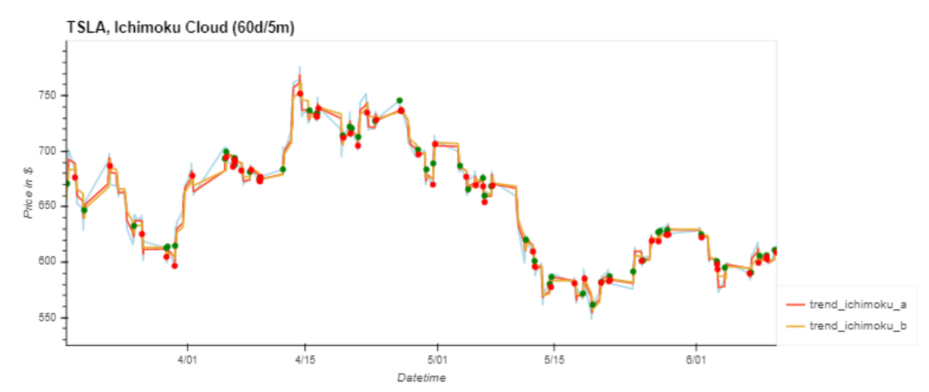
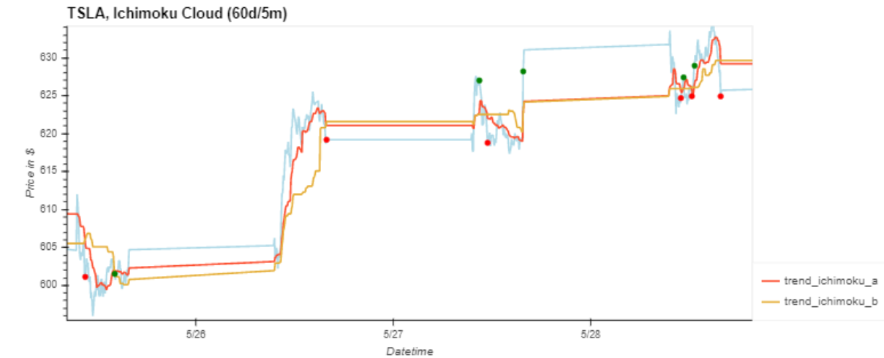

Slide 11
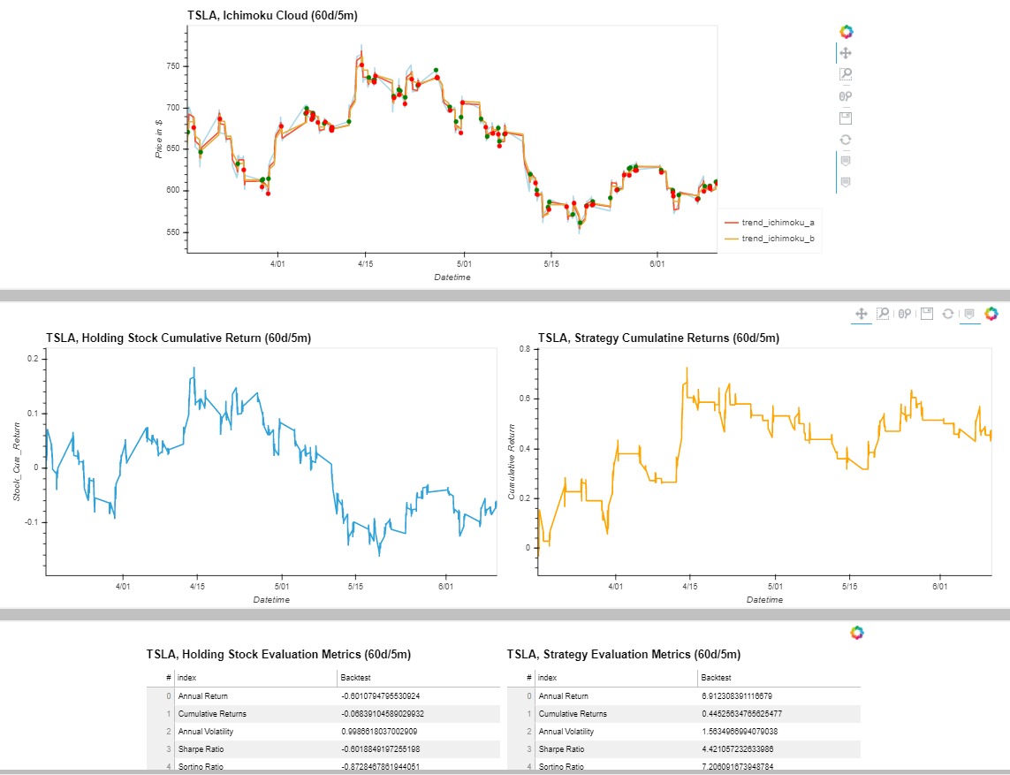

Slide 12
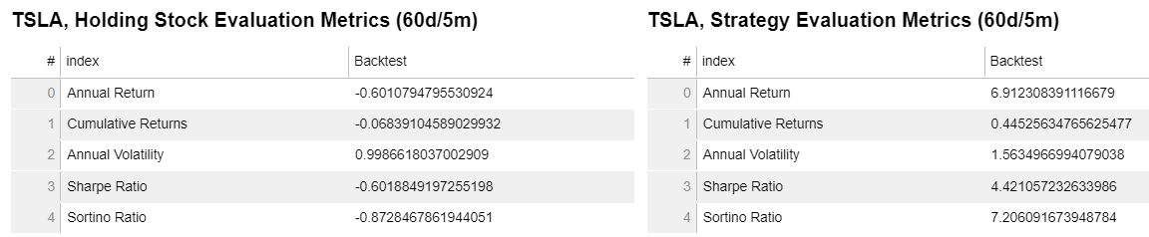
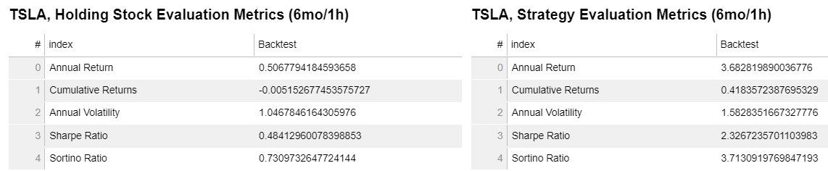
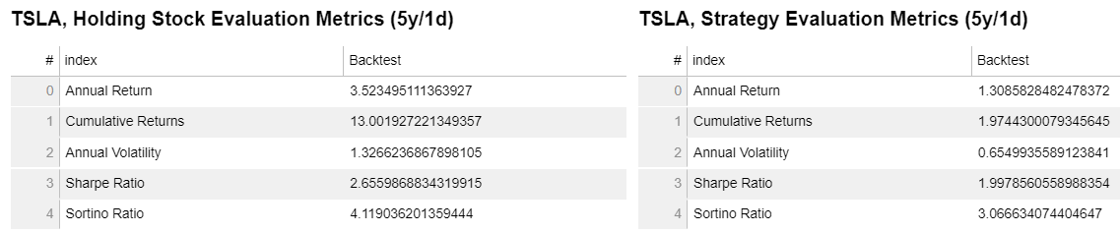

Slide 13
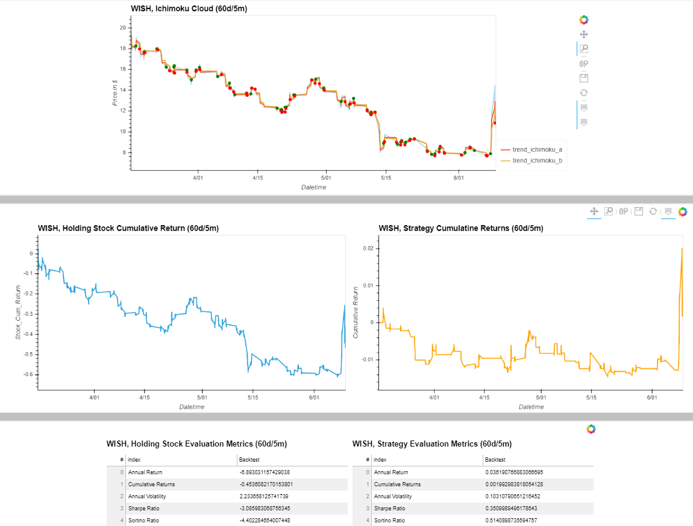

Slide 14
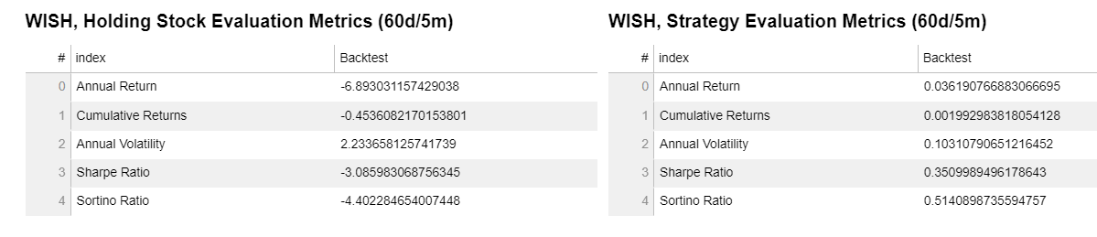
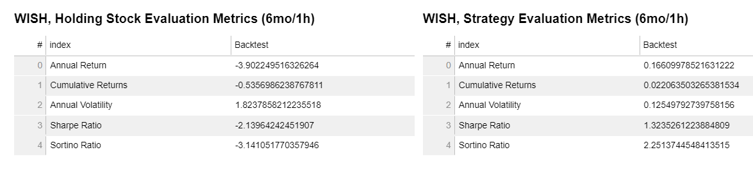
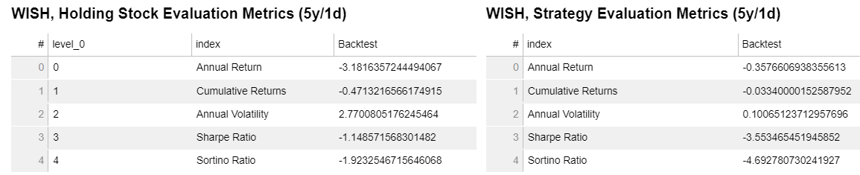

Slide 15
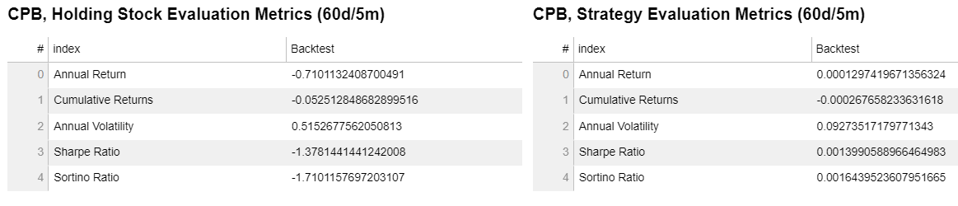
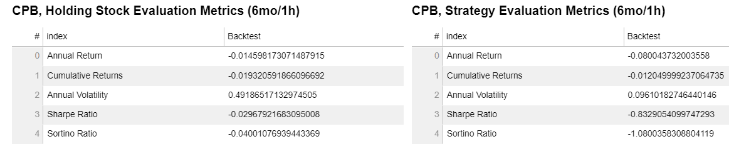
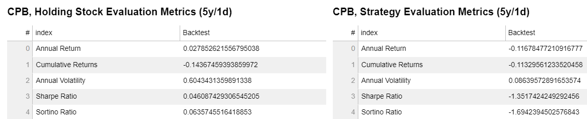

Slide 16
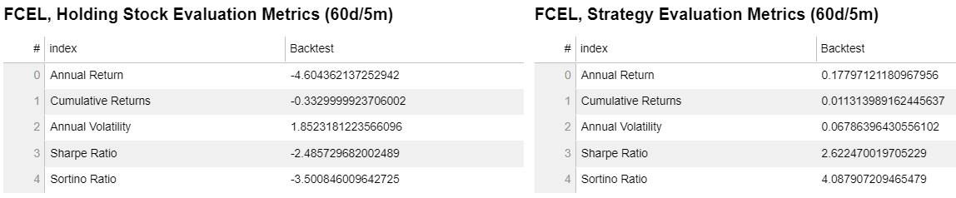
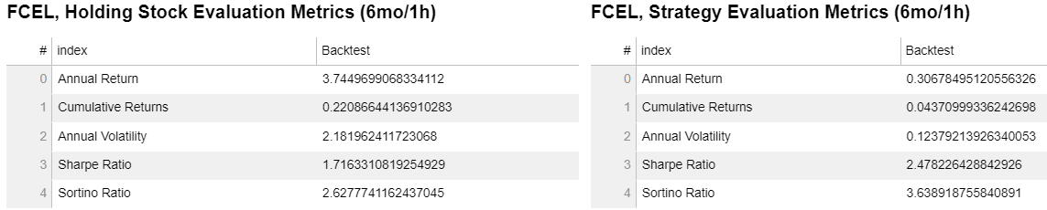
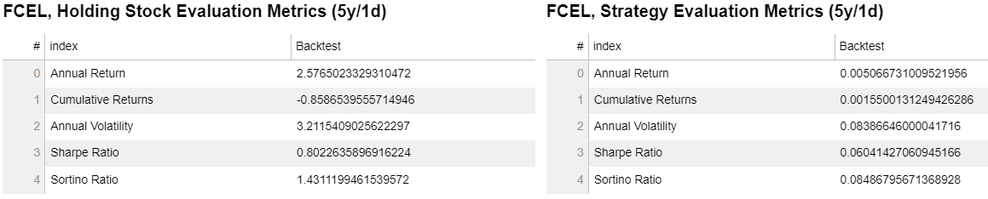

Slide 17
You’ve got an eMail
Conclusions
The Ichimocu Strategy is more recommended to be use in a short time frame (60 days/5 min) where it shows the cumulate returns most of the time is better than holding the position for the same time frame.
In stocks with negative trend, the Ichimocu strategy can mitigate the loss compared to the holding position strategy.

Slide 18
Back up …. Extra slides

Slide 19
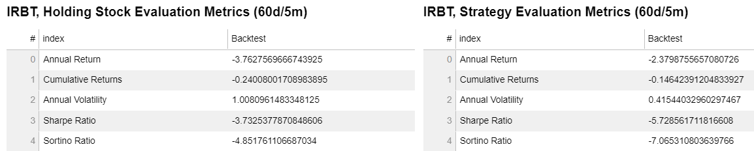
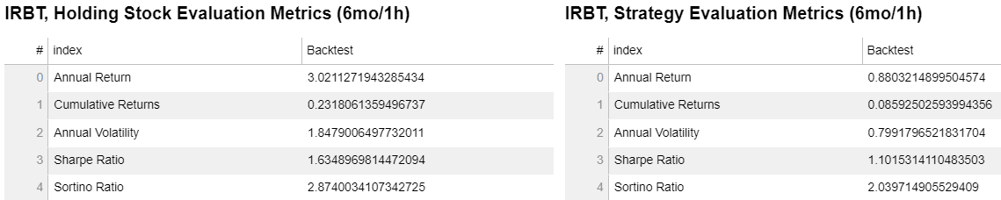
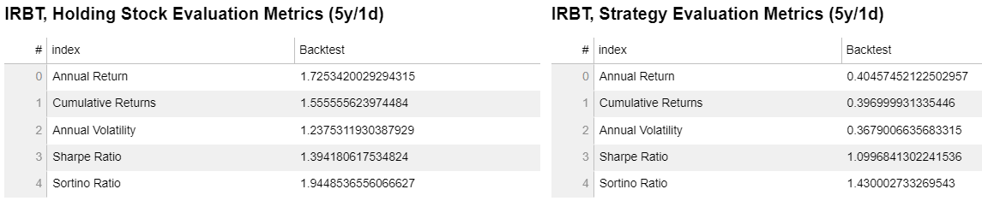

Slide 20
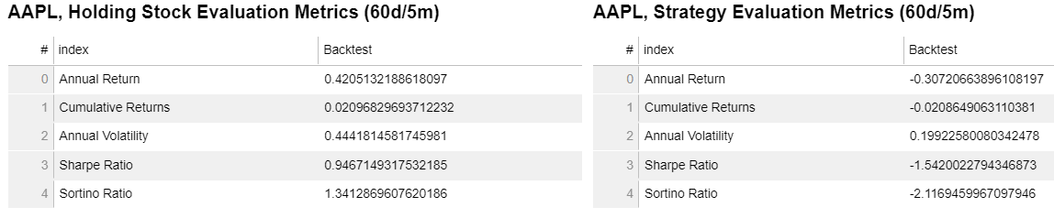
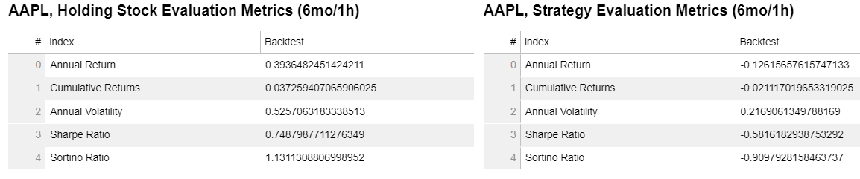
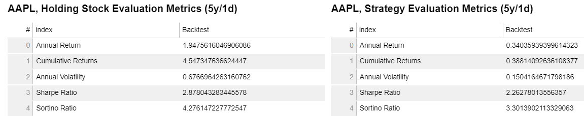

Slide 21
