Slide 1

Project 3:
You’ve Got an eMAIL
Presented by:
Raquel Quaglia
Tyler Ryan

Slide 2
Motivation:
Create a pool of strategies using different Price Indicators to execute an order to enter in a Long position, for the Stock(s) who has the maximum accuracy in the sentiment analysis from a basket of selected stocks.
The strategies have been built using Moving Average (SMA), and Bollinger Bands (BB).
We are going to use the strategy that presents the best evaluation Metrics and cumulative return in the specific stock, i.e.: AAPLE better strategy is SMA Crossover 50/200.
Strategies evaluated:
SMA Long Strategy: Crossover fast-SMA over slow-SMA. We used Three different combinations:
fast-SMA = 50 / slow-SMA = 200, fast-SMA = 20 / slow-SMA = 70, fast-SMA = 30 / slow-SMA = 120.
Bollinger Bands: iueggwuhgiw gutgw p9w8gw rut[0r
S&P500 Stocks (5 years data)
AAPL, XOM, CMG, TSLA, WMT, ABNB

Slide 3
You’ve got an eMail
Machine Learning
5 Days
Stock Price
Prediction
Stock Price Will Go Up
Stock Price Will Go Down
Buy and Hold for 5 Days
Waite for New Opportunity
Trade Stock with Ichimoku Strategy
Execute Strategy

Slide 4
You’ve got an eMail
Machine learning

Slide 5
You’ve got an eMail

Slide 6



a Japanese technical analysis technique.

Slide 7
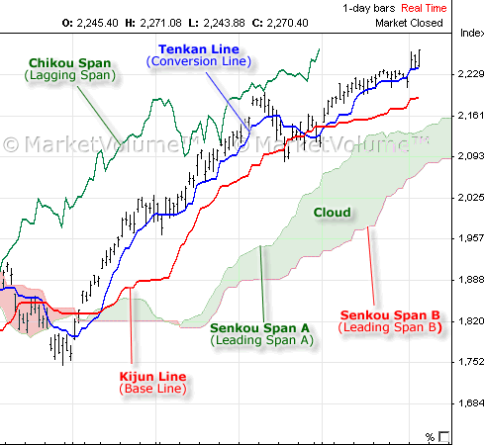
The Ichimoku Cloud, developed by Goichi Hosoda in 1960
Is a technical indicator composed of five lines or calculations
Conversion and Base lines: a 9-period average, a 26-period average of high and low prices.
Lagging Span, 26 closing price line.
Leading Span A line, average of Base line and Close price, and Leading Span B line, a 52-period average of high price. The space between these two lines forms the Cloud. Used to forecast support and resistance price.

Slide 8
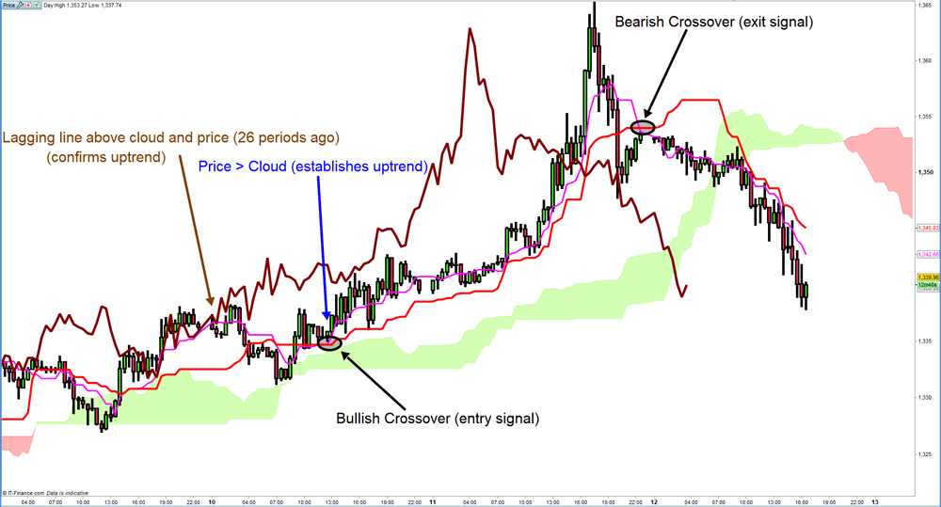
Strategy: Tenkan line > Kijun Line, Buy
Strategy: Tenkan line < Kijun Line , Sell

Slide 9
Data: Yahoo! Finance
import yfinance as yf
Indicator: The Technical Analysis Library for Python, ta
import ta
from ta import add_all_ta_features
To get: Tenkan line 'trend_ichimoku_a’,
Kijun Line 'trend_ichimoku_b'
Main condition on the Code: Strategy: (Tenkan line > Kijun Line, Buy, Sell)
signals_df['trend_ichimoku'] = np.where(
signals_df['trend_ichimoku_a'] > signals_df['trend_ichimoku_b'], 1.0, 0.0)

Slide 10
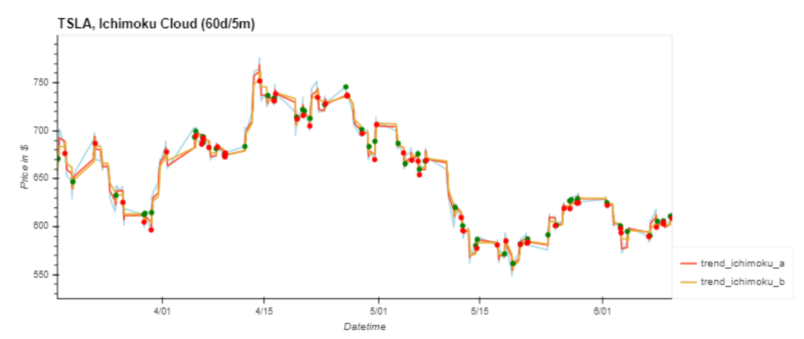
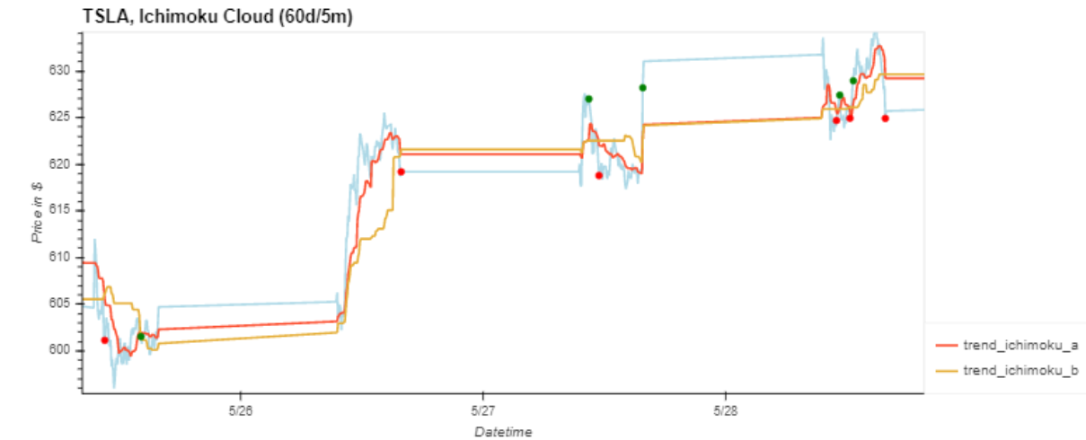

Slide 11
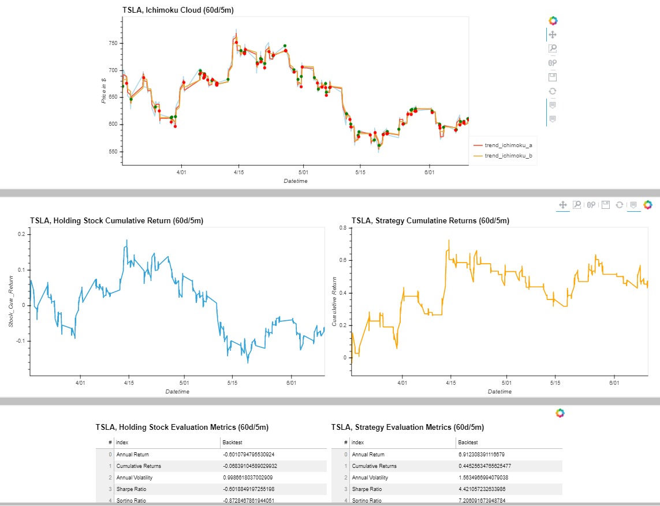

Slide 12
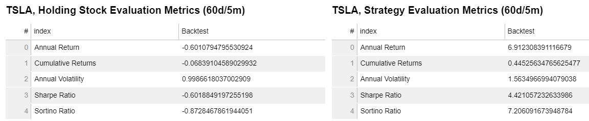
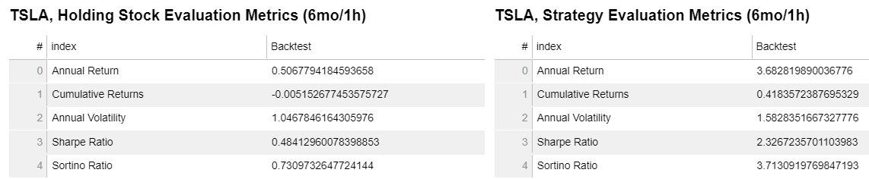
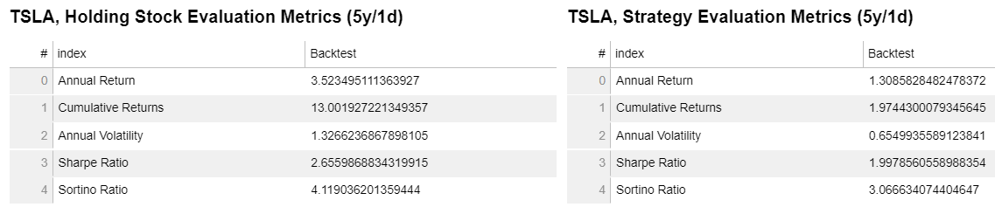

Slide 13
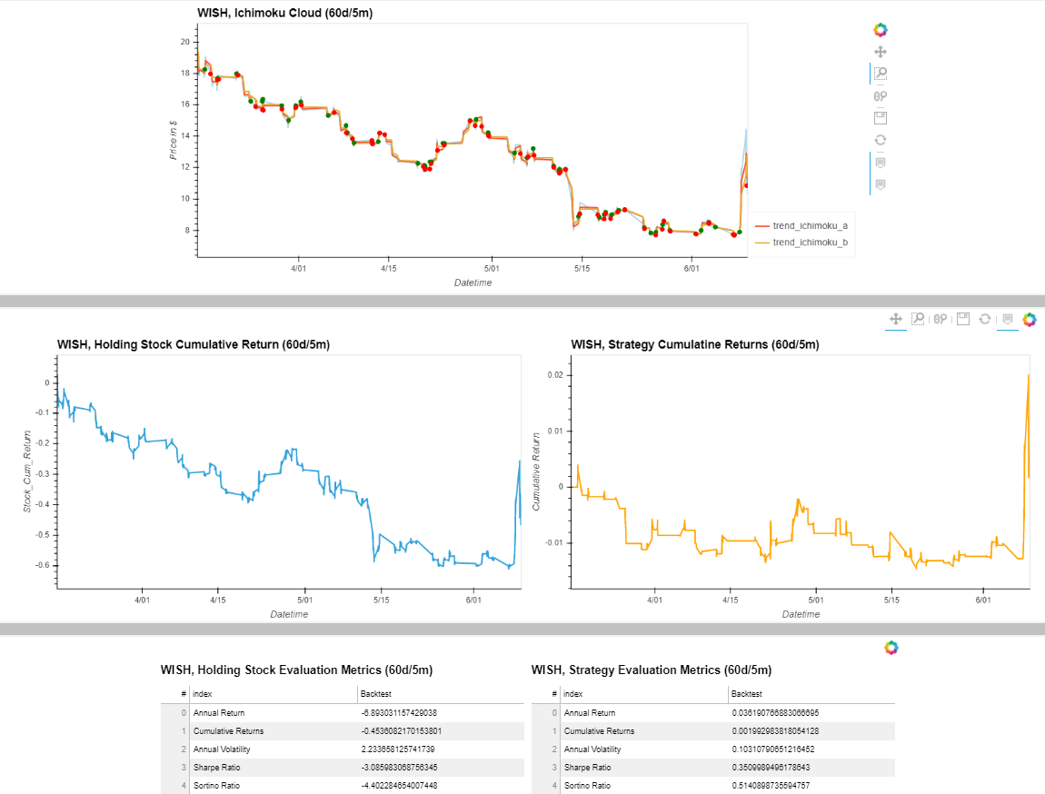

Slide 14
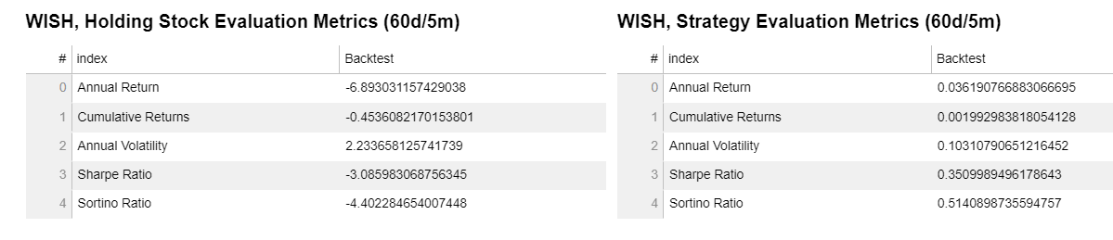
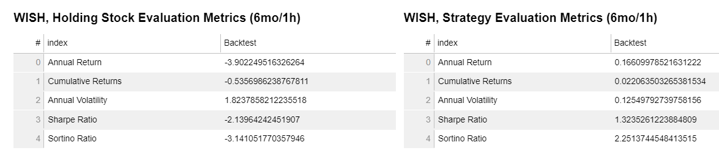
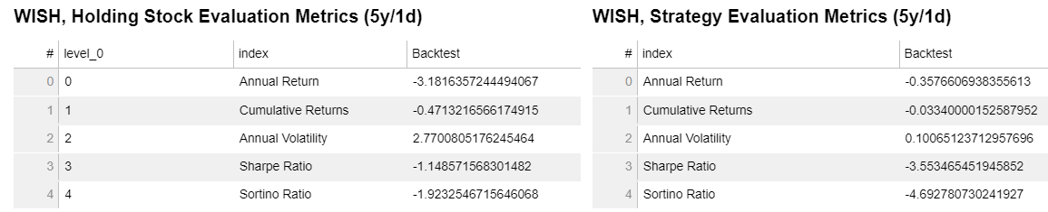

Slide 15
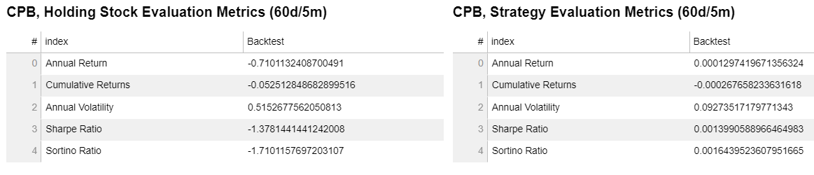
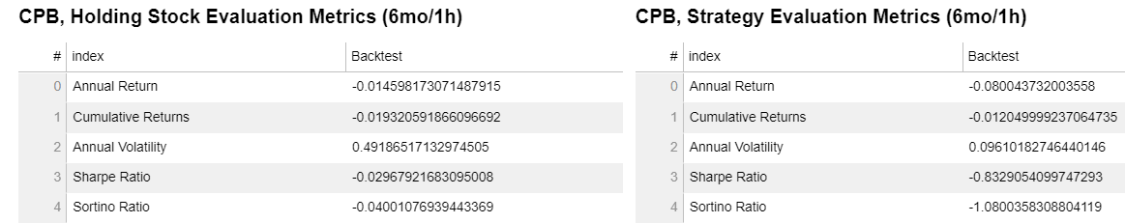
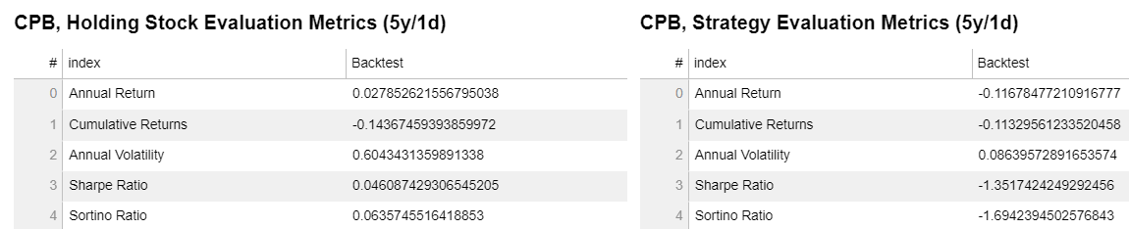

Slide 16
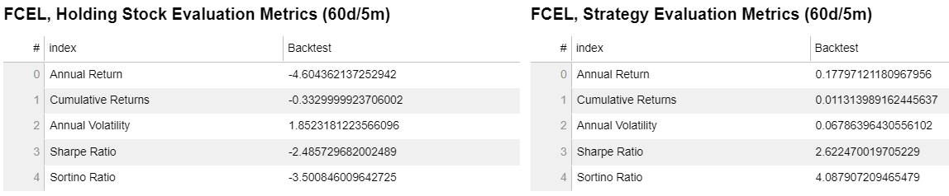
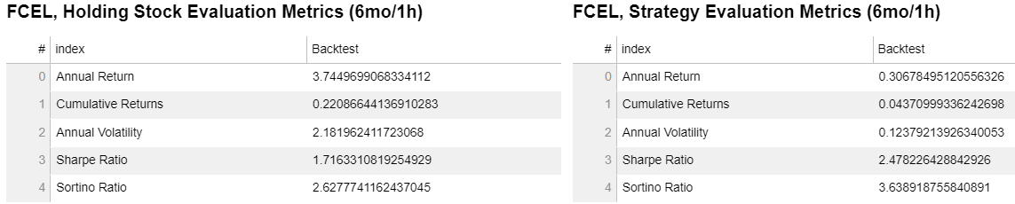
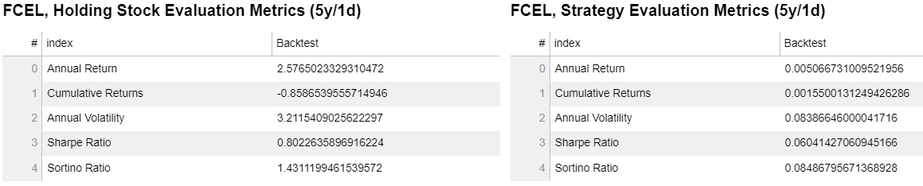

Slide 17
You’ve got an eMail
Conclusions
The Strategy is more recommended to be use in a short time frame (60 days/5 min) where it shows the cumulate returns most of the time is better than holding the position for the same time frame.
In stocks with negative trend, the strategy can mitigate the loss compared to the one holding the position.

Slide 18
Back up …. Extra slides

Slide 19
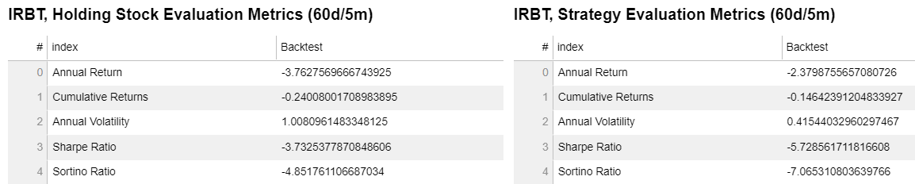
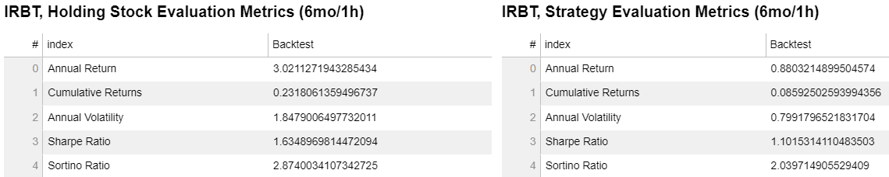
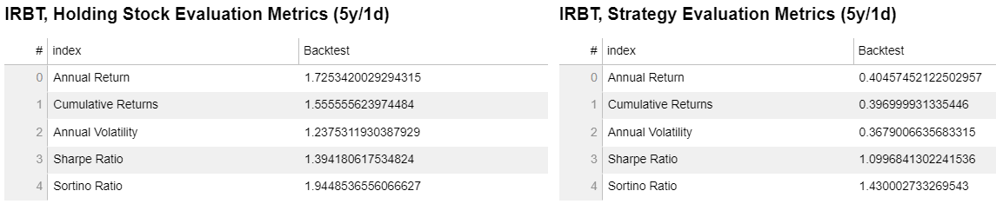

Slide 20
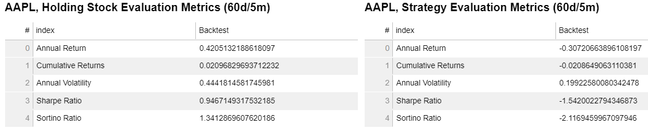
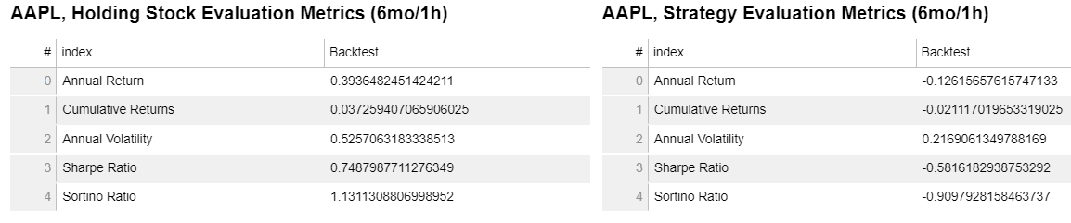
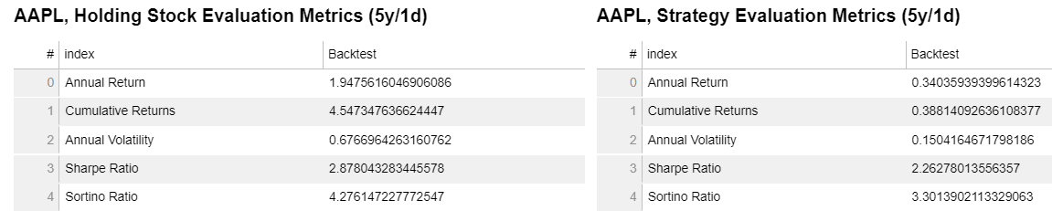

Slide 21
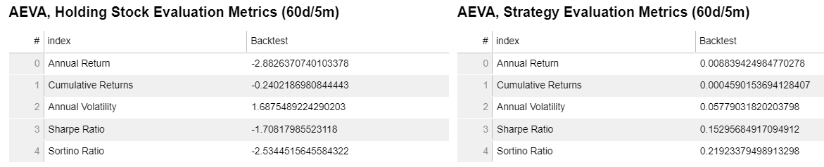
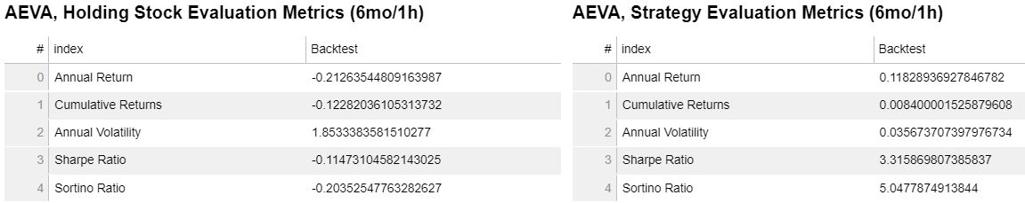
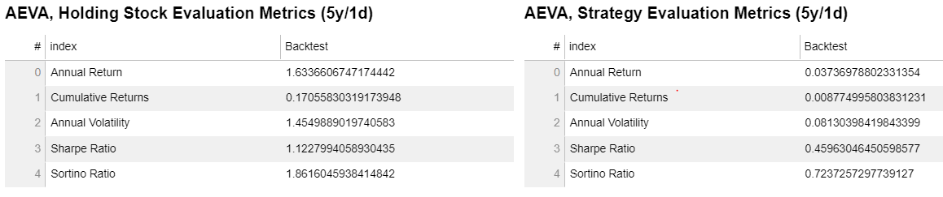

Slide 22

a Japanese technical analysis technique.

