Slide 1

Project 3:
You’ve Got an eMAIL
Presented by:
Raquel Quaglia
Tyler Ryan

Slide 2
Motivation:
Create a simple way to keep track of your favorite stocks and some of their basic indicators without having to look them up yourself and give a default strategy you can use.
The original idea I had:
Keep track of a list of stocks
Set up some indicators
Email me a list of stocks that set off the indicators in a dataframe format.

Slide 3
General Overview
Pull in the data from library/API
Returns dataframe/json request
Preprocess and Send to ARIMA
Returns Predicted Close appended to actual close.
Send predictions to get analyzed
Returns basic moving average indicators dataframe
Create a graph and save it locally
Returns new saved files
Email saved files
Based off this result, you can use the given strategy we came up with.

Slide 4
You’ve got Mail
Strategy Inception
Stock Price Drops
Stock Price Goes Up
Trade Stock with Ichimoku Strategy
Wait for New Opportunity
Stock Price Drops Below the Moving Averages.
Why? If I got emailed every time it thought the stock price was to go up, I’d pull my hair out.
Stay vigilant. This is the time to think about buying.

Slide 5


Data Collection and Preprocessing
Stocks
yfinance.
Preprocessing pretty much done as is.
Cryptocurrencies
Coin API
Required url manipulation, api_key, and constantly looking at their documentation.
Has a very limited number of calls per day.
Uses odd time zones.
Gives way too much data for a simple call.
A general pain to use.

Slide 6
ARIMA
ARIMA order:
AR = Auto-Regressive
Number of lags the model uses
I = Integrated
How many times the data has been differenced (Stationarity)
MA = Moving Averages
Size of the moving average window.
A list of orders is given to the the machine and ran. The order that produces the lowest Akaike Information Criterea (AIC) will be the one used.

Slide 7
ARIMA Cont.
The model trains on the first 80% of the data and tests on the last 20%.
Since percentages go in they also come out of this model.
To fix this we found the cumulative returns and multiplied them by the price at the start of the period to find the actual returns.
These predicted prices were then appended to the actual prices to create a single dataframe.
To ensure the model performed well, in addition to the AIC, we tracked the Root Mean Squared Error (RMSE).

Slide 8
Default Analysis
The purpose of a default analysis is to give the end user a a general idea of the performance of the stock.
This adds two columns to the current close only dataframe we have now:
50 day moving average
100 day moving average
It turns them into matplotlib graphs and saves them locally to your computer.
Below is the result of the number crunching without the graphs.
It also shows the RMSE

Slide 9
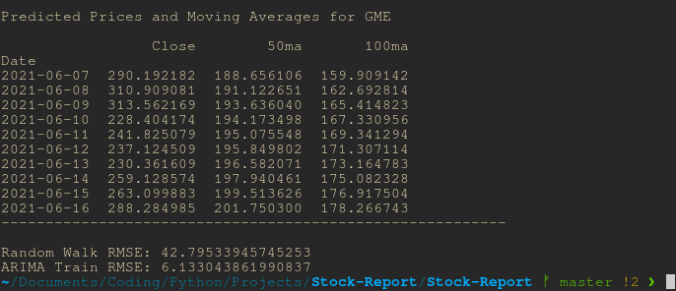

Slide 10
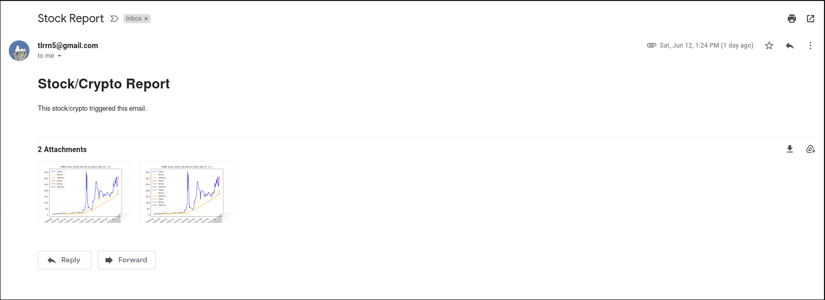
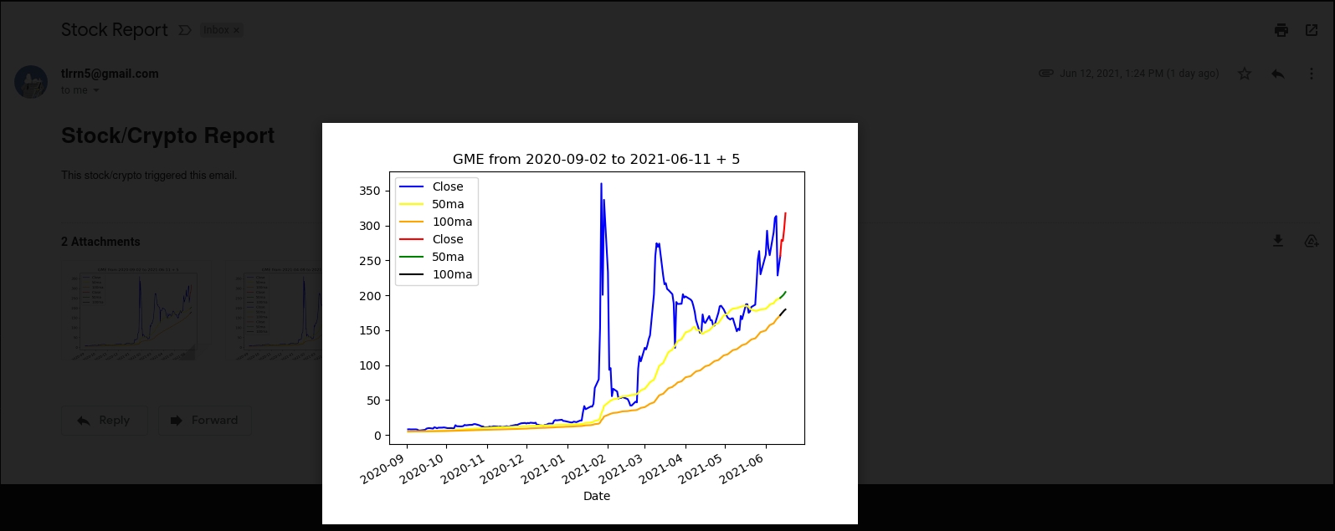
Email
This takes in the new pictures and sends them to the account specified in the env file created by the user.
Here is an example of the actual message on the left and a picture on the right:

Slide 11

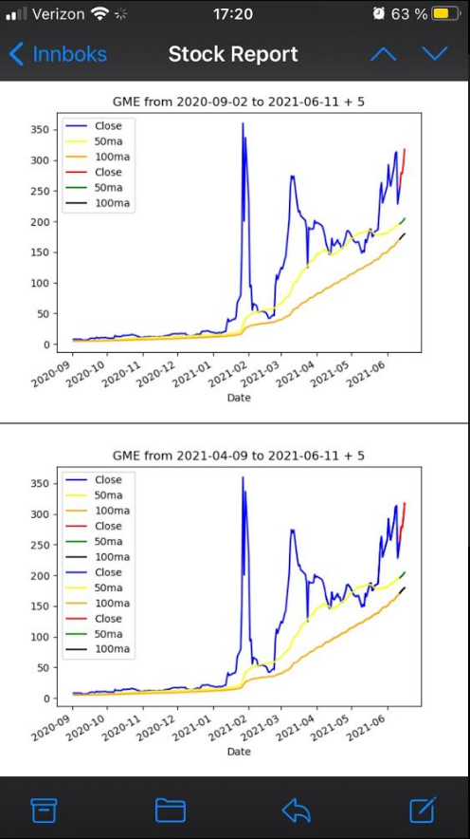

Slide 12

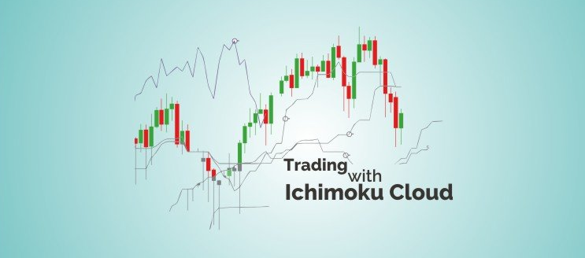

a Japanese technical analysis technique.

Slide 13
Algo_Trading:
Ichimoku Clouds:
Is a technical indicator, that can be used as support and resistance levels, as well as momentum and trend direction.
The strategy has been built using the Conversion and Base lines from the Ichimoku Cloud indicator.
To evaluate the strategy, we calculated Metrics Values and cumulative returns and compared them against the Strategy of Holding the Position for the same time frame.
Strategy evaluated:
Ichimocu_trend: Conversion line > Base line , Buy
Holding_Position : Buy (sell at the end of period)
We used Three different time frame:
60 days / 1 hour
6 months / 1 hour
5 years / 1 day

Slide 14
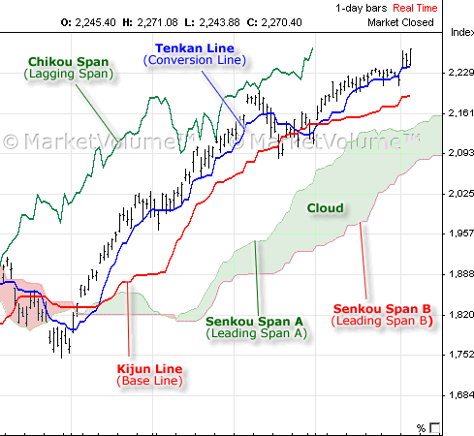
The Ichimoku Cloud, developed by Goichi Hosoda in 1960
Is a technical indicator composed of five lines or calculations
Conversion and Base lines: a 9-period average, a 26-period average of high and low prices.
Lagging Span, 26 closing price line.
Leading Span A line, average of Base line and Close price, and Leading Span B line, a 52-period average of high price. The space between these two lines forms the Cloud. Used to forecast support and resistance price.

Slide 15
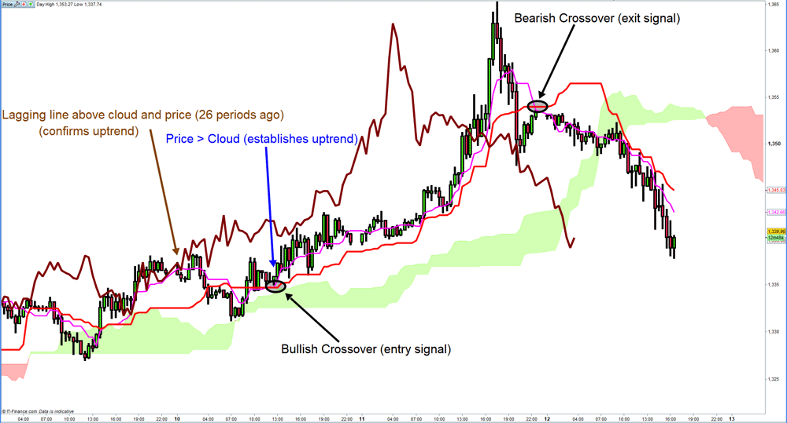
Strategy: Tenkan line > Kijun Line, Buy
Strategy: Tenkan line < Kijun Line , Sell

Slide 16
You’ve got an eMail
The Ichimoku Cloud Strategy
Indicator: The Technical Analysis Library for Python, ta
import ta
from ta import add_all_ta_features
To get: Tenkan line 'trend_ichimoku_a’,
Kijun Line 'trend_ichimoku_b'
Data: Yahoo! Finance Library
import yfinance as yf
to get: Date, Close, High, Low
Main condition on the Code: Strategy: (Tenkan line > Kijun Line, Buy, Sell)
signals_df['trend_ichimoku'] = np.where(signals_df['trend_ichimoku_a'] > signals_df['trend_ichimoku_b'], 1.0, 0.0)
Calculate: Backtest - Cumulate Returns - Metrics

Slide 17
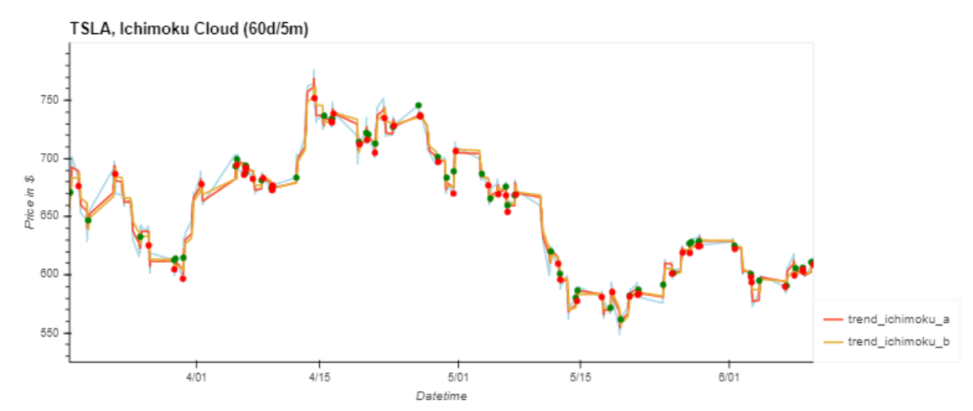
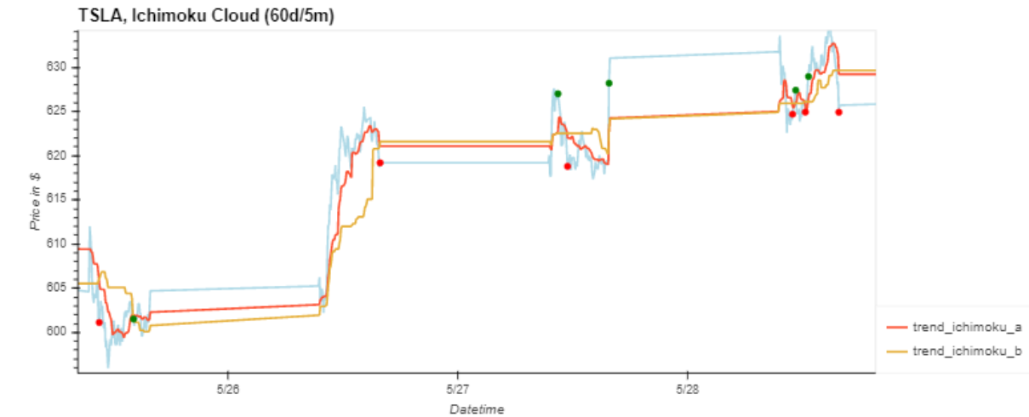

Slide 18
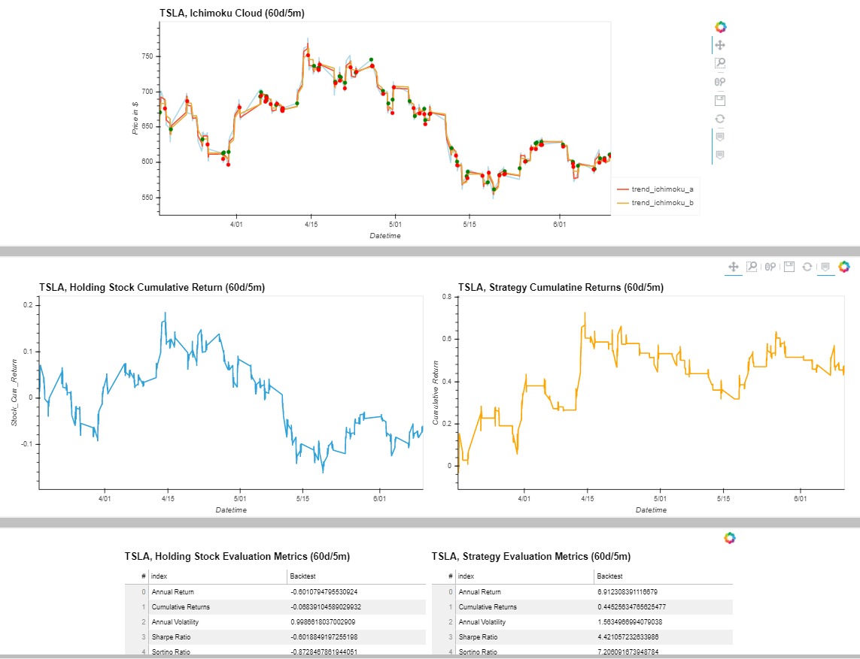

Slide 19
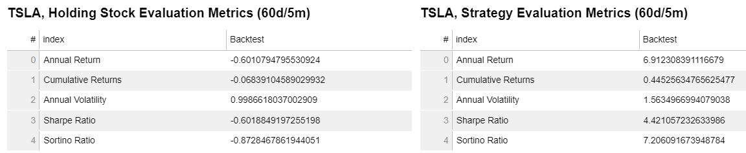
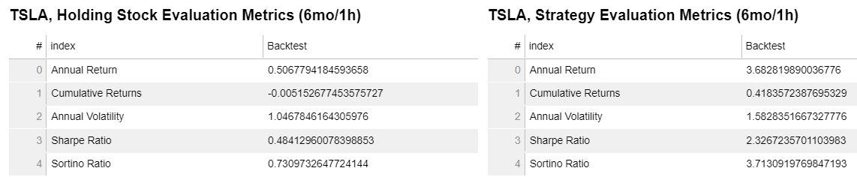
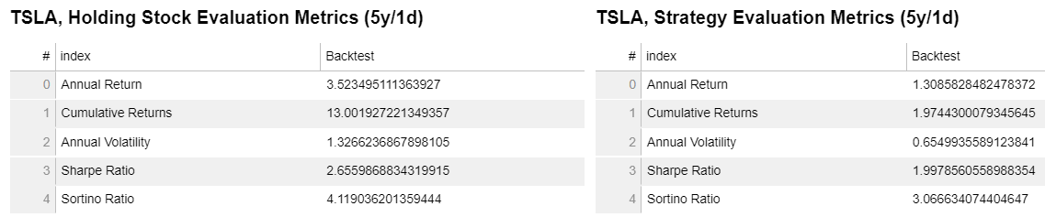

Slide 20
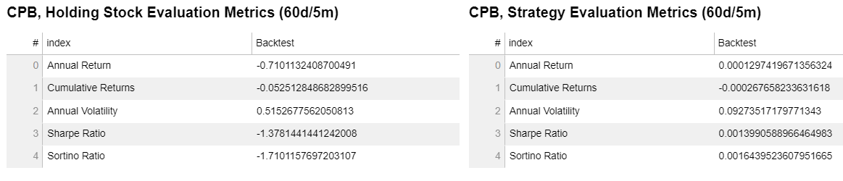
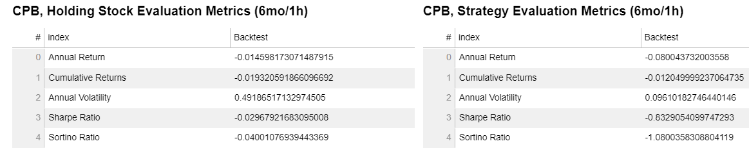
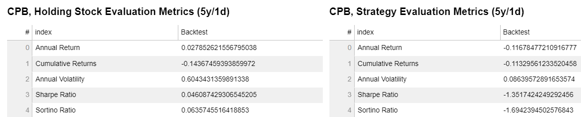

Slide 21
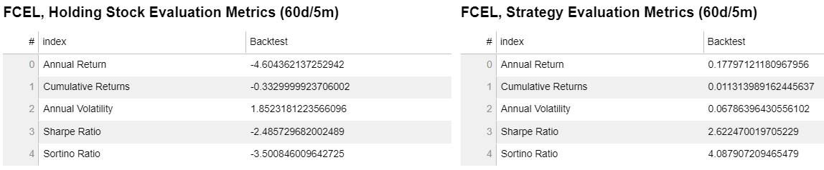
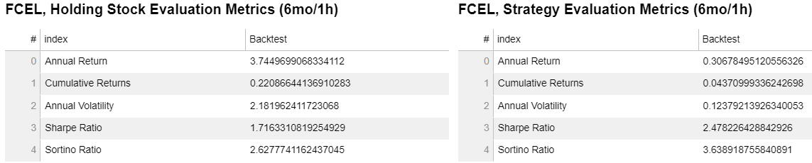
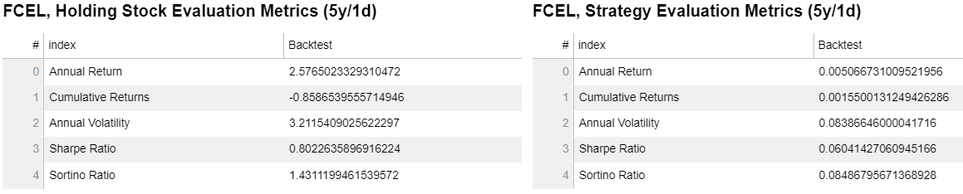

Slide 22
You’ve got an eMail
Conclusions
The Ichimoku Strategy is more recommended to be use in a short time frame (60 days/5 min) where it shows the cumulate returns most of the time is better than holding the position for the same time frame.
In stocks with negative trend, the Ichimoku strategy can mitigate the loss compared to the holding position strategy.

Slide 23
Back up …. Other Strategies

Slide 24
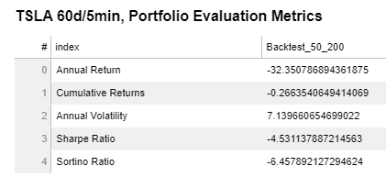
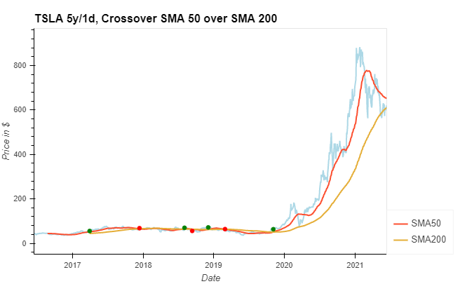
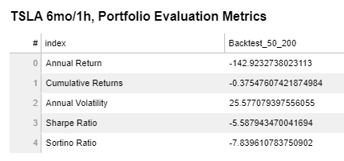
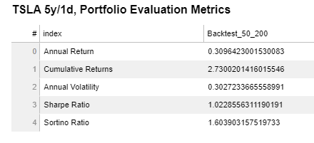
Simple Moving Average: calculates the average of a selected range of prices, usually closing prices, by the number of periods in that range. A simple moving average is a technical indicator that can aid in determining if an asset price will continue or if it will reverse a bull or bear trend.

Slide 25
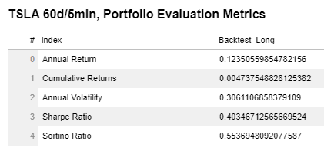
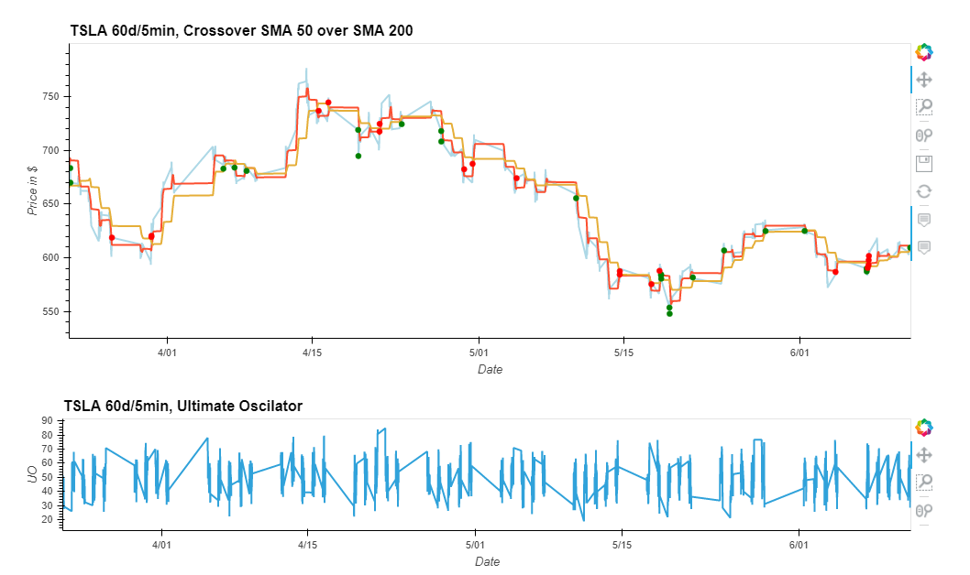
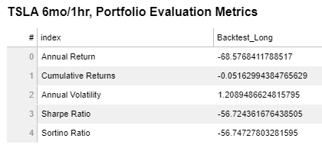
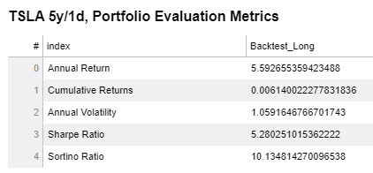
Ultimate Oscilator: combines short-term, intermediate-term, and long-term price action into one oscillator. It attempts to give overbought and oversold readings, potential buy and sell signals, and confirmations of price action as well as divergences that might warn of future price reversals.

