Slide 1
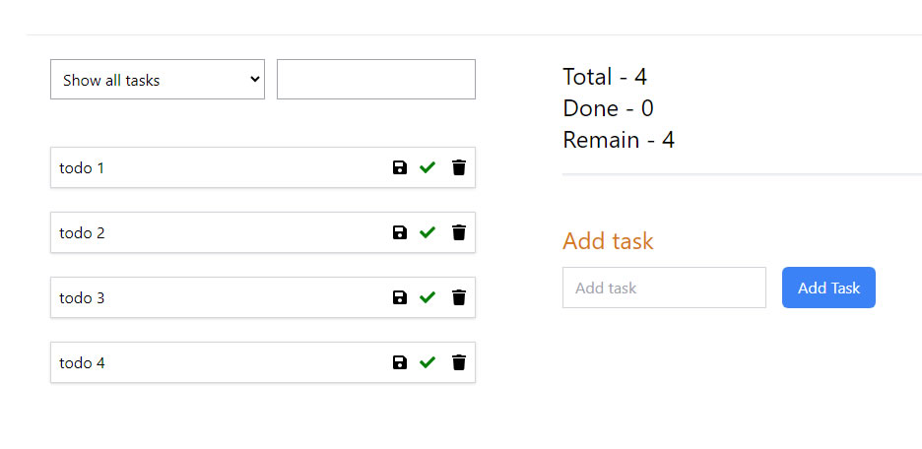
App.jsx
TasksList.jsx
TaskFilter.jsx
TaskInfo.jsx
Task.jsx
Task.jsx
TaskInfo.jsx
Task.jsx
Task.jsx

Slide 2
_
_
_
_
_
_

