Slide 1
Open Source Audio Processing Platform--Live Workshop!
Feasibility studies
Funded by NIDCD R44 DC015445 (Creare)

Slide 2
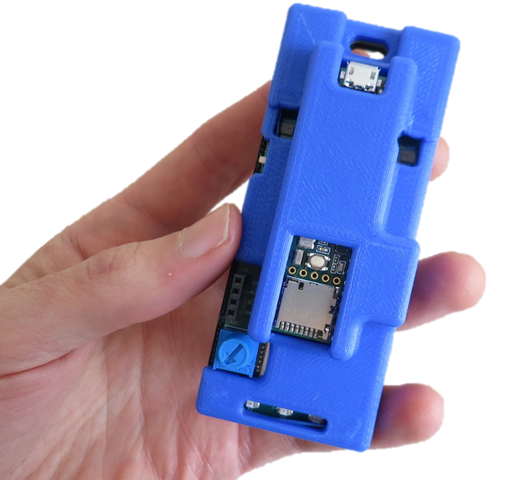
Background
Ability to modify hearing-aid signal processing is limited
Free and Open-Source Software (FOSS)
Tympan Hardware
Teensy 3.6 microcontroller
2 analog inputs/outputs
USB, Bluetooth, Ethernet, serial bus interface
Microphones
Uses the Arduino development environment
Notes:
Proprietary algorithms
FOSS successfully used for other research

Slide 3
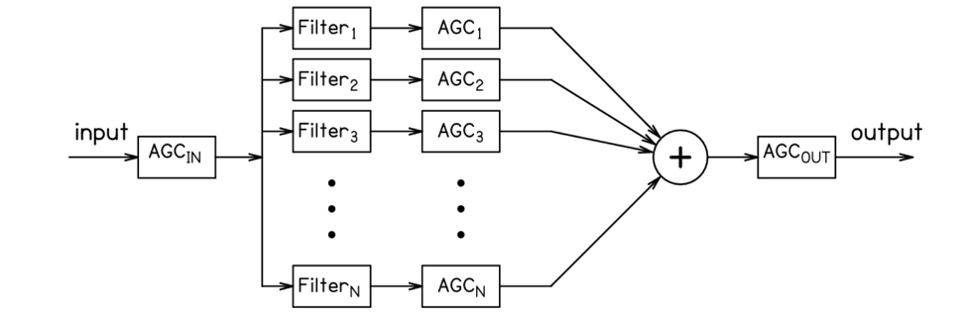
Tympan Hearing-Aid Algorithms
8-channel filterbank followed by WDRC (Alexander et al. 2015)
Envelope peak detector (Kates 2008)
Adaptive feedback circuit
Notes:
selectable IIR or FIR filters, cutoff frequencies…4.4 ms impulse response

Slide 4
Feasibility experiments: Purposes
Benchmark Tympan to a commercially available device
Electroacoustic measures
ANSI
Hearing-aid speech perception index (HASPI, Kates et al. 2014)
Hearing-aid speech quality index (HASQI, Kates et al. 2010)
Behavioral measures
AzBio sentences in 10-talker babble (Spahr et al. 2012)
CASPA vowel-consonant-vowel words (Mackersie et al. 2001)
Notes:
HASPI and HASQI account for envelope and TFS of speech, correlate w/ quality and perception ratings in other studies, are relative to NAL-R
Interest in using HASPI/HASQI to develop signal processing methods
Documented accuracy of HASPI relative to Behavioral measures

Slide 5
Feasibility experiments: Participants
n=21 adults
Conditions:
Unaided
Tympan (8 ch, 5 ms AT, 300 ms RT)
Phonak Bolero (20 ch, 10 ms AT, 150 ms RT)
Set to NAL-NL1, feedback manager on
Measured added stable gain in KEMAR (50 dB HL)
Notes:
Belore: premium, 10- and 150-ms AT/RT. channel-specific 4-microphone adaptive-directional microphones, frequency lowering, 20-compression channels, and adaptive feedback control. The adaptive feedback control consisted of both a phase cancellation system and an adoptive notch filter.
ASG: 2 NH listeners, 5x

Slide 6
Feasibility experiments: Analysis
Outcome variables
added stable gain
hearing-aid output levels
proportion correct for CASPA & AzBio
HASPI and HASQI scores
Series of repeated-measures ANOVAs to examine effect of processing condition

Slide 7
Feasibility experiments: Real ear output
Mean added stable gain = 15.9 dB (SD=2.1)

Slide 8
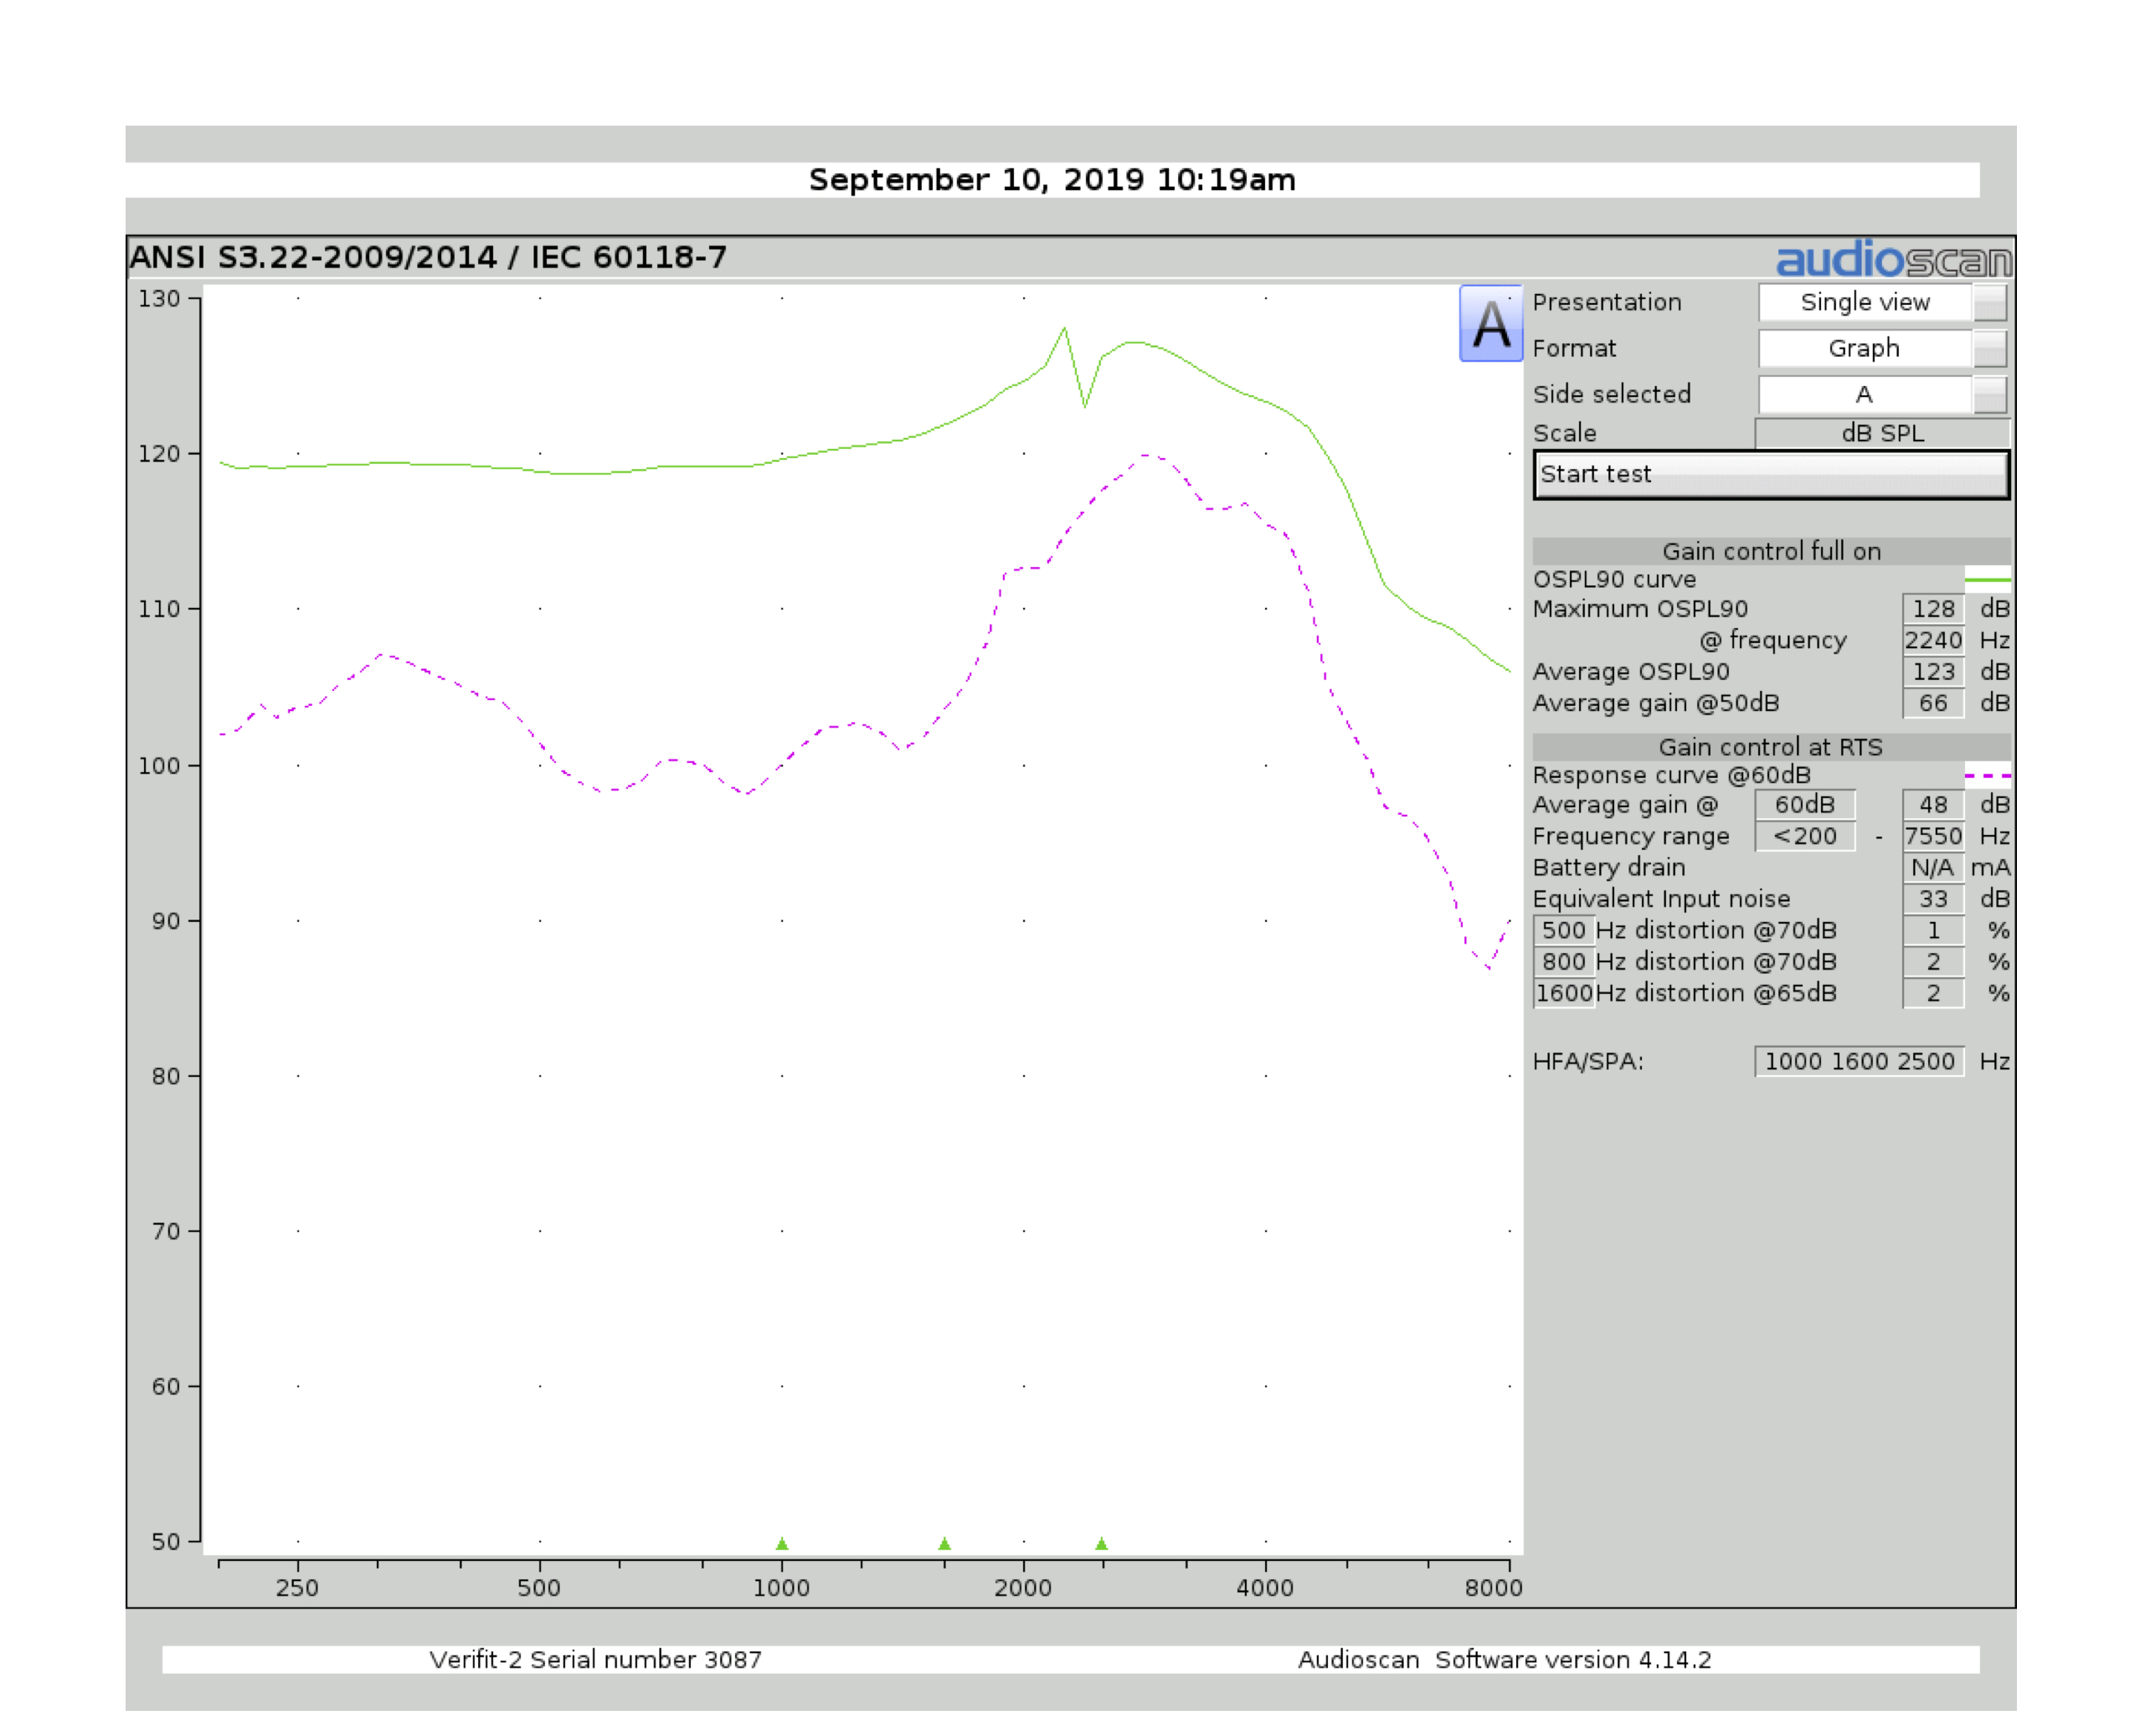
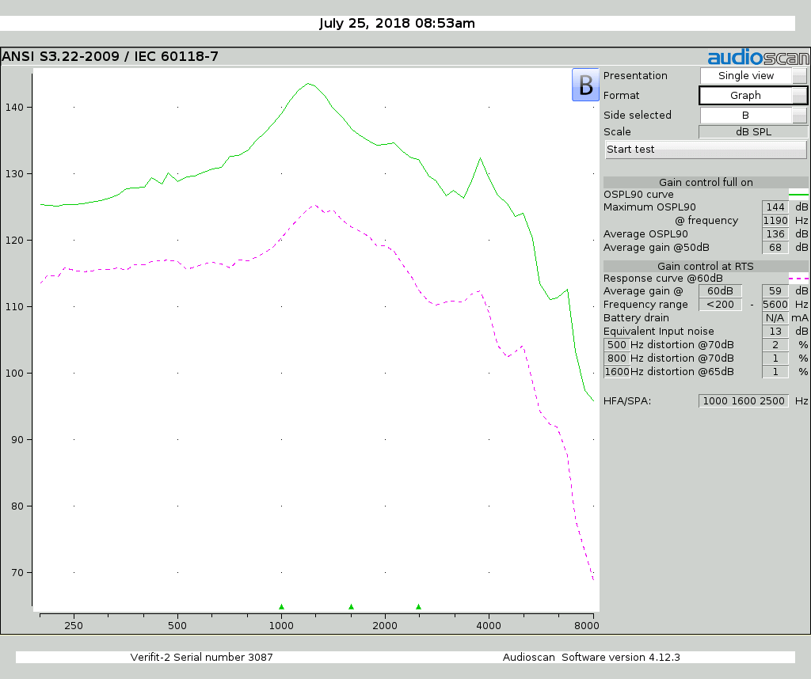
Feasibility experiments: ANSI
Tympan
Bolero

Slide 9
Feasibility experiments: Speech recognition
Notes:
First, percent correct improved significantly from 55 to 65 dB SPL for the unaided but not for the aided conditions.
Second, percent correct was significantly better aided than unaided at 55 dB SPL but not at any other input level.
Third, for each input level, percent correct did not differ significantly between the two aided conditions.
AzBio: Did not differ significantly.

Slide 10
Feasibility experiments: HASPI/HASQI

Slide 11
Discussion
Added stable gain (15.9 dB) consistent with prior work
HASPI predicted
better unaided speech recognition: HA noise, feedback management
100% recognition in quiet: floor effect
Higher equivalent input noise likely due to microphone noise
May have contributed to lower HASPI score

Slide 12
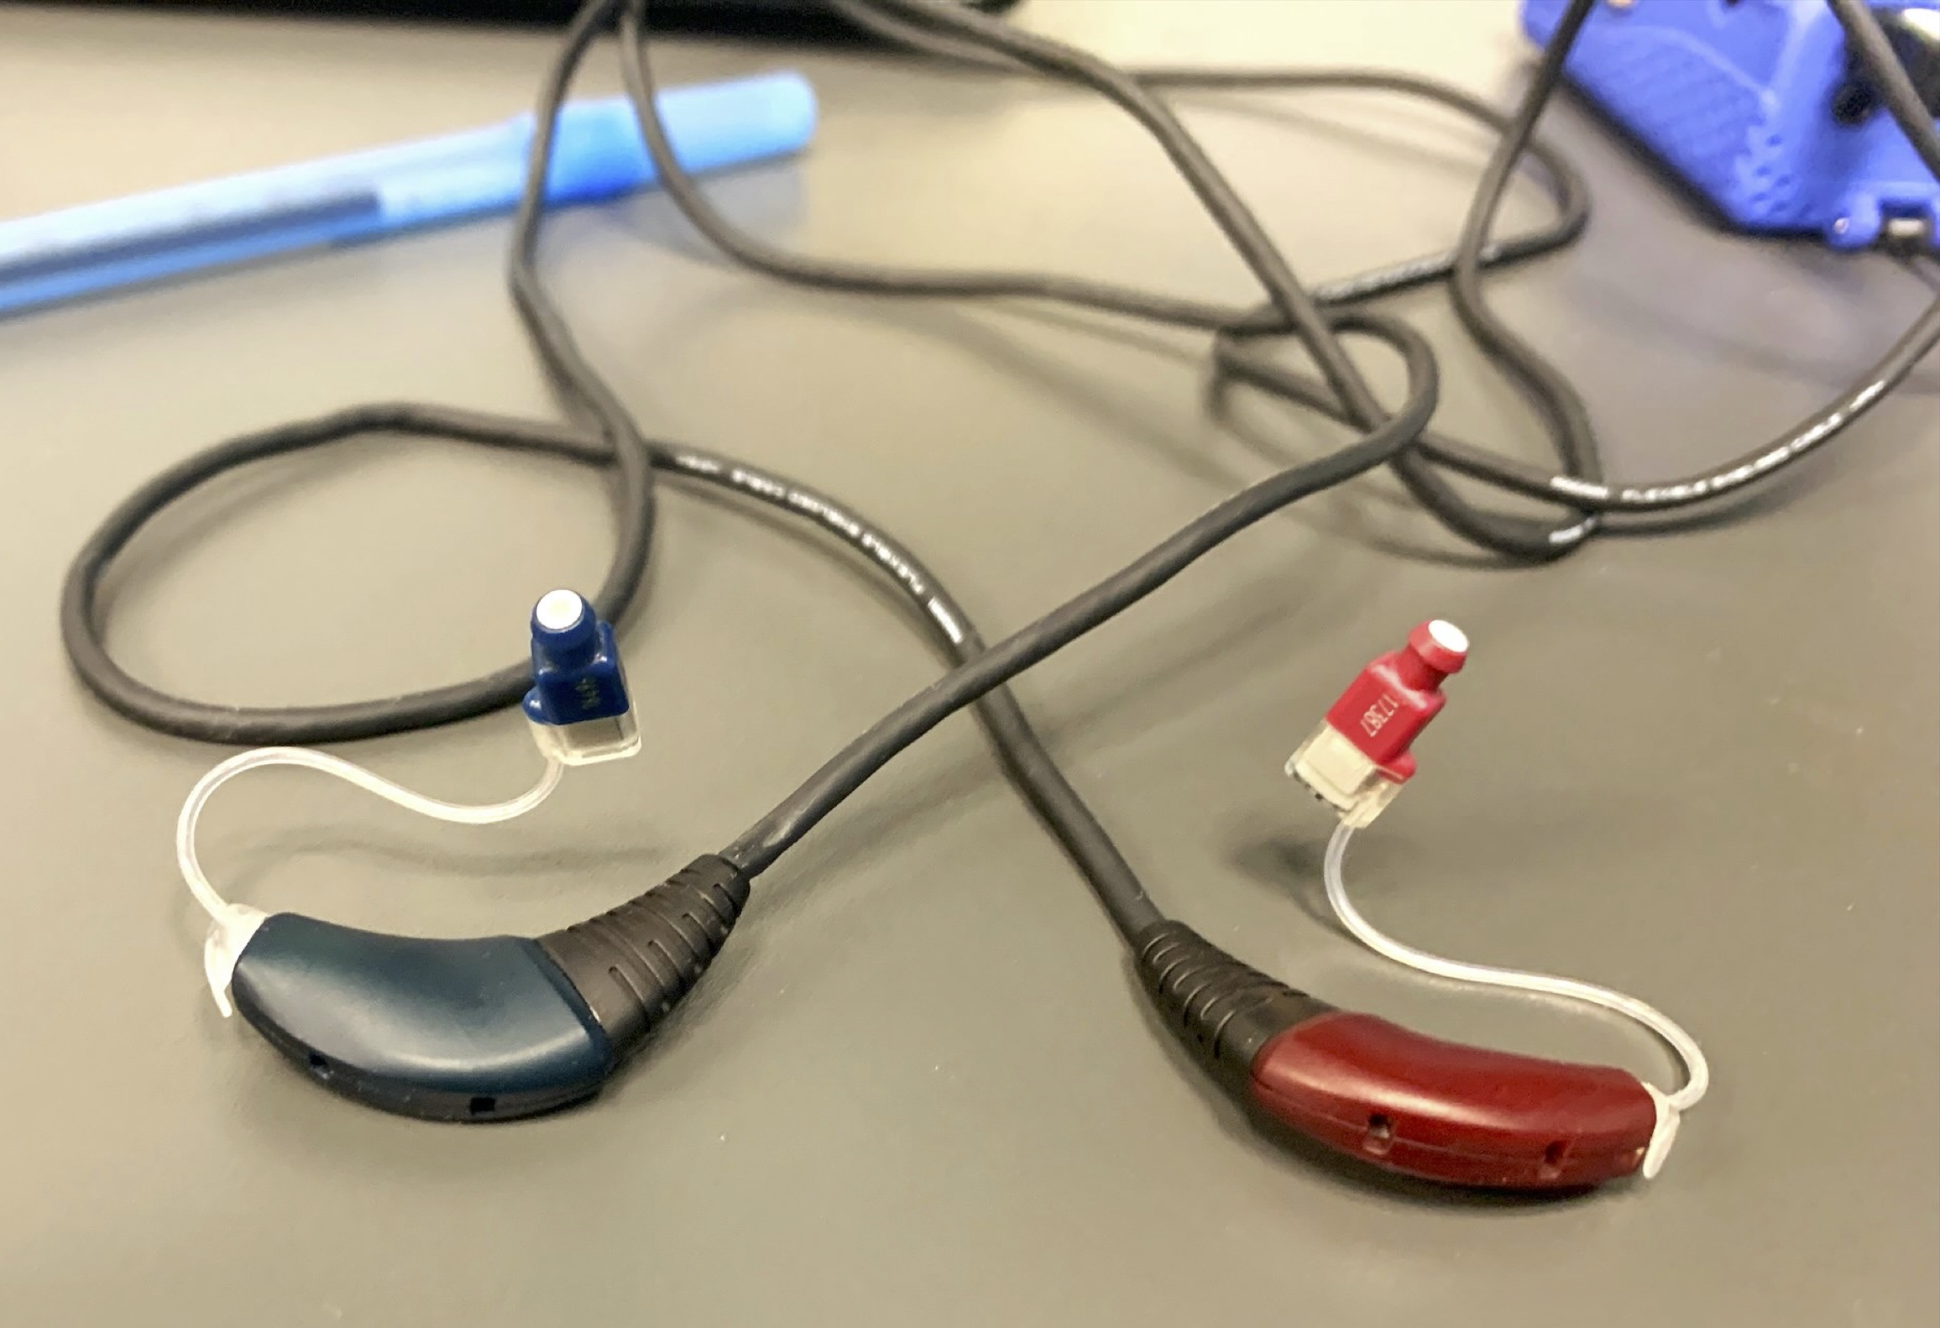
Future work
Manipulate feedback cancellation parameters to test effects on added stable gain / sound quality
RIC earpiece
I/O measurements
Nonlinear frequency compression
Directional performance

Slide 13
Thank you!

Slide 14
References
Alexander, J. M., & Masterson, K. (2015). Effects of WDRC release time and number of channels on output SNR and speech recognition. Ear and Hearing, 36, e35-e49.
Boike, K. T., & Souza, P. E. (2000). Effect of Compression Ratio on Speech Recognition and Speech-Quality Ratings With Wide Dynamic Range Compression Amplification. Journal of Speech, Language, and Hearing Research, 43(2), 456-468.
Bor, S., Souza, P., & Wright, R. (2008). Multichannel Compression: Effects of Reduced Spectral Contrast on Vowel Identification. Journal of Speech, Language, and Hearing Research, 51(5), 1315-1327.
Brennan, M. A., McCreery, R. W., Kopun, J., Lewis, D., Alexander, J. M., & Stelmachowicz, P. G. (2016). Masking Release in Children and Adults with Hearing Loss When Using Amplification. Journal of Speech, Language, and Hearing Research, 59, 101-121.
Brennan, M., & Souza, P. (2009). Effects of expansion on consonant recognition and consonant audibility. Journal of the American Academy of Audiology, 20(2), 119-127.
Kates, J. M. (2008). Digital hearing aids: Plural Publishing.
Kates, J. M., & Arehart, K. H. (2010). The hearing-aid speech quality index (HASQI). Journal of the Audio Engineering Society, 58(5), 363-381.
Kates, J. M., & Arehart, K. H. (2014). The hearing-aid speech perception index (HASPI). Speech Communication, 65, 75-93.
Mackersie, C. L., Boothroyd, A., & Minniear, D. (2001). Evaluation of the computer-assisted speech perception assessment test (CASPA). Journal of the American Academy of Audiology, 12(8), 390-396.
Marcrum, S. C., Picou, E. M., Bohr, C., & Steffens, T. (2018). Feedback reduction system influence on additional gain before feedback and maximum stable gain in open-fitted hearing aids. International Journal of Audiology, 57(10), 737-745.
McCreery, R. W., Venediktov, R. A., Coleman, J. J., & Leech, H. M. (2012). An evidence-based systematic review of amplitude compression in hearing aids for school-age children with hearing loss.
Moore, B. C. J., Peters, R. W., & Stone, M. A. (1999). Benefits of linear amplification and multichannel compression for speech comprehension in backgrounds with spectral and temporal dips. The Journal of the Acoustical Society of America, 105(1), 400-411.

Slide 15
References
Novick, M. L., Bentler, R. A., Dittberner, A., & Flamme, G. A. (2001). Effects of release time and directionality on unilateral and bilateral hearing aid fittings in complex sound fields. Journal of the American Academy of Audiology, 12(10), 534-544.
Rallapalli, V. H., & Alexander, J. M. (2019). Effects of noise and reverberation on speech recognition with variants of a multichannel adaptive dynamic range compression scheme. International Journal of Audiology, 1-9.
Ricketts, T., Johnson, E., & Federman, J. (2008). Individual differences within and across feedback suppression hearing aids. Journal of the American Academy of Audiology, 19(10), 748-757.
Salorio-Corbetto, M., Baer, T., Stone, M. A., & Moore, B. C. J. (2020). Effect of the number of amplitude-compression channels and compression speed on speech recognition by listeners with mild to moderate sensorineural hearing loss. J Acoust Soc Am, 147(3), 1344.
Spahr, A. J., Dorman, M. F., Litvak, L. M., Van Wie, S., Gifford, R. H., Loizou, P. C., . . . Cook, S. (2012). Development and validation of the AzBio sentence lists. Ear and Hearing, 33(1), 112-117.
Spriet, A., Moonen, M., & Wouters, J. (2010). Evaluation of feedback reduction techniques in hearing aids based on physical performance measures. The Journal of the Acoustical Society of America, 128(3), 1245-1261.
van Buuren, R., Festen, J., & Houtgast, T. (1999). Compression and expansion of the temporal envelope: Evaluation of speech intelligibility and sound quality. The Journal of the Acoustical Society of America, 105(5), 2903-2913.

Slide 16
I/O and directional measurements

Slide 17
Review of WDRC
Trade-off between audibility, SNR, and distortion
Poorer speech recognition w/ fixed and high (≥ 3:1) compression ratios (van Buuren et al. 1999; Boike et al. 2000; Bor et al. 2008)
Smaller effect for compression ratios set to a prescriptive procedure
Better speech recognition with a faster compress speed for:
low-level speech in quiet (Brennan et al. 2009; McCreery et al. 2012)
noise—depending on # of channels and study (Moore et al. 1999; Alexander et al. 2015 but see Novick et al. 2001; Brennan et al. 2016; Rallapalli et al. 2019, Salorio-Corbetto et al. 2020)

Slide 18
Review of HASPI and HASQI?

Slide 19
Review of adaptive feedback control
Methods include all-pass filter, phase cancellation, narrowband filter, gain reduction, frequency shifting
Models of feedback pathway
Static or adaptive
Pre-determined or measured
Implementations vary by manufacturer and model
Effectiveness quantified with
added stable gain
power concentration ratio
Notes:
all pass filter
filter entire signal
changes phase, which can prevent phase of two signals from being in phase
to my knowledge, no longer used
phase cancellation
inject signal—with opposite phase to that of feedback pathway
narrowband filter
attenuate at frequency where feedback occurs OR
use filter to shift phase of feedback pathway
frequency shifting
shift frequencies over 10-25 Hz range
prevents phase from aligning
Implementations: single/multiple, do/do not measure feedback pathway, adaptive/static, speed
Maximum stable gain (MSG)
highest gain prior to feedback
feedback typically detected via a nearby listener
measure with and without feedback control
Aided stable gain (ASG)
difference, in dB, between MSG with and without feedback control
Power concentration ratio
split signal into frequency bins
measure output in each bin
take 5 bands with highest level / by overall power
higher means peakier signal
> .5 indicates feedback

Slide 20
Review of adaptive feedback control
ASG varies from 0-25 dB
More effective systems tend to result in poorer sound quality
Use of multiple methods does not improve ASG

