Slide 1
Measuring Hearing Aid Compression Algorithm Preference with the Tympan Jennifer J. Lentz Donghyeon Yun Stuart Smiley
2021 Meeting of the Acoustical Society of America Tympan Challenge

Slide 2
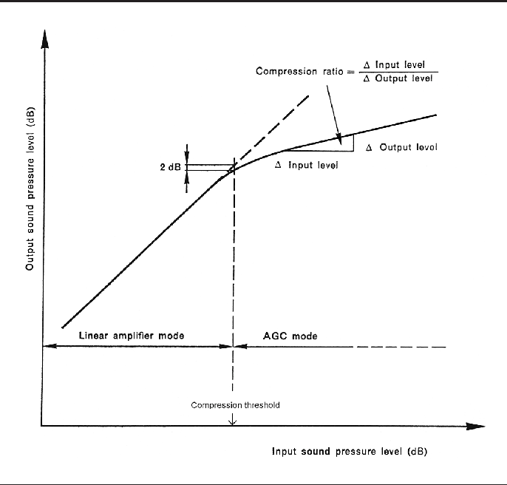
Background: WDRC
Modern hearing aids use nonlinear algorithms (such as Wide Dynamic Range Compression) to provide audibility to low-level sounds without contributing to added discomfort for high-level sounds (e.g., Souza, 2002).
These algorithms alter the gain based on stimulus level and are defined by a variety of parameters:
attack and release time, compression ratio, compression threshold, etc.
Moore (2008)

Slide 3
Background: WDRC
The nonlinear nature of the algorithms can distort the envelope of sounds (e.g., Jenstead and Souza, 2005) and alter the signal to noise ratio (SNR) at the output of the hearing aid (e.g., Miller, 2017)
Influenced by compression ratio, compression speed, amount of gain applied (usually determined by hearing aid prescriptions), number of channels, etc.
The environment is also important
Type of background noise (e.g., fluctuating or not)
Or reverberation (Reinhart at al., 2017)

Slide 4
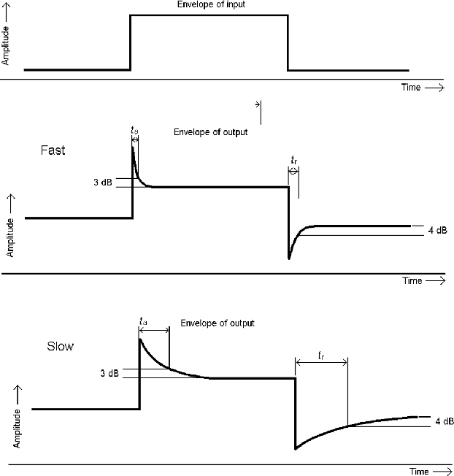
Background: Compression speed
Fast-acting better amplifies low-level sounds
Slow-acting compression produces less distortion to the stimulus
Can sound less “choppy”
better preserves SNR
Moore (2008)

Slide 5
Background: Other factors
Many studies evaluating subject’s preference, speech intelligibility, and the acoustic changes imposed by these algorithms have been conducted in a lab environment using pre-processed stimuli (e.g., Souza et al., 2006; Naylor and Johannesson, 2009; Reinhart at al., 2017)
Whether subjects benefit/prefer more from fast or slow compression (intelligibility and preference) is a complex problem that relates to the environment and characteristics of the hearing aid wearer (Gatehouse 2006; Souza et al., 2019)
Some studies have used clinically fit hearing aids (Souza and Sirow, 2014; Miller, 2017) and some also conducted measurements outside of the laboratory

Slide 6
Purpose
We plan to use the Tympan to:
Aims: Determine subject preferences for compression speed and compression ratio in real-world environments and relate the subjective results to stimulus acoustics
Make real-world acoustic measurements of the environment while subjects are answering questions about their preferences (pre and post processing)
Use ecological momentary assessment to get preference data (“head to head” comparisons) from participants wearing the Tympan.
This study will also:
will gather preference data for a variety of environmental sounds
will acoustically survey the acoustic environments

Slide 7
Methods
Tympan will be programmed with gain and compression settings based on NAL-NL2 for an 8-band WDRC algorithm. These will be the baseline hearing aid fit
Subjects will be asked to wear the Tympan for 1-2 days (8 hours/day)
Roughly every hour, subjects will use the Tympan app to listen to different algorithm settings and leave notes
Subjects will select between two compression speeds (fast vs. slow) and two compression ratios (high versus low)
Fast vs. slow will be 10% above and below baseline settings
Compression ratios will be 10% above and 10% below baseline settings
Pilot testing will be conducted to ensure that these differences are noticeable
During these sessions, the Tympan will record environmental sounds for 1 minute

Slide 8
Analysis
Sound recordings will be analyzed for envelope distortion, overall level, and maybe(!) SNR using classification algorithms or a power subtraction technique (Sneds, 2015)
Also provides a survey of the environments in which these subjects use their tympan (e.g., Wu et al., 2018)
Preference data and recorded feedback will be related to various acoustic metrics

Slide 9
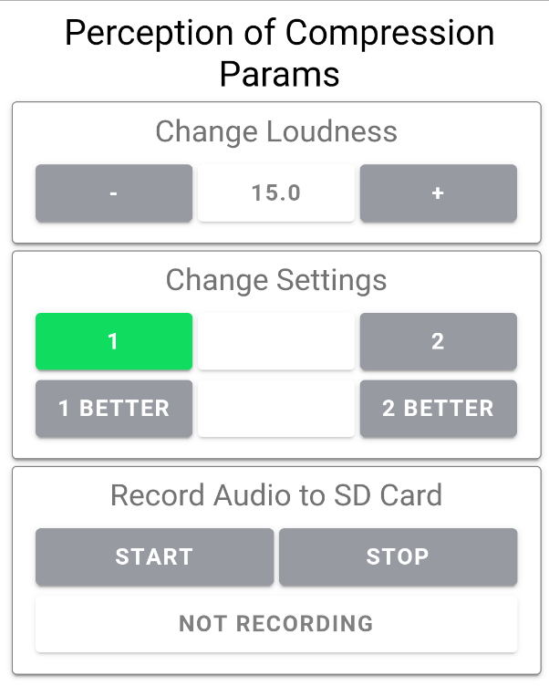
App sample
Allows subject to change overall gain and switch between compression settings
Settings will be fast/slow compression; high/low compression ratio
Subject can also record notes to SD card
Perceptions of environment
Type of environment
Perceived difficulty in listening
Description of the target sound (speech, music, something else?)

Slide 10
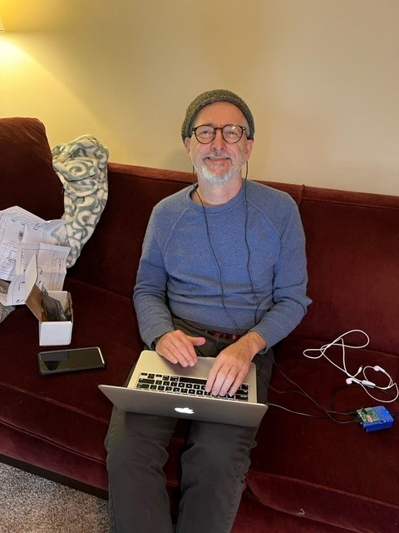
Update and current status
Prelim version of app mostly complete
Pilot testing of compression settings is our next step
Earpieces arrived a few weeks ago
Subjects likely will need a training session
In process of getting small grant support to pay subjects
Stuart programming the tympan

Slide 11
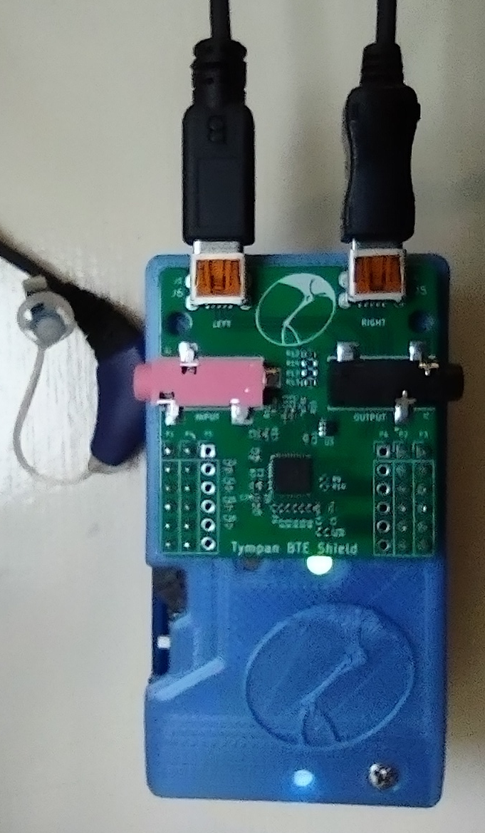
Things left to consider
How will subjects feel about wearing the Tympan and using the app?
Potential consequences of allowing subjects to control the loudness (overall gain)
We’ve programmed the tympan to beep for the EMA, but what if subjects remove their earpieces?
Can we really get SNR estimates?

Slide 12
Acknowledgements
Eric and Chip (Creare) for their help and support
Acoustical Society of America for the Tympan Challenge

