Slide 1
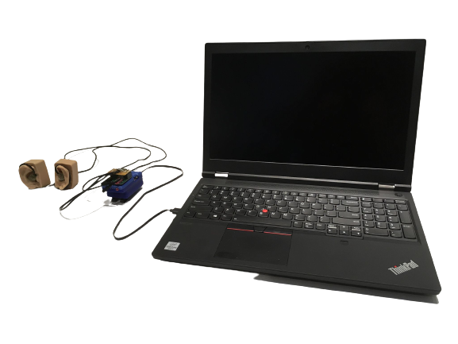
ASA 2021
4 in 4 out USB implementation using Tympan
Valentin PINTAT/Elliot Drees
2021-11-26
Notes:
Project from Elliot and Valentin
Part of the ASA/Tympan challenge
Focused on the USB audio transmission from PC to Tympan

Slide 2
Summary
⬤ ● ● ● ⭘ ○ ○ ⭘ ○ ○
Our Team
Context
Problem
Objectives
Our quest
Developed System
Results
Benefits
Notes:
Rapid presentation of the summary

Slide 3



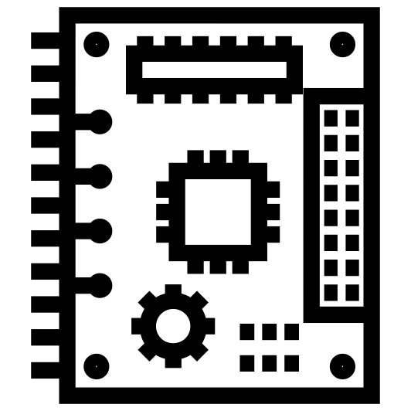

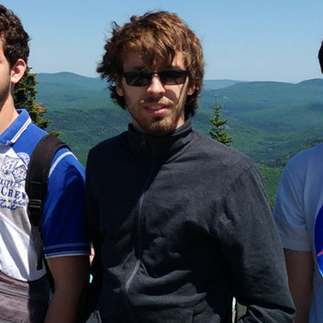
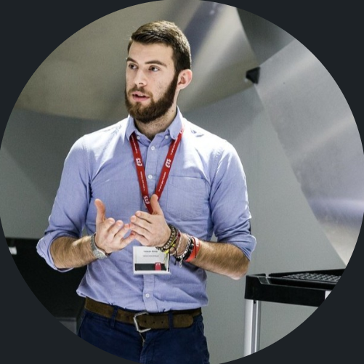



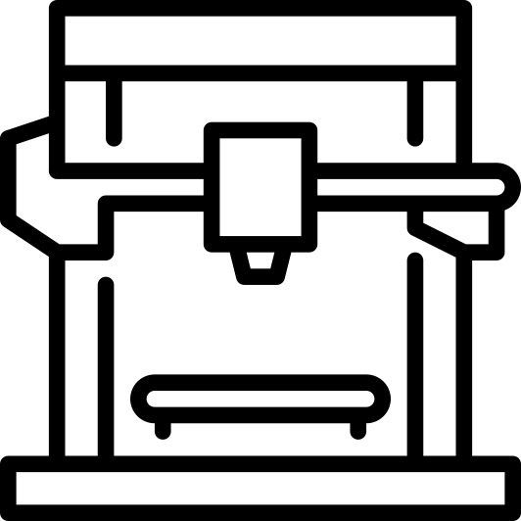


Our team
Audio wearables
In ear devices
Digital signal processing
Electronics
3D Design
Audio systems
Prototyping
Elliot Drees
Valentin PINTAT
3D Printing
Programming
Audio Measurement
Notes:
Presentation of Elliot and Valentin
Valentin
CESI engineering school in France
Research assistant at CRITIAS
Elliot
Centrale Marseille engineering school in France
PhD Candidate at CRITIAS
Both
Quick overview of our skills

Slide 4












Context
Hardware possibility :
.
4 Line IN (with Audio Shield)
Smart wearables
Tympan
4 Headphone OUT (with audio Shield)
Programmable Microphone Bias
Data width programmable as 16, 20, 24 or 32 bits
Maker community
Open source
Notes:
Developpmeent of smart wearable
Necessity of prototyping devices like the Tympan
Open source community for ease of developpement
Hardware possibilities of the tympan
4 line in
4 headphone out
Programable microphone bias on the codec
I2S/TDM link with codec programmable
Compatible with all operating systems OSX, Linux Windows
Because it’s the standard USB audio device

Slide 5







Problem
Cost
.
Ease of use
USB:
2 CH IN
2 CH OUT
16 bits
Flexibility
Notes:
A device that facilitate the developpement of wearables has to be
Cheap
Easy to use
Flexible
It’s hard to find such a device on the market
Luckily tympan and teensy saves the day!
However the tympan has software limitations with USB
We need 4 in 4 out for the devellopement of wearables in our lab (CRITIAS)
Tympan only provides 2in 2out 16 bit in it’s software

Slide 6

Objectives
Out of Ear Microphone
In Ear Microphone
.
High/Mid Frequency Speaker
USB:
2 CH IN/2 CH OUT
16 bits
Low Frequency Speaker
.
.
Notes:
The plan
Go from 2i2o software to 4i4o software
Need to work on the teensy library
Link it to the tympan library
Results
We will be able to facilitate the developpement of smart wearables
4 in for inner and outer microphone in each earphone
4 out for 2 speaker in each earphone to be able to control the two speakers independently.

Slide 7




Our quest
I’m so glad to hear about your ideas! Thank you!
I think that 4-channel audio via USB would be great. Please do be aware, however, that you would be modifying parts of the system that are outside of Tympan, which means that it is outside of my ability to provide much help.
So, looking forward, be aware that understanding USB protocols can be very difficult for non-specialists. It is much too hard for me. But, if you and your team are brave, and if you are not scared by the idea of reading USB specification documents, your idea of a 4-channel USB audio interface would be an amazing contribution to the community!
Chip
It‘s ok to try and break everything, git is your friend ☺
Notes:
So we expose our idea to the Tympan team and this is the response we have
To summerize, they tell us we are being ambitious
But they do not stop us from going forward
We are happy to move on and start working on the project

Slide 8



Our quest
Studying the documentation
Teensy
Microcontroller data sheet
Codec data sheet
USB standards
Understanding the code when there wasn’t any comments
Microcontroller-specific functions
Short timeframe
No support on teensy forum
Notes:
We run into some issues
First it’s not a simple problem as we were told
USB standards are a mouthfull
Embedded software developpement is not simple
People underestimate the size of documentation
Microcontroller manual? 4000+ pages
USB standards 700+ Pages
Understanding code without comment
It’s basically retro engineering and retro engineering takes a lot of work
Microcontroler specific functions
Short timeframe
No support on forums
We are at the edge of the spear so no one can help us in our work

Slide 9
Results
.
4i2o implementation
Profit ?
1
2
3
4
Original 2i2o
4i4o implementation
.
.
Notes:
Step 1
Started from the library created by paul
Step 2
We added the capability of having 4 microphone working
Step 3
We added the capability to have 4 microphone and 4 speakers
Step 4
Profit?
Now we can do whatever implementation we wish with a 4 in and 4 out USB system
This is nice but how do we know it works?
Verified by plugging USBin to USBout directly in the tympan code
Found some issues with the quad I2S block but we had no time to work on it

Slide 10


Results
desc.c
Modified libraries
desc.h
usb_audio.c
AudioStream.c
usb.c
usb_audio.h
AudioStream.h
The PC is sending 4CH of audio using ASIO to the teensy
usb.h
Teensy
The GIT will be released soon for more details !!!
Notes:
This is what the audio chain we were working on looked liked
Tympan identifies itself with the PC as a 4i 4o device
PC sends 4 channels to the Tympan
Tympan sends back 4 channels to the PC
So, what did we change?
The usb descriptor usb_desc.c
Changed the size of some buffers
The usb_audio
Block that interfaces with the teensy audio library
Changed the input bloc and output bloc

Slide 11


Benefits
Access to the Audio Data in real time
Contributing to an open source project
Accelerating the dev. of the next-gen wearables
Responding to the needs of the community
Helping our Lab to have a better audio research platform.
Notes:
What did we bring to the community
We now have access to 4 in 4 out
Facilitate the devellopement of wearables
We are helping our lab have a common platform to devellop wearables
Provide the open source community with more powerful tools.

Slide 12

Thanks !
Thanks to Chip and Eric for sending us some beautiful hardware and supporting us in our endeavors
Thanks to ASA for hosting the Hackaton
Thanks to Paul Stoffregen for the work on the teensy GIT repo
Thanks to CRITAS to let us use the Laboratory space.
Notes:
Thanks for the ASA hosting
Thanks for Chip and Eric for the hardware they sent us and their encouragments during hard times
Thanks for our lab CRITIAS for the space
Thanks for all the work from Paul Stoffregen for the work on the teensy

Slide 13
Valentin PINTAT Elliot Drees
vpintat@critias.ca
edrees@critias.ca
Don’t hesitate to contact us for more information or any questions !

