Slide 1
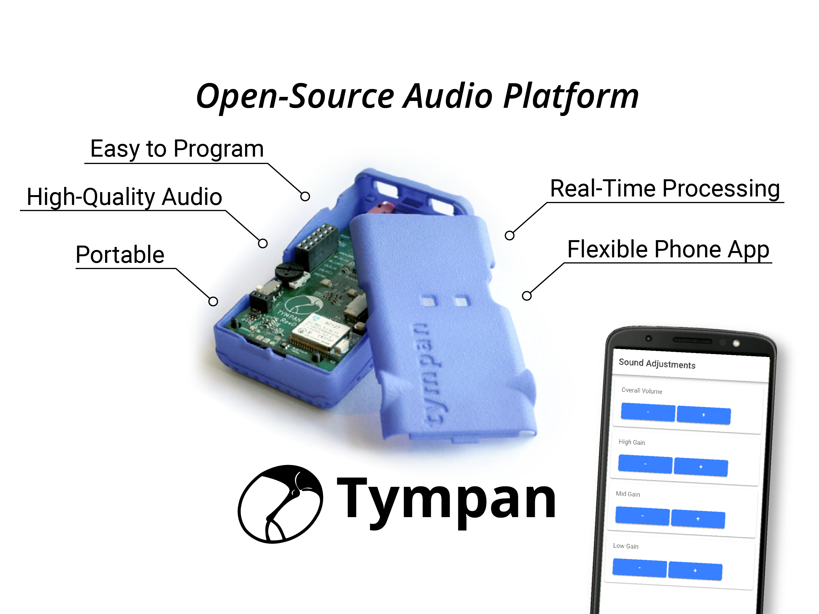
4aPP

Slide 2
Open Source Audio Processing Platforms
US Government - NIH/NIDCD Initiative
Open source tools to:
Standardize implementations across groups
Sustain research to extract user benefit from algorithms
Speed use of new commercial semiconductor hardware
Lower barriers for development of new audio processing algorithms.
Embedded Hardware & Software built for Audio Processing
Several groups were funded
3 RO1’s (algorithm focus) and 3 SBIRs (hardware focus)
http://www.nidcd.nih.gov/funding/programs/Pages/Open-Speech-Signal-Processing-Platform-Workshop.aspx
Notes:
Common platform, not only to build off of, but to share our results
So if you are a researcher with interest in electronics – easy entry to embedded programming
Or if you are into software, audio processing hardware that’s ready to integrate

Slide 3
Tympan Platform
The Tympan was developed through a collaboration between:
Creare LLC
Boys Town Medical Research Center
University of Nebraska, Lincoln
tympan.org
tympan.org was created as a result of a Phase I SBIR for this project
tympan.org is independent of Creare but received funding from the grant to help with commercialization

Slide 4
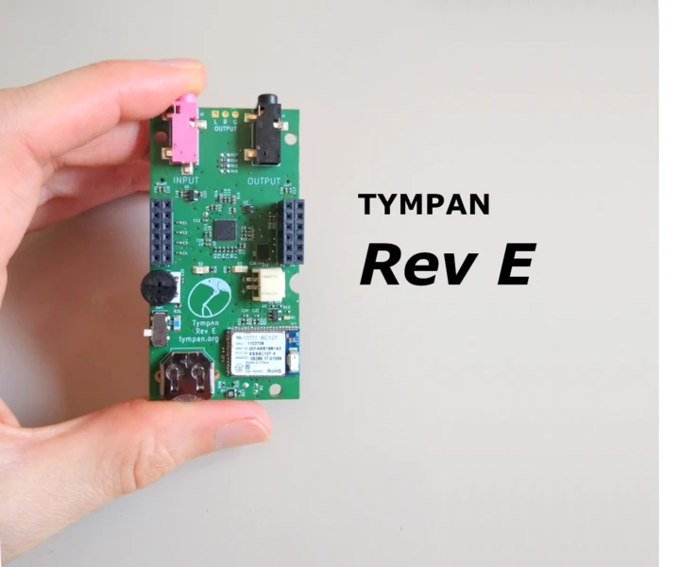
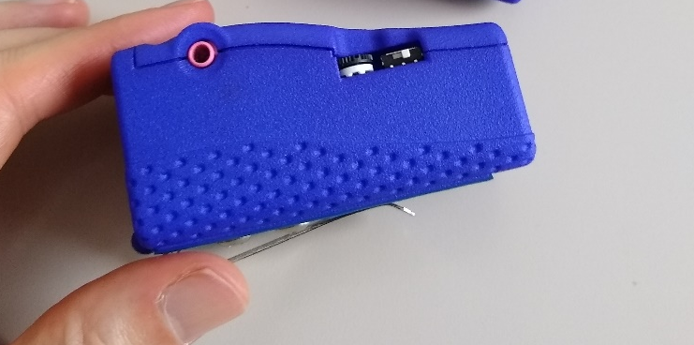
What’s Next?
We will continue to support the forum and encourage everyone to share questions or special results on the forum
Consider subscribing to NIDCD’s list serve:
NIDCD-OPENSPEECH-ANNOUNCEMENTS-L@LIST.NIH.GOV
Consider submitting grants using the tympan – we’re happy to provide support
Creare will continue to seek grant support for the continued development of tympan

Slide 5







Acknowledgements
Joel Murphy tympan.org
Chip Audette Creare LLC
Eric Yuan Creare LLC

Slide 6
Today’s presentations
4aPP1: Speech envelope enhancement to improve cocktail-party listening
4aPP2: Influence of number of hearing aid compression channels on spatial release from masking
4aPP3: Measuring Hearing Aid Compression Algorithm Preference with the Tympan
4aPP4: Directionality characteristics of the Tympan open-source hearing aid and earpieces
4aPP5: Immersive multitalker remote microphone system
4aPP6: A general-purpose pipeline to interface the Tympan hardware with an external computer
4aPP7: Smart earphone development platform
4aPP8: Open-Source Baby Monitor
4aPP9: Open Source Audio Platform Ultrasound Dosimeter
4aPP10: Spatial Acoustic Processing with a Laser Distance Sensor using a Tympan Device

