Slide 1
Ecommerce Product Analysis– Technical Presentation
Date: March 7th, 2023
Presenter: Tynan Groot

Slide 2
How can we identify an Ecommerce product that is consistent in sales and makes substantial revenue?
!
A substantially demanded product will meet criteria 1, which is selling in quantities of 7 or more on average and having a price of 20 pounds per unit.
Criteria 1
The product should be high demand; selling in large quantities
!
Criteria 2
The product should have some reasonable potential to sell in even higher quantities.
This will be defined by criteria 2, which is selling in quantities >=10 in at least 20% of its sales.
!
We want a product that is not prone to any seasonal changes or economic downturns within a given country. For these we have criteria 3, selling in similar quantities year-round, and criteria 4, selling in 4 of more countries.
Criteria 3 &4
The product should sell stably and consistently
!
Revenue Analysis
The product should score high in revenue and whatever aspect of the product is most correlated with it
Which product is the most demanded and has that which translates to a large revenue?

Slide 3
Through descriptive and inferential statistics, we see that the best product is the doormat fairy cake for being high in the variables most correlated with revenue, and for having a high number of criteria.
How can we identity a great, high- price (above 20 pounds per unit) E-commerce product that is bought in quantities higher than 10 in more than 20% of purchases and sells in at least 4 countries?​
Descriptive stats: We will find the products meeting criteria 1 by measuring average price per unit and quantity per order of each product. We will use these product in the rest of our criteria to narrow our search.
Inferential stats: We will use linear regression to find which criteria/aspect (quantity, quantity per order, price, etc.) leads to the most revenue.

Slide 4
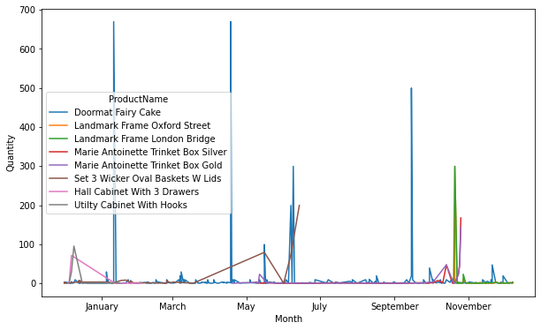
Of all criteria 1 products in the data, the doormat fairy cake checks-off the most criteria. This item sold the most units and had the most revenue by far.
Key Insights
Criteria 1: The doormat fairy cake sells in an average quantity of 7.93 units per order and has an average price of 20.14 pounds per unit
Revenue and Quantity: This item sold 45.9% more units than all other products combined to make the most revenue (49,437 UK pounds)
Quantity per Order Over Year
Source: Southern Water Corp Statistical Records

Slide 5
Criteria 1: “Selling in quantities of 7 or more on average and having a price of 20 pounds per unit.” Out of 3768 unique products, only six meet criteria 1. The hall cabinet with three hooks and the utility cabinet with hooks have the highest average quantity and price, respectively.
Criteria 1 Products
The hall cabinet with 3 drawers has the highest quantity of these at 109% higher than the runner-up.
The utility cabinet with hooks has a 43.6% higher price than the runner-up the hall cabinet.
ProductName Avg. Price Avg. Quantity
Doormat Fairy Cake 7.932615 20.135768
Hall Cabinet With 3 Drawers 15.20000 68.172000
Landmark Frame London Bridge 7.600000 20.072545
Landmark Frame Oxford Street 7.186441 20.040508
Marie Antoinette Trinket Box Gold 8.678571 21.052143
Marie Antoinette Trinket Box Silver 8.187500 23.740625
Set 3 Wicker Oval Baskets W Lids 14.030303 25.240000
Utilty Cabinet With Hooks 21.833333 32.565000

Slide 6
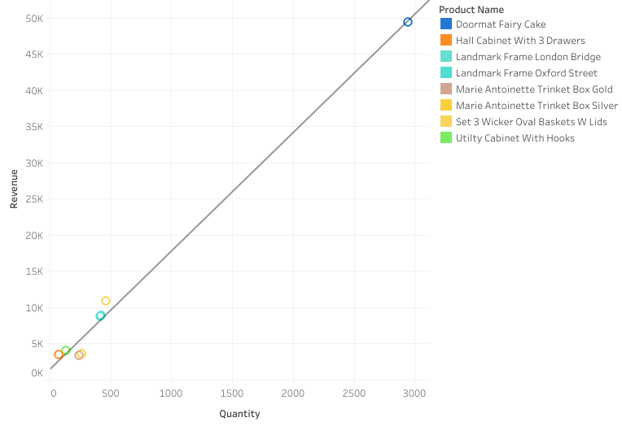
Revenue Analysis: The doormat fairy cake made the most revenue by selling the most units overall. We can identify this as the reason through a very clear trend line between overall quantity and revenue.
Key Insights
The Doormat Fairy Cake produced 355% more revenue than the runner-up of the set three wicker basket with lids
There is a clear correlation between overall quantity and overall revenue
This is indicated by and r-squared value of .992 and a p-value of >.0001
Note: This must be taken with a grain of salt as the only datapoints in this model were those product passing criteria 1, making this not generalizable data to the broader dataset.

Slide 7
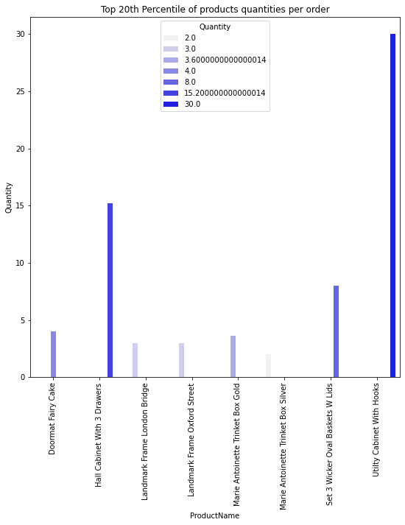
Criteria 2: “Selling in quantities >=10 in at least 20% of its sales.” The doormat fairy does not meet criteria 2, it does not sell more than 10 units in at least 20% of orders.
Key Insights
The only two products that meet this criteria are the utility closet and the hall cabinet
These product had the lowest overall quantity sold, making this an empty win

Slide 8
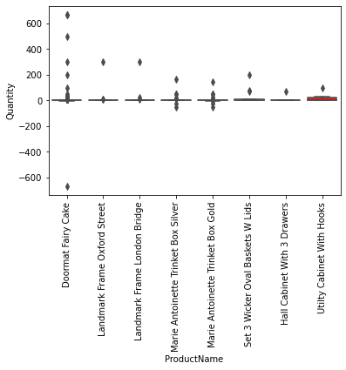
Criteria 3: “Selling in similar quantities year-round” The doormat fairy cake is the only product to sell in all 12 months of the year and has a quantity IQR of only 2 units, indicating fairy consistent sales near its median quantity.
Insights
The doormat fairy cake has the most quantity outliers, and all but one are higher then the 4 quartile
This means that there is plenty of potential to sell in exceptionally high quantities.
ProductName Quantity IQR # Months sold
Doormat Fairy Cake 2.0 12
Hall Cabinet With 3 Drawers 0.0 3
Landmark Frame London Bridge 1.5 3
Landmark Frame Oxford Street 2.0 3
Marie Antoinette Trinket Box Gold 2.0 6
Marie Antoinette Trinket Box Silver 1.0 6
Set 3 Wicker Oval Baskets W Lids 7.0 6
Utilty Cabinet With Hooks 22.0 2

Slide 9
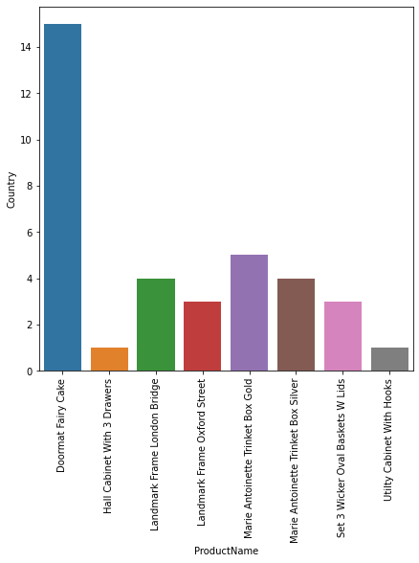
Criteria 4: “Selling in 4 of more countries.” The doormat fairy cake sells in 15 different countries, that’s 200% more than the runner-up of the Marie Antoinette trinket box gold
Insights
96% of all sold doormat fairy cakes went to the UK, making this a less than perfect win of criteria 4
Marketing analysis would be great next step to better capitalize on the broad appeal of the doormat fairy cake

Slide 10
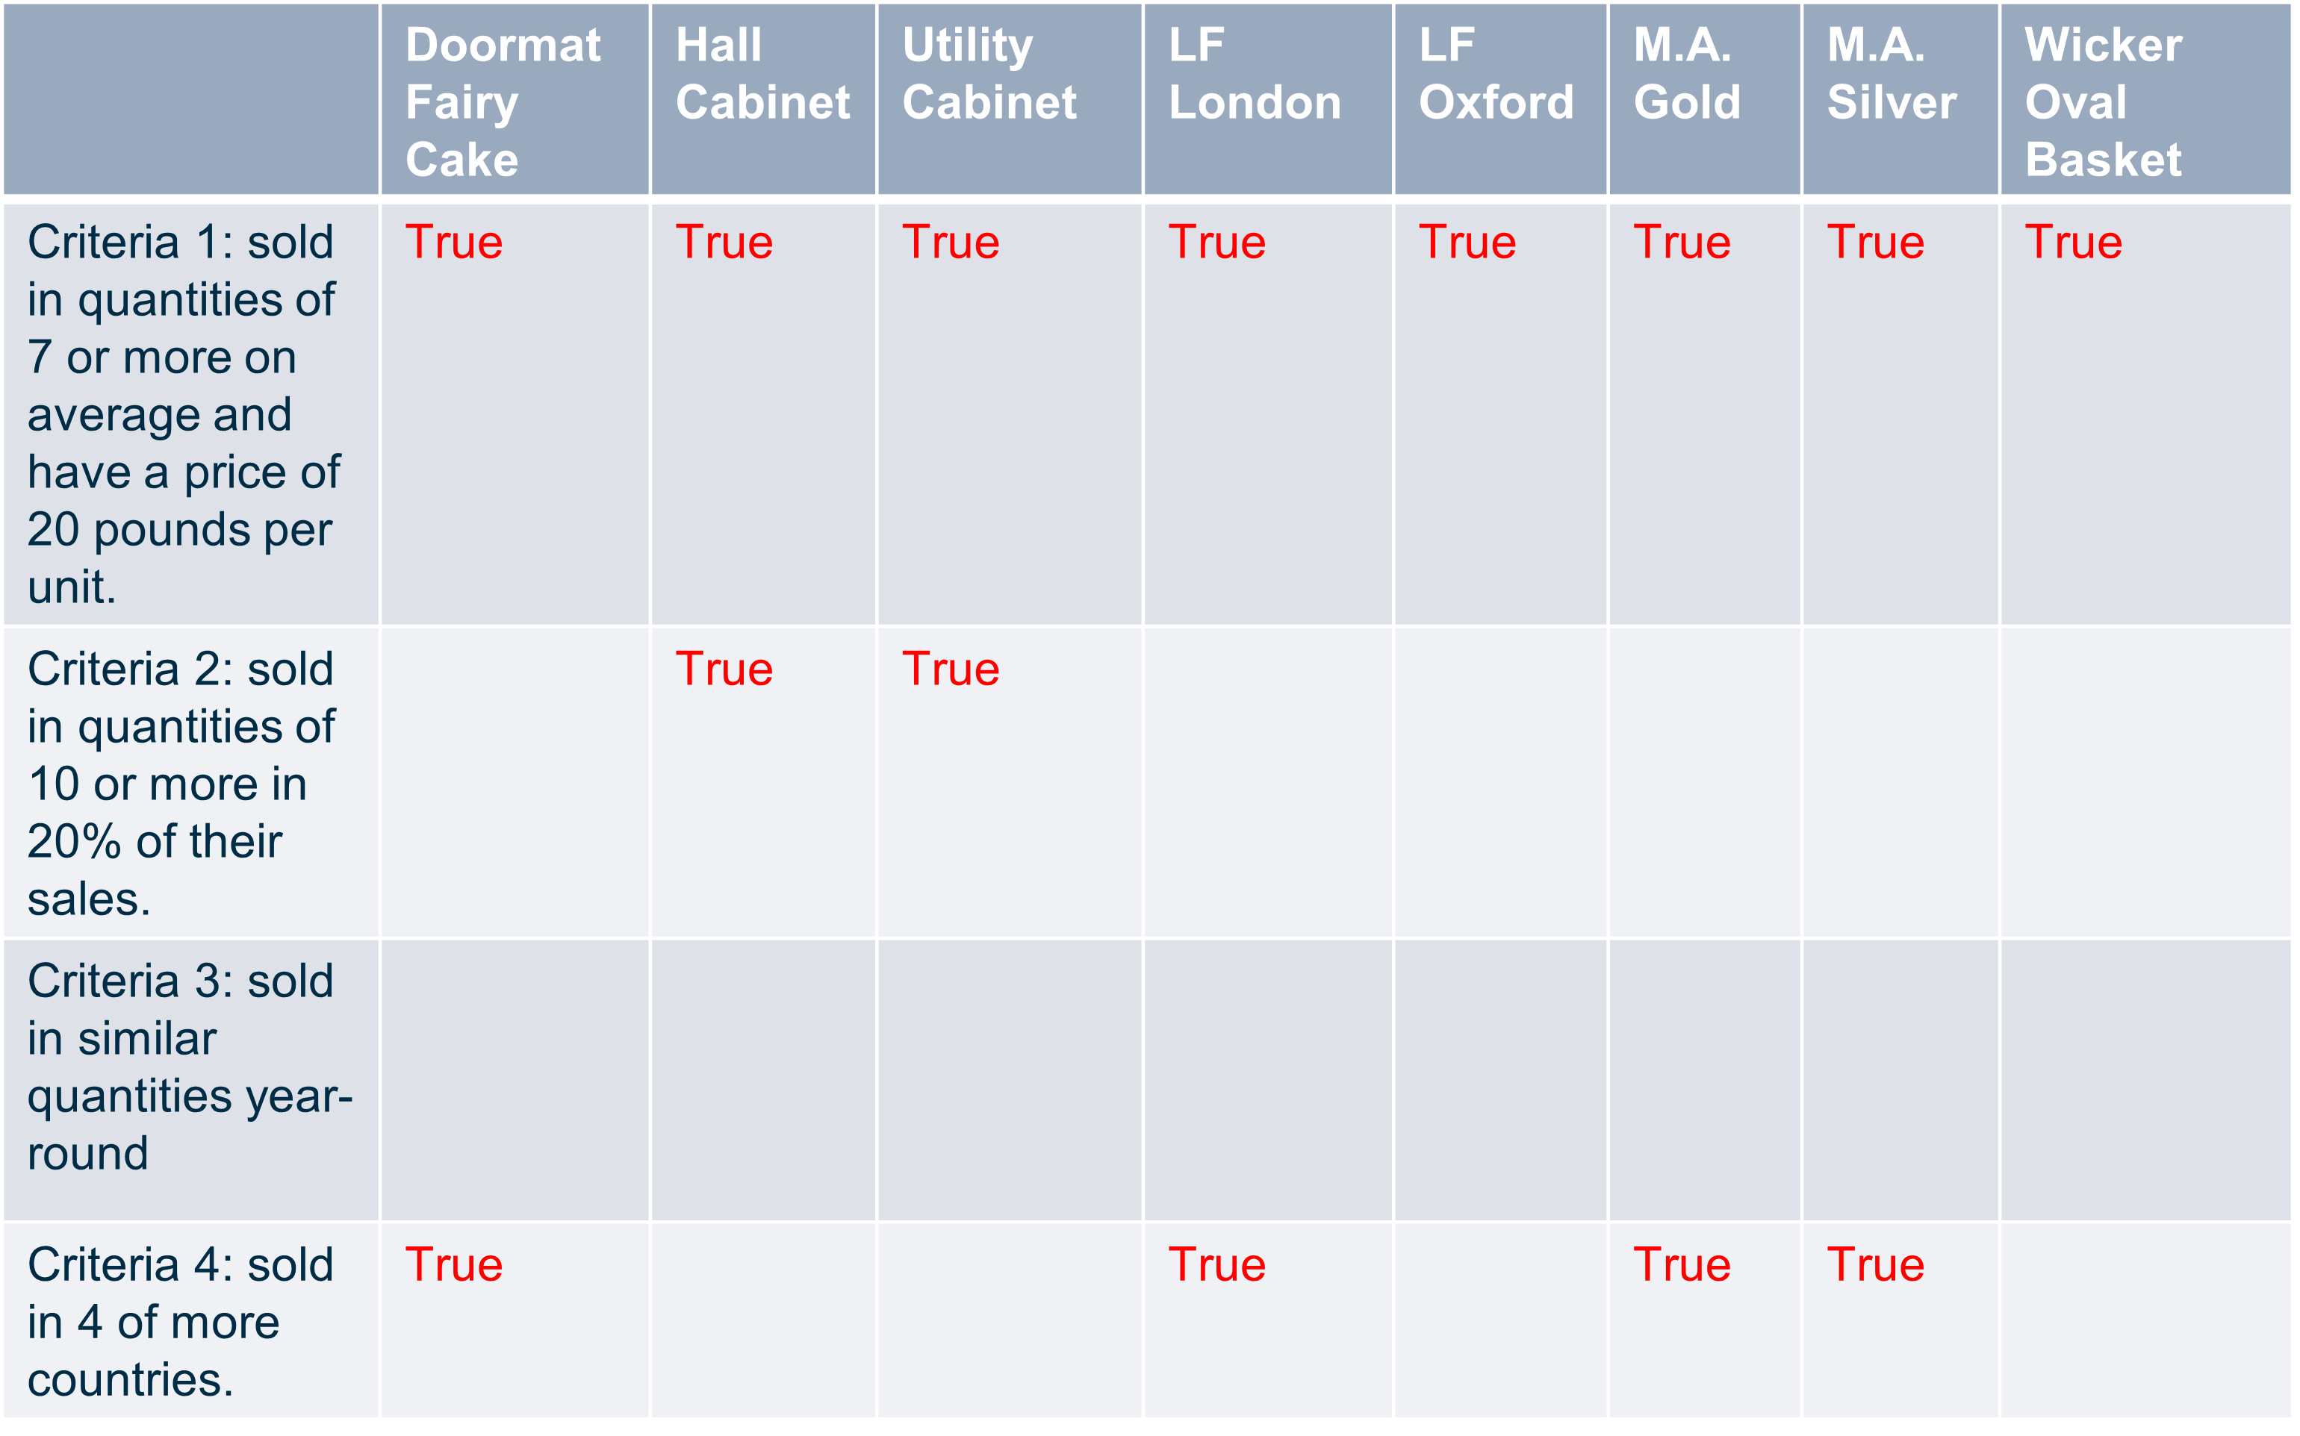
The doormat fairy cake checks-off three criteria, the most of any criteria 1 product. This item also has the highest overall revenue (49,437 UK pounds) by far. The doormat fairy cake is the best product to sell under these criteria.
It should be noted that the doormat fairy cake does not PERFECTLY fit criteria 4 as it still sells low outside the UK. More statistical analysis should be done to understand how to make it appear higher to the top of searches on various ecommerce websites, perhaps also an analysis on its marketing is in order.
True

