Slide 1
Tinashe Tanyaradzwa Mabika [n01519975j]
PROJECT TITLE : SOIL MOISTURE PREDICTION FOR SMART IRRIGATION SCHEDULING

Slide 2


Slide 3
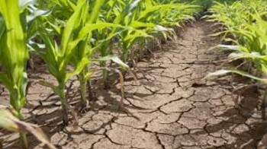
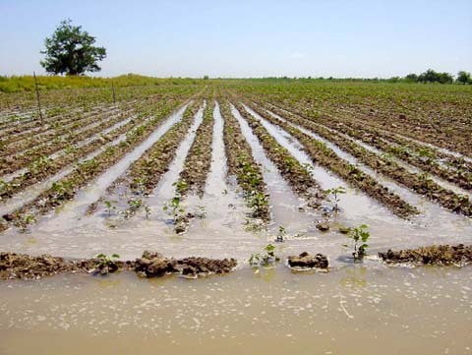
PROBLEM BACKGROUND
UNDER IRRIGATED LAND(Manual work)
OVER IRRIGATED LAND(OPEN LOOP)

Slide 4
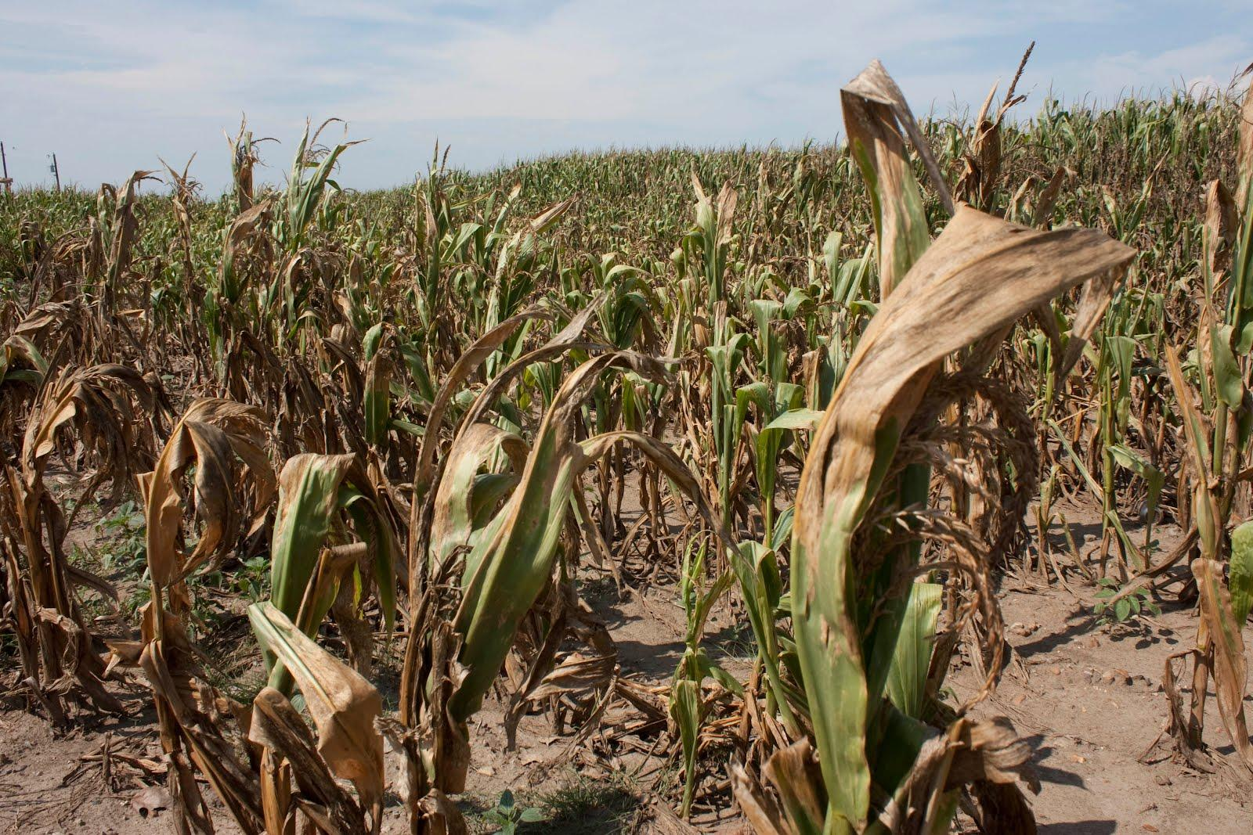
Poor crop health leading to low yields
Most of irrigation controllers that are locally available are ON/OFF type

Slide 5
PROPOSED PROJECT ARCHITECTURE
Field
Moisture Sensors
MAIN HARDWARE CONTROLLER
MongoDb
DANN
Rain Sensor
LDR
dht22
Backend Service Controller
Flow Meter
Solenoid Valves
Pump
Phone
Web App
Operator

Slide 6
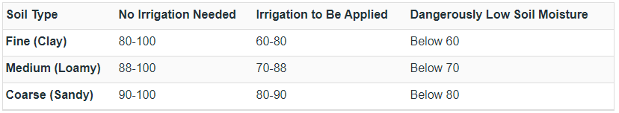
Appropriate Soil Moisture Levels by Soil Type
Delmhorst’s KS-D1 soil moisture meter
Different crops require different Moisture contents under different soil types.
Wheat – 60-90% uses 7mm
Corn - 50% then maintain ranges in table

Slide 7
Project AIM
To develop a smart irrigation system that is able to predict soil moisture contents to optimize irrigation schedules.

Slide 8
GOALS
Design an irrigation controller based on AVR micro-controller.
Design SMS notification interface and web application for remote monitoring.
Create a Neural Network Model to predict soil moisture contents.
Size pipe work for a 100m² prototype

Slide 9


Slide 10
How the Project is going to be achieved
Data Gathering to obtain training data for soil moisture predictive model
Concept selection through scoring of possible solutions.
Developing an Artificial Neural Network in Matlab to create soil moisture content forecasts
Developing cloud server controllers to interface backend services.
Programming WeMos atmega2560 micro-controller for hardware controlling system.
Building a prototype.

Slide 11


Slide 12


Slide 13
Revenue Streams
Selling data
Installation of Units

