Slide 1
SOIL MOISTURE PREDICTION FOR SMART IRRIGATION SCHEDULING
Tinashe Tanyaradzwa Mabika – N01519975j
Supervisor : Eng. Chikowore

Slide 2
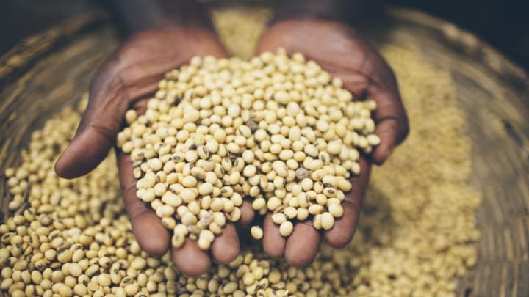
Problem Statement
Food Security
Irrigation as input
Technological Shift

Slide 3
PROJECT AIM
To develop a smart irrigation system that is able to predict soil moisture contents to optimize irrigation schedules.

Slide 4

Objectives
Design an irrigation controller based on AVR micro-controller.
Design SMS notification interface and web application for remote monitoring.
Create a forecasting Model to predict soil moisture contents.
Size pipe work for a 266m² prototype

Slide 5
Literature Review
Types of Agricultural Water Use
Specific Plant Water Requirements
Control Systems
Cloud Services
Data Forecasting
Hardware

Slide 6
Methodology
Consumer needs
Interviews
Research
Journals
Articles
Software
C++
Autodesk Eagle

Slide 7

CONCEPT DEVELOPMENT
Determination of Customer Requirements
Generation of Concepts
Concept Screening
Concept Scoring
Proposed Concepts

Slide 8

Customer Requirements
Efficiency of the irrigation system
Ease of Use
Taking other parameters into consideration which affect soil moisture content.
Ease of Maintenance
System Durability
Remote Monitoring and Control
Uniform monitoring of the field
Precision and Accuracy in Responsiveness

Slide 9
Generation of Concepts

Slide 10
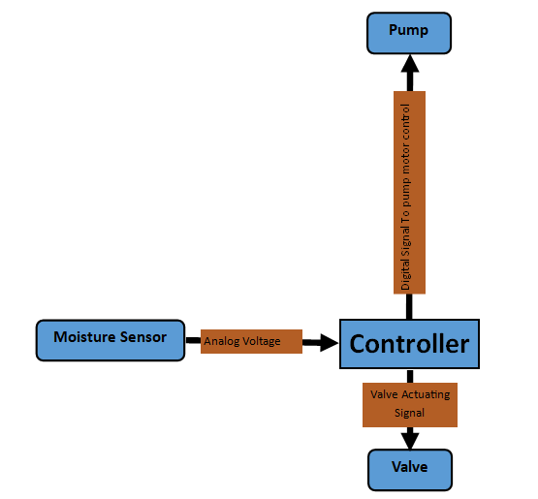
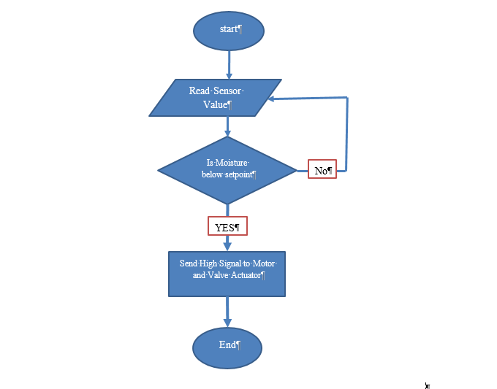
Concept A
Overview
Flow-Chart

Slide 11
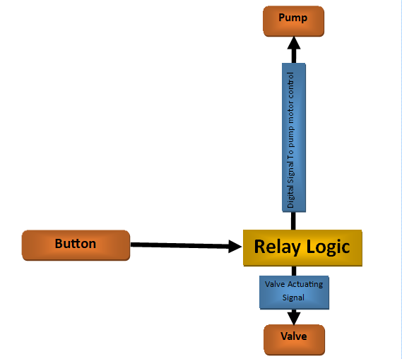
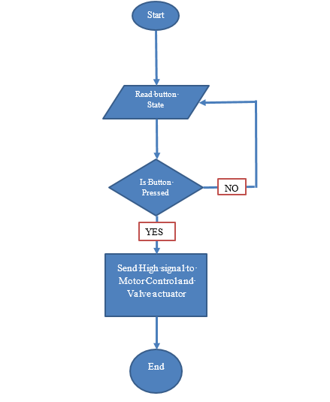
Concept B
Overview
Flow-Chart

Slide 12
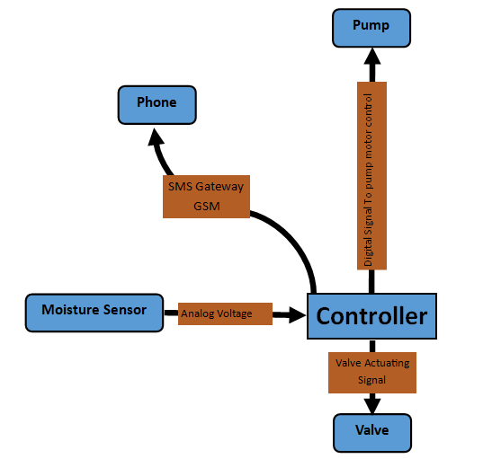
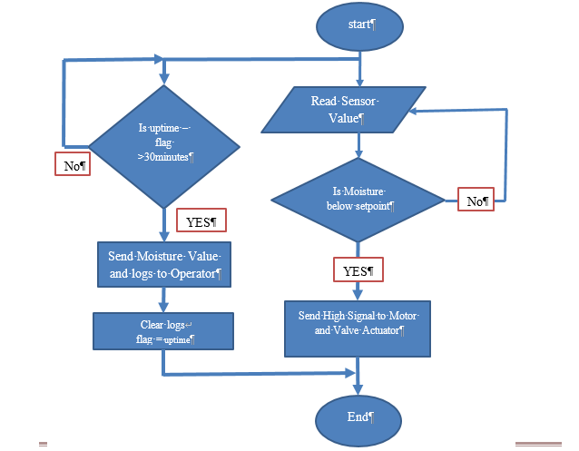
Concept C
Overview
Flow-Chart

Slide 13
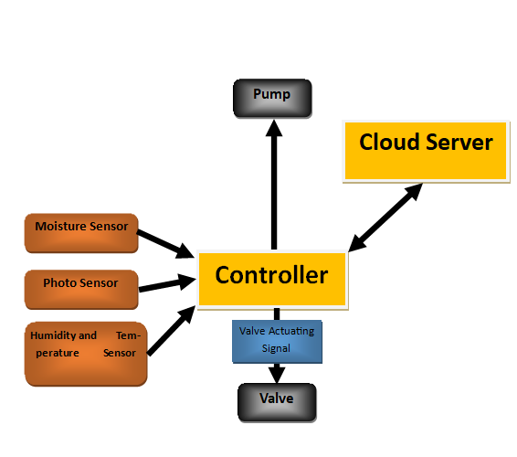
Concept D
Overview
Flow-Chart

Slide 14

Concept Screening
SELECTION CRITERIA | CONCEPT
 | A | B | C | D | Reference
Ease of Use | 0 | + | + | 0 | 0
Ease of Maintenance | 0 | + | 0 | - | 0
Remote Monitoring and Control | - | - | + | - | 0
Uniform monitoring of the field | - | - | + | + | 0
Precision and Accuracy in Responsiveness | - | - | 0 | + | 0
System Durability | + | 0 | 0 | + | 0
Efficiency of the irrigation system | 0 | - | 0 | + | 0
Considerations of other parameters | - | - | 0 | + | 0
Sum of “+” s | 1 | 2 | 3 | 5 | 0
Sum of “0” s | 3 | 1 | 5 | 1 | 8
Sum of “-” s | 3 | 5 | 0 | 2 | 0
Net Score | -2 | -3 | 3 | 3 | 0
Rank | 3 | 4 | 1 | 1 | 0
Continue? | NO | NO | YES | YES

Slide 15

Concept Scoring
SELECTION CRITERIA | WEIGHTS % | CONCEPTS
 |  | C |  | D |  | C+D
 |  | Rank | Weight | Rank | Weight | Rank | Weight
Ease of Use | 10 | 4 | 0.4 | 3 | 0.3 | 3 | 0.3
Ease of Maintenance | 13 | 4 | 0.52 | 3 | 0.39 | 3 | 0.39
Cost | 5 | 4 | 0.2 | 3 | 0.15 | 2 | 0.1
Remote Monitoring and Control | 30 | 0 | 0 | 4 | 1.2 | 5 | 1.5
Uniform monitoring of the field | 22 | 2 | 0.44 | 3 | 0.66 | 4 | 0.88
Precision and Accuracy in Responsiveness | 10 | 2 | 0.2 | 3 | 0.3 | 3 | 0.3
System Durability | 6 | 3 | 0.18 | 2 | 0.12 | 3 | 0.18
Considerations of other parameters | 4 | 1 | 0.04 | 3 | 0.12 | 4 | 0.16
Total Score |  | 1.98 |  | 3.24 |  | 3.81
Rank |  | 3 |  | 2 |  | 1
Continue? |  | N0 |  | NO |  | YES(Develop)

Slide 16
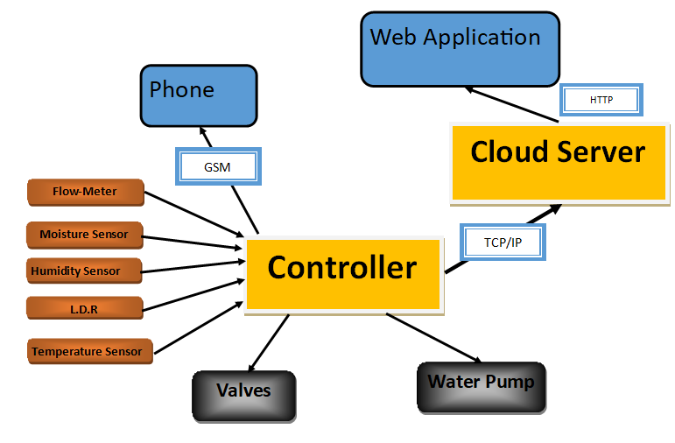
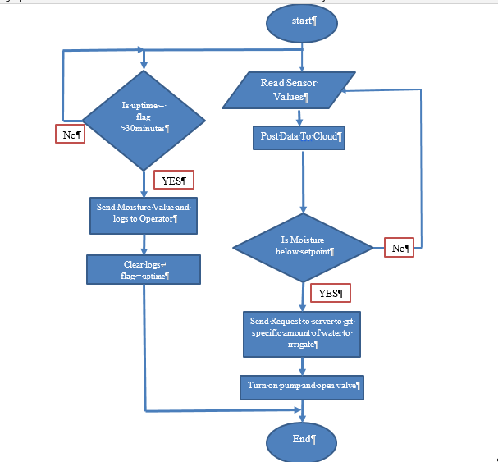
Proposed Concept
Flow-Chart

Slide 17
“If the farmer is rich, then so is the nation.”
Agriculture looks different today - our farmers are using technology and can monitor irrigation systems over the Internet.

