Slide 1
Healthcare Data Cleaning Pipeline
Name: Tynisha Niles
Role: Data Analyst
Date: May 15, 2026
Notes:
This presentation covers the development of a structured healthcare data cleaning pipeline built in R to transform a messy dataset into an analysis-ready dataset.”

Slide 2
The Dataset
What it is | Healthcare patient dataset containing demographic, visit, and medical information. Includes inconsistencies, duplicates, and missing values.
Source | Provided as part of the healthcare data cleaning assignment
Raw dataset size | approximately 1000 observations and 10 variables
Date of download/access | Tuesday, April 21, 2026
Notes:
“The dataset contained several intentional data quality issues including duplicates, inconsistent formatting, missing values, and mixed data types.”

Slide 3
Objective
To transform a messy healthcare dataset into a clean, analysis-ready dataset using a structured pipeline.
Scoped variables:
Patient Name
Gender
Condition
Medication
Visit Date
Notes:
The goal was not only to clean the data, but to create a modular reproducible pipeline that could run end-to-end.
Generate analysis-ready datasets and automated reporting outputs.
Additional supporting validation and auditability steps were implemented to improve reproducibility and transparency of the pipeline.”
Support reproducibility, auditability, and multi-format exports.

Slide 4
Pipeline Architecture
RAW DATA
STEP 1
01_ingest.R – data ingestion & validation
STEP 2
02_diagnose.R- diagnostics & logging
STEP 7
07_report.Rmd – automated word report
STEP 5
STEP 4
STEP 3
STEP 6
03_clean.R – cleaning & duplicate handling
04_impute.R - imputation
05_dictionary.R – data dictionary generation
06_export.R – export outputs
00_config.R – global paths and settings
CLEANED DATA
Notes:
Modular pipeline structure
Each script performs one responsibility
“The project was divided into separate stages to improve readability, maintenance, and reproducibility.”

Slide 5
Top Data Quality Issues
Patient identifier inconsistencies in Patient.Name
Multiple date formats in Visit.Date
Free-text diagnosis inconsistencies in Condition
Near-duplicate patient records requiring resolution
Inconsistent categorical coding in Gender and Medication
Notes:
These issues prevented reliable analysis and required structured cleaning and standardisation
Missing Age values
Inconsistent Age format
Phone number formatting inconsistencies
Were additional issue found in the data set

Slide 6
How You Cleaned It
Issue | Cleaning Action
Patient identifier inconsistency | Standardized patient.name using lower case conversion, trimming and punctuation removal.
Multiple visit data formats | Parsed dates into a consistent date format using parsed_date_time()
Inconsistent diagnosis formatting | Standardized condition values into consistent categorical labels.
Duplicate Patient records | Grouped by patient name and visit date and retained one consistent record.
Inconsistent categorical casing | Standardized gender and medication formatting.
Notes:
Patient names standardised
Gender, Condition, Medication normalised
Dates parsed into standard formats
Additionally
Age was cleaned
Phone numbers cleaned to digits-only
Duplicate visits resolved using Patient Name + Visit Date
Cleaning audit logs and duplicate summaries generated

Slide 7
Imputation
Variable: Age
Method: Median imputation
Reason: Robust to outliers and maintains realistic values
Imputation tracking variables created
Imputation summary exported automatically
Notes:
Missing ages were replaced using the median because it provides stable values without being heavily affected by outliers

Slide 8
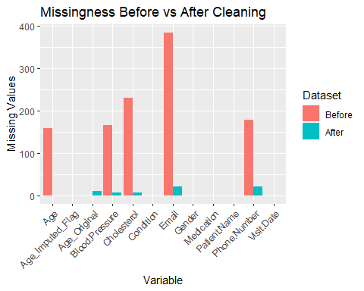
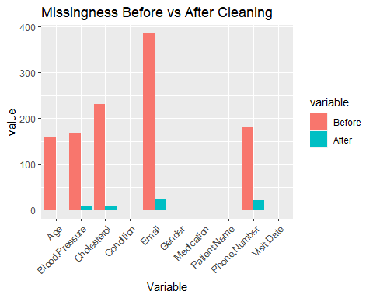
Chart That Tells a Story
Notes:
This chart compares the level of missing data before and after the cleaning process for each variable in the dataset.
Before cleaning, several variables contained high levels of missingness. Email had the largest number of missing values, followed by Cholesterol, Phone Number, Blood Pressure, and Age. Whilst the variables leading were not the scoped variables, these missing values reduced the reliability and completeness of the dataset for analysis.
After the cleaning and imputation stages, missing values in Age were fully resolved through median imputation, while other variables showed reductions where invalid entries and blank values were standardised into proper missing values. Some missingness still remains in variables such as Email and Phone Number because no reliable information was available to safely replace those values.
Overall, this chart demonstrates the impact of the cleaning pipeline by showing improved data completeness and more consistent handling of missing information across the dataset.

Slide 9
Outputs
.xlsx export with data dictionary
.sav export (SPSS)
.dta export (Stata)
.rds export
Automated Word report
Notes:
Multi-format export capability
Automated reporting
“The cleaned dataset was exported into multiple formats to support different analytical environments.”

Slide 10
What Went Well
Successfully built a modular and reproducible pipeline
Resolved duplicate identity issues
Automated reporting with R Markdown
GitHub version control maintained throughout project
Improved documentation and auditability after interim feedback
Notes:
“One major success was achieving a complete automated workflow from ingestion to reporting.”

Slide 11
What Was Hard
Resolving duplicate patient identities with conflicting information while preserving traceability.
Deciding how to handle missing values
Separating cleaning from imputation logically
Managing pipeline dependencies and file paths
Debugging dynamic data dictionary generation
Fixing R Markdown rendering errors
Balancing technical work with documentation requirements
What you would do differently:
Explore probabilistic/fuzzy identity matching (wasn’t allowed)
Add automated validation checks
Notes:
Handling duplicate patient identities
- Deciding which records to retain
- Structuring pipeline stages correctly
This stage required the most critical decision-making because duplicate records did not always contain matching supporting information.”

Slide 12
Time Breakdown
-
Phase | Time (hrs)
Week 1: Setup & diagnostics | 12
Week 2: Cleaning pipeline | 14
Week 3: Imputation, exports, reporting, presentation | 10
Notes:
Most of the project time was spent resolving data quality and structural pipeline issues.”

Slide 13
What I Would Do With More Time
Improve duplicate detection
Implement additional imputation strategies
Add validation rules
Expand analysis beyond cleaning
Expand validation and outlier flagging
Enhance logging and monitoring outputs
Increase automated testing coverage
Notes:
With more time, I would focus on improving identity resolution accuracy and expanding downstream analysis

Slide 14
Thank You
Questions?
Notes:
Thank you for listening. I welcome any questions or feedback

