Slide 1
Machine Learning Project Title: Loan Prediction Classification Project Name: Tinotenda Chidume 43981

Slide 2
Description of Dataset
The dataset contains information about loan applications, including applicant details, loan characteristics, and asset values.
The primary goal is to predict whether a loan application will be approved or rejected based on these attributes.
The aim is to classify loan applications into two categories: "Approved" and "Rejected".

Slide 3
Dataset Features
The dataset containts 12 features and 4269 observations.
Categorical Features:
education (Graduate, Not Graduate)
self_employed (Yes, No)
Loan_status (Approved, Rejected)

Slide 4
Numerical features
no_of_dependents (Number of dependents)
income_annum (Annual income)
loan_amount (Loan amount)
loan_term (Loan term in months)
cibil_score (Credit score)
Residential_assets (Value of residential assets)
Commercial_assets (Value of commercial assets)
luxury_assets (Value of luxury assets)
bank_assets (Value of bank assets)

Slide 5
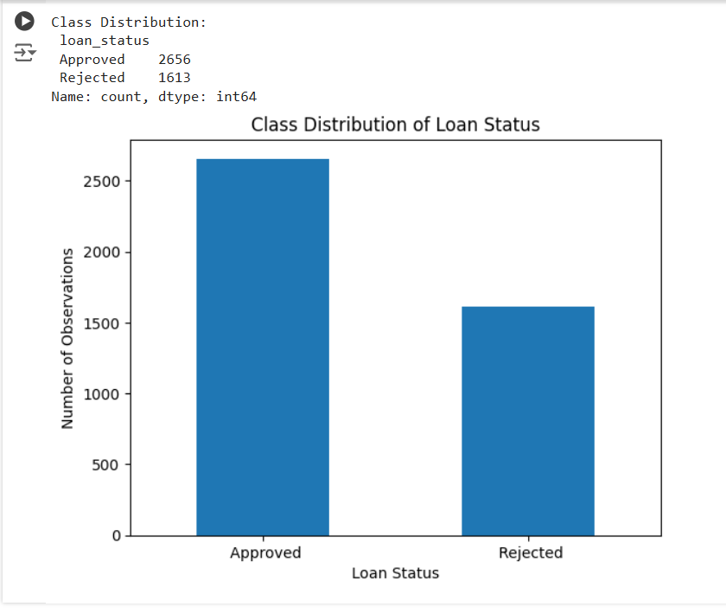
Observations in each class

Slide 6
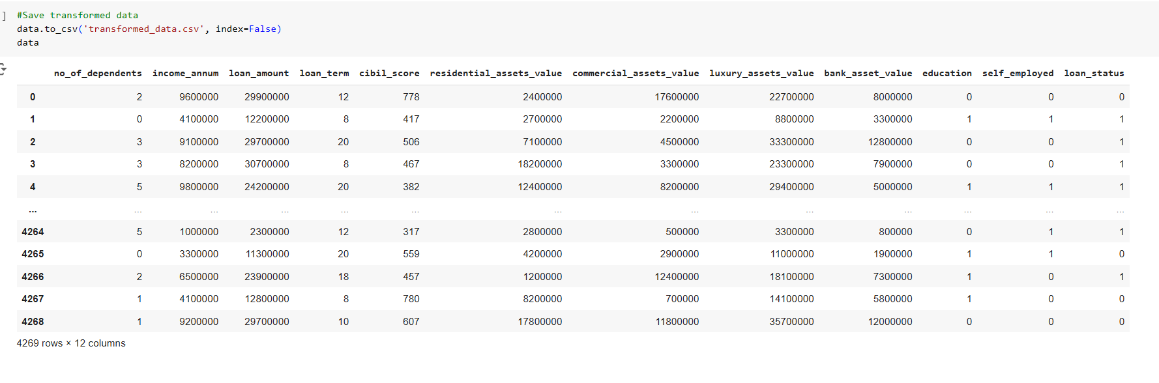
Dataset after Transformations

Slide 7
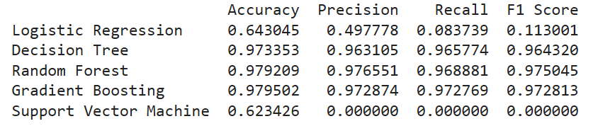
Classifiers
Logistic Regression
Decision Tree
Random Forest
Gradient Boosting
Support Vector Machine

Slide 8
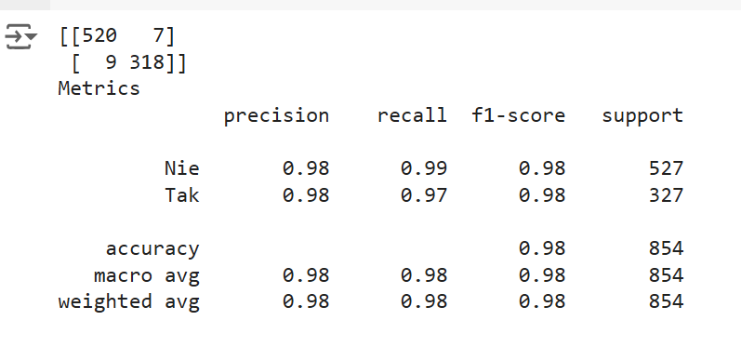
Confusion matrix
Random Forest classifier was used for training

Slide 9
Technologies Employed in Application
Flask: creating and handling web application.
Joblib: loading the pre-trained machine learning model.
Pandas: For data manipulation and creation of DataFrames.
SQLite: For database management, storing client data and prediction results.
Traceback: For exception handling and debugging.
HTML: For structuring the web page.
CSS: For styling the web page.
JavaScript: more interactive web app

Slide 10
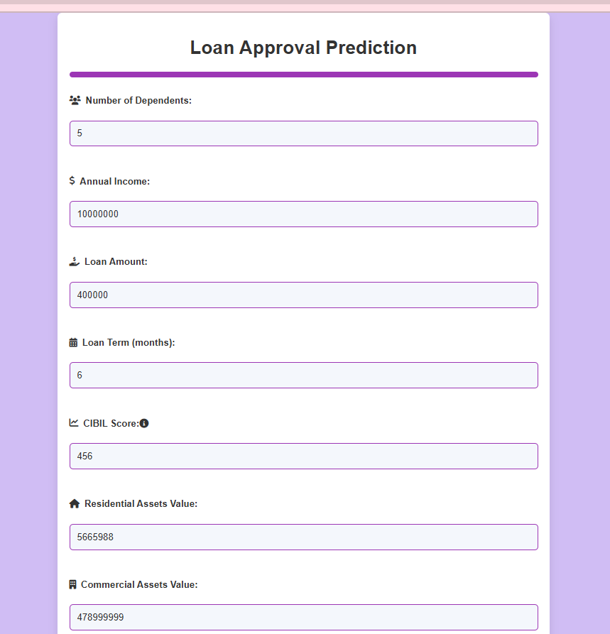
Application Screen

