Slide 1

Does higher quality of education lead to better lacrosse high school lacrosse teams?
An exploration into the correlations between education and lacrosse at the high school level
Timothy Yost
Data Analytics 7: Nashville Software School
Date

Slide 2
Why This Topic?

Slide 3
What is Lacrosse?
Lacrosse is an outdoor team sport played with a lacrosse stick and lacrosse ball.
Lacrosse is the oldest sport in North America

Slide 4
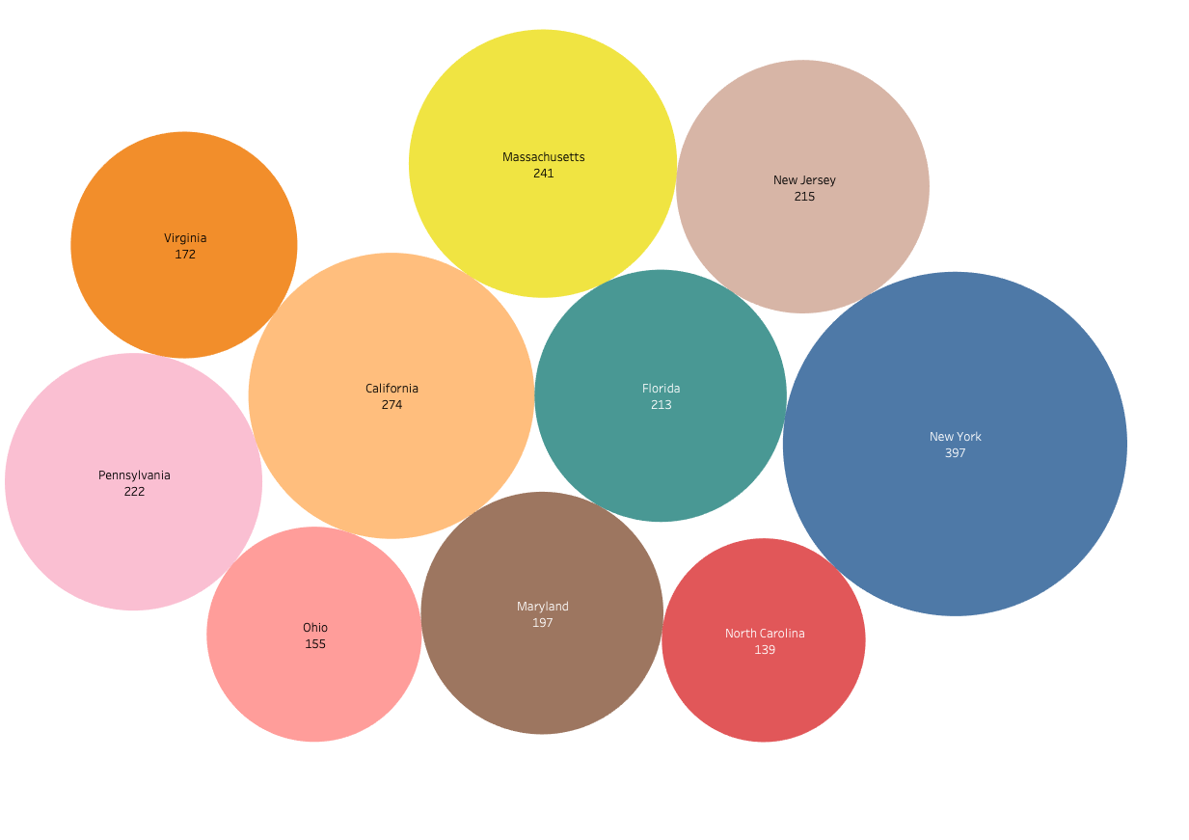
Top 10 states with the most boys high school lacrosse teams in 2020.

Slide 5



U.S. States by School Quality and Safety

