Slide 1


Directional Alarm Clock
Levi Terry
University of Advancing Technology
Robotics Engineering
Digital Maker and Fabrication, SIP311

Slide 2
Problem Statement
When normal alarm clocks go off, they can easily wake up everyone in a room. This can become a problem if multiple people share a bedroom and have different wake up schedules. This is especially common in college dorm rooms, for example. My product will solve this by targeting the alarm to a specific person, so not everyone in the room will wake up if they don't need/want to.
This alarm clock will use an ultrasound speaker for directional audio to target a specific person, so only the person using the alarm will be awoken. Along with directional audio, the clock will require the completion of a task to disable the alarm clock to activate the brain and get the user ready for the day.
For Statistics see Appendix A: Statistics
Notes:
Guidelines:

Slide 3
Innovation Claim
The Directional Alarm Clock is a user-specific method of alerting users with the use of an ultrasound speaker to direct the alarm towards the specific sleeper who needs to be woken up without disturbing other nearby sleepers.

Slide 4
Technical Expertise & Skills
This project requires experience in the following fields:
Programming
Electronic design
3D modeling
Fabrication
Notes:
Guidelines: Refer to the Tech Resources document provided by your SIP Instructor

Slide 5
Project Description & Scope
This project combines an alarm clock and an ultrasonic speaker creating a directional alarm clock that will be able to "target" one specific person as to not disturb others that may want to continue sleeping.
I'm not planning on working with a team for this project with a team, but I am open to collaboration and help from other people.
As for timeline I'm planning on making progress throughout this and next semester to create a MVP consisting of an ESP32-powered touchscreen for setting alarms and an ultrasonic directional speaker.
Notes:
PM: Project Management

Slide 6
Target Market
This will be primarily targeted for people who sleep in the same ro with someone else with each person having a different schedule. This might include:
Married Couples
Roommates
Siblings

Slide 7
Prior Art
Focusonics® Model B - Focusonics - Directional Speaker
CLOCKY Extra Loud Alarm Clock - Amazon - Alarm clock that tries to run away
Sonic Bomb Alarm Clock with Super Shaker - Sonic Alert - Loud alarm clock with function to shake bed

Slide 8
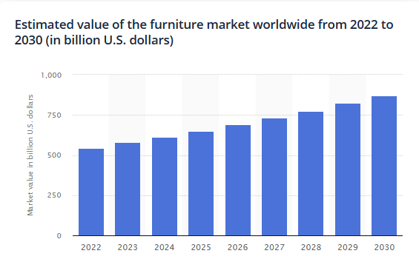
Appendix A: Statistics
Projected value of furniture market (Furniture, Furnishings & Household Items. n.d.)
Morning Feelings
Approximately 53.86% of people feel dreadful when their alarm goes off in the morning. Additionally, 27.12% of people feel anxious, 11.24% feel energized, 2.32% feel excited, and 0.32% of people feel awake. (Morgan 2019)
Snooze Usage
Most people hit the snooze button at least once. 35.57% of women and 43.39% of men never press snooze. While 6.31% of women and 5.65% of men say they press snooze over 3 times.
Additionally, 61.94% only have 1 alarm set, 21.16% set 2, 12.44% set more than 2, and 4.46% of people don’t set alarms. (Morgan 2019)

Slide 9
References
Furniture, Furnishings & Household Items. (n.d.). Statista. https://www.statista.com/markets/415/topic/469/furniture-furnishings-household-items/#statistic1
Morgan, B. (2019, May 3). How Many Times Do Most People Hit the Snooze Button? (And More Fascinating Alarm Clock Stats). apartment therapy. https://www.apartmenttherapy.com/how-many-times-do-most-people-hit-the-snooze-button-and-more-fascinating-alarm-clock-stats-243011

Slide 10
Proof of Concept/Early-Stage Prototype
Insert image(s), sketch, schematic, flowchart, rendering, etc.
Notes:
Note: add more slides as needed

Slide 11
Q&A
Levi Terry, Robotics and Embedded Systems + Digital Maker and Fabrication
This alarm clock will use an ultrasound speaker for directional audio to target a specific person, so only the person using the alarm will be awoken. Along with directional audio, the clock will require the completion of a task to disable the alarm clock to activate the brain and get the user ready for the day.

