Slide 1

SMART INDIA HACKATHON 2026
Problem Statement ID – SIH26028
Problem Statement Title- Dynamic Forecast of Expected Time of Arrival (ETA) for Coaching Trains
Theme- Smart Automation
PS Category- Software
Team ID-
Team Name - TypeError-4-ever

Slide 2
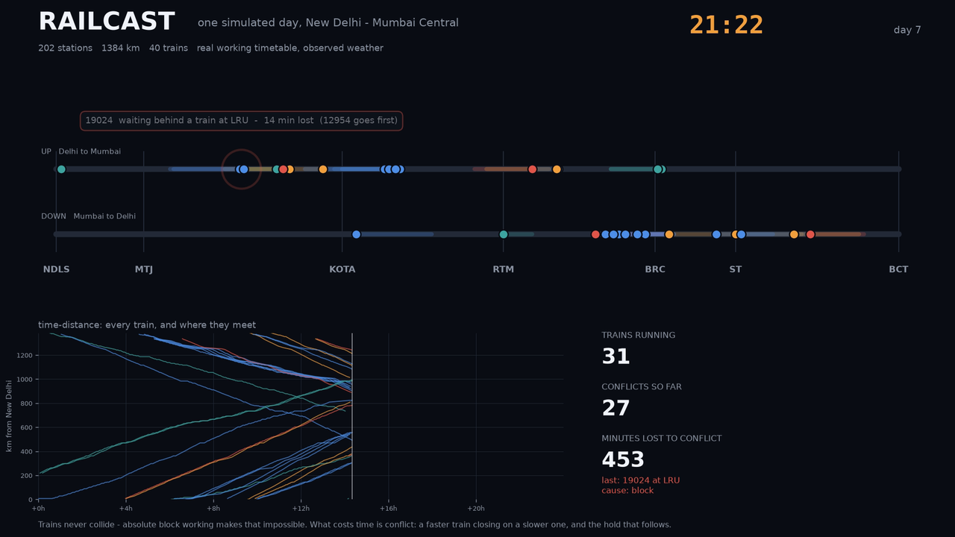
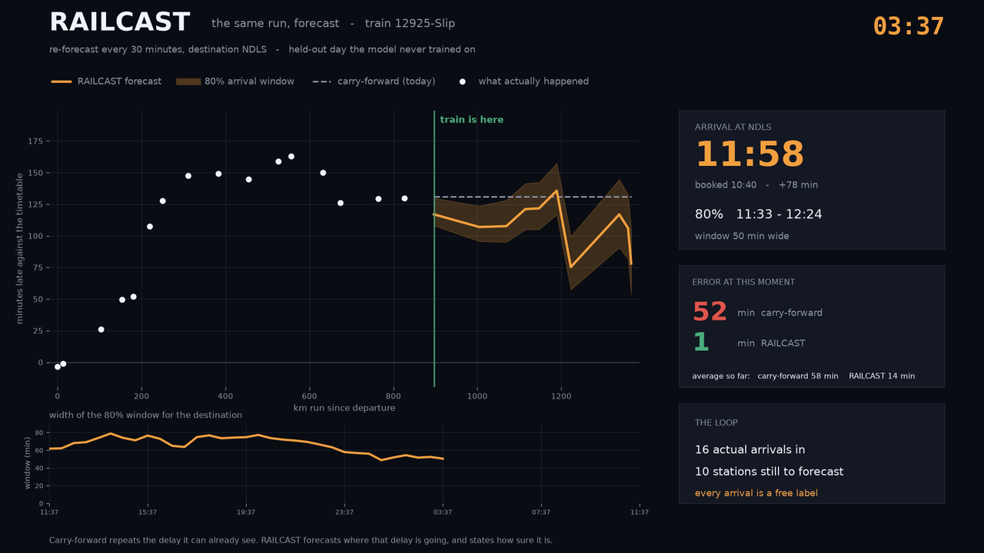
Dynamic Forecast of Expected Time of Arrival (ETA) for Coaching Trains
TypeError-4-ever
Proposed Solution
forecast the cause, not the clock
PROTOTYPE (RUNNING)
PROBLEM AT HAND
HOW ONE FORECAST IS MADE
Delay is repeated, not forecast
LIVE STATE
position, delay, block occupancy, restrictions
Today's ETA carries the current delay forward and trusts timetable padding. It cannot see congestion building ahead.
A · Free-run time
the physics of the section
The network goes blind between stations
Conflict on the block ahead?
no
every actual
arrival re-fits
the rest of
the run
Position is reported only at instrumented stations - gaps of 40–60 minutes on long sections.
yes
The problem — conflict and cascade
B · Conflict simulation
advance every train on the block graph
Cascades are invisible
One train held at a junction delays every train behind it, yet no deployed ETA model represents that dependency.
C · Learned residual
corrects what the rules cannot
One number hides the risk
D · Calibrated window
audited 80% coverage
No confidence attached, so nobody knows when it is safe to act - and nothing handles a diversion mid-run.
DECISION SURFACES
window · connection risk · costed precedence
The answer — one journey re-forecast

Slide 3
TECHNICAL APPROACH
TypeError-4-ever
NTES / FOIS
TIMETABLES
OSM + WEATHER
PostgreSQL
PostGIS
LIVE STORE
FastAPI
REST
WEBSOCKET
Passenger App
Station Displays
SMS
IVR • Control
DATA SOURCES · BUILT
DATA LAYER · PLANNED
API / SERVING · PLANNED
CLIENTS · PLANNED
POSITION REPORT
or the 30 s clock fires
Update live state
delay, momentum, block occupancy
Train running?
A · Free-run time
per remaining section
B · Advance the block graph
every train, in event order
yes
Show booked schedule
no
D · Conformal interval
horizon × segment × time of day
C · Learned residual
one shot per horizon, never chained
Loop the slower train
yes
Higher-priority train behind?
Block section ahead occupied?
yes
Queue behind the block
no
Coverage on target for this group?
PUBLISH THE ARRIVAL WINDOW
monotone arrivals · attribution · connection risk
yes
no
Re-fit the quantiles
3

Slide 4
FEASIBILITY AND VIABILITY
TypeError-4-ever
TECHNICAL FEASIBILITY
HOW WE PROVE IT
RISKS AND HOW WE RETIRE THEM
Every component is mature
1 Baseline stated
Delay model not yet fitted
LightGBM and conformal prediction are established open source.
Current delay carried forward, on exactly the same rows.
Validated on 499 live arrivals: the tail is too heavy. Refit as data accumulates.
No new trackside hardware
2 Temporal holdout
Error compounds over a 40-hour run
Consumes position feeds IR already produces, via a swappable adapter.
Train on earlier months, test on later. A random split leaks.
Direct multi-horizon residual - never chained.
Cheap at national scale
3 Error by horizon
Coverage fails in the monsoon
One commodity node per zone; no GPU at serving time.
Next station, 1-3 h, 3-8 h, 8-24 h, beyond 24 h.
Mondrian calibration by segment and season, alarmed not assumed.
The simulator is its own fallback
4 Coverage audited
Controllers distrust a black box
With the learned layer off, rules still beat carry-forward past 3 hours.
Against nominal 80%, by segment, horizon and time of day.
Per-section attribution; advisory only, never a movement order.
Validated against live running data
5 Shadow mode — planned
No public archive of past arrivals
499 real arrivals collected from a live feed, compared station by station.
Run live beside the existing ETA before a passenger sees it.
None exists, so history is accumulated by polling a live feed — already collecting.
IMPLEMENTATION ROADMAP
01
02
03
04
05
06
Build the block-section graph
Calibrate the simulator
Train free-run and residual
Add conformal calibration
Ship the decision layer
Shadow-mode pilot, then zone by zone
4

Slide 5
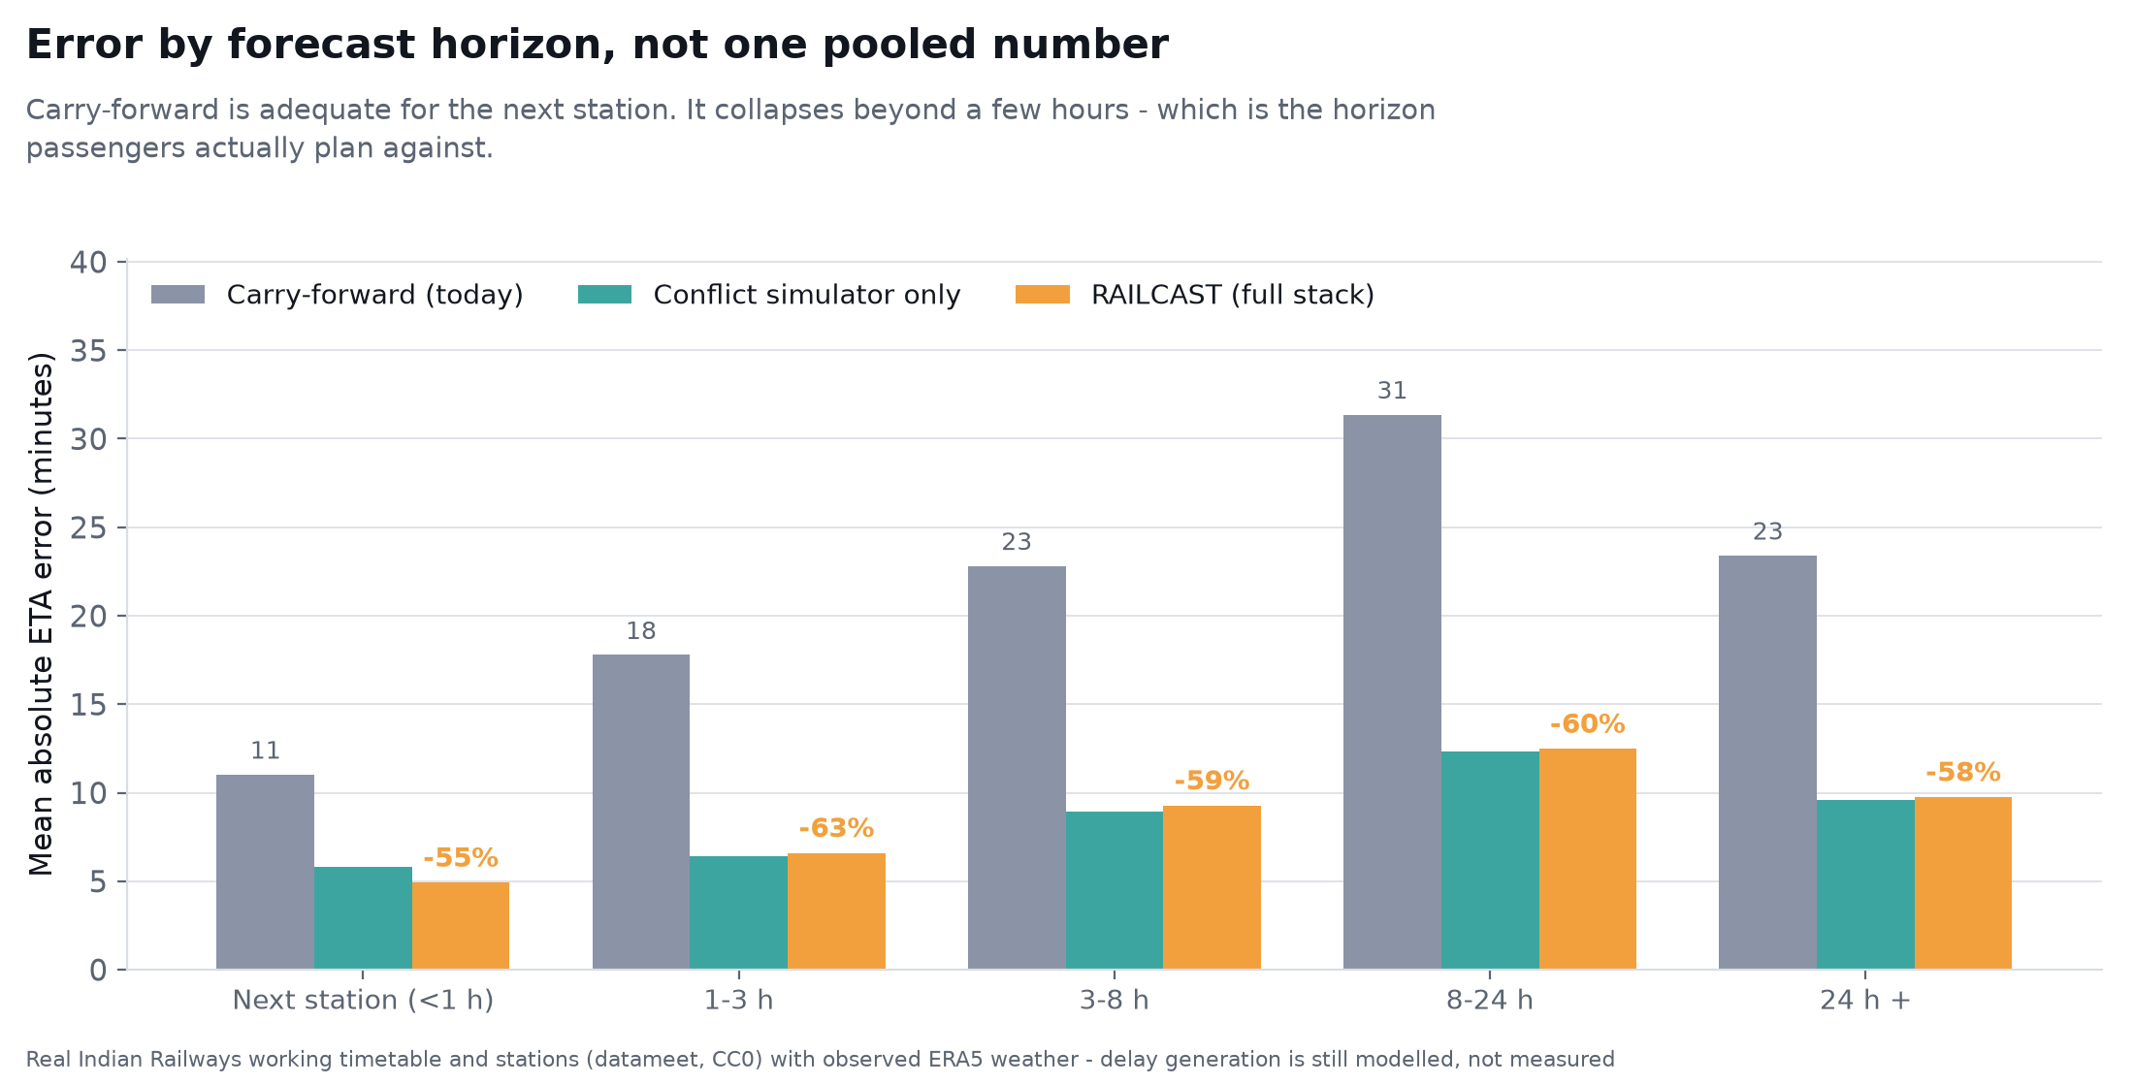
IMPACT AND BENEFITS
TypeError-4-ever
60%
62%
78.4%
0.006
lower mean ETA error
lower P90 error
achieved coverage
reliability error
carry-forward 26.9 min
RAILCAST 10.9 min
the bad days: 77 min against 29
of the nominal 80% window, audited per segment
on connection-make probability
ERROR BY HORIZON, NOT ONE POOLED NUMBER
WHAT CHANGES AGAINST TODAY
PARAMETER
TODAY
RAILCAST
ETA method
Delay repeated forward
Per-section forecast, conflicts simulated
Horizon
The next few stops
The whole run, 40+ hours
Uncertainty
None stated
Audited 80% arrival window
Explains cause
No
Names the blocking train and section
Between stations
Blind for 40-60 min
Position inferred between stations by block-graph replay
Disruption
Estimate simply breaks
Re-forecast every 30 s from the current state
Carry-forward is adequate for the next station and collapses beyond a few hours - which is the horizon passengers actually plan against.
Decision support
None
Connection risk and costed precedence
Scored on 73,268 held-out forecasts on the real New Delhi - Mumbai Central working timetable with observed ERA5 weather. How delay arises is still modelled; the calibration loop fits it to live running data.

Slide 6
RESEARCH AND REFERENCES
TypeError-4-ever
SCALE OF DEPLOYMENT
RESEARCH WE BUILD ON
Prototype corridor
1 R. Oneto et al., Train delay prediction systems: a big data analytics perspective, Big Data Research, vol. 11, 2018.
40
New Delhi - Mumbai Central, 1384 km, 202 stations
2 P. Kecman and R. M. P. Goverde, Predictive modelling of running and dwell times in railway traffic, Public Transport, vol. 7, 2015.
3 F. Corman and P. Kecman, Stochastic prediction of train delays in real time using Bayesian networks, Transportation Research Part C, 2018.
800
Zonal pilot
One zone, one control office, one model shard
4 T. Buker and B. Seybold, Stochastic modelling of delay propagation in large networks, J. Rail Transport Planning and Management, 2012.
5 Y. Romano, E. Patterson and E. Candes, Conformalized quantile regression, NeurIPS 32, 2019.
13,000
National
Coaching trains a day, 7,300 stations, 68,000 route km
6 V. Vovk, A. Gammerman and G. Shafer, Algorithmic Learning in a Random World, Springer, 2005 - Mondrian and conditional validity.
7 G. Ke et al., LightGBM: a highly efficient gradient boosting decision tree, NeurIPS 30, 2017.
DATA SOURCES
8 The Digital Personal Data Protection Act, 2023 (India).
National Train Enquiry System
live running position, via FeedAdapter
Open Government Data Platform
schedules and station master
WHERE WE ADD TO THIS
None of the above combines a conflict-resolution simulator over the real block-section graph, a direct multi-horizon learned residual, and conditionally calibrated intervals on Indian Railways operating data.
OpenStreetMap / Overpass
block sections, junctions, loops
Open-Meteo / ERA5
historical and forecast weather, no key
IR Year Book, WTT, TSR notices
punctuality returns and restrictions
Project links => https://github.com/TypeError-4-ever/Railcast

