Slide 1

SMART INDIA HACKATHON 2026
TITLE PAGE
Problem Statement ID – SIH26028
Problem Statement Title – Dynamic Forecast of Expected Time of Arrival (ETA) for Coaching Trains
Theme – Smart Automation
PS Category – Software
Team ID – [TEAM ID]
Team Name (Registered on portal) – [TEAM NAME]

Slide 2
RAILCAST — an arrival window, not a single number
[TEAM NAME]
THE PROBLEM
THE DECISION THE SIMULATOR RESOLVES
WHAT MAKES IT DIFFERENT
Today's ETA repeats the delay a train already has and trusts timetable padding.
LIVE STATE
position, delay, block occupancy
Forecasts the cause, not the clock
Trains advanced over the real block-section graph until they conflict — so the ETA moves for a reason we can name.
Block section ahead occupied?
It cannot see a conflict building ahead, so a held train surprises everyone behind it.
States how sure it is, and audits it
One number, no confidence — nobody knows when it is safe to act.
yes
80% window, coverage checked per segment, horizon and time of day — not pooled once and asserted.
Higher-priority train behind?
yes
no
HOW IT WORKS — ONE FORECAST
A
Free-run time
Names the blocking train
physics of each section
Loop the slower train
Queue behind block
Attribution separates a controller's loop from a physical queue behind an occupied block.
B
Conflict simulation
advance every train on the block graph
ARRIVAL WINDOW
+ the train that caused the hold
Learned residual
Checks itself against reality
C
corrects what the rules cannot
A live feed collects real arrivals; the model is re-fitted to them and reports where it still misses.
every actual arrival re-forecasts the rest of the run
D
Calibrated window
audited 80% coverage
Working prototype — every stage above runs today.

Slide 3
TECHNICAL APPROACH
[TEAM NAME]
PIPELINE — BUILT AND RUNNING TODAY
Coverage on target?
1 · DATA IN
real timetable, stations,
observed weather
2 · BLOCK GRAPH
202 stations, 1384 km,
sectional speeds
3 · FORECAST CORE
A free-run · B conflict sim
C residual · D conformal
4 · ARRIVAL WINDOW
+ attribution, connection risk,
costed precedence
yes
no
re-fit the conformal quantiles for the group that missed
BUILT AND MEASURED — THIS REPOSITORY
PLANNED FOR DEPLOYMENT — NOT BUILT YET
Language and models
Serving
Python 3 · LightGBM (free-run, quantile residual) · scikit-learn · NumPy / pandas
FastAPI · Redis Streams · PostgreSQL + PostGIS · Docker / Kubernetes, sharded by zone
Simulation
Passenger interface
Custom event-driven block-graph simulator (heapq priority queue) — no graph library
React · MapLibre GL for app and station displays
Uncertainty
Reaching every passenger
Own conformalised quantile regression, Mondrian groups by horizon × segment × time of day
SMS and IVR (139) in regional languages, for travellers without a smartphone
Data adapters
Between-station sensing
Indian Railways working timetable (CC0) · Open-Meteo ERA5 weather · RailRadar live feed
Opt-in passenger-phone motion to close the 40–60 minute reporting gap
Attribution
Operations
LightGBM split gain, plus the blocking train and cause recorded by the simulator
Drift monitor, scheduled retraining, and a shadow-mode pilot beside the existing ETA
The prototype runs end to end on one commodity laptop with no GPU: 0.46 ms per station forecast, 0.32 s to re-forecast all 688 station arrivals on the corridor.

Slide 4
FEASIBILITY AND VIABILITY
[TEAM NAME]
WHY IT IS FEASIBLE
RISKS AND HOW WE RETIRE THEM
STATUS TODAY
It already runs
The delay model is not yet fitted to reality
✓
Corridor from the real timetable
The whole pipeline executes end to end on a laptop — corridor, simulator, models, calibration, evaluation.
Validated against 499 real arrivals: our tail is too heavy. The collector runs daily; refit as data accumulates.
✓
Block-graph conflict simulator
No new trackside hardware
No public archive of past arrivals
✓
Four-stage forecast core
It consumes position data Indian Railways already produces, through a swappable adapter.
None exists, so history is accumulated by polling a live feed — already collecting.
✓
Calibrated 80% window, audited
Cheap to serve
Error compounding over a 40-hour run
✓
Live feed connected, collecting
Boosted trees, no GPU. 0.46 ms per station forecast on one commodity node.
Retired: each station is forecast in one shot from current state, never chained.
✓
Validation against real arrivals
Free, open inputs
Coverage good on average, bad in a season
Timetable and station master are CC0; ERA5 weather needs no key.
Retired: calibration is conditioned on segment, horizon and time of day, and audited per cell.
○
Delay model fitted to real data
○
Serving stack and passenger apps
Degrades safely
Controllers distrust a black box
With the learned layer off, the rule-based simulator still produces a forecast.
Every forecast names the blocking train and section. Advisory only — the system issues no movement order.
○
Shadow-mode pilot on a corridor
ROADMAP
Six of nine stages are built and measured. The remaining three are engineering, not research.
01
02
03
04
05
06
Collect live arrivals
Refit the delay model
Zonal pilot
Serving stack
Passenger channels
Shadow mode, then rollout

Slide 5
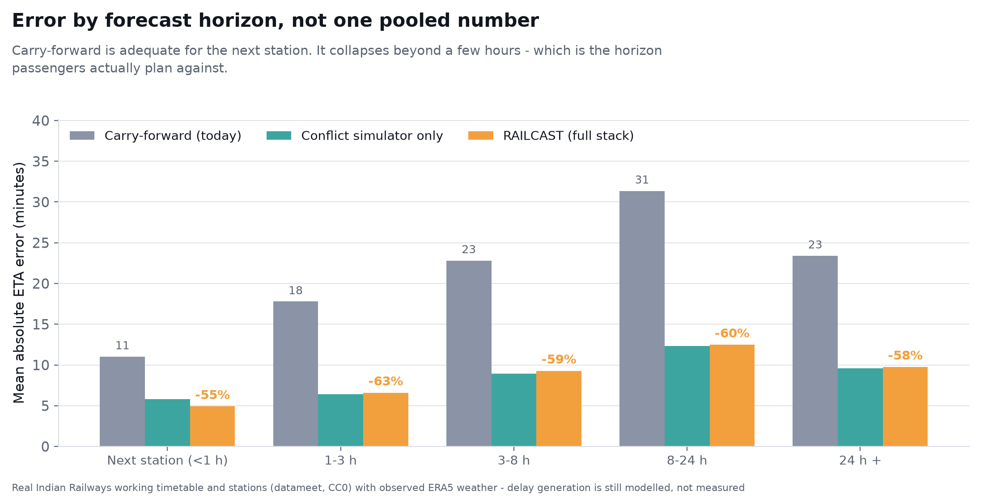
IMPACT AND BENEFITS
[TEAM NAME]
60%
62%
78.4%
40 h
lower mean ETA error
lower P90 error
coverage achieved
forecast horizon
26.9 → 10.9 min
77 → 29 min
of the nominal 80% window
station by station
Measured on 73,268 forecasts from held-out days, against carry-forward computed on exactly the same rows.
WHO FEELS THE DIFFERENCE
Passengers
An arrival window to plan around, the odds of making a connection, and when to leave home.
Section controllers
Conflicts surfaced before they happen, with the blocking train named and the cost of each precedence call.
Station operations
Platforms, cleaning turnaround and crew duty planned against a forecast with a stated confidence.
Feeder and logistics
Carry-forward is adequate for the next station and collapses beyond a few hours — the horizon passengers actually plan against.
Bus, taxi and parcel operators schedule to the real arrival instead of idling at the kerb.
Honest scope. These are prototype results on a simulated corridor built from the real timetable. Delay generation is modelled, and validation against 499 real arrivals shows it is not yet right — which is why the calibration loop exists.

Slide 6
RESEARCH AND REFERENCES
[TEAM NAME]
DATA ACTUALLY USED
RESEARCH WE BUILD ON
Indian Railways working timetable
1.
R. Oneto et al., Train delay prediction systems: a big data analytics perspective, Big Data Research 11, 2018.
datameet/railways, CC0 — 8,697 stations, 5,208 trains, 417,080 scheduled calls
2.
P. Kecman, R. M. P. Goverde, Predictive modelling of running and dwell times in railway traffic, Public Transport 7, 2015.
Weather
3.
F. Corman, P. Kecman, Stochastic prediction of train delays in real time using Bayesian networks, Transp. Research Part C 95, 2018.
ERA5 reanalysis via Open-Meteo — observed daily, per corridor segment, no API key
4.
Y. Romano, E. Patterson, E. Candès, Conformalized quantile regression, NeurIPS 32, 2019.
Live running position
5.
V. Vovk, A. Gammerman, G. Shafer, Algorithmic Learning in a Random World, Springer 2005 — Mondrian conditional validity.
RailRadar REST API — 499 observed arrivals collected across 10 trains so far
6.
G. Ke et al., LightGBM: a highly efficient gradient boosting decision tree, NeurIPS 30, 2017.
Route geometry
7.
The Digital Personal Data Protection Act, 2023 (India).
Station coordinates scaled to the published route distance; 1384 km reproduced exactly
SCALE OF DEPLOYMENT
WHERE WE ADD TO THIS
Prototype
New Delhi – Mumbai Central, 1384 km, 202 stations, 44 trains — built and evaluated
None of the above combines a conflict-resolution simulator over the real block-section graph, a direct multi-horizon learned residual and conditionally calibrated intervals — then validates the result against live Indian Railways running data.
Zonal pilot
One zone, one control office, one model shard
Project links code and reproducible results · simulation videos · evaluation tables and charts — [REPOSITORY LINK]
National
Order of 13,000 coaching trains a day (Indian Railways published figure — confirm before submission)

