Slide 1
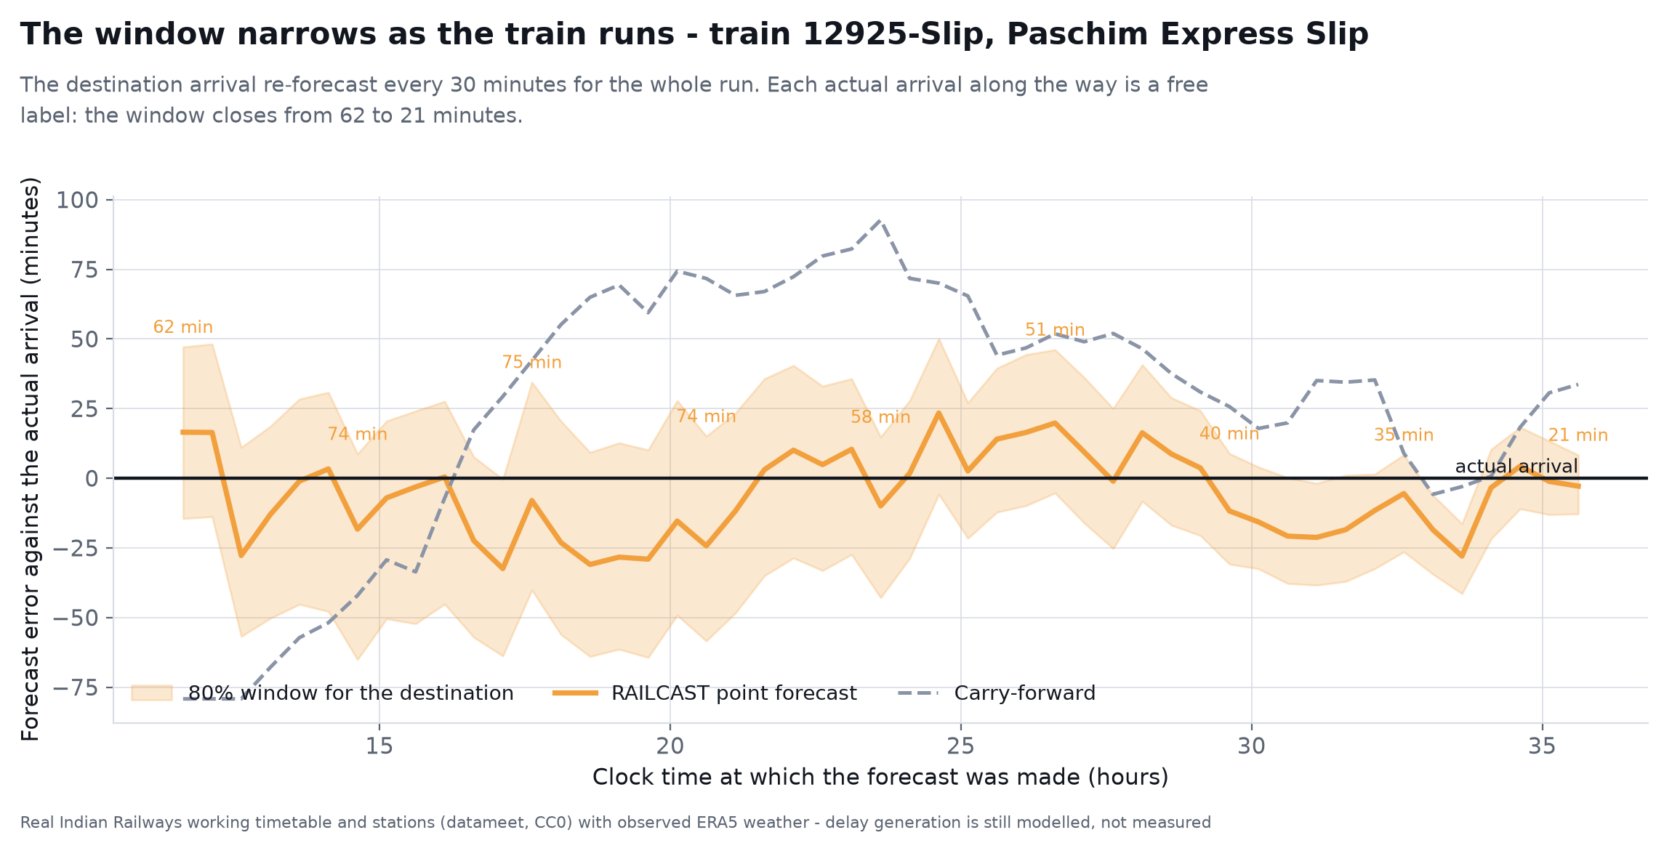
SMART INDIA HACKATHON 2026
RAILCAST
Network-aware arrival forecasting for Indian Railways
Today a passenger gets one number with nothing attached to it. RAILCAST gives an arrival window whose coverage is audited on held-out data — per segment and per horizon, not asserted once and pooled.
60%
80%
40h
The window narrows as the train runs. Every remaining station gets an interval. It widens with distance and closes as each actual arrival comes in — 62 minutes down to 21.
lower ETA error than
carry-forward
arrival window,
coverage audited
forecast horizon,
station by station
Forecasting how delay will move through the network — not repeating the delay we already have.
PS ID
PROBLEM STATEMENT
ORGANISATION
THEME
CATEGORY
TEAM
SIH26028
Dynamic Forecast of Expected
Time of Arrival (ETA)
Ministry of Railways
Smart Automation
Software
[TEAM NAME · ID]
Prototype built on the real New Delhi – Mumbai Central working timetable with observed ERA5 weather.

Slide 2
Proposed Solution
02
forecast the cause, not the clock
PROBLEM AT HAND
HOW ONE FORECAST IS MADE
INNOVATION
Delay is repeated, not forecast
LIVE STATE
position, delay, block occupancy, restrictions
Forecasts the cause, not the clock
Today's ETA carries the current delay forward and trusts timetable padding. It cannot see congestion building ahead.
Trains advanced over the real block-section graph until they conflict, so the ETA moves for a reason we can name.
A · Free-run time
the physics of the section
The network goes blind between stations
Conflict on the block ahead?
Says how sure it is, and proves it
Position is reported only at instrumented stations — gaps of 40–60 minutes on long sections.
no
Conformal calibration gives an 80% window checked per horizon, segment and time of day.
yes
every actual
arrival re-fits
the rest of
the run
B · Conflict simulation
advance every train on the block graph
Cascades are invisible
Turns the window into a decision
One train held at a junction delays every train behind it, yet no deployed ETA model represents that dependency.
Connection-make probability, a leave-home prompt, and the cost in network-minutes of letting one train go first.
C · Learned residual
corrects what the rules cannot
One number hides the risk
D · Calibrated window
audited 80% coverage
Survives a disrupted network
No confidence attached, so nobody knows when it is safe to act — and nothing handles a diversion mid-run.
Cancellations and diversions re-plan the remaining sections instead of breaking the forecast.
DECISION SURFACES
window · connection risk · costed precedence

Slide 3
Technical Approach
03
five stages, each one testable on its own
3 · FORECAST CORE
A free-run · B conflict simulator
C learned residual · D conformal
4 · Coverage on target,
per segment and horizon?
1 · DATA IN
position feed, timetable,
block graph, weather
2 · STATE & FEATURES
delay momentum, padding left,
trains in the same block
5 · DELIVERY
app · displays · SMS/IVR
control console · API
yes
no
re-fit the conformal quantiles for the group that missed
WHAT MAKES THE FORECAST MOVE
TECH STACK
Arrivals forced monotone
Attribution on every change
Models
Simulation
A run can never arrive somewhere before the station behind it.
Names the blocking train, the section and the feature responsible.
Python · LightGBM
scikit-learn · MAPIE · SHAP
NetworkX block graph
event-driven, priority rules
Online correction at every halt
Drift monitor and retraining
Serving
Interface
Each actual arrival is a free label: the rest of the run re-forecasts.
Weekly refit, alarm on coverage or MAE drift by segment.
FastAPI · Redis Streams
PostgreSQL + PostGIS · K8s
React · MapLibre GL
REST / WebSocket · SMS gateway
Every component is established open source with published benchmarks. No new trackside hardware — the system consumes position feeds Indian Railways already produces, through a swappable adapter.

Slide 4
Tech Stack — system design
04
six layers, one direction of flow, and the loop that keeps it honest
SOURCES
NTES / FOIS
Working timetable
OSM / Overpass
Open-Meteo ERA5
CALIBRATION
LOOP
live position feed
schedules, halts, padding
block sections, loops
observed + forecast weather
No public archive of past arrivals exists. History is accumulated by polling, then used to fit what cannot be measured.
INGEST
StaticFeed
WeatherFeed
LiveFeed
Phone motion
stations, roster, WTT
fog index, rain
position + delay, polled
opt-in, optional
collect
PostgreSQL + PostGIS
Redis Streams
LiveStore
Object store
poll the live feed
STORAGE
block graph, run history
live state, feature cache
observed arrivals, append-only
models, calibration sets
validate
observed vs simulated
COMPUTE
Offline — nightly
Conformal calibration
Online — every 30 s
Batched inference
free-run + residual fit
per group quantiles
block-graph replay
0.46 ms per station
calibrate
fit to the real distribution
SERVING
FastAPI
Docker · Kubernetes
Sharded by zone
p95 < 200 ms
REST + WebSocket
one node per zone, no GPU
national run inside 30 s
API latency budget
SimConfig
carries its own residuals
CLIENTS
Passenger app
Station displays
SMS / IVR 139
Control console
React · MapLibre GL
window + platform
regional languages
costed precedence
Sources, corridor, timetable and weather are measured from published data. How delay arises is modelled — the calibration loop fits it to live running data as that is collected.

Slide 5
Runtime flow — one re-forecast
start / end
process
decision
data
05
what happens every 30 seconds, for every running train
POSITION REPORT
or the 30 s clock fires
Update live state
delay, momentum, block occupancy
Train running?
A · Free-run time
per remaining section
B · Advance the block graph
every train, in event order
yes
no
Show booked schedule
Loop the slower train
yes
Higher-priority train behind?
Block section ahead occupied?
D · Conformal interval
horizon × segment × time of day
C · Learned residual
one shot per horizon, never chained
yes
Queue behind the block
no
no — runs clear
Coverage on target for this group?
PUBLISH THE ARRIVAL WINDOW
monotone arrivals · attribution · connection risk
yes
no
Re-fit the quantiles
Two mechanisms cost time and the flow keeps them apart: a train LOOPED at a station is a decision by control, a train QUEUED behind an occupied block is physics. Only the first is a choice the costed-precedence surface can price.

Slide 6
Feasibility and Viability
06
mature components, a stated baseline, every risk given a retirement plan
TECHNICAL FEASIBILITY
HOW WE PROVE IT
RISKS AND HOW WE RETIRE THEM
Every component is mature
1 Baseline stated
No live IR feed in development
LightGBM and conformal prediction are established open source.
Current delay carried forward, on exactly the same rows.
FeedAdapter plus a movement simulator; swap at deployment.
No new trackside hardware
2 Temporal holdout
Error compounds over a 40-hour run
Consumes position feeds IR already produces, via a swappable adapter.
Train on earlier months, test on later. A random split leaks.
Direct multi-horizon residual - never chained.
Cheap at national scale
3 Error by horizon
Coverage fails in the monsoon
One commodity node per zone; no GPU at serving time.
Next station, 1-3 h, 3-8 h, 8-24 h, beyond 24 h.
Mondrian calibration by segment and season, alarmed not assumed.
The simulator is its own fallback
4 Coverage audited
Controllers distrust a black box
With the learned layer off, rules still beat carry-forward past 3 hours.
Against nominal 80%, by segment, horizon and time of day.
Per-section attribution; advisory only, never a movement order.
Phone sensing is optional
5 Shadow mode
Phone motion is not train motion
An accuracy bonus, never a dependency.
Run live beside the existing ETA before a passenger sees it.
Gyro gating and consensus; degrades to the timetable model.
IMPLEMENTATION ROADMAP
01
02
03
04
05
06
Build the block-section graph
Calibrate the simulator
Train free-run and residual
Add conformal calibration
Ship the decision layer
Shadow-mode pilot, then zone by zone

Slide 7
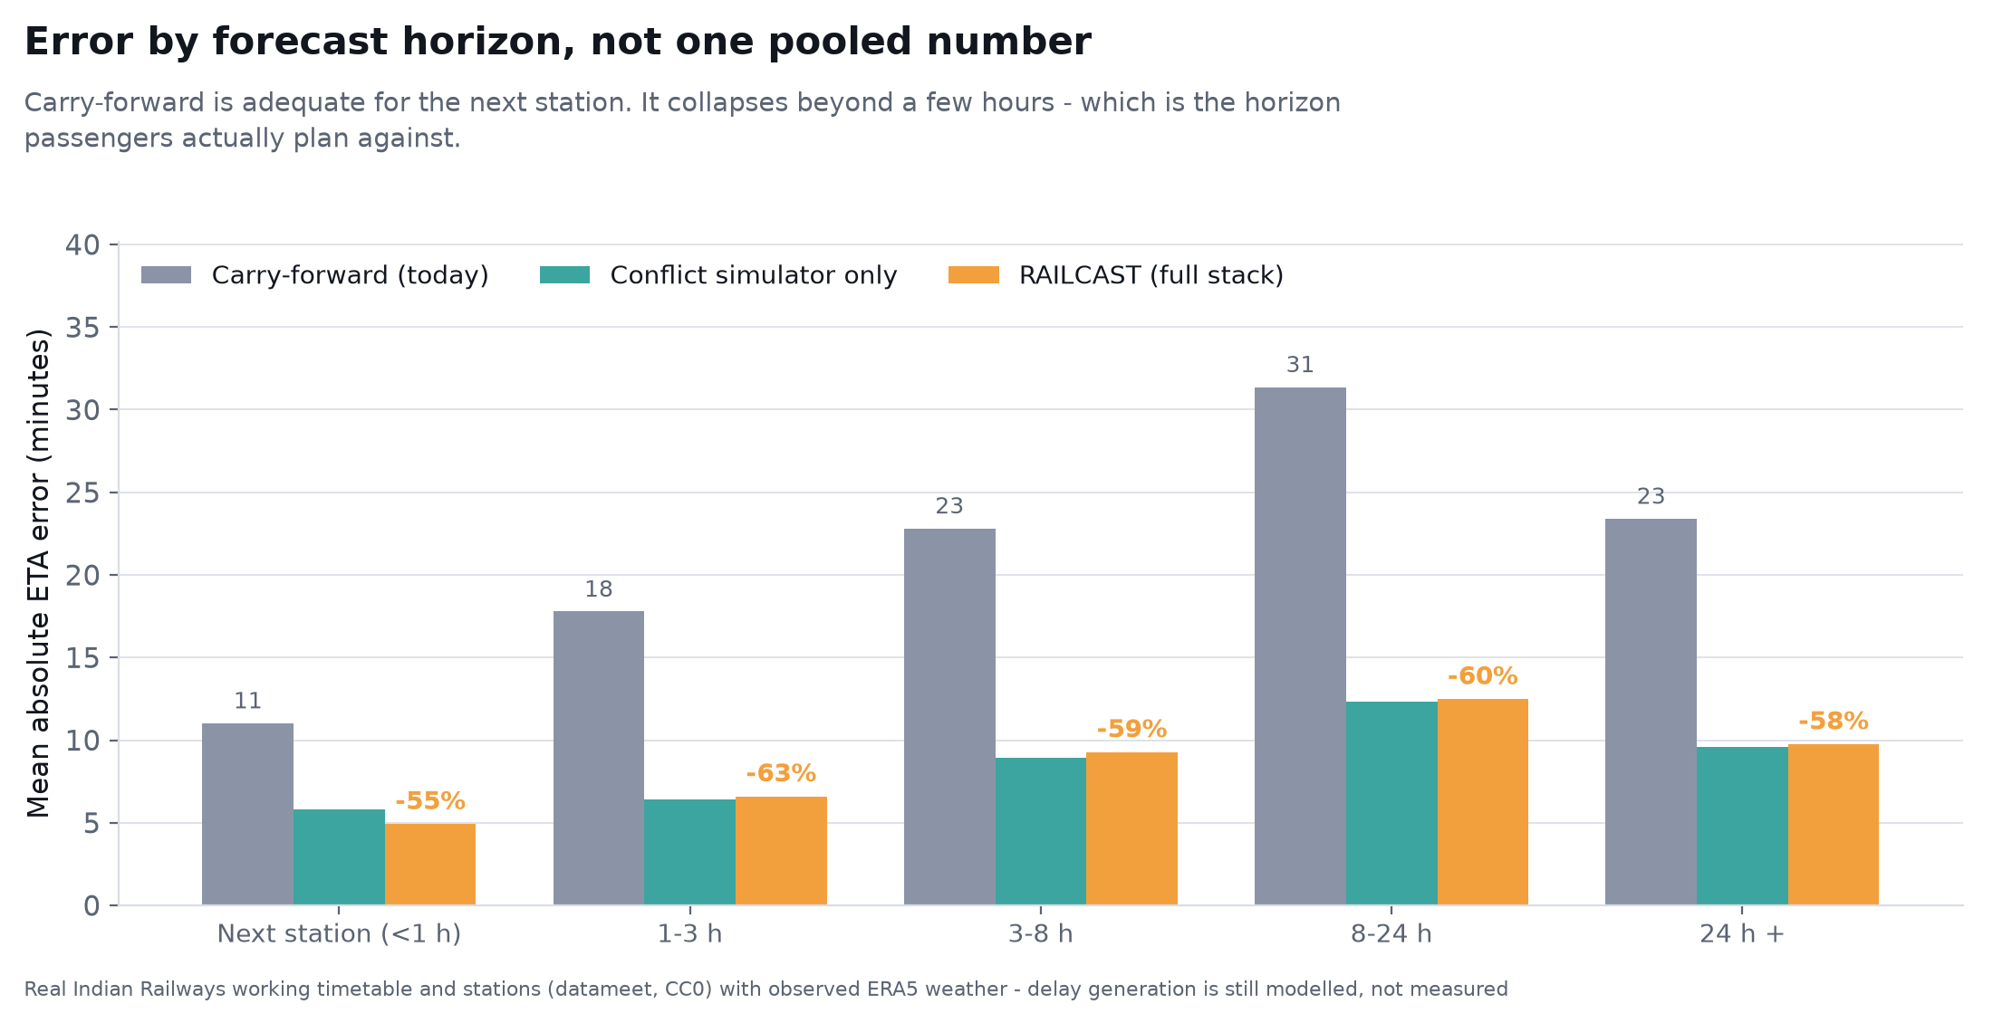
Impact and Benefits
07
measured on held-out days against a stated baseline
60%
62%
78.4%
0.006
lower mean ETA error
lower P90 error
achieved coverage
reliability error
carry-forward 26.9 min
RAILCAST 10.9 min
the bad days:
77 min against 29
of the nominal 80% window,
audited per segment
on connection-make
probability
ERROR BY HORIZON, NOT ONE POOLED NUMBER
WHAT CHANGES AGAINST TODAY
PARAMETER
TODAY
RAILCAST
ETA method
Delay repeated forward
Per-section forecast, conflicts simulated
Horizon
The next few stops
The whole run, 40+ hours
Uncertainty
None stated
Audited 80% arrival window
Explains cause
No
Names the blocking train and section
Between stations
Blind for 40-60 min
Phone-sensed stop and crawl events
Disruption
Estimate simply breaks
Remaining route re-planned mid-run
Carry-forward is adequate for the next station and collapses beyond a few hours - which is the horizon passengers actually plan against.
Decision support
None
Connection risk and costed precedence
Scored on 73,268 held-out forecasts on the real New Delhi - Mumbai Central working timetable with observed ERA5 weather. How delay arises is still modelled; the calibration loop fits it to live running data.

Slide 8
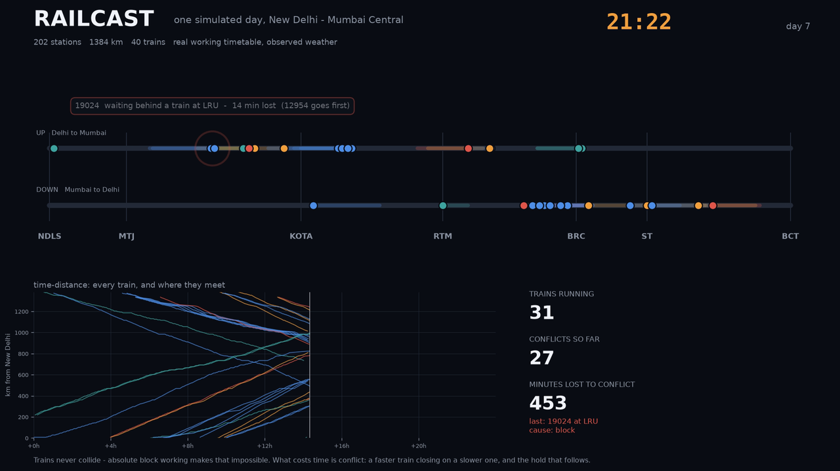
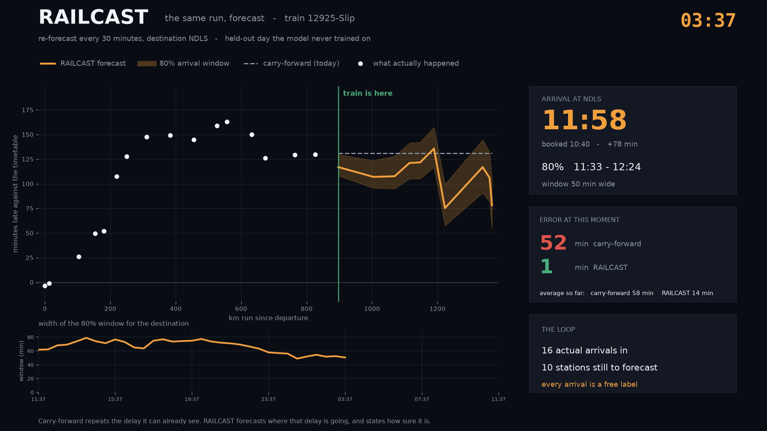
The prototype, running
08
both clips are the simulator itself - nothing is hand-animated
The problem — conflict and cascade
The answer — one journey re-forecast
40 trains on the real 1384 km corridor over one day. Captions name the train that actually caused each hold, read out of the run log.
The 80% window narrowing from 62 to 21 minutes as actual arrivals come in. Carry-forward 57 min average error against RAILCAST 15.
Trains never collide. Absolute block working makes that impossible - a train cannot enter a section another train occupies. What costs Indian Railways time is conflict: a faster train closing on a slower one, the hold that follows, and the delay cascading behind it. That is what the left-hand clip shows.
Click a clip to play in presentation mode. If the deck is opened somewhere the embedded video will not run, the same files are in outputs/video/ as MP4 and GIF.

Slide 9
Research and References
09
what we build on, and where we add to it
SCALE OF DEPLOYMENT
RESEARCH WE BUILD ON
Prototype corridor
1 R. Oneto et al., Train delay prediction systems: a big data analytics perspective, Big Data Research, vol. 11, 2018.
40
New Delhi - Mumbai Central, 1384 km, 202 stations
2 P. Kecman and R. M. P. Goverde, Predictive modelling of running and dwell times in railway traffic, Public Transport, vol. 7, 2015.
3 F. Corman and P. Kecman, Stochastic prediction of train delays in real time using Bayesian networks, Transportation Research Part C, 2018.
800
Zonal pilot
One zone, one control office, one model shard
4 T. Buker and B. Seybold, Stochastic modelling of delay propagation in large networks, J. Rail Transport Planning and Management, 2012.
5 Y. Romano, E. Patterson and E. Candes, Conformalized quantile regression, NeurIPS 32, 2019.
13,000
National
Coaching trains a day, 7,300 stations, 68,000 route km
6 V. Vovk, A. Gammerman and G. Shafer, Algorithmic Learning in a Random World, Springer, 2005 - Mondrian and conditional validity.
7 G. Ke et al., LightGBM: a highly efficient gradient boosting decision tree, NeurIPS 30, 2017.
DATA SOURCES
8 The Digital Personal Data Protection Act, 2023 (India).
National Train Enquiry System
live running position, via FeedAdapter
Open Government Data Platform
schedules and station master
WHERE WE ADD TO THIS
None of the above combines a conflict-resolution simulator over the real block-section graph, a direct multi-horizon learned residual, and conditionally calibrated intervals on Indian Railways operating data.
OpenStreetMap / Overpass
block sections, junctions, loops
Open-Meteo / ERA5
historical and forecast weather, no key
IR Year Book, WTT, TSR notices
punctuality returns and restrictions
Project links technical documentation · demo video · simulator notes · model results against baseline · GitHub repository
Problem Statement SIH26028 · Ministry of Railways · sih.gov.in/sih2026PS

